Slide 1
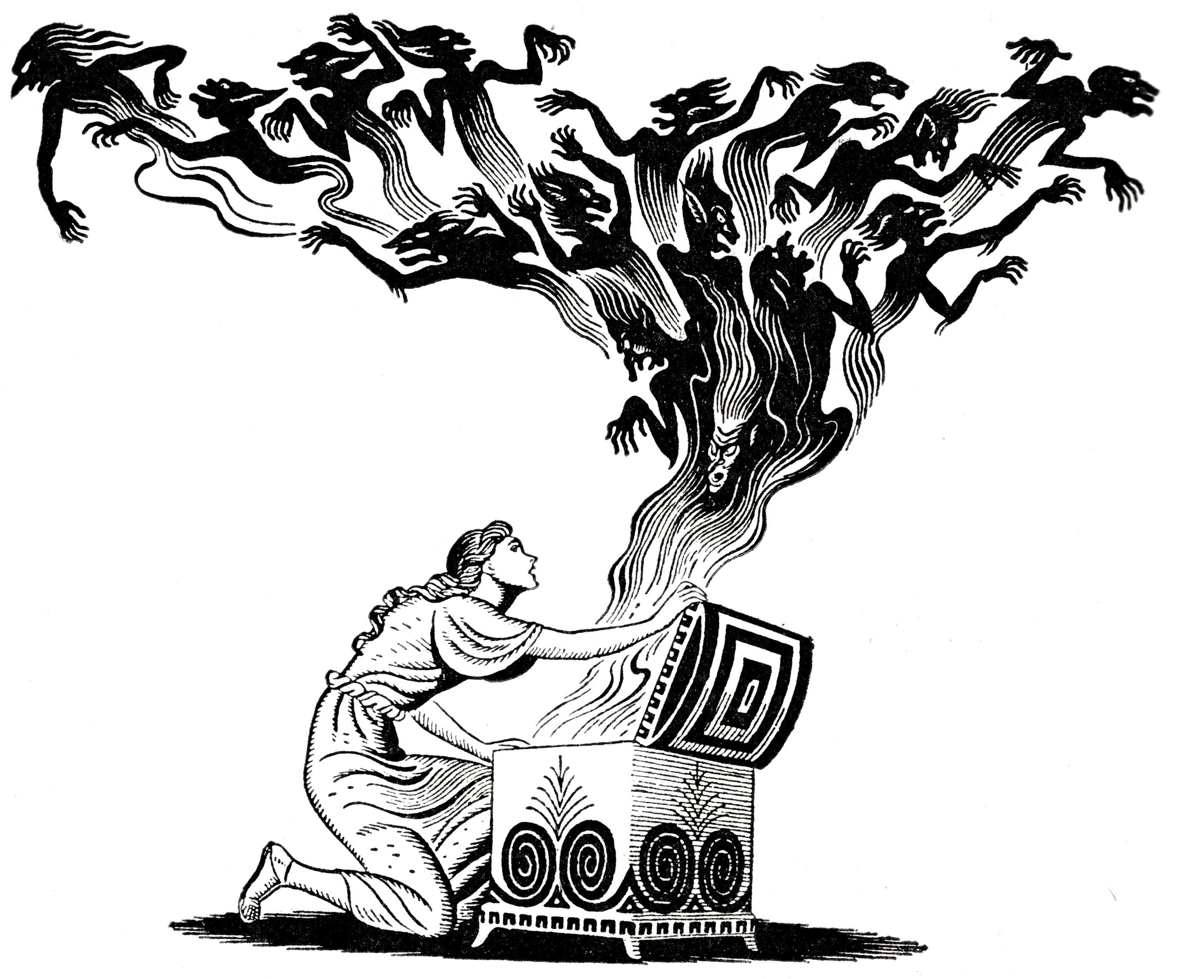
Paragraphs

Slide 2
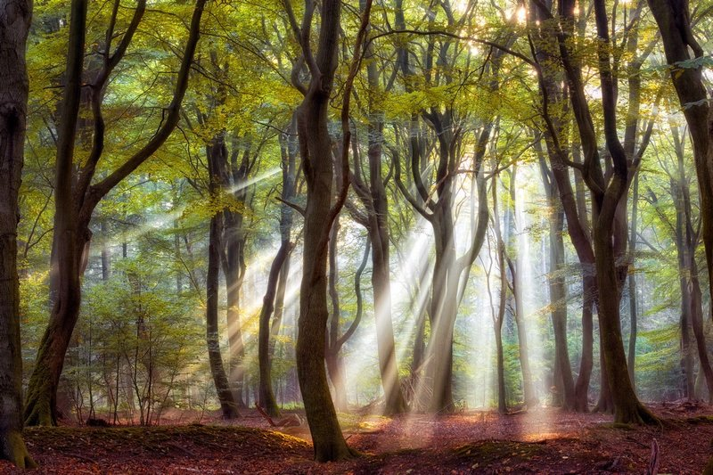
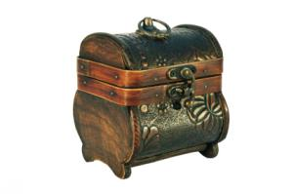
Your do now task
A patchwork of greens and blues.
Twinkling like stars
Using the example of the sun through the trees, can you come up with six pieces of descriptive writing to describe Pandora’s box?
A green parasol
Glinting
The sun was a spotlight on the forest floor
Shafts of light

Slide 3
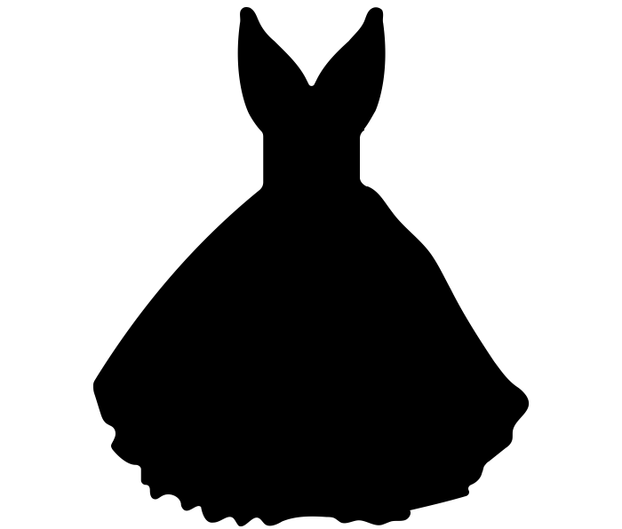
Prometheus
Athene
Hephaestus
Epimetheus
Zeus
Hera
Pandora
Humans

Slide 4
Using these icons as reminders try to remember and write out the plot of “Pandora’s box” in dot points. You can talk to each other but, DO NOT LOOK BACK AT THE STORY
Prometheus
Athene
Hephaestus
Epimetheus
Zeus
Hera
Pandora
Humans

Slide 5
Prometheus

Slide 6
Prometheus
Athene

Slide 7
Prometheus
Athene
Humans

Slide 8
Prometheus
Athene
Zeus
Hera
Humans

Slide 9
Athene
Zeus
Hera
Humans
Prometheus

Slide 10
Athene
Prometheus
Zeus
Hera
Humans

Slide 11
Prometheus
Zeus
Humans

Slide 12
Zeus
Prometheus
Humans

Slide 13
Zeus
Prometheus
Humans

Slide 14
Zeus
Hephaestus
Ha-fa-stus

Slide 15
Zeus
Hephaestus
Pandora
Epimetheus

Slide 16
Pandora
Epimetheus

Slide 17
Pandora

Slide 18
Your task – 7 minutes
In today’s lesson we will be focussing on the presentation of the characters, just like we did with Persephone.
Begin by making a mind-map for the four main characters, with seven ADJECTIVES per character to describe them.
Epimetheus
Pandora
Prometheus
Zeus

Slide 19
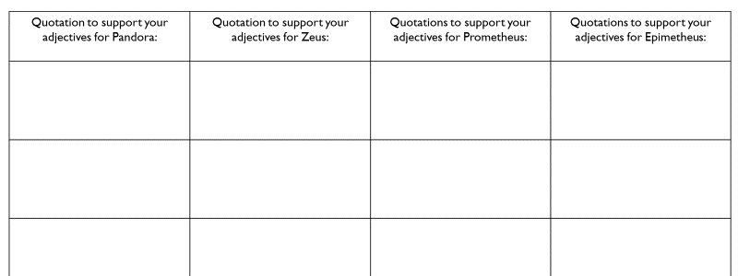
Your task
We must always support our ideas with quotations! Choose four of your adjectives from your mind-maps and support them with word for word quotations from the text
Finished your worksheet?
Can you analyse one of your quotations in a paragraph?

Slide 20
Quotations to support your adjectives for Pandora: | Quotations to support your adjectives for Zeus: | Quotations to support your adjectives for Prometheus: | Quotations to support your adjectives for Epimetheus:
Notes:
Green for growth!

Slide 21
Your task: exploding quotations
Can you do this for three of your own quotations from your worksheet?
When we explode a quotation, this means we write it in the middle of our page and analyse as many of the words in it as we possibly can.
Prometheus rode up to the sun and, using his bare hands, broke off a blazing fire-brand.

Slide 22
Your task: exploding quotations
A dangerous thing to do – he is brave and dedicated to mankind.
Can you do this for three of your own quotations from your worksheet?
When we explode a quotation, this means we write it in the middle of our page and analyse as many of the words in it as we possibly can.
Prometheus rode up to the sun and, using his bare hands, broke off a blazing fire-brand.
Strong, Godly, not human
Strength again – violent almost. Cares deeply about saving mankind.
Adjective intensifies the danger – repeated ‘B’ sounds seem violent.
Fire has connotations of danger, death, violence

