Slide 1
Your do now task: recall questions
List six key features of a Greek Myth.
Number 1 might be ‘it must teach us a lesson’.
1. List four negative things that Pandora inflicted upon society by opening the box.
2. Why was Pandora created?
3. What was Prometheus’ punishment inflicted on him by Zeus?
Tip: always answer your recall questions in FULL sentences

Slide 2
Your task:
Next lesson you will be writing a Greek myth of your own.
In today’s lesson you must plan the myth in great detail.
Your myth:
Must teach the reader about something in the world, e.g. explaining the weather, or explaining sickness etc.
Must invent a character
Must have Zeus + two other Greek Gods.
Must teach the reader a lesson
Must be set on Mount Olympus
Must be at least 400 words long.
What will you be explaining about the world to your readers? | What character will you invent? Name/appearance/personality/family etc. | What problem will they cause and how will they cause it? | How will Zeus respond to it? | Other than Zeus, which two Greek gods will feature and what will they do? | What lesson will you teach your readers?

Slide 3
What will you be explaining about the world to your readers? | What character will you invent? Name/appearance/personality/family etc. | What problem will they cause and how will they cause it?
1
2
3
How will Zeus respond to it? | Other than Zeus, which two Greek gods will feature and what will they do? | What lesson will you teach your readers?
4
5
6
Notes:
This one goes first!

Slide 4
Upgrade your sentences | Simile Start The grubby face of the boy was flecked with mud and oil, like beard stubble across his young face. | Triple adjective + colon Dirt, oil, grease: the boy’s face was smeared with evidence of his grubby work.
Brackets + although The boy’s face looked grubby, (although it wasn’t as if he was trying to keep clean), and grease, oil and mud flecked his cheeks. | The boy looked dirty. | Adverb + comma Quickly, the boy tried to scrub the dirt from his grubby face with the back of his sleeve.
So, so The boy’s face was so grubby, so utterly filthy, that he was barely recognisable. | It wasn’t/it was It wasn’t just your ordinary, everyday dirty, it was layers of deep grime that would need hours of scrubbing to remove. | Verb start Smiling wryly, the boy’s face was just about visible through the layers of dirt and grease.
Notes:
Worksheet for students on next slide. These take longer than you think they will!

Slide 5
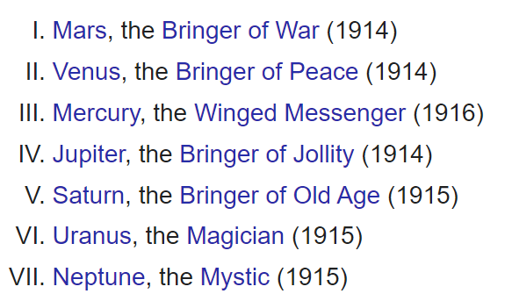

Slide 6
Your final task:
Next lesson you will be writing a Greek myth of your own.
In today’s lesson you must plan the myth in great detail.
Storyboard:
Draw and caption six key events that are going to happen in your Greek myth. They must be in chronological order!

