Slide 1
Your starter: Biopoems
A biographical poem, or biopoem, was a simple but specific structure used to describe the most important facts about someone.
Create one about yourself using the structure!
Greek Example :
Aphrodite, Goddess of Love, Desire, Beauty and Fertility. A daughter of Zeus and Dione; wife of Hephaestus. Lover of sons Aeneas and Cupid and brother Ares. Who protects sailors. Who needs a chariot. Who fears War, Athena and Hera. Resident of Mt. Olympus. Venus.
Follow this format exactly
Name + God/Goddess of…,
I am (list four traits)
I am [a relative] of (1-3 people)
Lover of (1-3 things)
Who protects (1-3 things)
Who needs (1-3 things)
Who fears (1-3 things)
Resident of
Example :
Miss Forster, Goddess of English and Reading. Only daughter of Christopher and Jane; Lover of pretty highlighters and excellent classroom displays. Who protects books, at all costs. Who needs a cup of tea every two-three hours. Who fears spiders, wasps, and running out of teabags. Resident of the city of York, and Boston Spa Academy.

Slide 2
The BIG idea: Transition Unit: Greek Mythology
We are learning to…
Create our own Greek Myths
Good learning…
Can include all of the components of a Greek myth in my writing
Great Learning…
Can use high-level vocabulary, including adjectives, in my writing
Even better learning…
Can ensure that my writing does not change tense or lose meaning throughout by proof reading my work
Key words: Greek myths, Gods, Goddesses, Mount Olympus
Notes:
Encourage students to look back on things like the ‘upgrade your sentences’ starter, and the description of Pandora’s box. They could also introduce any of their new characters using the biopoem structure.

Slide 3
Remember The criteria!
Your task
Write up your Greek myth into your exercise book.
Must teach the reader about something in the world, e.g. explaining the weather, or explaining sickness etc.
Must invent a character
Must have Zeus + two other Greek Gods in that we have read about.
Must teach the reader a lesson
Must be set on Mount Olympus
Must be at least 400 words long

Slide 4
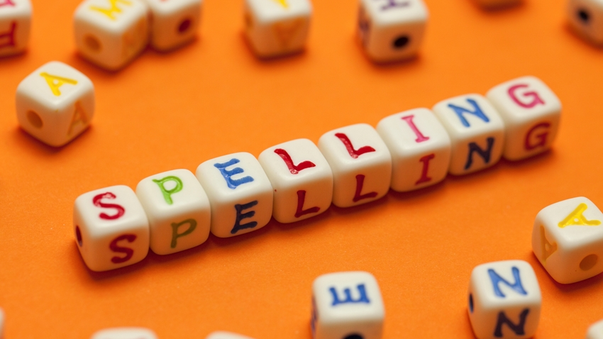

Slide 5
Peer assessment:
Explains something about the world to the reader 15 points
Describes their character 15 points
Includes at least two gods or goddesses 20 points
Describes what the setting looks like10 points
Meets minimum word length 10 points
Teaches the reader a lesson15 points
Makes sense throughout 30 points
Notes:
Make sure you allow enough time to let pupils read out their myths!

Slide 7
Font size: 11 or 12
Font style: Calibri, Arial, Times New Roman (simple and easy to read)
Title can be bigger and a fancy font

