Slide 1
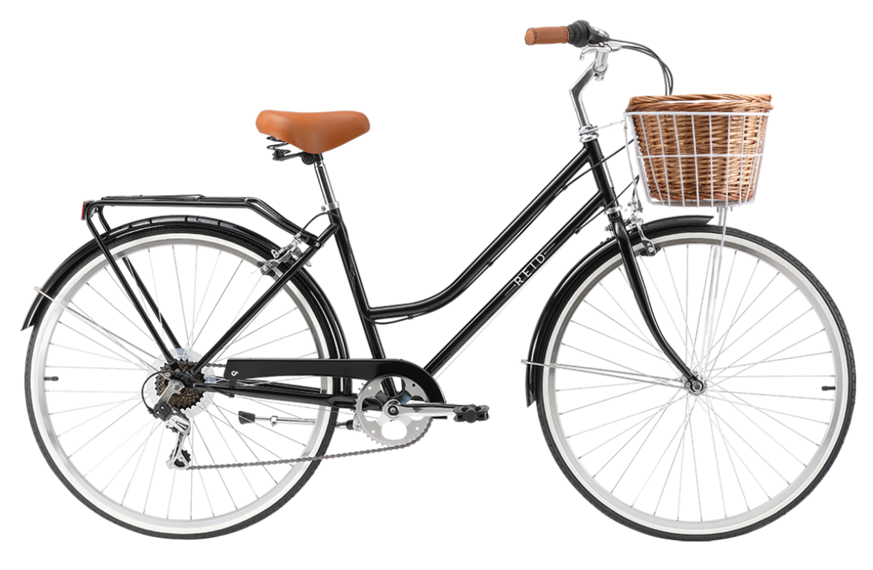
Writing Correct Sentences

Slide 2
What is a sentence?
Here are three sentences:
He smiles.
Autumn leaves twirled gently to the ground.
The local council will open a new outdoor skatepark in November.
Notes:
BEGIN WITH EXAMPLES, NOT DEFINITION. CONCRETE, NOT ABSTRACT.
SENTENCES OF DIFFERENT LENGTH -- BASIC WRITERS THINK LENGTH DETERMINES SENTENCEHOOD.

Slide 3
Sentences need two parts to be a sentence: a subject and a predicate.
The subject tells us who or what.
The predicate tells us what about it.
Notes:
OUT OF LENGTH-MINDSET.
A MEANING-CENTERED DEFINITION. MEANING OF THE WORDS, NOT ABSTRACT IDENTIFICATION OF PARTS OF SPEECH.

Slide 4
Who or what?
He
Autumn leaves
The local council
What about it?
smiles.
twirl gently to the ground.
will open a new outdoor skatepark in November.
These 2 parts (subject + predicate) = an independent clause.
Notes:
AGAIN, CONCRETE EXAMPLES.
THE WHO/WHAT AND WHAT ABOUT IT MAKES SENSE TO STUDENTS.
INTRODUCE TERMS BASIC SENTENCE AND INDEPENDENT CLAUSE.

Slide 5
Another way to describe a sentence is to compare it to a bike: The subject is one wheel; the predicate is the other wheel.
These two parts connect to form a stable structure.
Notes:
IMAGE. ALSO STABLE STUCTURE – IMPORTANT FOR UNDERSTANDING SENTENCE BOUNDARIES.
WILL SEE THIS AS WE MOVE ALONG

Slide 6
It’s possible to have just one word in each wheel…
Children play.
Students studied.

Slide 7
But most of the time our ideas include more details. We add extra words to the wheels.
The neighborhood children play basketball at the
community center.

Slide 8
But most of the time our ideas include more details. We add extra words to the wheels.
Students in the biology lab studied cells under
an electron microscope.

Slide 9
Dependent clauses
Dependent clauses cannot stand alone. They are like baskets that need to be attached to a basic sentence.
One kind of dependent clause begins with a subordinating conjunction.

Slide 10
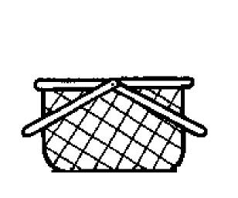
When the music began
Everyone started to dance.
When the music began, everyone started to dance.

Slide 11
Here are some more dependent clauses:
As soon as it stopped raining
Because I registered early
When we need a quiet place to study

Slide 12
We can place these baskets on the front of a bike.
As soon as it stopped raining, the sun emerged from behind the clouds.
Because I registered early, I got the classes I wanted.
When we need a quiet place to study, we go to the library.

Slide 13
We can also place them on the back of a bike.
The sun emerged from the clouds as soon as it stopped raining.
I got the classes I wanted because I registered early.
We go to the library when we need a quiet place to study.
Notes:
MOVE BASKETS FROM FRONT TO BACK. LEARNING HOW TO MANIPULATE SENTENCES – MATURE WRITER.

Slide 14
More Dependent Clauses
Another kind of dependent clause begins with the relative pronouns who, which, and that.
who works part-time
which includes a swimming pool
that is parked in my driveway
These clauses are not sentences. They are like baskets that need to be attached to a bike.

Slide 15
These baskets go after the word they describe. Sometimes they’re in the middle of the bike.
Frank, who works part-time, will be our guide.
The new fitness center, which includes a swimming pool, will open in February.
The car that is parked in my driveway is Henry’s.
Notes:
CAN EXPLAIN RESTRICTIVE AND NON-RESTRICTIVE INFORMATION BY EXPLAINING RESTRICTIVE INFO SNAPS INTO THE WHEEL ITSELF. IT EXPANDS THE WHEEL. IT’S NOT EXTRA BY-THE-WAY INFORMATION.

Slide 16
Sometimes they are on the back of the bike.
We are making pasta for the Richardsons, who do not eat meat.
I have tickets to the jazz festival, which begins at noon.
Karen likes books that have a happy ending.
Notes:
RESTRICTIVE AND NON-RESTRICTIVE. EXPLAIN RESTRICTIVE INFO SNAPS INTO THE WHEEL ITSELF. EXPANDS THE WHEEL. NOT EXTRA BY-THE-WAY INFO

Slide 17
Sentence Support
Regardless of what kind of basket we add, we need a basic sentence to support it.
Example: The new fitness center, which includes a swimming pool, will open in April.
Basic sentence: The new fitness center will open in April.
Basket: which includes a swimming pool
Notes:
COMMON ERROR: NOT TO HAVE BASIC SENTENCE SUPPORT ADDITION. BASKETS HELP STUDENTS SEE HOW PARTS RELATE TO THE WHOLE

Slide 18
Fragments
A fragment is just a part of a sentence. It may lack a subject or a predicate.
Often, it’s a disconnected basket.

Slide 19
Disconnected dependent clauses
As soon as I understood the problem. I thought of a solution.
I was not responsible. When I was sixteen.
The village will enlarge the parking lot. Which serves weekday commuters.
Let’s rent the same movie. That we saw last weekend.

Slide 20
Disconnected description and detail
It was an easy task. Especially for someone so small.
The company provides employees with benefits. Like medical insurance and a pension.
We have ordered everything on the menu. Except fried buffalo wings.
We put an ad in the Lake Norman Times. Our local newspaper.

Slide 21
Disconnected -ing and –to fragments
I sprinted down the street. Trying to catch the train.
The scientists continued their research. Hoping to find a cure.
To celebrate their anniversary. They are going to Asheville for the weekend.
We walked up sixteen flights of stairs. To prove to ourselves we could do it.

Slide 22
We can correct these fragments by attaching them to the sentence.
As soon as I understood the problem, I thought of a solution.
I sprinted down the street, trying to catch the train.

Slide 23
Sentence Variety
Baskets are excellent ways to create sentence variety. Once we have a stable structure, we can add a variety of baskets on the front, in the middle, or on the back.

Slide 24
We can add a variety of baskets on the front.
Earlier this spring, the viaduct was closed because of flooding.
Eight months ago, we bought a truck.
By the time we got home, it was dark.
Irritable after a long day at work, we took a nap before studying.
Notes:
SEEING HOW PARTS RELATE TO THE WHOLE

Slide 25
A variety of baskets in the middle:
My little brother, unable to sleep, turned on the light.
The elderly couple, walking slowly up the driveway, waved at their grandchildren.
A modern art gallery, funded by a million-dollar grant, is under construction.
John Jackson, a friend since grade school, is my math tutor.
Notes:
COVERS A LARGE VARIETY OF SENTENCE STRUCTURES

Slide 26
And a variety of baskets on the back:
Jeff wants a hybrid, his best hope for good gas mileage.
A gentle rain fell throughout the night, lulling us to sleep.
We are building a home with Habitat for Humanity, a national volunteer program.
Everyone wants to leave at noon, even my sister.

Slide 27
The Logic of Punctuation
Readers are looking for the who or what and what about it of a sentence, the main idea. Commas help them see that main idea.
If you begin a sentence with a basket, use a comma to show readers where the addition ends and the basic sentence begins.
According to the weather report, tomorrow will be hot and humid.
If we go to the early movie, we can save money.
Notes:
LOGIC OF PUNCTUATION

Slide 28
If the basket interrupts the sentence, use commas to show readers where the addition begins and ends.
The art gallery, which opens this weekend, features local artists.
Ruby, my sister’s best friend, will loan me her car.
Notes:
CAN SEE COMMAS AS HANDLES LIFTING OUT THE ADDITION. LOGIC OF PUNCTUATION

Slide 29
If the basket is attached to the end of the sentence, the comma shows readers where the addition begins.
The award was given to James Johnson, the most respected person in our town.
They are living in the present, not the past.

