Slide 1
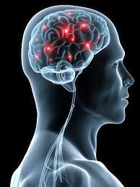
Nervous Control
Most people can walk across a room without really thinking about it.
You listen to music and smell sausages cooking on a barbecue without having to decide how to hear or smell.
Your nervous system controls all these actions.

Slide 2
Pupil dilation activity

Slide 3
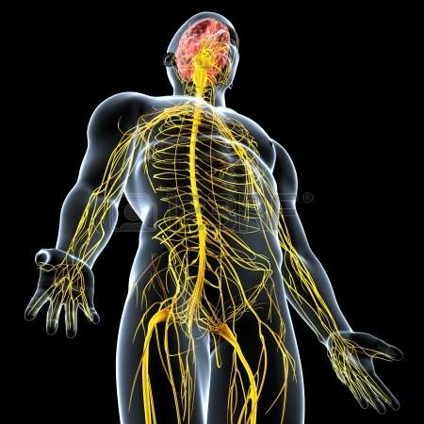
Nervous system
The nervous system is a communication network that controls all the other systems of your body, such as the digestive and circulatory system.
The two parts of the nervous system are:
Central nervous system (CNS), made up of your brain and spinal cord. The CNS receives information from all over the body, processes that information, and then sends out messages telling the body how to respond.
Peripheral nervous system (PNS), made up of the nerves that carry messages to and from the CNS and other parts of the body.

Slide 4
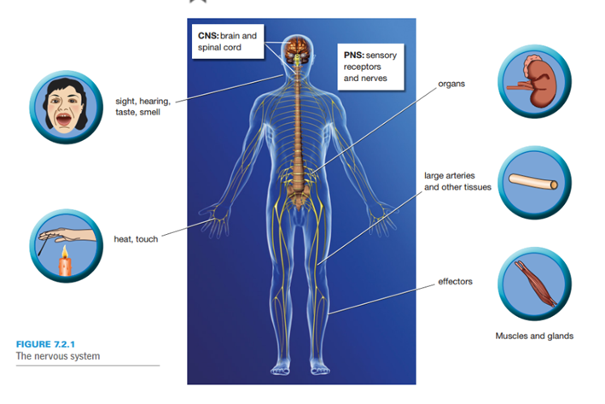
Nervous system

Slide 5
Nerve cells
The nervous system is made up of trillions of nerve cells called neurons.
Neurons are specialized cells that transmit electrical messages from one part of your body to another at very high speed. These electrical messages are called nerve impulses and they can travel in one direction.
A neutron has all the usual features of any animal cell including nucleus, cell membrane and cytoplasm. It also has other specialized parts including dendrites, an axon and axon terminal.

Slide 6
Nerve Speed Activity
Arrow Catcher

Slide 7
Nerve cells
The cell body contains the nucleus, which is the control centre of the cell. The dendrites branch out from the cell body and receive messages from other nerve cells, which are then sent on to the cell body. The axon or nerve fibre sends nerve impulses in only one direction – away from the cell body. The axon terminals pass the message on to the next neuron.

Slide 8
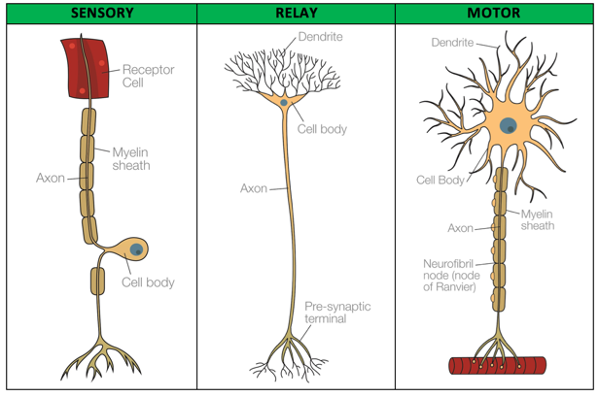
Nerve cells
There are different types of neurons. Each type of neuron has a different function within the nervous system.
Motor neurons – carry messages from the CNS to effectors. Effectors are muscles or glands (tissues that secrete hormones) that translate the messages into action.
Connector neurons – transmit messages between neurons in the CNS.
Sensory neurons – have specialized receptors, which are sensitive to stimuli such as heat or light. They carry messages to the brain and spinal cord from cells in the sense organs (such as your eyes, ears, tongue and skin).

Slide 9
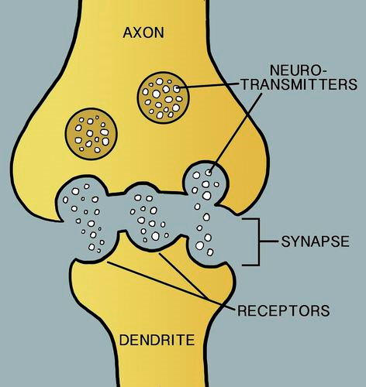
The messages sent along the neuron are electrical – but don’t activate all at once – our body controls which nerves ‘fire’ at a certain time.
When the nerve impulse reaches the axon terminals at the end of an axon, a chemical called a neurotransmitter is released into the space between the neurons. This space is a called a synapse. The dendrite receives the chemical message and sends off an electrical signal.

Slide 10
About 50 different neurotransmitters carry electrical impulses across these gaps. These neurotransmitters control which nerves fire and when.
In your body, the neurons are bundled together to form nerves. Neurons are covered with an insulating layer called a myelin sheath. The myelin sheath electrically insulates the neurons from each other and increases the speed of the nerve impulse.
The parts of the CNS that contain neutrons covered in myelin are called white matter. The parts that contain mainly cell bodies are called grey matter. The outer parts of the brain are made up mainly of grey matter.

Slide 11
Nervous System summary
https://online.clickview.com.au/libraries/videos/3714774/06-the-nervous-system

