Slide 1
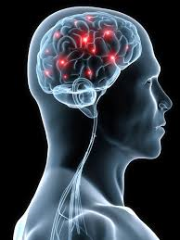
The Brain
Compared with other animals, humans have a very large brain for their body size.
The human brain contains about 100 billion neurons.
Medical imaging techniques can look inside a living brain, for example MRI (magnetic resonance imaging) uses strong magnetic fields to diagnose brain tumors and injury to the brain.

Slide 2
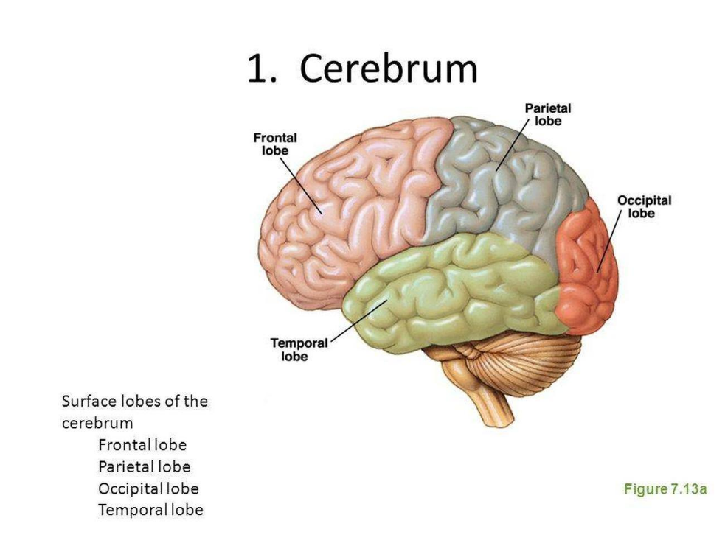
The Cerebrum
Occupies more than 80% of the brain
The location of human higher order thinking
Controls human thought and movement and receives sensory message from all body parts.
Made up of two parts called the left and right hemispheres.
https://www.nationalgeographic.com/science/health-and-human-body/human-body/brain/

Slide 3
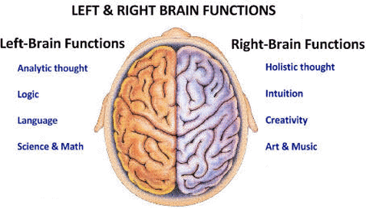
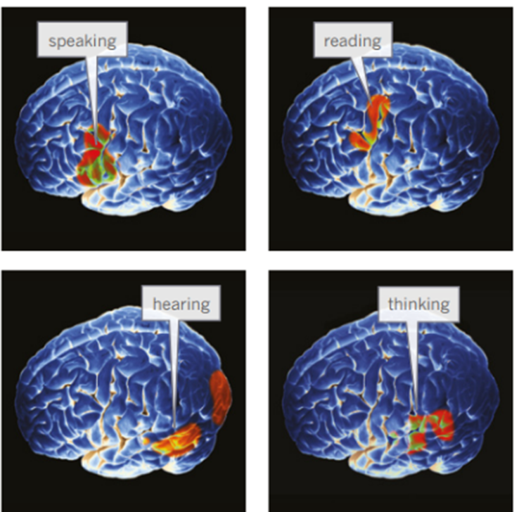
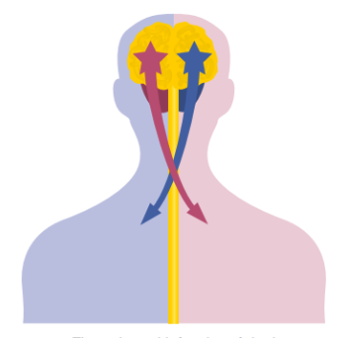
The Cerebrum
Right side controls your left side, and the left side controls your right hand side.
One side usually dominates in a particular tasks.
Logical thinking – left side
Creative and emotion – right side.

Slide 4
Fool the brain
Name the colour the word is printed in. Do NOT read the actual words.
Red
Blue
Orange
Green
Yellow
Violet

Slide 5
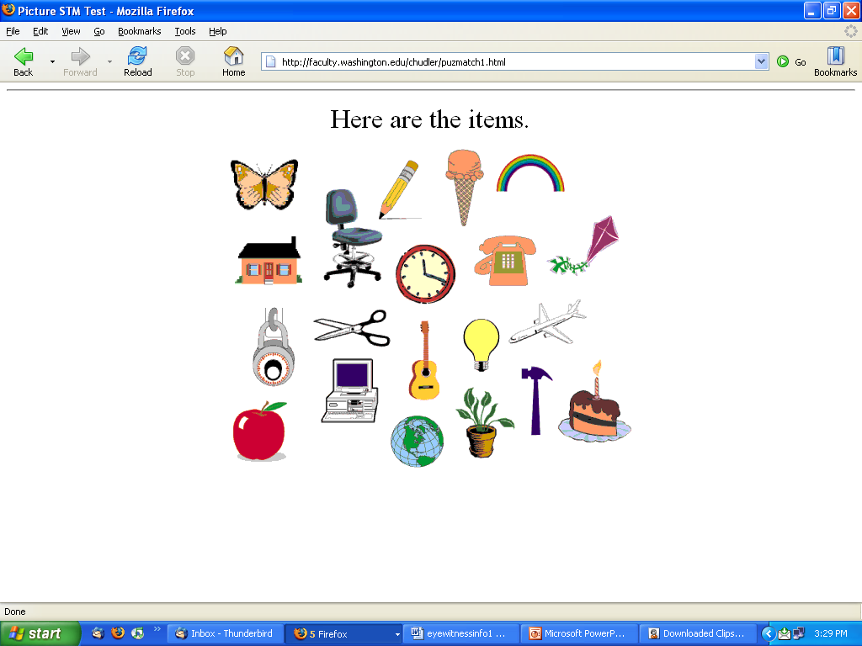
Memory Challenge
Directions:
You will have 30 seconds to view the next screen.
Try to memorize all 20 items you see!
You are NOT allowed to write anything down
You CANNOT talk to anyone else.

Slide 6
Items to remember ...
Neuroscience for Kids - http://faculty.washington.edu/chudler/puzmatch1.html

Slide 7
What do you remember?
You have 2 minutes to list as many of the items as you can!
How did you do?
All 20 – Awesome
15-19 – Great
10-14 – Pretty swell
5-9 – Could be better
4 or Less – Wake up
Notes:
Teacher Note: Try to influence the students’ memory of the items. As they are writing down the items they remember, suggest two or three items that were not shown, such as a banana (on the info slide), a nail (goes with hammer), or pen (instead of the pencil). As you go over the correct items, ask the students if they added any of the ones you told them to remember. Tie this into the discussion (next slide) on how a person’s memory can be affected by another person.

Slide 8

The cerebellum, brain stem and spinal cord
The cerebellum is located at the base of the cerebrum and is responsible for coordination and balance.
Lower part of the brain stem or medulla can be seen where the spinal cord widens just after it passes into the skull.
Controls the body’s vital functions, such as breathing, blood pressure and heart rate – dame to this area can be fatal.
Special protective areas cover the brain and spinal cord – cranium and vertebrae.
Both are surrounded by fluid called cerebrospinal fluid (CFS) which provides nutrients and acts as a shock absorber.

Slide 9
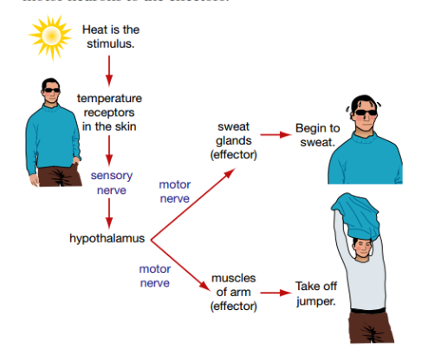
Responding to Stimuli
Receptors stimulate the sensory neurons – stimulus.
The brain works out the response that is required and sends a message along the motor neurons to the effectors.

Slide 10

Reflex actions

