Slide 1
Chemical Control
There are small chemical messengers in your body that are responsible for big changes. Hormones control many functions of your b0ody.
Hormones are responsible for the changes of puberty as well as being responsible for controlling water balance and the volume of glucose in your blood.
The glands of the endocrine system release hormones.

Slide 2
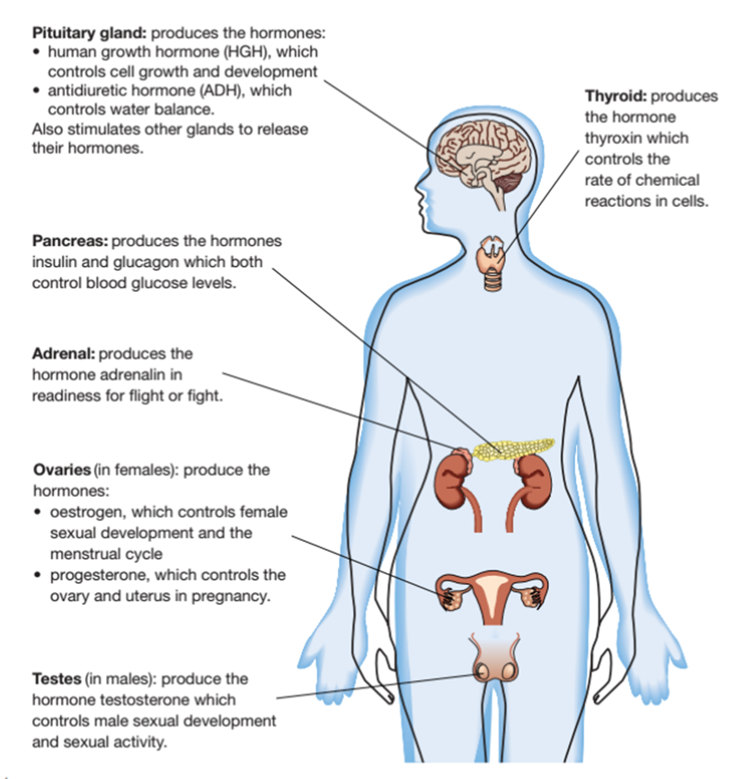
The endocrine system
The endocrine system is a communication system that controls the internal environment of the body. Water and glucose levels in your blood, body temperature and the changes your body goes through during puberty and pregnancy are all controlled by the endocrine system.
Hormones are chemical substances that act as messengers in the body. They are produced by the endocrine glands, which are located all around your body.

Slide 3
Chemical messengers
Hormones are secreted in very small quantities and travel through the blood stream. Only the target cells will respond to the particular hormones as other cells don’t have the receiver to read the hormones.
Hormones have a specific chemical structure and shape that fits chemically onto the receptor of the cell membrane – much like a jigsaw puzzle.
When the hormone binds to the receptor of the target cell, this starts the changes in the activities of the cell.

Slide 4
Activity – what address does my key unlock

Slide 5
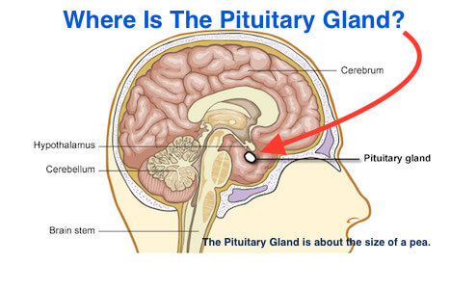
Systems working together
The endocrine system is coordinated by the pituitary gland, which responds to information from the hypothalamus. It constantly checks the internal environment - conditions of your internal organs, tissues and systems of your body. If the conditions change, then the hypothalamus responds.
The most important function of the hypothalamus is to link the nervous system and the endocrine system by releasing hormones that act on the pituitary gland.
The pituitary gland (the ‘master gland’) controls the activities of the other endocrine glands – the ovaries, the testes and the thyroid gland.

Slide 6
Fight or flight
In situation of fear or stress, both the nervous system and the endocrine system have a role to play – known as ‘fight or flight’.
Endocrine system – releases the hormones adrenaline and cortisol, which increases heart rate, breathing rate and blood pressure.
Nervous system – works with the endocrine system to increase the rate of breathing and increase heart rate. Pupils dilate, to improve vision, sweat glands produce more sweat and the digestion slows down or ceases.

Slide 7
Correct Terminology

Slide 8
Correct Terminology
Adrenal Gland: Regulates fluid and sodium balance; emergency warning system under stress.
Endocrine Gland: A gland in the body which secretes hormones into the bloodstream.
Hormone: A chemical secreted by endocrine glands which carries instructions to the body.
Ovary: Controls development of secondary sex characteristics and functioning of sex organs.
Pancreatic islets: Helps regulate blood sugar.
Pineal gland: Believed to regulate biorhythms and moods and stimulate the onset of puberty.
Pituitary Gland: Regulates other endocrine glands; secretes growth hormone.
Receptor: A specific site on a cell designed to recognize and accept a specific hormone.
Testis: Controls development of secondary sex characteristics and functioning of sex organs.
Thymus: Assists in development of the immune system.
Thyroid: Regulates metabolic rate.

Slide 9
Review Questions
7.3 – Endocrine System
Page 298
Complete Questions 1- 10

