Slide 1
Have you ever wondered ……
What causes you to get sick?
How vaccinations work?
Why you should wash your hands before eating?
What is meant by a healthy diet?

Slide 2
8.1 – Infectious disease
Everyone gets sick at some time. Most of us get better quickly. However, sometimes it takes longer and help is needed to get better. Sometimes the reason for being sick is not clear and further tests and treatments are needed.

Slide 3
Disease
Disease is defined as any condition in which the body or parts of the body do not function properly.
Factors that cause disease include infection by microscopic organisms; environmental and lifestyle factors.

Slide 4
Bacteria
One group of microorganisms that can cause disease is bacteria.
Bacteria are microscopic, unicellular (single-celled) organisms. There are unknown numbers of species of bacteria – but in the thousands.
Bacteria are an important part of the natural environment. They are decomposers which convert dead plant and animal matter and wastes into nutrients that plants use to grow.
Some bacteria lives in the intestines of herbivores to help digestion.
Humans use bacteria to make medicines , and break down pollutants.
Harmful bacteria are known as pathogenic bacteria.

Slide 5
Bacterial diseases
Pathogenic bacteria cause hundreds of disease, such as whooping cough, tetanus, diphtheria, impetigo, pneumococcal, meningococcal, and typhoid fever – all of which we describe as infectious diseases.
Disease can be spread by close contact with an infected (contagious) person.
Infected people may need to be quarantined – isolated from healthy people to prevent the spread of the disease (e.g. school sores).
Quarantine is used to prevent the spread of disease within a community, between communities and between countries.

Slide 6
The immune system
Pathogens can enter the body in a number of ways:

Slide 7
The immune system
The first line of defence is to prevent the pathogens from entering the body:
Skin is an effective barrier;
Fluids such as tears and saliva have mild antiseptic properties and wash away pathogens, dust and harmful substances;
Air entering through the nose is filtered by hairs in the nostrils. Unwanted particles are captured in the mucus lining of the trachea. Coughing and sneezing help to get rid of these foreign particles.
Pathogens entering the digestive system are killed by acids in the stomach.

Slide 8
The immune system
Once a pathogen enters the body tissues, the affected area becomes red, hot and swollen – inflamed.
Inflammation is a response of the body to infection – immune cells release histamine, a chemical that causes more blood to flow to the infected area.
Within the blood are white blood cell that consume and destroy bacteria. This action may cause the white blood cells to die, which forms the yellow pus that collects around infected wounds.

Slide 9
The lymphatic system
The lymphatic system is a series of vessels and capillaries that carry fluid from around your cells back to your heart. In areas of the lymphatic system that are nodules called lymph nodes.
The lymph nodes detect a pathogen and make a protein called an antibody which causes the pathogen to clump together in preparation for the white blood cells to destroy more pathogens at one time.
The antibodies made are specific to the pathogen – in other words, the recipe is ready for the next time – you are now immune.

Slide 12
Vaccination
Some diseases are so serious that you cannot rely on your body developing immunity by itself.
Vaccines are substances that cause your body to react as if it had met a pathogen.
A small amount of the toxin produced by a bacterium;
A weakened or killed bacteria.
Both of which are harmless but your immune system responds and you become immune to the pathogen.
Australian vaccinations include: Tetanus, diphtheria and whooping cough.
https://online.clickview.com.au/libraries/videos/3714291/developing-a-vaccine-rotavirus

Slide 13
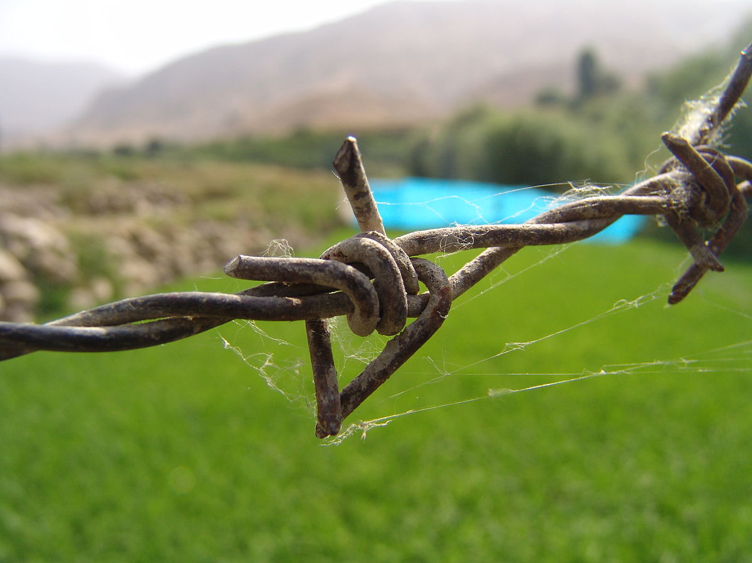
Tetanus
A bacterial infection that lives in the soil and can enter the body through puncture wounds such as barbed wire or rusty nails.
Symptom (indicator of the disease) - Causes muscle spasm and lock jaw.
Vaccination against tetanus can last up to 10 years.

Slide 14
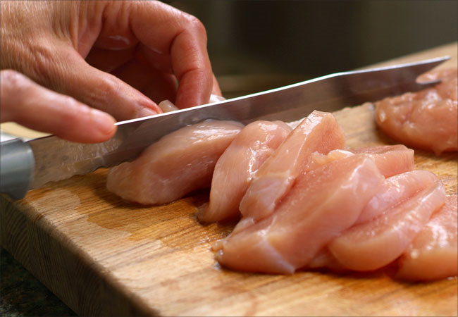
Salmonella
A bacterial that lives naturally in the intestines of humans and animals, and can be found in faeces and on dirty egg shells. If found in food and multiply in the stomach producing poisonous waste called toxins.
Symptom (indicator of the disease) – fever, headache, stomach pain – body tries to reject the toxin through vomiting and diarrhoea.
Avoidance:
Wash hands thoroughly and frequently;
Wash surfaces where food is prepared;
Keep food refrigerated;
Use different chopping boards

Slide 15
Review Questions Q 1-5

