Slide 2
Viruses
After it was discovered that bacteria were the cause of many infectious diseases, scientists began to isolate and identify the bacteria responsible.
In some cases no bacteria could be found, and it was suggested that these diseases were caused by microscopic organisms.
1931 was the first time these viruses
Could be seen, and since then over
5000 types of viruses have been
Discovered.

Slide 3
Viruses
Viruses cause many common diseases, including colds and flu. They also cause measles, mumps, rubella, polio, chickenpox and cold sores (herpes).
The droplets in a sneeze travel out of your mouth at over 160 km/h. If you breath in an infected droplet, then the virus has entered your body – easy as that!
The reduce your chance of catching or spreading a cold by:
Covering your mouth when you cough or sneeze;
Washing your hands frequently;
Don’t share personal items with someone sick;
Avoid close contact with someone coughing or sneezing;
Staying at home if you are sick.

Slide 4
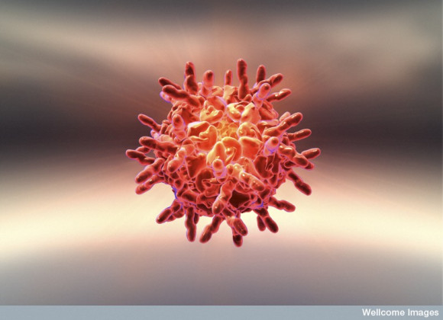
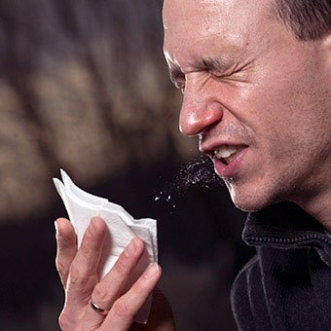
Common Cold
The cold virus attacks the lining of the nose and throat. Extra mucous is produced, so your nose keeps running or becomes blocked, making it difficult to breathe. Your throat gets sore and red, and you feel unwell.

Slide 5
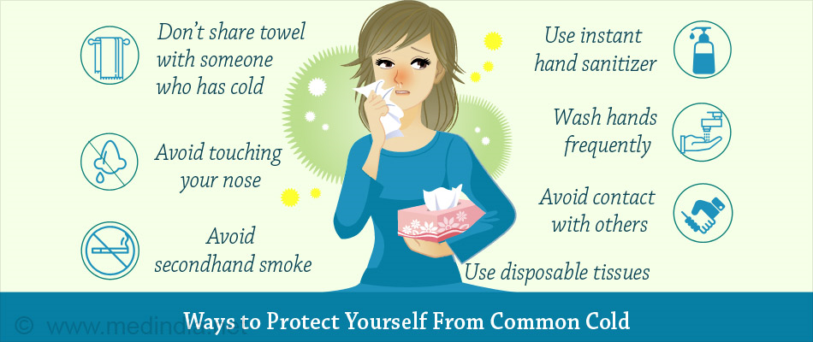
Viruses

Slide 6
Fighting Viruses
Antibiotics do not work against viruses. However, sometimes when you have a viral infection, bacteria invade the body and cause a secondary infection (bronchitis and pneumonia).
Antiviral drugs do not target viruses directly, instead they stop the reproduction of viruses.
Nanomedicine is one promising area for treating viruses, it involves trapping the virus in tiny nano-traps rather than entering and infecting cells.

Slide 7
Disease | Symptom | Treatment
Measles
Chickenpox
Malaria
Amoebic dysentery
Tinea
Thrush
8.2 - Review Questions 1-9

