Slide 2
Burn a balloon demo

Slide 3
The particle model
Heat is a form of energy that can be transferred through solids, liquids and gases. To understand this we need to understand the particle model of matter.
In a solid, the particles are closely packed, but vibrate on the spot but keep the shape of the substance they form.
In a liquid, the particles are closely packet, but the are free to move or flow over each other.
In a gas, the particles are not bound together at all and are free to move in straight lines until they collide with other gas particles or the wall of the container that they are in.

Slide 4
Heating substances
Heating a substance adds energy to its particles. Some of this energy is stored in the material itself as potential energy. The remaining heat increases the Kinetic energy of the particles in the material. Kinetic energy is the energy of movement.
Temperature up = faster moving particles and spread out
Temperature down = slower moving particles and closer together.
When there sufficient heat is added to a solid or liquid the particles break free from each other and the substance melts or evaporates.

Slide 6
Temperature
Temperature can be measured using a thermometer (alcohol or mercury). The liquid expands when heated and contracts when cooled. It is read on a scale, commonly measured in Celcius but also in Fahrenheit and Kelvin.
The temperature of a substance is a measure of the average kinetic energy of its particles. The movement of particles stops altogether at a point called absolute zero -273 C

Slide 7
Temperature
Thermometers measure temperature but do not measure of a substance. Heat is a form of energy and is a way of describing the total energy of all particles within an object.

Slide 8
Convection
As air is heated, its particles gain energy and move further apart. This hot air is less dense than cool air, and so it is pushed upwards by cooler air around it. This method of heat transfer is called convection. The air flow it creates is called a convection current.

Slide 9
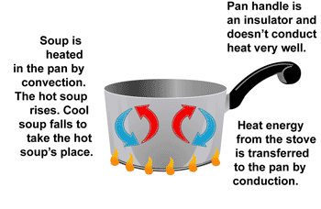
Convection
Heat is transferred by convection in liquids and gases because their particles can move around. Convection cannot happen in a solid because the particles can only vibrate.

Slide 10
Convection
Convection explains the formation of a sea breeze during the day and a breeze towards the sea at night.

Slide 11
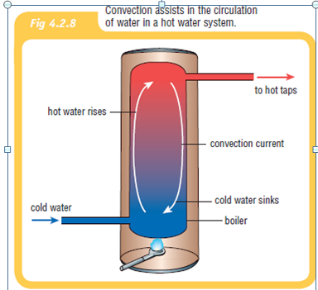
Convection

Slide 12
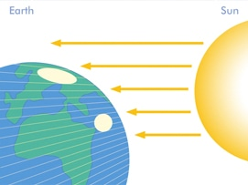
Radiation
Radiation is heat from the sun which travels through empty space to reach you. It cannot be transferred by conduction or convection on its journey because there are no particles to vibrate or flow in the vacuum of space.
Radiation transmits heat as invisible waves that travel at the speed of light, which is around 300,000 km/s.

Slide 13
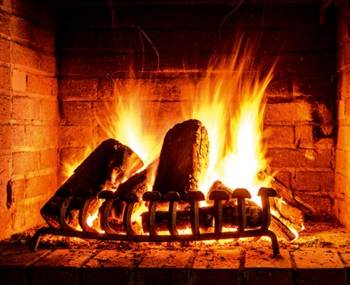

Slide 15
