Slide 2
Straw Clarinets

Slide 3
Sound Waves
Sound is produced when something vibrates, moving back and forth very quickly.
Sound | Vibrating source
Speech | Folds of skin (vocal cords)
Drum | Drum skin
Piano | String inside of piano when you strike a key, the string is struck by a hammer)
Saxophone | Reed inside the mouthpiece and therefore the air inside the saxophone
Car stereo system | Speaker cone
Bell ringing | Metal casing of the bell (when struck)

Slide 4
Sound Waves
When something vibrates, it passes the vibrations into its surroundings, e.g. air. These vibrations create regions of space in which the air particles are bunched together and regions in which they are more spread out.
The bunched up areas are called compressions and the spread-out areas are called rarefactions.
A sound wave is the movement of alternating compressions and rarefactions.

Slide 5
Sound Waves
Sound relies upon vibrating particles. This means that sound can pass through solids, liquids and gases but not through a vacuum where there are no particles.
Whale Sound - https://www.youtube.com/watch?v=mHyoFDPy6XI

Slide 6
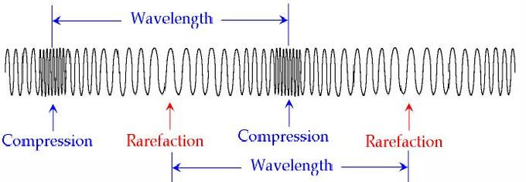
Types of Waves
A wave carries energy from one point to another. This can happen in two ways. The energy carried by waves at a beach moves horizontally, but the particles making up the wave move vertically – this is described as a transverse wave.
A sound wave differs from a transverse wave. In a sound wave, the particles that make up the wave move back and forth in the same direction as the wave is travelling – this is called a longitudinal wave or compression wave.
https://www.youtube.com/watch?v=_vYYqRVi8vY

Slide 7
Transmission of sound
Sound energy is transmitted through a material as longitudinal waves. The particles of the material vibrate as the sound energy flows through it (examples - concert or aircraft taking off – physically feel the energy transmitted by sound).
Sound travels faster through a solid than a liquid, and faster through a liquid than a gas – because the particles are packed closer together.

