Slide 3
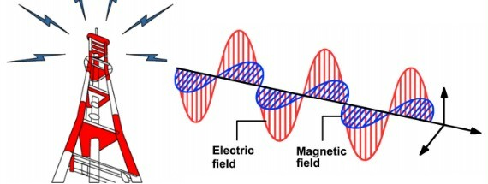
Properties of light
Radiated heat travels through space from the sun to Earth as infrared radiation. Light also travels through space from the Sun to Earth, lighting up our day. Both radiated heat and light are examples of electromagnetic radiation.
They travel as a wave known as an electromagnetic wave. It can pass through a vacuum, and can travel at 300,000 km/s

Slide 4
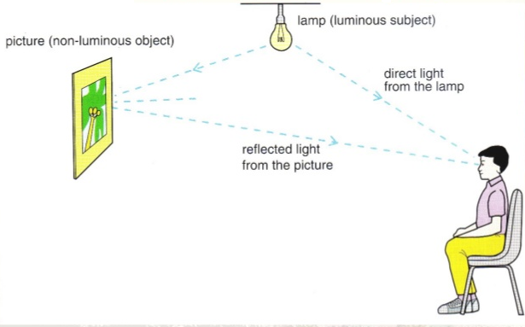
Properties of light
An object that releases or emits light is said to be luminous. However, most objects do not produce their own light. They are non-luminous. You see most objects, such as the moon, because light bounces off them and then into your eyes. This process is called reflection.

Slide 5
Diffuse and regular reflection
When light reflects off a very smooth surface such as a mirror or a window, it undergoes regular reflection. This produces a clear image – all the light rays are reflected in the same direction.

Slide 6
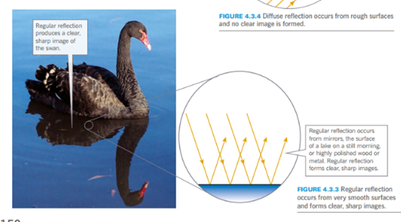
Diffuse and regular reflection

Slide 7
Diffuse and regular reflection
The surfaces of most objects are quite rough when viewed up close. These surfaces reflect or scatter light in many directions, and do not form an image.
Example – ball thrown against the wall

Slide 8
The law of reflection
When a billiard ball on a pool table is hit so that its path is at a right angle to the edge of the table, the ball bounces straight back along the same path. When it is hit at a different angle to the cushion, it bounces off the cushion at the same angle. In the same way , an incoming ray of light is reflected off a mirror at the same angle. This is called the law of reflection.
The incoming ray is known as incident ray and the ray that bounces off the mirror is known as the reflected ray. A dotted imaginary line, called the normal, is shown at right angles to the surface of the mirror. This is used to measure the angle of incidence (i) and the angle of reflection (r).

Slide 9
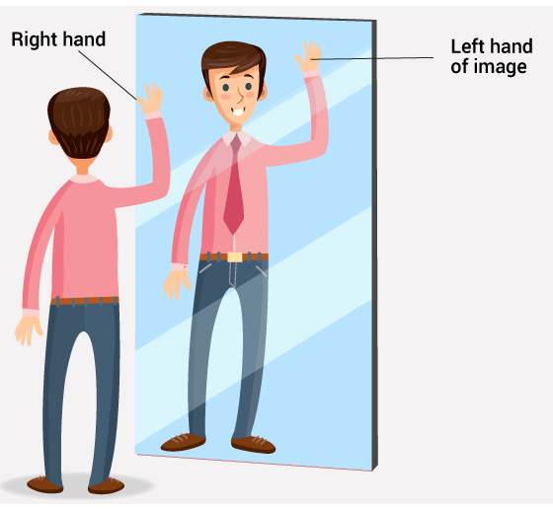
Plane mirrors
A flat mirror is also called a plane mirror. When you stand in front of a plane mirror in a fitting room when trying on clothes, your image is the same size as you. Your image appears to be behind the mirror the same distance as you are in front of it. Your image is identical to you in every way except that it is reversed sidewards: your right side appears as your left – this is called lateral inversion.

Slide 10
Forming an image

Slide 11
Vocab….
Angle of incidence
Angle of reflection
Angle of refraction
Concave lens
Convex lens
Critical angle
Incident ray
Lateral inversion
Law of reflection
Luminous
Normal
Plane mirror
Real image
Refraction
Refracted index
Total internal reflection
Virtual image

