Slide 3
Hearing sound
To hear a sound, its energy needs to be transmitted through your eardrums and delicate structures of the ears. Your ears collect sound waves as they enter the outer ear and travel through the ear canal. Vibrations of the sound wave strike the eardrum, causing the eardrum to vibrate. This vibration is then passed on to the three tiny bones of the middle of the ear. The movement of the bones of the middle ear set up vibrations in the fluid of the cochlea which is located in the inner ear. It is the cochlea that these vibrations are converted into the electrical impulses as sound.

Slide 4
Hearing sound

Slide 5
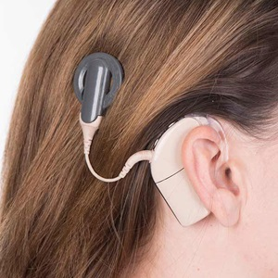
Hearing sound
Over on million Australian’s have a hearing
disability ranging from mild hearing loss to complete deafness.
These problems can be because:
The ear canal is blocked with wax, preventing the passage of sound waves
The middle ear is filled with fluid
The eardrum has been ruptured by an extremely loud noise or as a result of an infection
Sensory cells of the ear have been damaged by loud noise
A defect in the auditory nerve or the tiny hairs of the cochlea prevents sound impulses being transmitted correctly to the brain.
A cochlea implant, or bionic ear, has helped many people with serious inner-ear damage to hear sound for the first time.

Slide 6
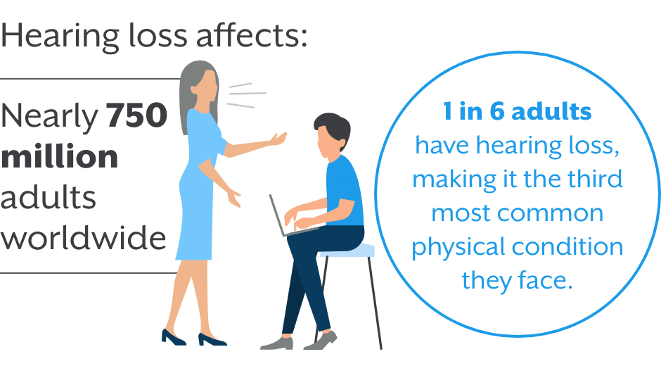

Slide 7
The eye

Slide 8
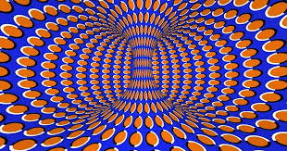
Optical illusions

Slide 9
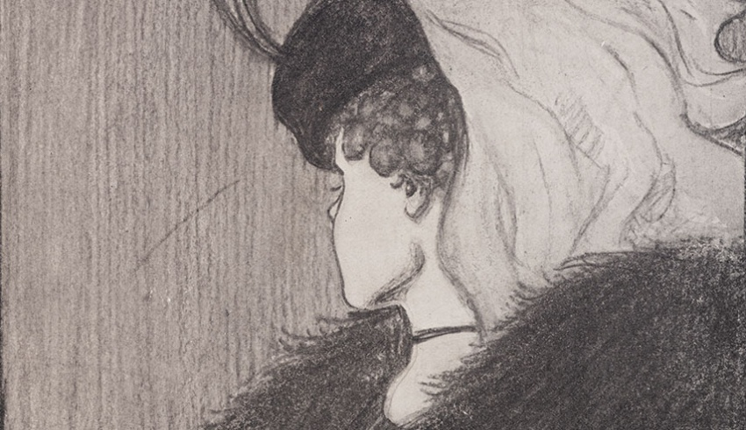
Optical illusions

Slide 10
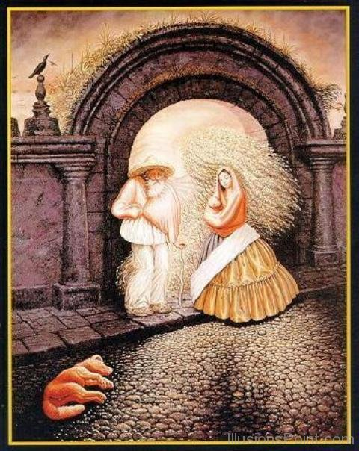
Optical illusions

Slide 11
Optical illusions

Slide 12
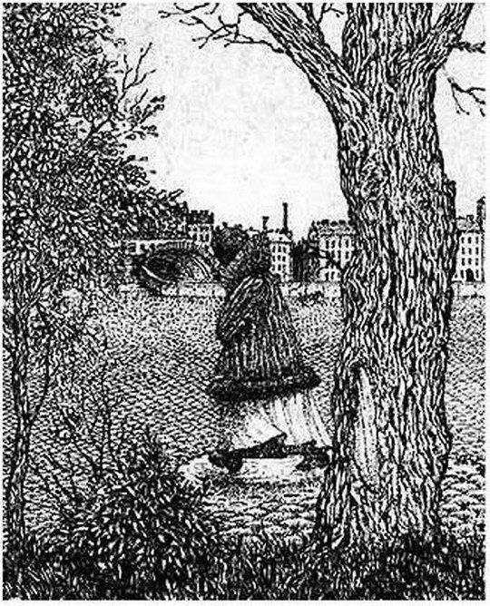

Slide 14
The eye
Light entering the eye is refracted by the cornea and focused by the convex lens. Incoming light is focused to form a clear, updie-down image on the retina, at the back of the eye. This image is converted into a series of electrical signals, which then travel along the optic nerve to the brain. The brain interprets this information as an image.

Slide 15
Vision problems
The lens in your eyes focus on objects at different distances by changing focal length. When the muscles attached to the lens contract, the lens stretches, becoming quite flat, and able to focus on distant objects. When the muscles relax, the lens gets much fatter and bends the light more, allowing close objects to become focussed. This process is called accommodation – and as we age the lens hardens making this process more difficult.

Slide 16
Vision problems
If light is not focused to a point at the retina, then the person will not see a clear image. This commonly leads to short-sightedness (myopia) or long-sightedness (hyperopia).
People who are short-sighted can focus on close objects such as a book, but distant objects, such as children in a playground, are not clear.

Slide 17
Vision problems
People who are long-sighted can see distant objects clearly, but have trouble focusing on close objects. They need to use glasses when reading or doing close work.

