Slide 1
The endocrine system
Science 9

Slide 2
What is the endocrine system
The endocrine system is made up of glands that produce and secrete hormones, chemical substances produced in the body that regulate the activity of cells or organs. These hormones regulate the body's growth, metabolism (the physical and chemical processes of the body), and sexual development and function.

Slide 3
What important part does it play?
Endocrine System. Your endocrine system works with your nervous system to control important bodily functions. The endocrine systems responsibilities include regulating growth, sexual development and function, metabolism and mood. Theendocrine system also helps give your body the energy it needs to function properly.

Slide 4
HORMONES
What are hormones?
a regulatory substance produced in an organism and transported in tissue fluids such as blood or sap to stimulate specific cells or tissues into action.
How are they circulated through the body?
Though few hormones circulate dissolved in the blood-stream, most are carried in the blood, bound to plasma proteins.

Slide 5
sound
Hannah Montana

Slide 6
Sound waves:
Sound is made when something vibrates moving back and forth very quickly.
When something vibrates, it passes the vibration into the air.
In a sound wave they are all bunched together and spread out, bunched areas are called compressions and spread out area called rarefactions.

Slide 7
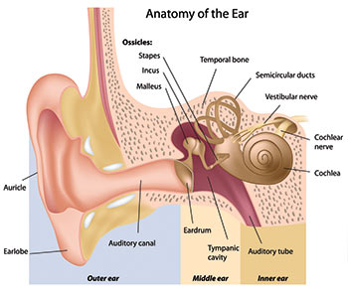
What are the important parts of the ear?
Eardrum
Separates the external ear from the middle ear. Used to transmit sound from the air to the middle ear.
Cochlea
It receives sound which the stereocilia receives and sends to the brain to interpret.
Semi circular
They are tree tiny fluid-filled tubes that helps you keep your balance.
cochlea

Slide 8
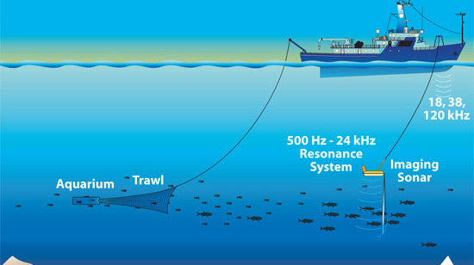
Why do you hear sound louder under water?
When you put your head under water the sound waves go directly to your ear so you can hear it louder. Water is a good conductor of sound.

Slide 9
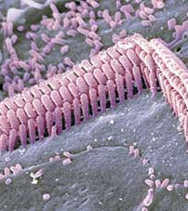
What is the reason of losing your hearing?
Exposure to loud noise for a long period of time can permanently damage your hearing. Noise destroys sensory cells in the inner ear. These cells detect vibrations and send signals to the brain. These cells cannot be replaced. Loud noise can lead to tinnitus which is a constant ringing in the ears.

Slide 10
heat
By max Mansfield and quin arnold

Slide 11
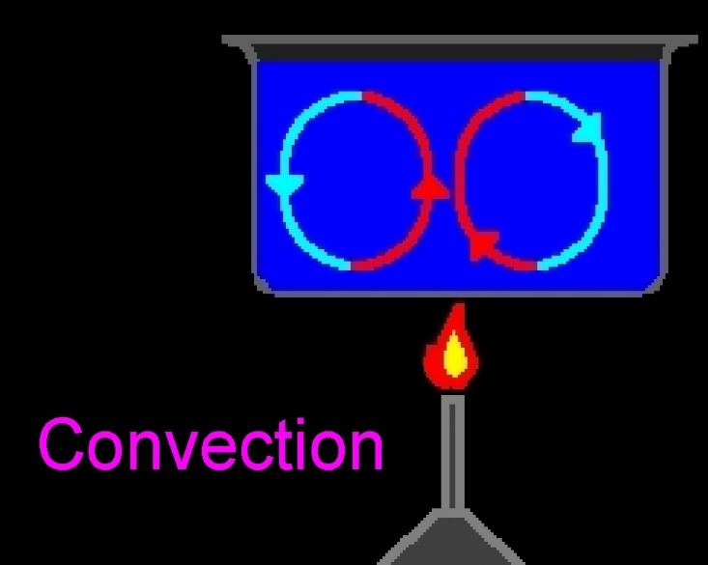
convection
Convection is the transfer of heat in a liquid or gas due to less dense, warmer matter like water rising and the denser, cooler matter falls if you want an easier explanation think of a lava lamp how when the globs of wax get heated up and then cool down and fall to the bottom just to get heated up again and go to the top.

Slide 12
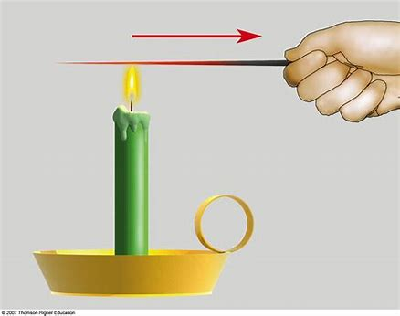
conduction
Conduction is a substance that allows heat to flow through it to the other side. Just like when you touch the metal handle of a sauce pan it is hot but if there is rubber on it isn’t hot because there are bad conductors and good conductors.

Slide 13
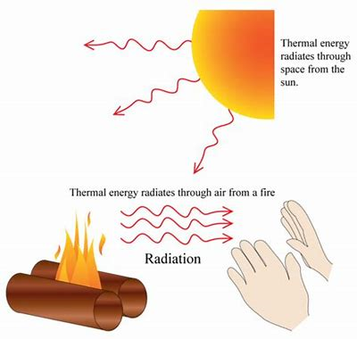
radiation
Movement of heat in the form of electro magnetic waves, that can travel through a vacuum. The sun gives of the most radiation that we can feel. It is that warm feeling that you get from being out in the sun to long but if you stay out in the sun to long the radiation can harm your skin and give you cancer.

Slide 14
Thank you for listening

Slide 15
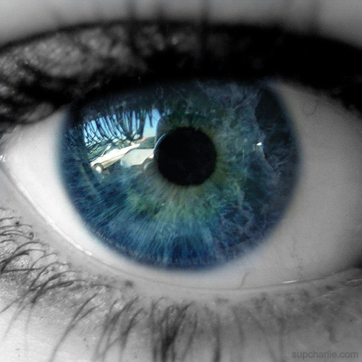
Long & short sight
Poppy & Annie

Slide 16
Convex lens
Before: After:
Hyperopia is the fancy name for long-sightedness.
Convex lenses fix long-sightedness.
The convex lens bulges outwards.
It causes light rays to come together.
It focuses light on a point to make a real image.
Before the convex lens is put in front of the long-sighted eye, the image is formed at a point behind the retina. The lens helps focus the image directly onto the retina.

Slide 17
Concave lens
Before: After:
Myopia is the fancy name for short-sightedness.
The lens curves inwards.
It causes light to spread out in parallel lines.
It produces smaller images.
Before the lens is put in front of the short-sighted eye, the image is formed in front of the retina. The lens help form the image on the retina.

Slide 18
The Nervous System

Slide 19
What is it
It is the communication network of the body
It controls the:
Digestive system
Circulatory system
It is made up of two main parts
The CNS (central nervous system) which is made up of your brain and spinal cord
The PNS (peripheral nervous system) which is made up the nerves that carry messages to the CNS

Slide 20
Types of Neuron
There are 3 types of neuron:
Motor Neuron
Sensory Neuron
Relay Neuron

Slide 21
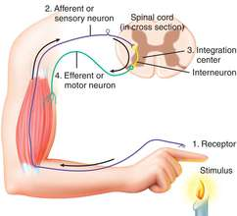
Reflex actions
Does not require conscious thought
A signal is sent from pain receptors in you hand to the spinal cord then the signal is passed to the arm muscles which contract
A message its then sent to the brain

Slide 22
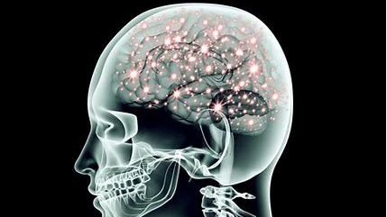
The Brain
Revision:

Slide 23
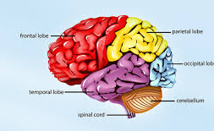
What Are The Parts Of The Brain?
There are a couple really important parts of the brain, those are the:
Cerebrum
Brain Stem
Cerebellum
Spinal Cord
Vertebrae Of The Spine

Slide 24
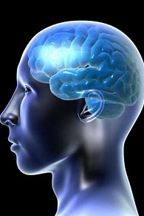
What Are Their Functions?
Cerebellum: The cerebellum receives information from the sensory.
Spinal Cord: It connects a large part of the peripheral nervous system to the brain. Messages sent from the sensory neurons are transmitted up into the brain.
Cerebrum: Controlled right and left hemisphere. Each hemisphere works together to control both sides of the body.
Brain Stem: It controls the flow of messages between the brain and the rest of the body, it controls basic body functions like breathing, swallowing, heart rate, blood pressure, consciousness and whether you’re awake or sleepy.
Vertebrae Of The Spine: In humans an additional function is to transmit body weight in walking and standing.

Slide 25
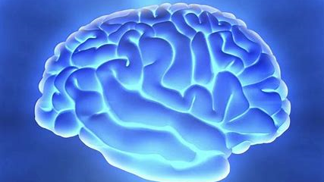
What Will Happen If One Of These Are Damaged?
If one of these main functions of the brain was to be damaged it could be fatal, walking would be impossible, wouldn’t be able to speak, read, think about words, balance or listen.

Slide 26
Sea Floor Spreading And Plate movement.
BY Joey and Bek.

Slide 27
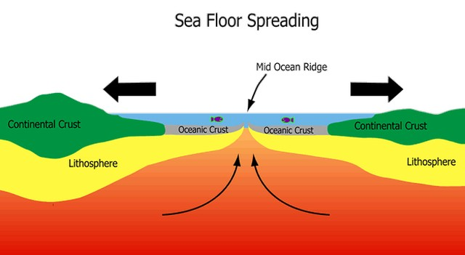
What is seafloor spreading:
It is where new oceanic crust is formed on an oceanic ridge and moving outwards.
Googles explanation:
Seafloor spreading is a process that occurs at mid-ocean ridges, where new oceanic crust is formed through volcanic activity and then gradually moves away from the ridge.

Slide 28
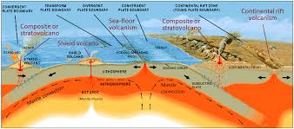
What evidence was used to support the theory of plate movement?
Plate tectonic theory had its beginnings in 1915 when Alfred Wegener proposed his theory of "continental drift." Wegener proposed that the continents plowed through crust of ocean basins, which would explain why the outlines of many coastlines (like South America and Africa) look like they fit together like a puzzle - Slab Pull -Ridge Push

Slide 29
Why do plates move:
The tectonic plates move because there not completely stable. The plates (crust) is on the top of a very hot substance called magma that is called the Mantel. The lower mantel is more solid than the upper mantel. The mantel moves around a bit, The crust is on top of the mantel and moves as a result.
Googles explanation:
Plates at our planet's surface move because of the intense heat in the Earth's core that causes molten rock in the mantle layer to move. It moves in a pattern called a convection cell that forms when warm material rises, cools, and eventually sink down. As the cooled material sinks down, it is warmed and rises again.

