Slide 2
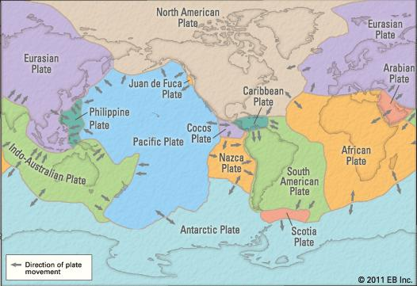
Continental Drift
In 1912 a revolutionary theory was proposed by Alfred Wegener that the continents were once connected to each other. He called the large land mass Pangaea, and concluded that the continents must of somehow separated and drifted across the oceans. His theory was called continental drift.

Slide 3
Continental Drift
Wegener based his theories on two main observations:
All continents seemed to fit together like a jigsaw;
Fossils of the same prehistoric species were found on continents that were a long way apart.
Therefore if the continents had drifted they had taken fossils with them.

Slide 4
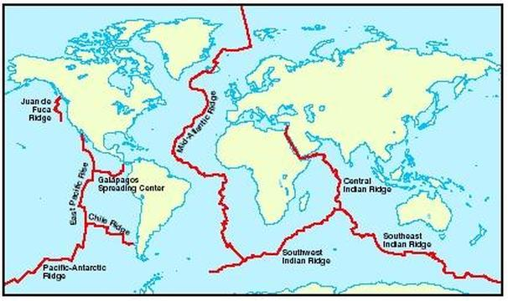
Seafloor Spreading
In 1872, scientists were surveying the ocean floor for an undersea telegraph cable to be laid between North America and Europe. In the middle of the Atlantic Ocean they discovered a large mountain ridge that extended a long way south.
In 1925 German scientists used sonar (echo sounding) to confirm that this ridge ran the entire length of the Atlantic Ocean.

Slide 5
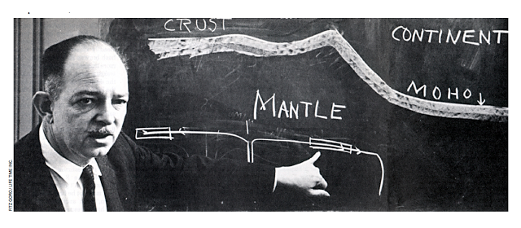
Seafloor Spreading
By 1953, the ridges were found to have a series of huge cracks along them. The cracks are called rifts, and so the system was named the Great Global Rift system. In 1962, Harry Hess (American geologist) used sonar to map the Pacific Ocean and found many flat-topped mountains under water. He proposed that new rocky crust was being formed at the ocean ridges and spreading outwards. This process was later called seafloor spreading.

Slide 6
Support for Hess’s theory
The theory of seafloor spreading proposed by Hess is supported by three important pieces of evidence:
Magnetic stripping
Age of the sea floor
Sediment thickness

Slide 7
Support for Hess’s theory
Magnetic striping
Magnetic iron oxide mineral called magnetite is found in many rocks. Magnetite has a north-seeking pole and a south-seeking pole, just like a compass needle which can be detected with a device called a magnetometer. The patters of strips of rocks with alternating magnetism are called magnetic stripping. New sea floor was being added equally on each side of the ridge.

Slide 8
Support for Hess’s theory
Age of the sea floor
The further the rocks of the sea floor were from the ridges, the older they were – which is exactly what we should expect if new rocks form near the mid-ocean ridge and move outwards away from it.
Sediment thickness
The sedimentary rock layers on the ocean floor become thicker As you move away from the ridges. This was interpreted by geologists as showing that sediments had been falling for longer on the rocks on the sea floor furthest from the ridges.

Slide 9
Tectonic Plates
The picture that scientists have now of Earth’s structure supports Wegener’s original view of continental drift. Earth’s outermost layer is called the crust – it’s the layer that we humans and all animal life can be found on. I varies in thickness but is about 5 km deep under the oceans to about 30 km under the continents. Each section is known as a tectonic plate.

Slide 10
Structure of the earth

Slide 11
Structure of the earth

Slide 12
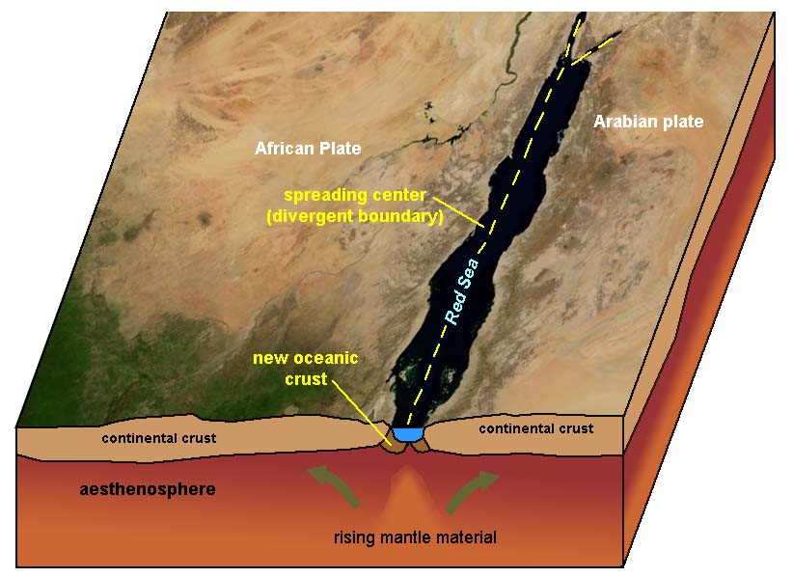
Rifting and continental drift
Wegener’s theory of continental drift did not explain how the continents moved. Hess’s theory of seafloor spreading offered a much more likely mechanism for movement of the continents. He believed that the continents broke up by a process called rifting. The crust cracked and subsided allowing in water from the oceans.

