Slide 1
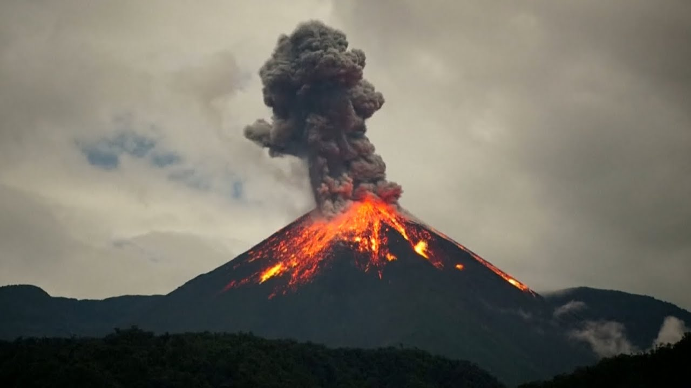
10.3 – Volcanoes and earthquakes
Volcanoes are among the most awesome sights on the planet. The largest explosion in recorded history was from a volcano. Earthquakes can also be deadly. Earthquakes and volcanoes provide evidence of the interior processes of the Earth. They provide information that supports the theory of plate tectonics.

Slide 2
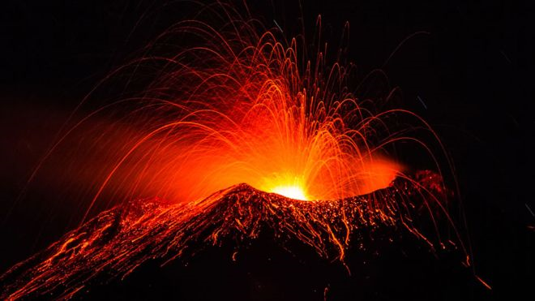
Volcanic eruptions
A volcano is a place where extremely hot material from inside Earth erupts at Earth’s surface.
This material can include:
Gas such as steam and hydrogen sulfide
Ash made of fine rock particles
Lava
Lumps of solid volcanic rock as scoria
Volcanos form where extremely hot molten rock called magma has accumulated below weak spots in Earth’s crust. This magma is pushed upwards and when it reaches the surface it is called lava reaching temperatures of over 1200 degrees.

Slide 3
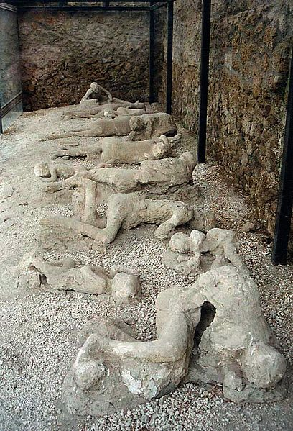
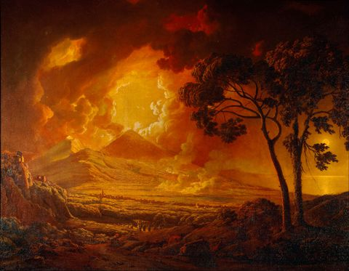
Mount Vesuvius
16,000 killed in 79AD
Ash covered bodies leaving a cavity in rock which scientists poured a plaster cast into the cavity to reveal the final struggle of the residents of this city.

Slide 4
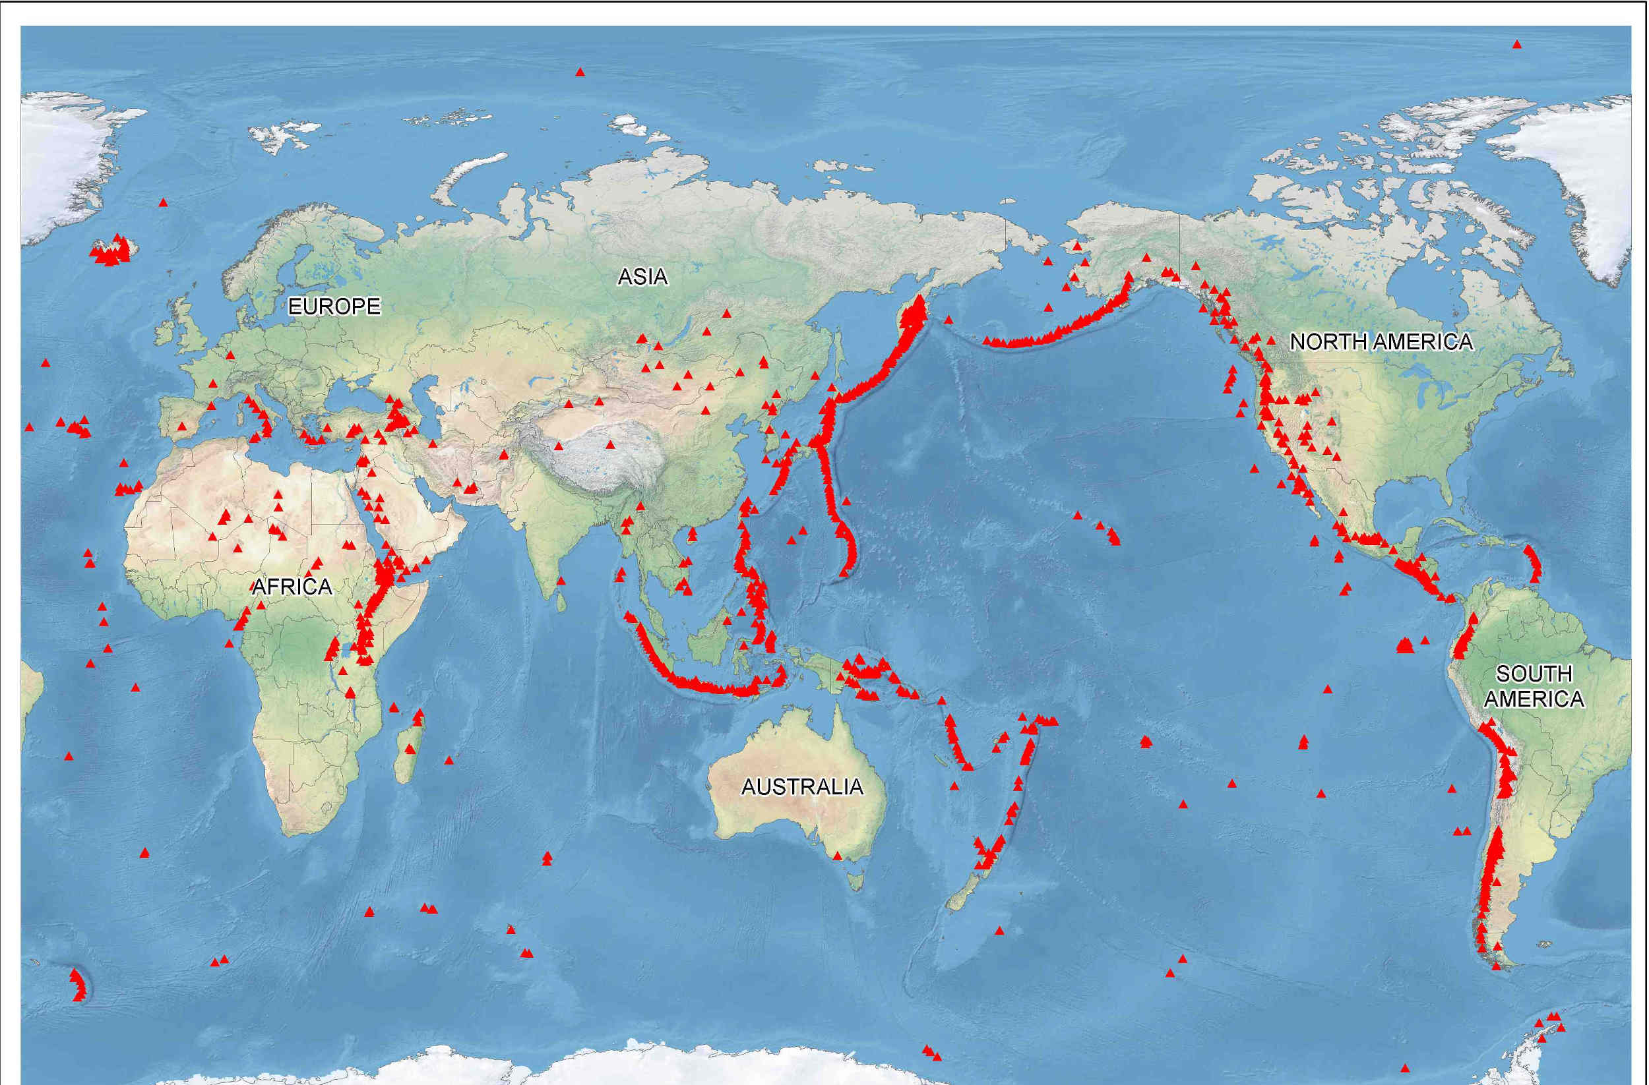
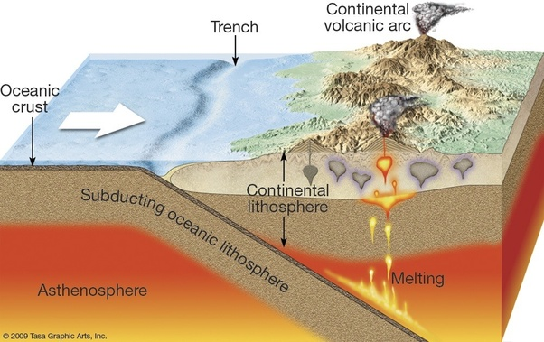
Volcanoes and plate boundaries
Most volcanoes are found on or at the edge of tectonic plates because the movement of the plates creates weaknesses in the crust and also generates intense heat that can melt rock.

Slide 5
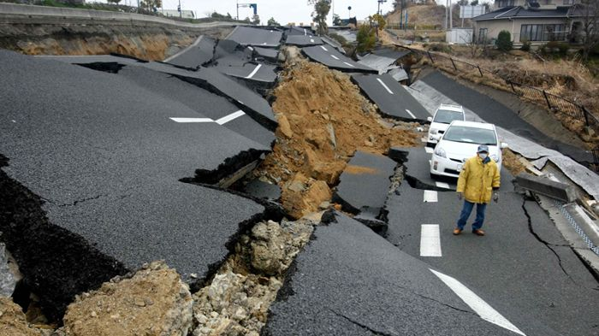
Earthquakes
An earthquake is the rapid movement of the ground, usually back and forth and up and down in a wave motion. It is caused by the rapid release of energy as the tectonic plates move. Tectonic plates are usually held together by the force of friction.
Sometimes, however, the forces in the crust become so large that they overcome the force of friction, and the plates suddenly move. This sudden movement sends out waves of energy through rock and the water. The ground and water then shake as the waves of energy pass through them.

Slide 6
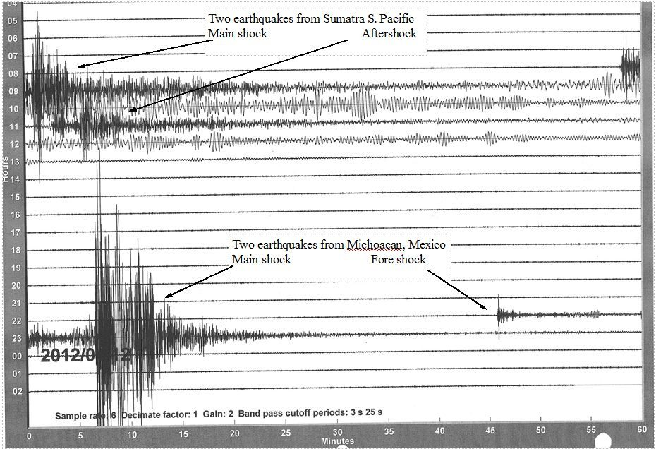
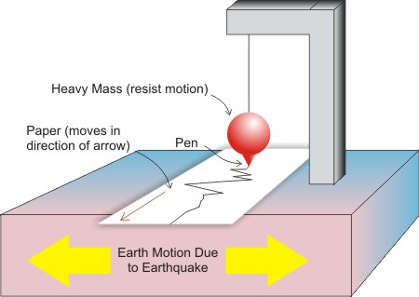
Earthquakes

Slide 7
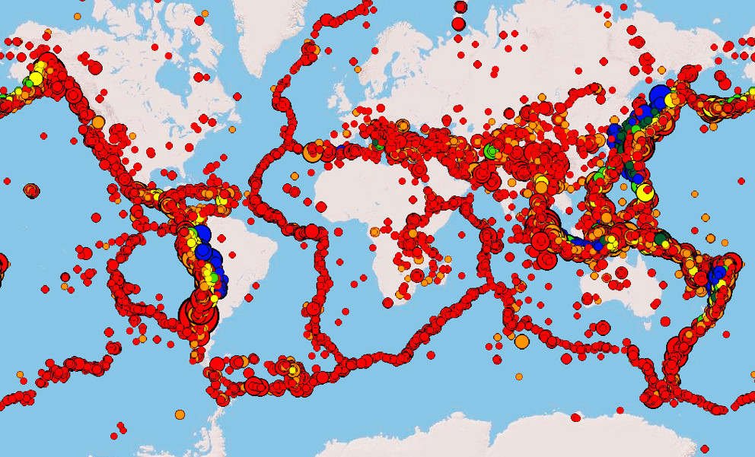
Earthquakes
The largest number of earthquakes and the strongest earthquakes occur near converging boundaries.
http://earth3dmap.com/earthquake-live-map/

Slide 8
Earthquakes
Earthquakes happen at particular places under the ground where Earth slips usually along a fault line. The place where it starts is called the focus. The point of Earth’s surface directly above the focus is called the epicenter.
Buildings near the epicenter are usually damaged heavily.
A scale called the Richter scale is used to calculate the severity of an earthquake.
The scale is open ended but usually finishes at 10. Each successive earthquake is ten times greater than the previous number – 5.0 is ten times more destructive than 4.0.

