Slide 1
Design and Technology
Timber Production

Slide 2
The Timber Industry
The forest products industries in broad terms are sawmilling, veneers and panelboards, pulp and paper, and woodchips. In addition, there are a number of related manufacturing activities including joinery, wooden structural components, wood and fibreboard containers, and paper manufacturers. These industries and activities directly provide jobs for about 82,500 people. This number includes about 57,000 jobs in the manufacturing component of the wood and wood based industries (for example, sawmilling, veneers, joinery, paper and paper products) and in forestry and logging operations.
http://www.timber.net.au/index.php/forest-management.html (Viewed 8th April 2016)
https://www.forestry.sa.gov.au/Plantation-Forestry

Slide 3
Forestry in Australia

Slide 4
South Australian Forests
https://www.forestry.sa.gov.au/About-Us/Maps

Slide 5
Timber Production
http://www.google.com.au/url?sa=i&rct=j&q=&esrc=s&source=images&cd=&cad=rja&uact=8&ved=0ahUKEwjizKjKlf7LAhWmq6YKHTy5BsMQjB0IBg&url=http%3A%2F%2Fwww.ukisawmill.com.au%2F&bvm=bv.119028448,d.dGY&psig=AFQjCNGu_c-nkqdR8X9rXoM8n2a7ErSzww&ust=1460174800962420

Slide 6
Where our Timber Comes From
http://www.forestryforum.com/

Slide 7
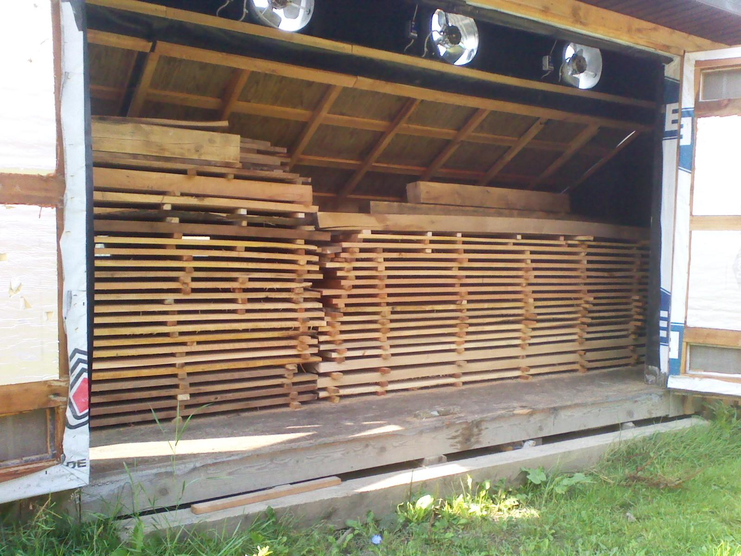
Kiln Drying
The moisture content of timber should be relative to the atmosphere where it will be used eg 50% humidity equals around 9% moisture content in timber. Sawmills dry timber in Kilns.
https://conscious98jhf.wordpress.com/2015/03/10/diy-solar-drying-lumber-wooden-pdf-cabinet-plans-free-woodworking/

Slide 8
Types of Timber
http://www.thoughtyoumayask.com/picsbtqq/hardwoods-and-softwoods-wikipedia

Slide 9
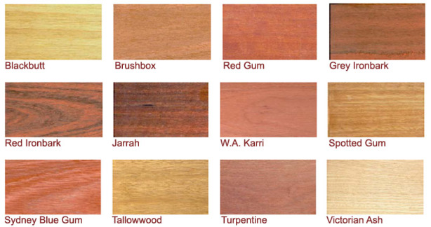
Types of Common Softwoods and Hardwoods
http://ketenewplymouth.peoplesnetworknz.info/friends_of_te_henui/images/show/10823-pinus-radiata-radiata-pine-insignis-pine-monterey-pine
https://diybb.wordpress.com/2010/09/16/best-deck-timber-in-australia/

Slide 10
Man Made or Engineered Timber Products
http://www.bing.com/images/search?q=Manufactured+Boards+Types&id=EDF506A850A2838E3553510EFC4DF783EE49BA7A&FORM=IDBQDM

Slide 11
Further Information
http://www.technologystudent.com
http://www.timber.net.au/
https://www.forestry.sa.gov.au/
Ask your local Timber Supplier
Contact an expert in your community.
Ask questions….remember there is no such thing as a dumb question.
Ask for Help.

