Slide 1
YEAR 9 DESIGN & TECHNOLOGY
Systems CAD – Laser Cutting
Contemporary Design & Manufacture
YOUR NAME

Slide 2
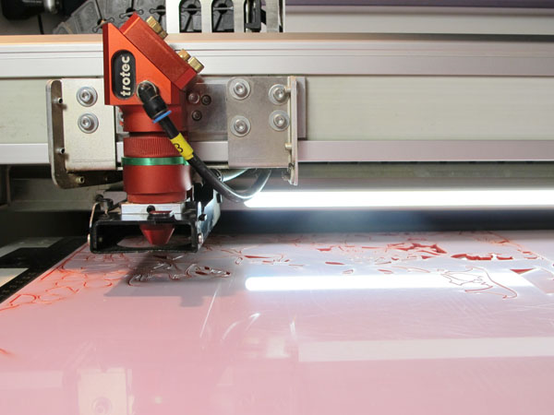
Task
Your task is to design and produce a unique contemporary Laser cut design product. It must be unique in its design, feature interlocking components, while still being functional and aesthetically pleasing. Your final design must be modelled in a Computer Aided Design program such as Autodesk Fusion 360 or Inventor and will be laser cut using the Trotec laser cutter.

Slide 3
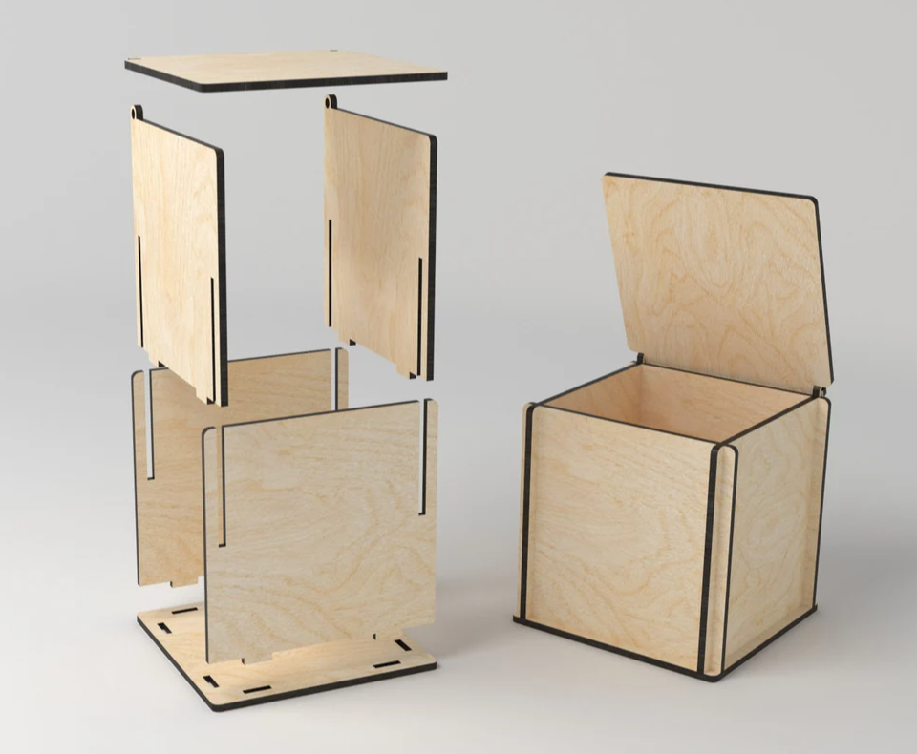
Task Constraints
The size of all the nested parts must fit on an A3 sheet
It must be made from 3mm Plywood and / or 3mm Acrylic (unless negotiated otherwise)
It must feature interlocking parts
It must be manufactured using the laser cutter

Slide 4
Laser Cut Design Investigation
Research and find 4 existing designs similar to what you intend to makes then:
Comment on:
What makes the chosen product appealing to you?
Why do you think it would be appropriate for your home?
What or how will the product be modified to suit the laser cutter?
Think of the design elements and comment on how the Material, Shape, Form, Contrast, Pattern or Scale suits your specific needs and makes it a successful design.

Slide 5
Design 1

Slide 6
Design 2

Slide 7
Design 3

Slide 8
Design 4

Slide 9
Idea Generation - Planning
STEP 2: DESIGN
Idea Generation:
After investigating existing examples of like products, you are to sketch at least 4 annotated conceptual design ideas of your product.

Slide 10
Annotated Planning Sketches
Insert your annotated sketches here. Be sure to include notes on all relevant information, for example dimensions, materials, etch lines, inlays etc.

Slide 11
Final Design
Insert your scanned page
of your refined final design sketch.
This needs to be a clear working drawing to enable you to begin creating it in Fusion 360.

Slide 12
Fusion Design
Insert an angled screenshot of your completed Fusion assembly. Be sure to add material appearance to your parts to make the appearance more realistic.

Slide 13
Fusion Technical Drawing
Insert your dimensioned technical drawing here

Slide 14
Finished Product Photo

Slide 15
Evaluation (300 words)
Are you happy with the final outcome of your product and why?
Discuss any issues or challenge that arose during this project.
What skills or processes did you learn from this task and are there any skill that you feel require more development?
Are there any changes or modifications you would make to your final product?

