Slide 1
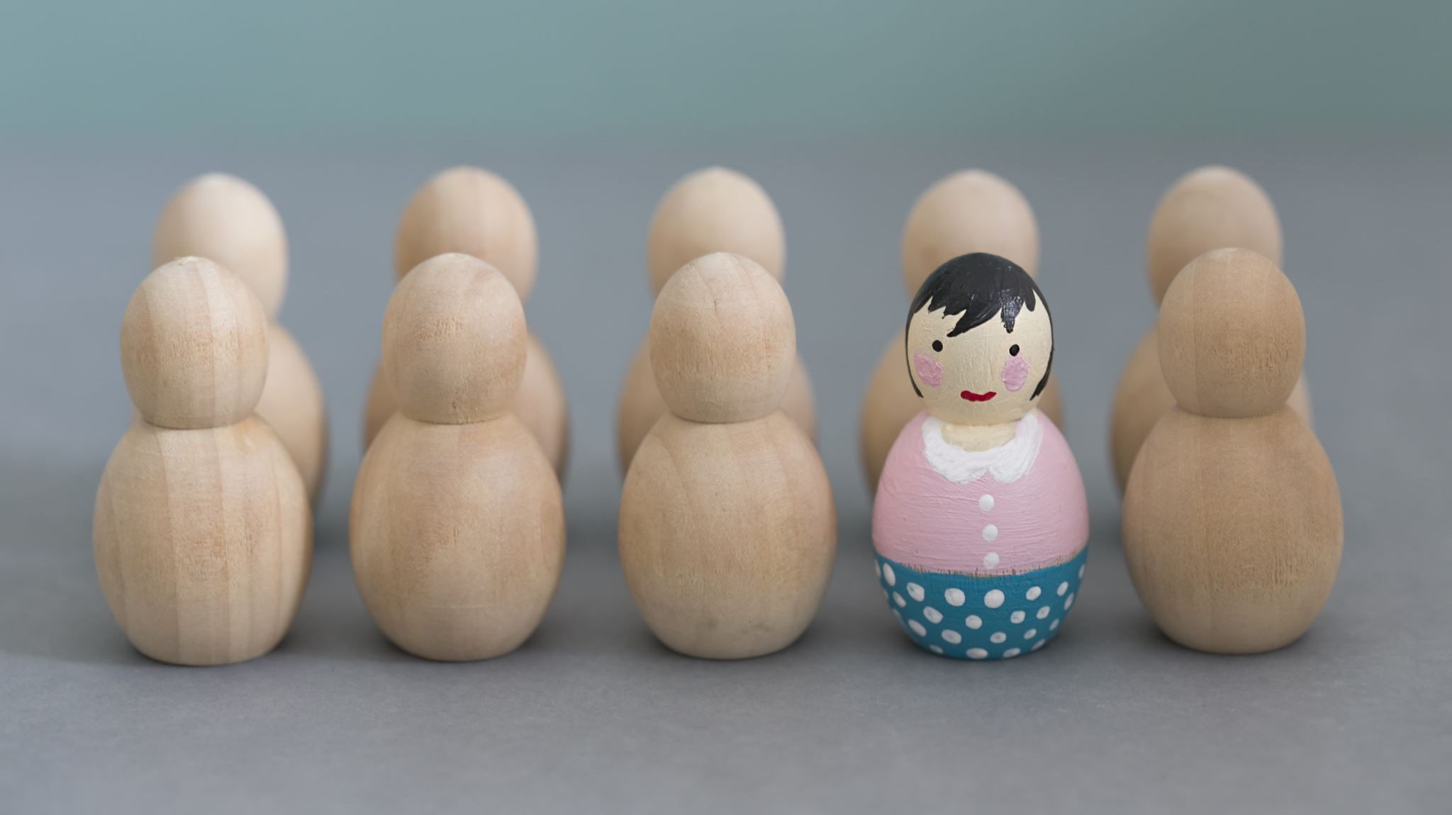
Character

Slide 2
Characters in novels
Show the reader how people react in various situations
The reader can internalize what these characters are going through: how they react, how they work through their problems.
This can help prepare them for their own life's circumstances
If you can’t relate to the character or don’t like them, you can still learn something: how you’d prefer NOT to respond to situations!

Slide 3
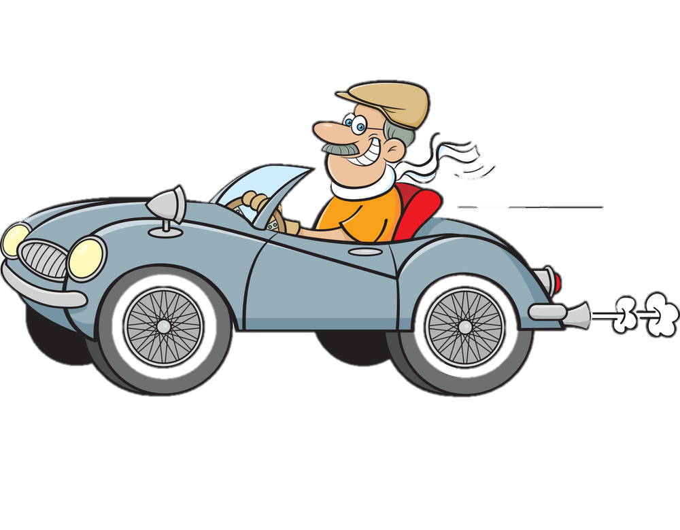
Drive Plot & Develop Themes
Characters make the plot happen. Their actions, thoughts and motivations are the driving force of the whole story.
Characters develop the theme. The author often gives clues/hints in the text that show what they think about a character’s actions
Using loaded words and positive/negative connotations when describing their actions
Might show good motives or deeds rewarded and bad characters suffering the consequences

Slide 4
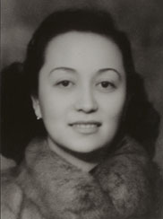
Character Description
The way a character is described or portrayed in a novel can give you a clue what the author thinks about them, or wants YOU to think about them
Not just what they look like – their actions & HOW they do them
“Keep still!” Niang screamed futilely again and again in a piercing voice.
It made me cringe to think of my gentle and dignified grandfather begging for pocket money from my haughty stepmother

Slide 5
Key Characters
Protagonist (main character but also the ‘good guy’)
Antagonist (main source of conflict, main villain)
‘Rounded’ vs ‘flat’ characters
Flat characters have only one main trait
Rounded characters are more complex and therefore more realistic
‘Static’ vs ‘dynamic’ characters
Some characters grow & change (e.g. Adeline), others don’t (e.g. Niang)

Slide 6
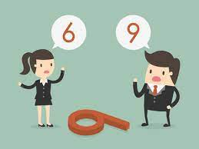
Characters in a memoir or autobiography
These are real people who actually existed, not fictional characters
Means they don’t always follow satisfying or logical plot arcs
Influenced by subjective view of author
Even if the author is making an effort to tell events exactly as they happened, they are still telling it from THEIR perspective.

