Slide 1
Setting

Slide 2
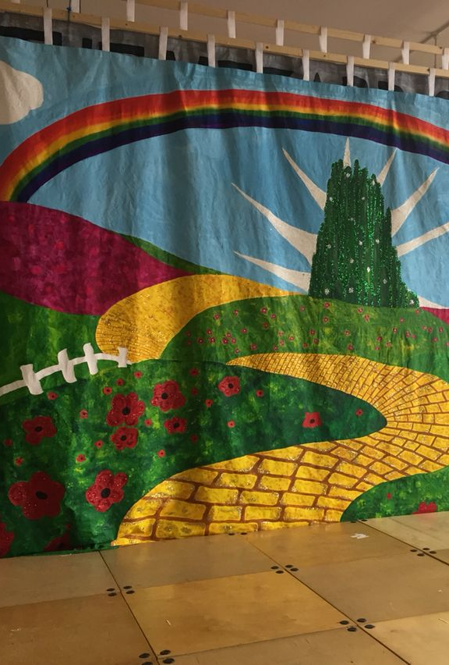
Setting
One of the key elements of fiction
Creates a backdrop for the events of the story
Creates a context for the action, character development, and conflict
Has a big effect on the feel or ‘mood’ of the novel
In a fiction novel: makes the story feel real and believable
In a memoir or autobiography = BONUS history/culture lesson!

Slide 3
5 Elements of Setting
Geographic location
Country, city, town, village?
Time period
Present or past? Over a long or short period?
Physical environment
Inside or outside? Forest, space station, school?
Mood
Weather, climate, lighting? Mostly day or night?
Social and cultural environment
Language, traditions, culture, expectations?

Slide 4
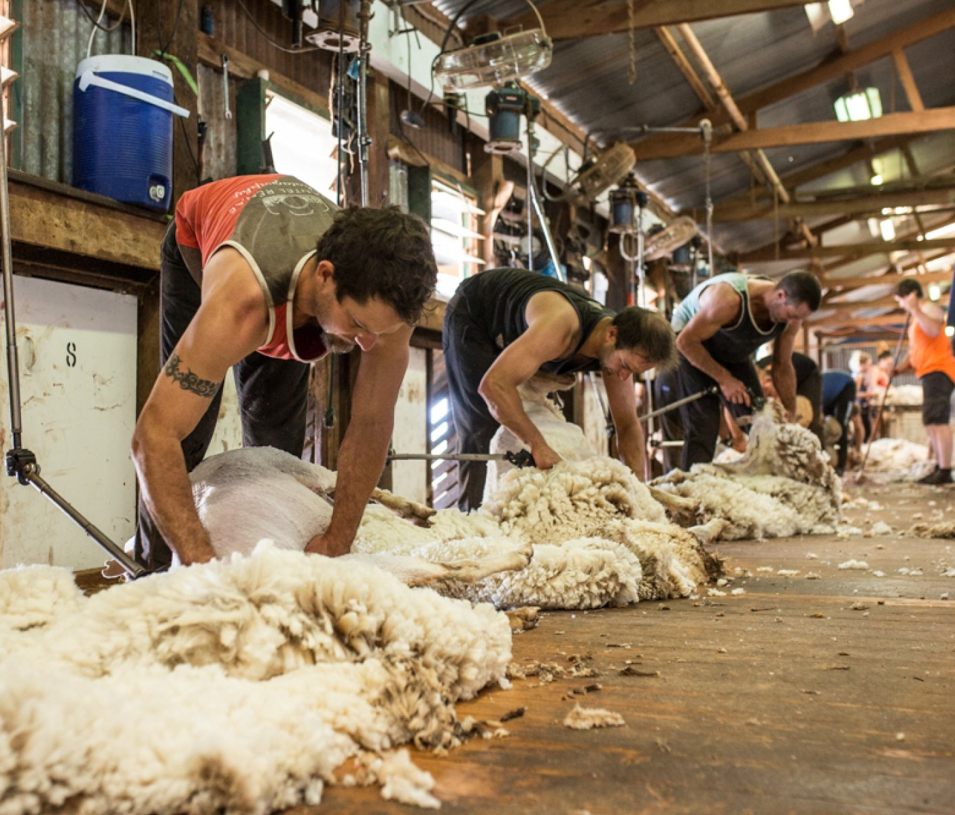
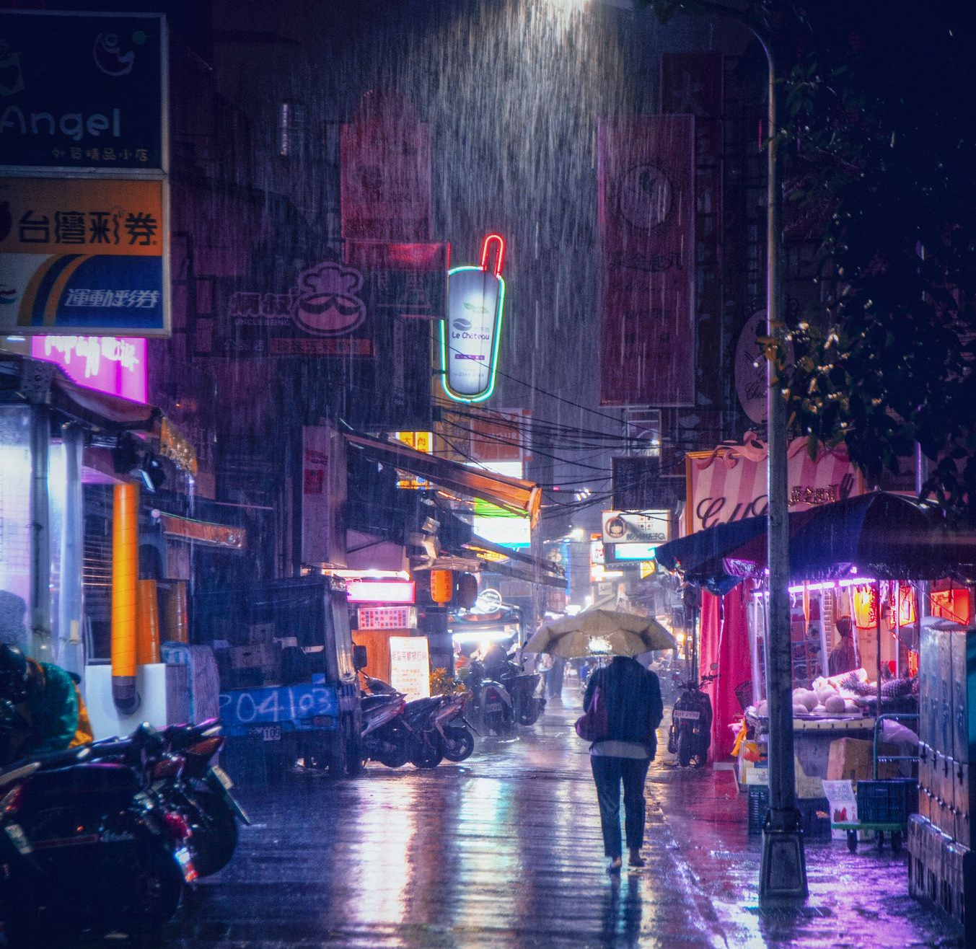
Effect of setting
Affects the ‘mood’:
Night, thunderstorm, city streets -VS- shearing shed, midday, summer
Affects the characters’ motivations, choices, expectations:
Poor woman in Great Depression, America -VS- Rich Duke in Victorian London
Can be symbolic – highlight themes
Autumn = change, spring = new beginnings
Changes in setting within a novel create ‘narrative tension’
Curiosity – how will the new location change the outcome?
Gives insight into characters
How they describe the setting reveals their feelings about it

