Slide 1
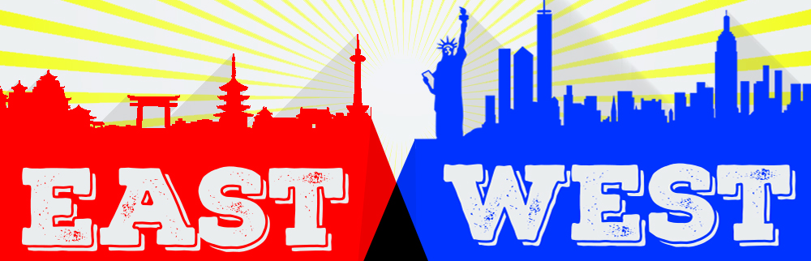
Western Culture vs Chinese Culture

Slide 2
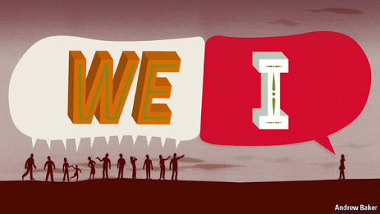
Individualism vs Collectivism
Western culture:
Good to stand out from the crowd
Make your own way
Chinese culture:
Good to fit in with the crowd
Support the whole group

Slide 3
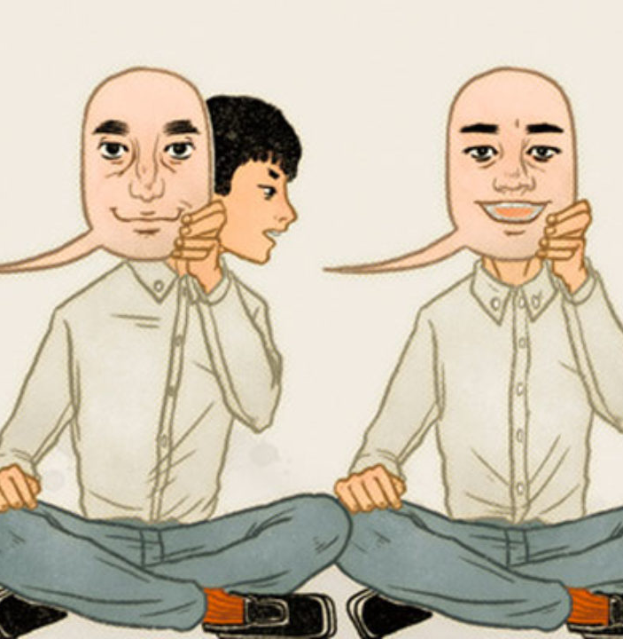
Honour and Shame
Chinese culture:
Concept of honour or ‘face’ very important
Not just about individual, affects your circle
Saving face more important than honesty
Western culture:
Socially acceptable to embarrass self or others
Your reputation is personal, doesn’t affect others
Honesty valued even if truth is embarrassing

Slide 4
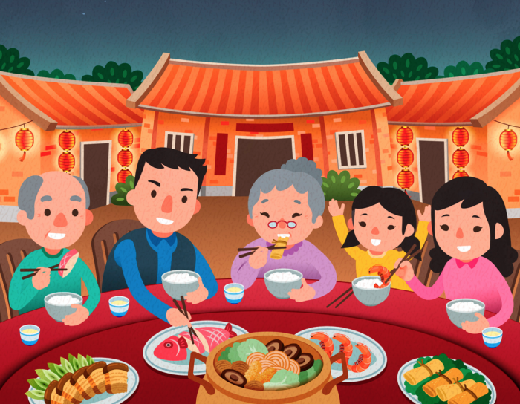
Family
Chinese culture
Adults live with parents & grandparents
Hierarchical structure, elders obeyed
Elderly cared for by their children
Western culture
Adults move away from parents
Parents respected, but younger generation goes their own way
Elderly live in care homes

Slide 5
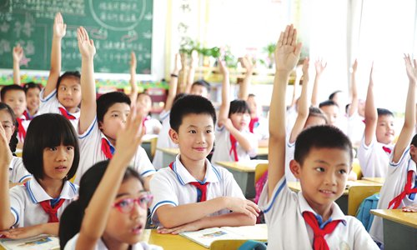
Work & Study
Chinese culture:
Memorise information
High pressure
Never question superiors, disrespectful
Work very long hours to show dedication
Western culture:
Problem solving, creativity
Lower pressure
Questioning encouraged
Work hours 9-5pm

Slide 6
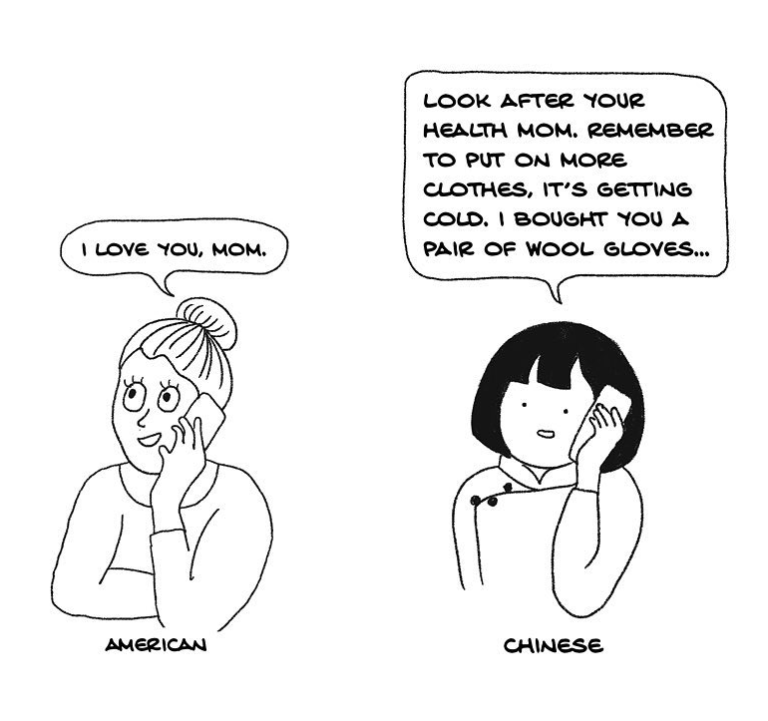
Privacy
Chinese culture:
Normal to ask personal questions
Don’t publicly display or voice affection, show love through care
Keep emotions hidden, keep face neutral
Western culture:
Impolite to ask personal questions
Display affection in public, verbally express love
Express feelings and emotions freely, show on face

Slide 7
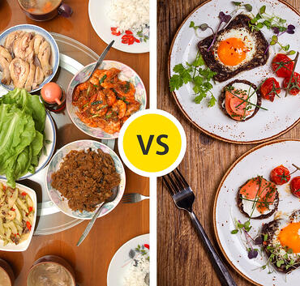
Food
Western culture:
Each person gets their own plate of food with a serving just for them
Presentation important
Chinese culture:
Dishes are placed in the middle, everyone shares
Presentation important

Slide 8
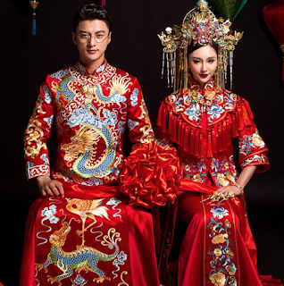
Love and marriage
Chinese Culture
Arranged marriages cultural norm until fairly recently
Young people often still pressured to marry someone chosen by parents
Strong expectation to marry before certain age
Western Culture
Arranged marriages died out in 17th century
Marriage based on love/choice, not practical considerations
Some expectation that people get married, but fading out

Slide 9
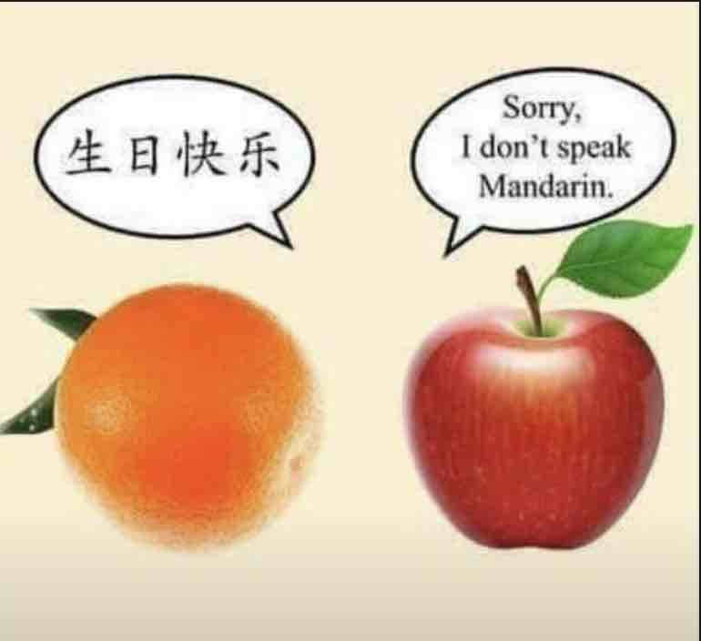
Humour
Western Culture
Humour part of normal interactions
Very few things can’t be joked about
Self-deprecating humour is good
Chinese Culture
Humour only acceptable in certain contexts
Serious topics should not be joked about
Laughing at yourself or others lowers status/face

Slide 10
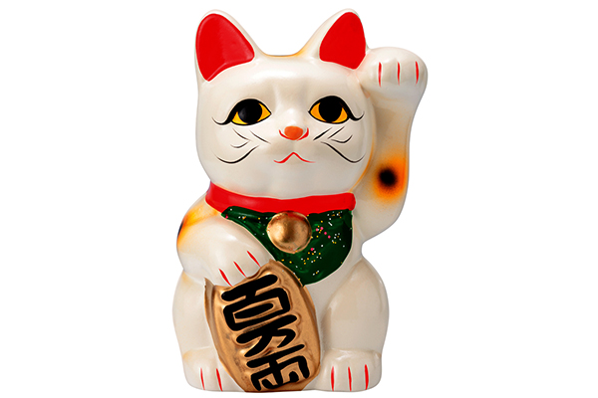
Money
Western culture
If you have money, spend it and show off expensive things
Ambition is a personal choice
Chinese culture
If you have money, save it, don’t flash wealth
Ambition is expected

Slide 11
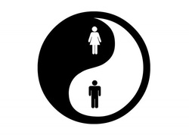
Traditional gender roles
Western Culture
Women’s role = domestic duties, care for children
Men’s role = work, provide, fight in wars
Socially unacceptable to choose a different role, even if unsuited.
This changed after feminist movement
Chinese Culture
Similar – Confucius taught strict adherence to roles would ensure social harmony. Everyone should know their place. “Men plough, women weave”.
Men & women = yin & yang
China also had feminist movement during Communist Revolution

