Slide 1
Year 9 English: Vocab
Term 3, week 3

Slide 2
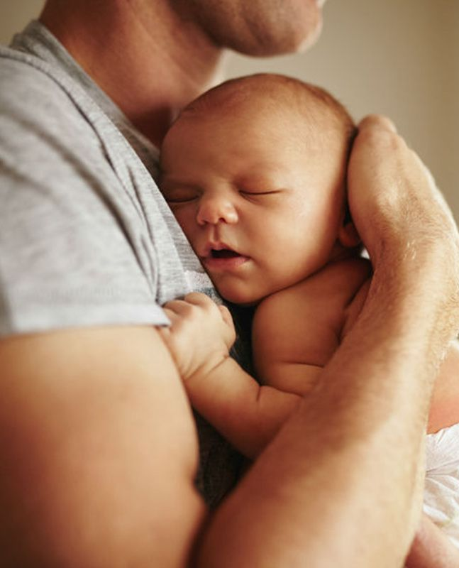
Beget
Part of speech: verb
Definition: to cause or bring about; to bring into existence; to produce offspring
Sentence 1: Charlie hoped that he would someday beget a son.
Sentence 2: Violence begets violence.

Slide 3
Delusion
Part of speech: noun
Definition: a false belief or opinion
Sentence 1: His argument sounded convincing but it was based on a delusion.
Sentence 2: Wendy was under the delusion that she could earn millions selling essential oils to her friends.

Slide 4
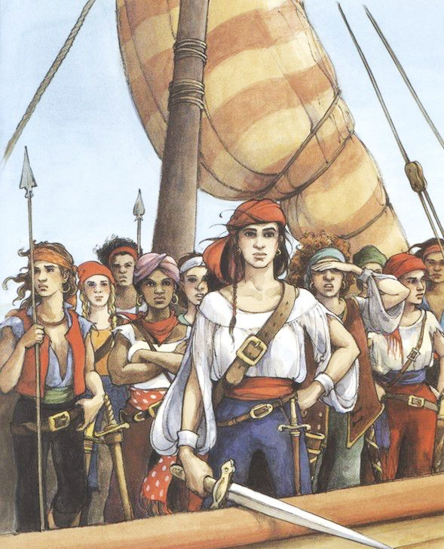
Recourse
Part of speech: noun
Definition: a source of help; a way of dealing with a difficult situation
Sentence 1: The small sailing ship had no recourse against the pirates.
Sentence 2: In some cases, surgery may be the only recourse.

Slide 5
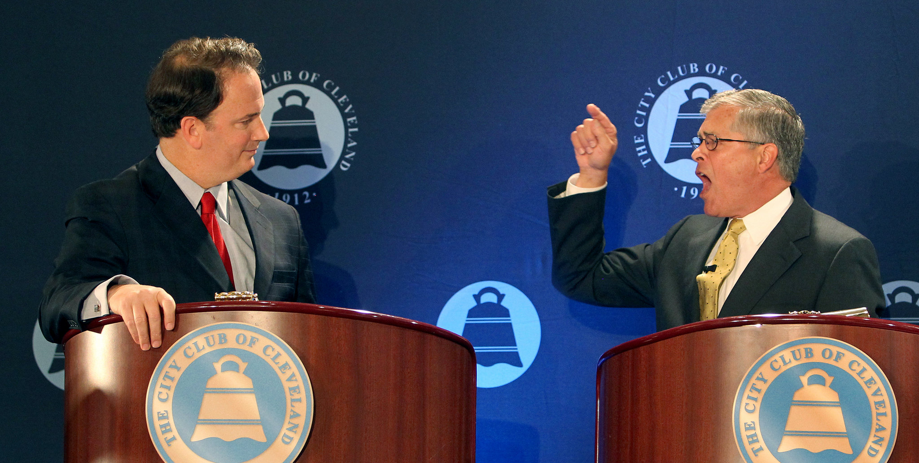
Discourse
Part of speech: noun
Definition: a conversation or discussion; a formal speech or debate
Sentence 1: At 3 o’clock the professor will begin his discourse on human rights.
Sentence 2: The discourse between the two candidates has been heated.

Slide 6
Bellicose
Part of Speech: adjective
Definition: warlike or hostile, aggressive, willing to fight.
Sentence: Adam’s bellicose manner made him hard to live with.

Slide 7
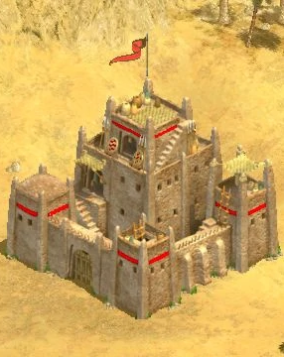
Garrison
Part of speech: noun
Definition: A military post, especially one that is permanently established
Sentence: The enemy planned to attack the garrison at dawn.

Slide 8
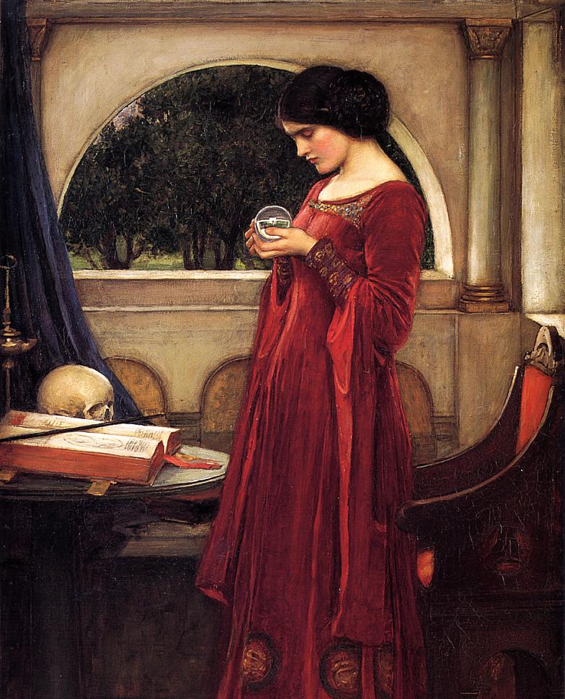
Auspicious
Part of speech: adjective
Definition: lucky or favourable; promising success or a good outcome.
Sentence: Hilda consulted her crystal ball to choose the most auspicious day to get married.

Slide 9
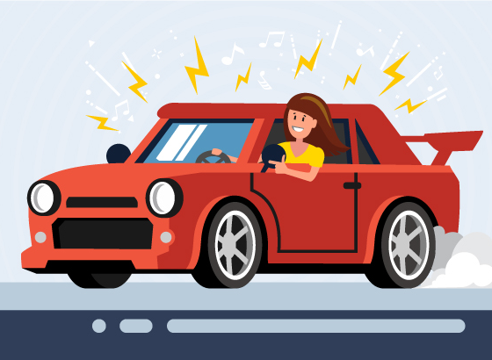
Vexation
Part of speech: noun
Definition: irritation; annoyance
Sentence: Tori frowned in vexation when Alice cranked up the music in her car.

Slide 10
Tumultuous
Part of speech: adjective
Definition: excited and disorderly; making an uproar or a loud, confused noise
Sentence: We were surrounded by a tumultuous crowd at the game.

Slide 11
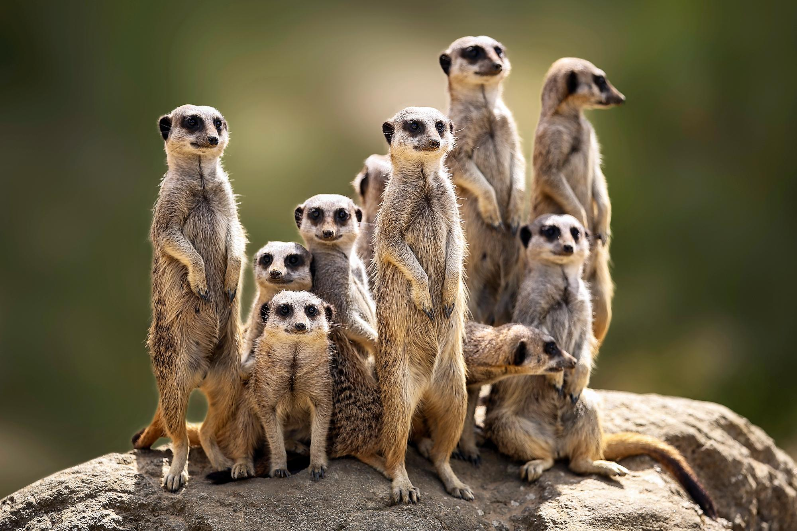
Vigilant
Part of speech: adjective
Definition: keenly watchful to detect danger
Sentence: The meerkats were vigilant about protecting their colony.

