Slide 1
Year 9 English: Vocab
Term 3, Week 4

Slide 2
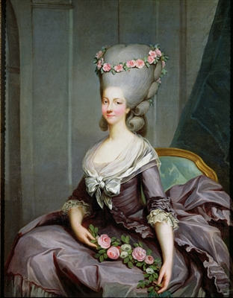
Emulate
Part of speech: verb
Definition: to imitate or copy, trying to do just as well or better
Sentence: That is not a hairstyle I wish to emulate.

Slide 3
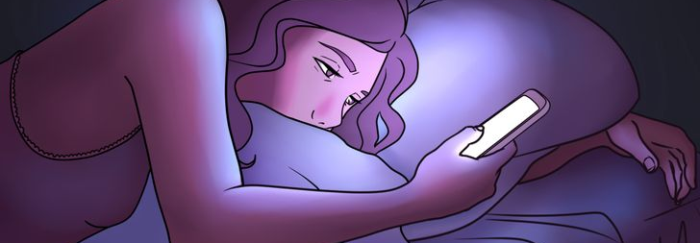
Conducive
Part of speech: adjective
Definition: making possible; providing the best conditions for something to happen or exist
Sentence: Too much screen time before bed is not conducive to a good night’s sleep.

Slide 4
Cavil
Part of speech: verb
Definition: to criticize or find fault with unnecessarily; to raise unimportant objections.
Sentence: There’s no need to cavil about the cost, you know we can afford it.

Slide 5
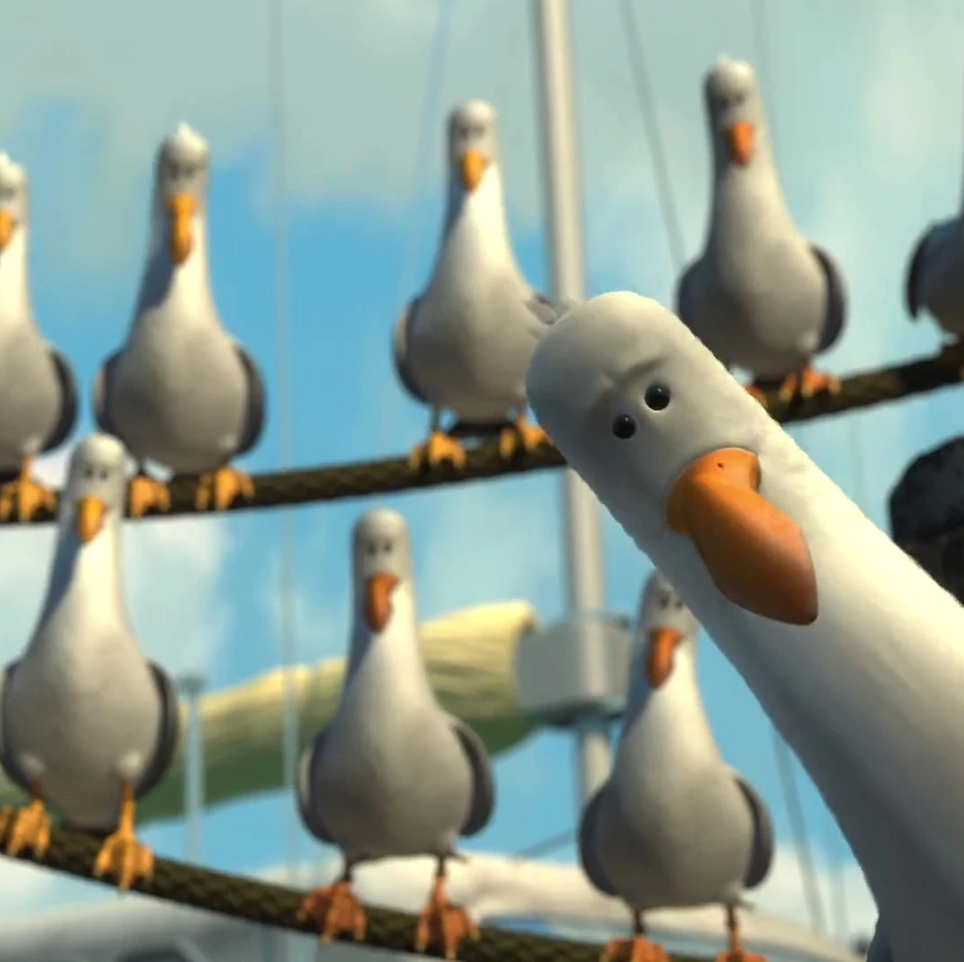
Proprietary
Part of speech: adjective
Definition: relating to ownership; having exclusive legal right to something.
Sentence: Seagulls seem to think they have proprietary rights to any chips.

Slide 6
Fungible
Part of speech: adjective
Definition: replaceable or interchangeable
Sentence: All money is essentially fungible.

Slide 7
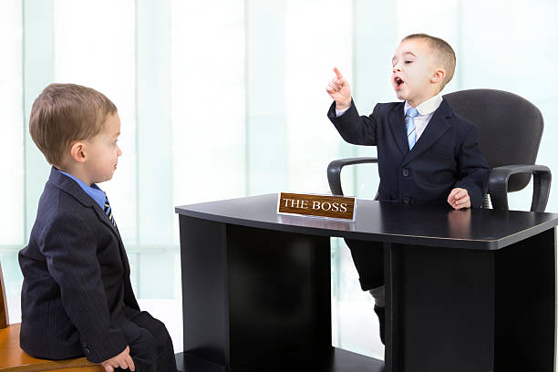
Imperious
Part of speech: adjective
Definition: arrogant and domineering; bossy; making demands in a haughty way.
Sentence: I don’t mind doing whatever my boss asks, but I wish he wouldn’t speak to me in such an imperious tone.

Slide 8
Morose
Part of speech: adjective
Definition: gloomy, sullen, bad-tempered
Sentence: The characters in Twilight always look morose.

Slide 9
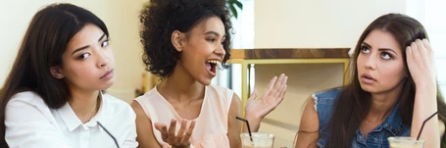
Garrulous
Part of speech: adjective
Definition: annoyingly talkative, especially about unimportant things.
Sentence: Emily is so garrulous that we can never get a word in edgeways.

Slide 10
Zeal
Part of speech: noun
Definition: great enthusiasm or eagerness
Sentence: Billy’s excessive zeal to get his work done quickly meant that he didn’t do a very good job.

Slide 11
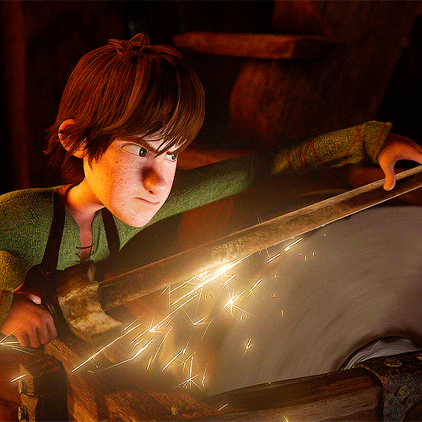
Whet
Part of speech: verb
Definition: to sharpen
Sentence: Hiccup used a grindstone to whet his sword.

