Slide 1
Year 9 English: Vocab
Term 3, Week 5

Slide 2
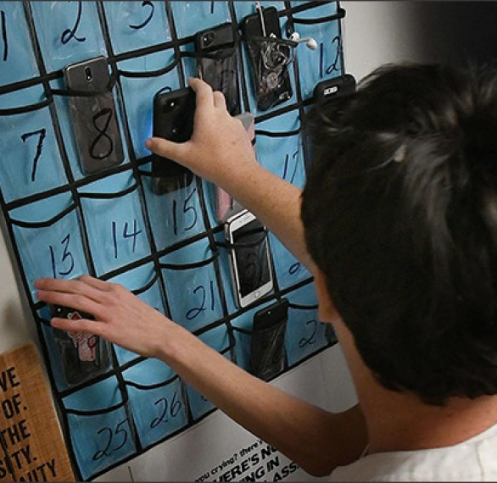
Abrogate
Part of speech: verb
Definition: to officially forbid or put an end to
Sentence: Most schools abrogate the use of cell phones in class.

Slide 3
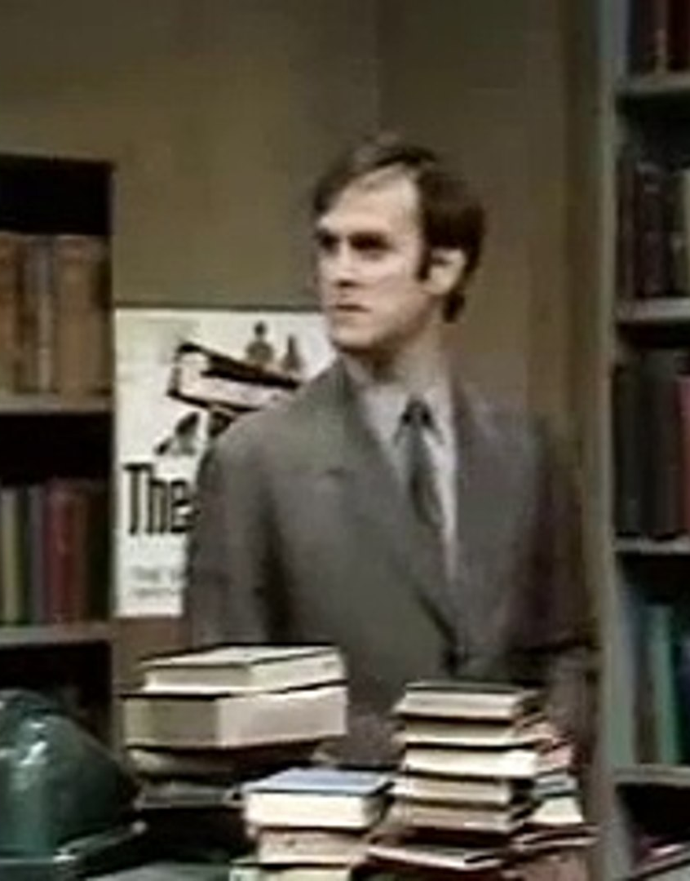
Expurgate
Part of speech: verb
Definition: To remove unsuitable or offensive material from a book before publication
Sentence:
P: The expurgated version of 'Olsen's Standard Book of British Birds’?
C: The one without the gannet.
P: The one without the gannet? They’ve all got the gannet! It's a Standard British Bird, the gannet!
C: Well, I don't like them. They wet their nests.

Slide 4
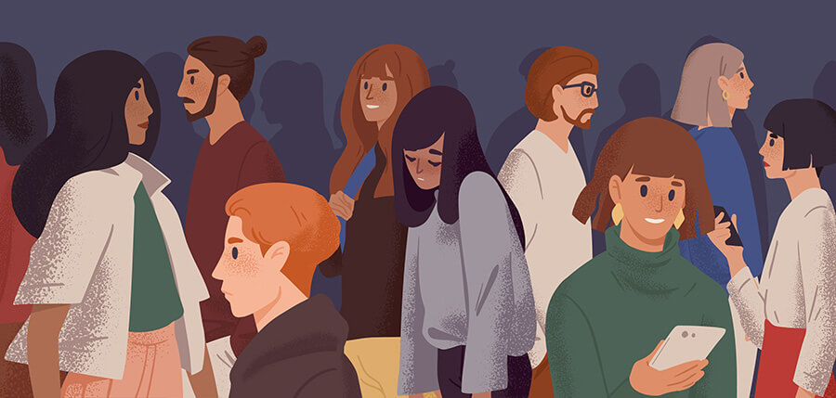
Gauche (rhymes with cloche)
Part of speech: adjective
Definition: unsophisticated, lacking social skills; awkward, crude or tactless
Sentence: Marissa felt shy and gauche compared to the other university students.

Slide 5
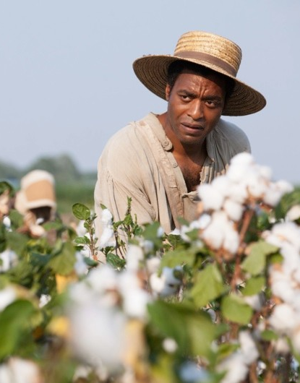
Antebellum
Part of speech: adjective
Definition: before the war (any war, but especially the American Civil War)
Sentence: During the antebellum period, African-American slaves lived lives of degradation and misery.

Slide 6
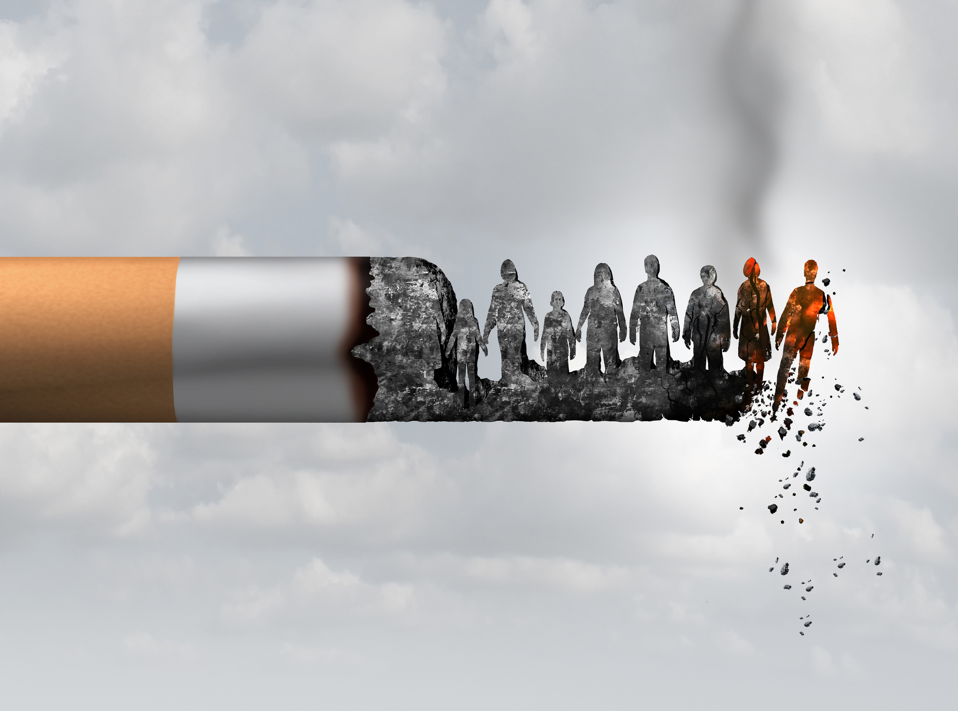
Deleterious
Part of speech: adjective
Definition: causing harm or damage
Sentence: Smoking is a vile and deleterious habit.

Slide 7
Inculcate
Part of speech: verb
Definition: to teach or instil something in the minds of others by frequent instruction or repetition
Sentence: Denny tried to inculcate a love of reading in her children.

Slide 8
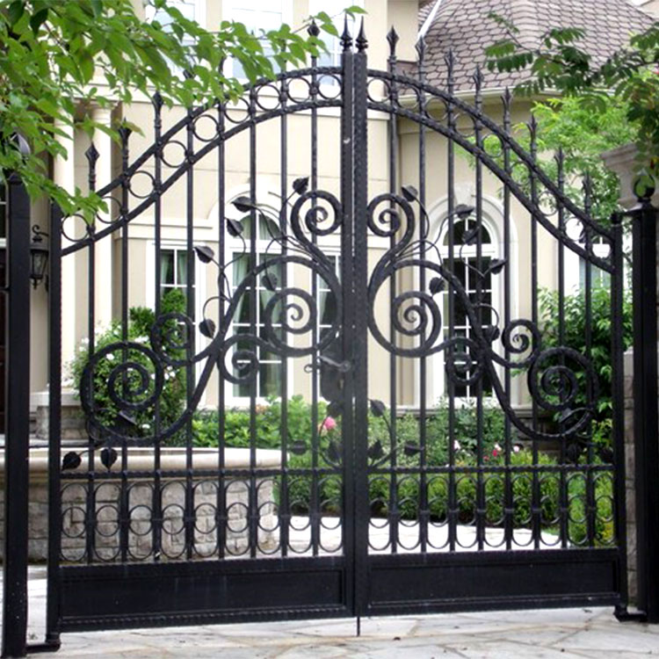
Wrought
Part of speech: adjective
Definition: carefully made, fashioned or worked; metal beaten into a particular shape
Sentence: The house had beautiful wrought iron gates.

Slide 9
Belie (beh-LYE)
Part of speech: verb
Definition: to prove false; to contradict
Sentence: Harold hoped his smile would belie the pain he felt inside.

Slide 10
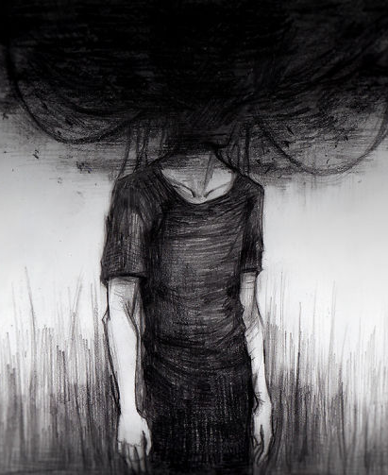
Nihilism
Part of speech: noun
Definition: The belief that nothing matters, all theories are false, and existence is pointless
Sentence: The artist’s nihilism can be seen in his dark and depressing works.

Slide 11
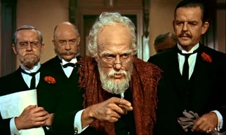
Fiduciary (fuh-DYOO-sherry)
Part of speech: noun
Definition: someone who acts on behalf of another, especially in matters of finance.
Sentence: Grandpa asked Mary to be his fiduciary, so now she takes care of his estate and banking.

