Slide 1
Year 9 English: vocab
Term 3, Week 8

Slide 2
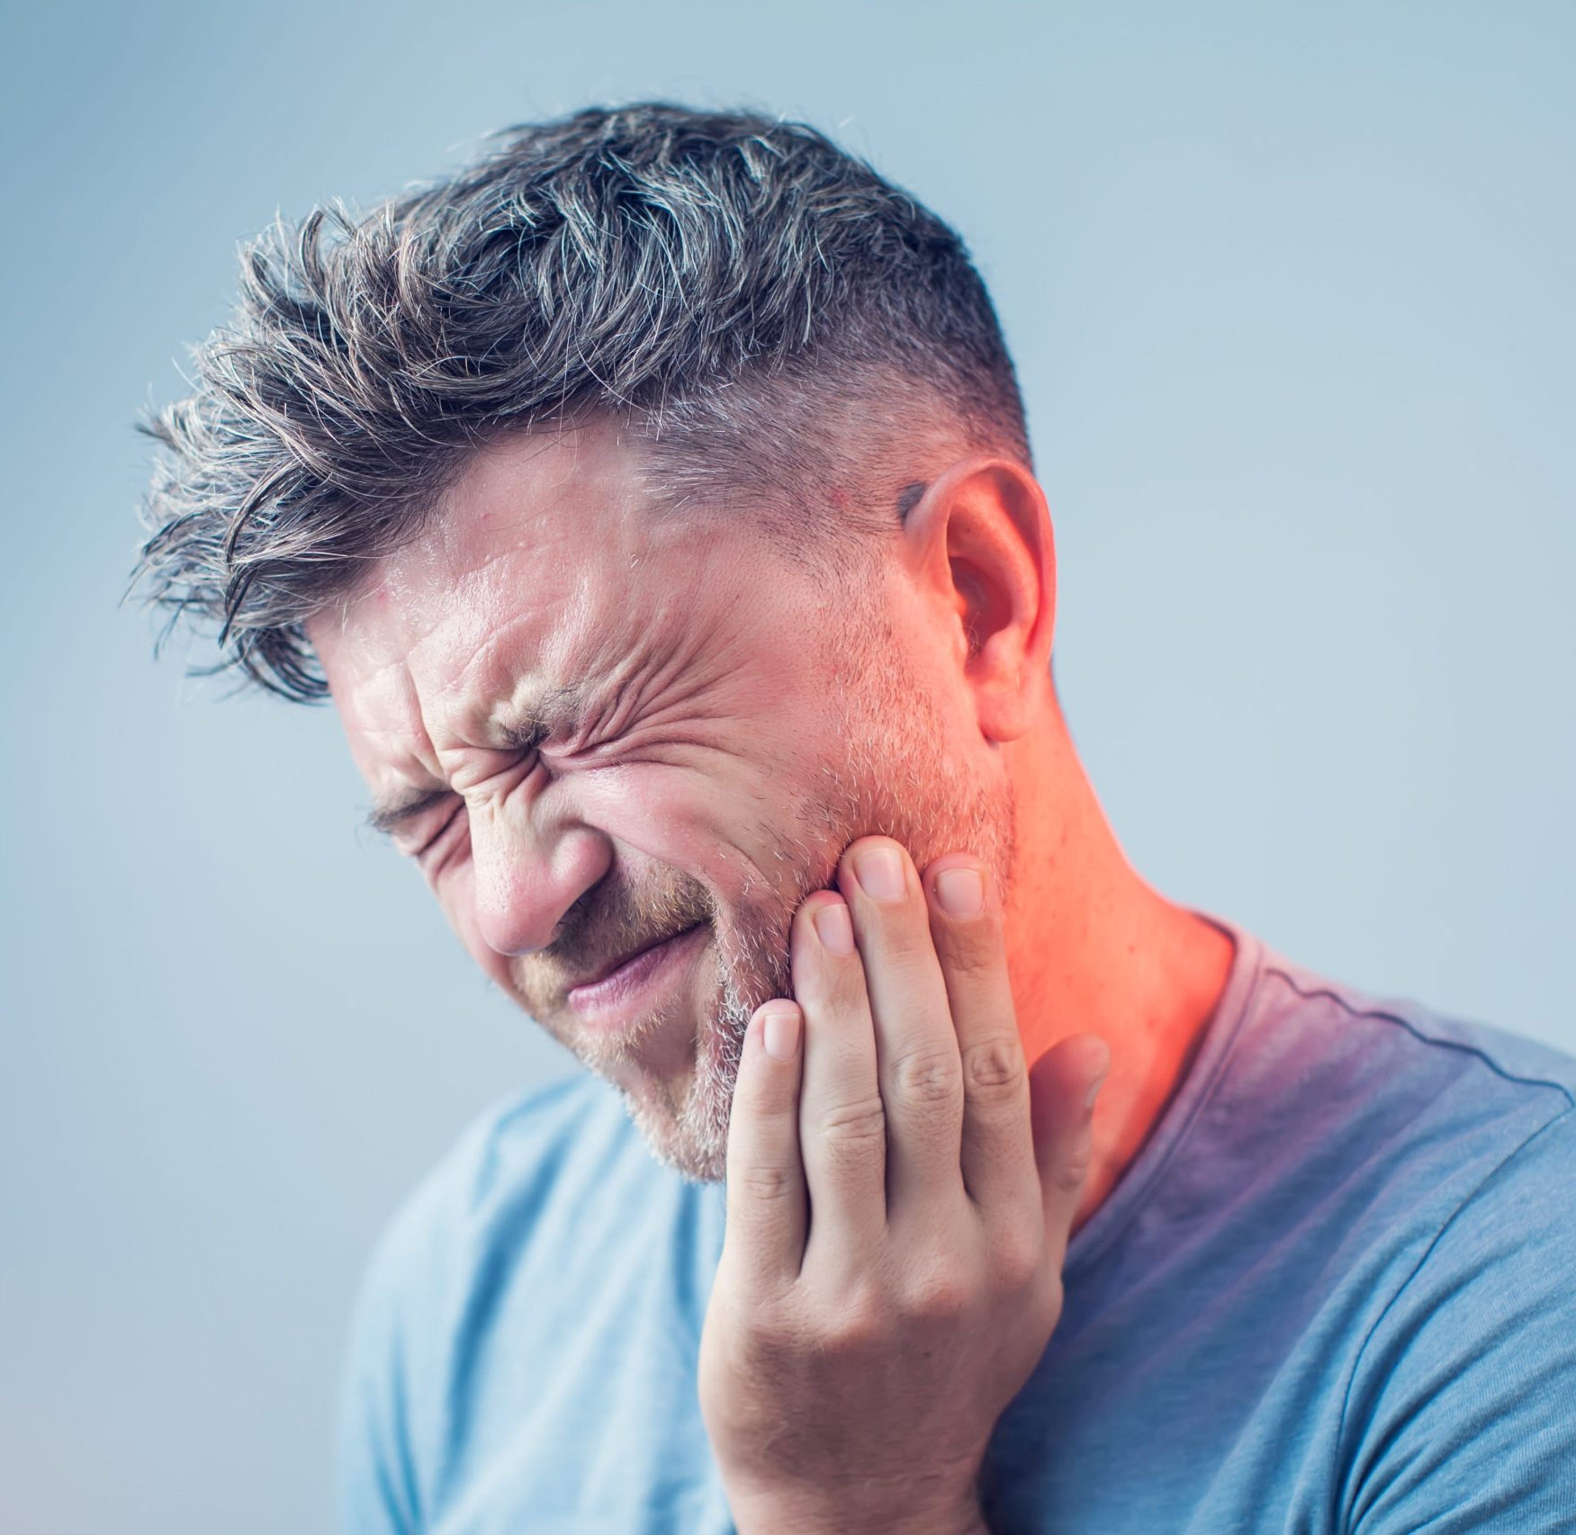
Abeyance
Part of speech: noun
Definition: a temporary pause; put on hold or suspended for a time
Sentence: The pain was in abeyance, but he went to the dentist in case it came back.

Slide 3
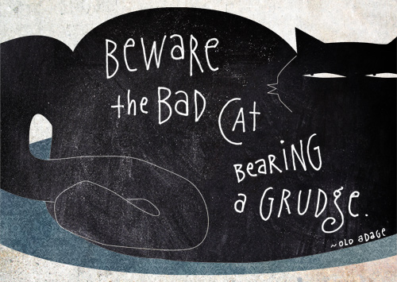
Adage
Part of speech: noun
Definition: a proverb or wise saying
Sentence: You would do well to heed the old adage ‘beware the bad cat bearing a grudge’.

Slide 4
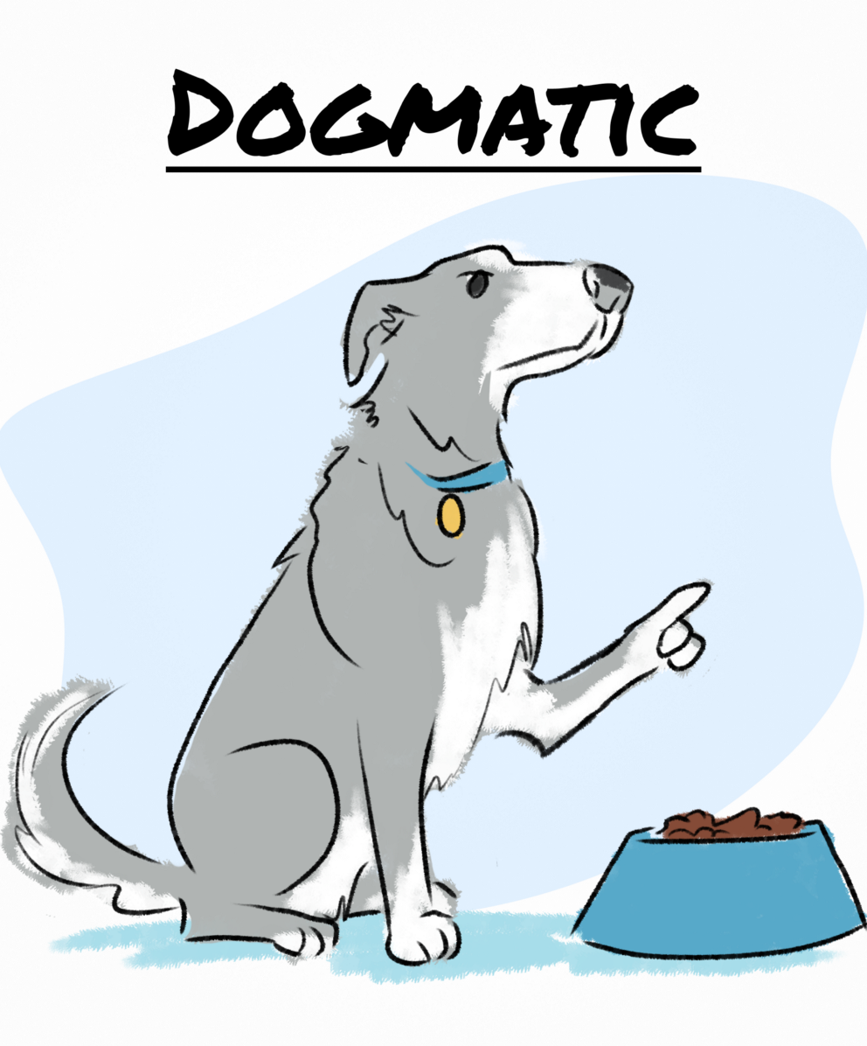
Dogmatic
Part of speech: adjective
Definition: having extremely strong beliefs; stating opinions as facts; being absolutely convinced you’re right
Sentence: Ned took a dogmatic stance when it came to mealtimes.

Slide 5
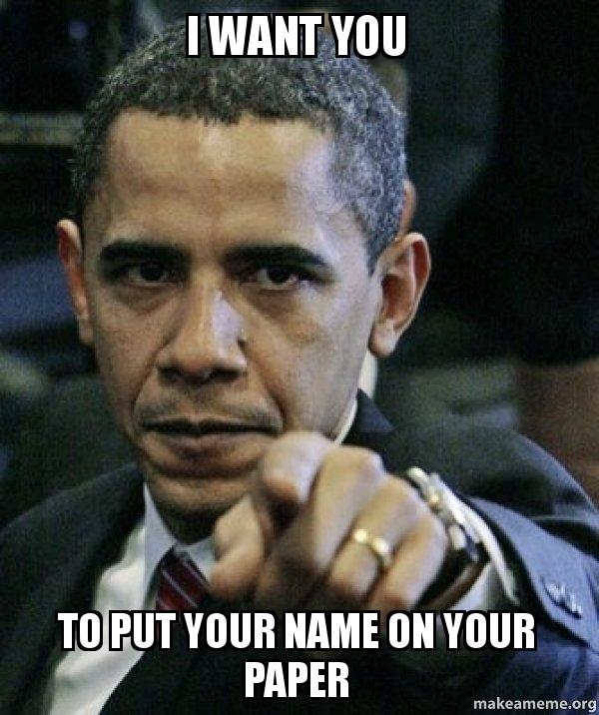
Cardinal
Part of speech: adjective
Definition: of the greatest importance; principal; fundamental
Sentence: Ben committed the cardinal sin of not putting his name on his test.

Slide 6
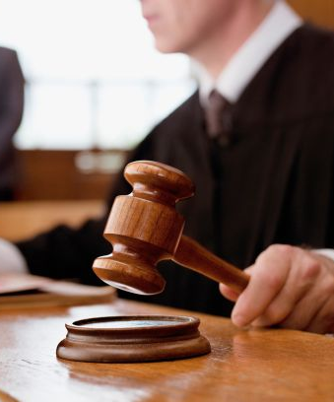
Egregious (uh-GREE-jus)
Part of speech: adjective
Definition: outstandingly bad; shocking; offensive
Sentence: The judge said it was the most egregious act of villainy he had ever seen.

Slide 7
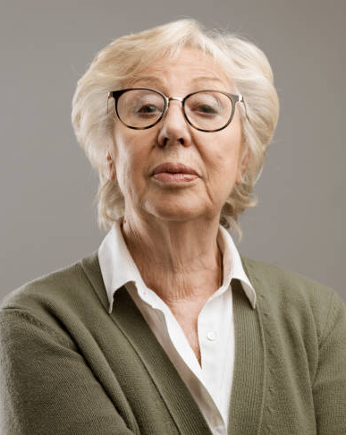
Haughty
Part of speech: adjective
Definition: proud; snobbish and unfriendly; looking down on others.
Sentence: The woman gave us a haughty look when we knocked on her door collecting for charity.

Slide 8
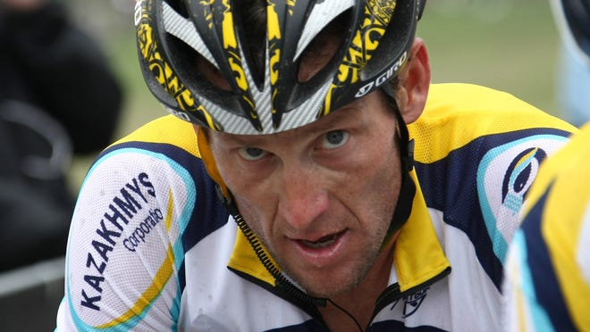
Pariah
Part of speech: noun
Definition: an outcast; someone who is disgraced or not accepted by society
Sentence: The athlete became a pariah after he was caught using performance-enhancing drugs.

Slide 9
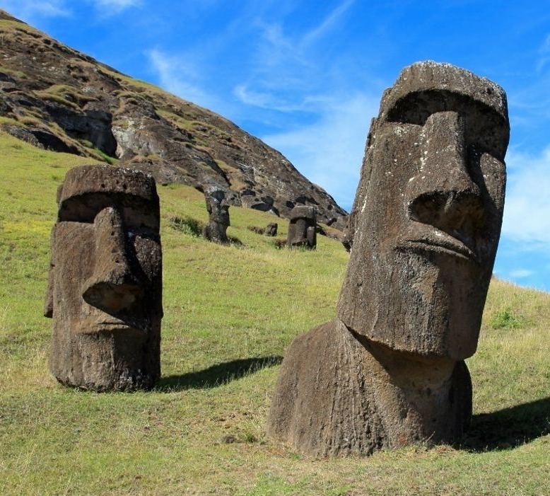
Monolithic
Part of speech: adjective
Definition: Massive or impressive; made from a single large block of stone
Sentence: The statues at Easter Island are monolithic, but somehow the ancient Polynesians moved them for miles.

Slide 10
Supersede
Part of speech: verb
Definition: to replace something older or less effective
Sentence: Do you think robots will ever supersede factory workers?

Slide 11
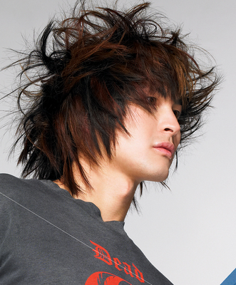
Unkempt
Part of speech: adjective
Definition: untidy, messy or scruffy; not well cared for
Sentence: The members of the K-pop group were known for their unkempt hairstyles.

