Slide 1
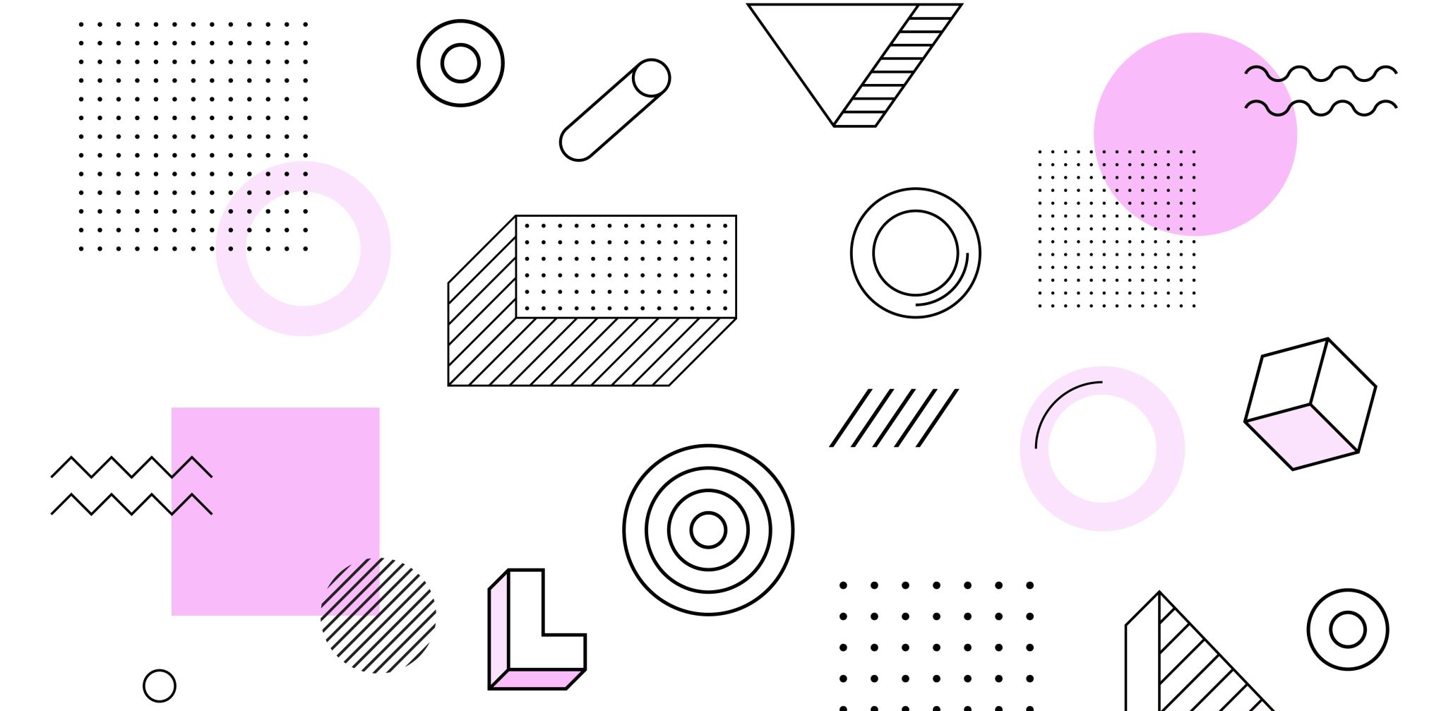
Symbolism
A secret language!

Slide 2
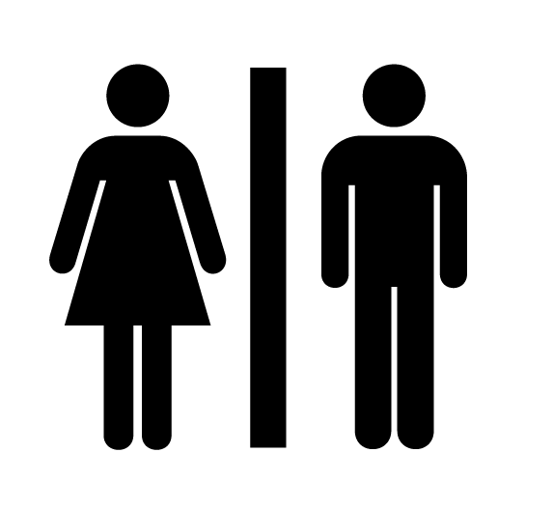
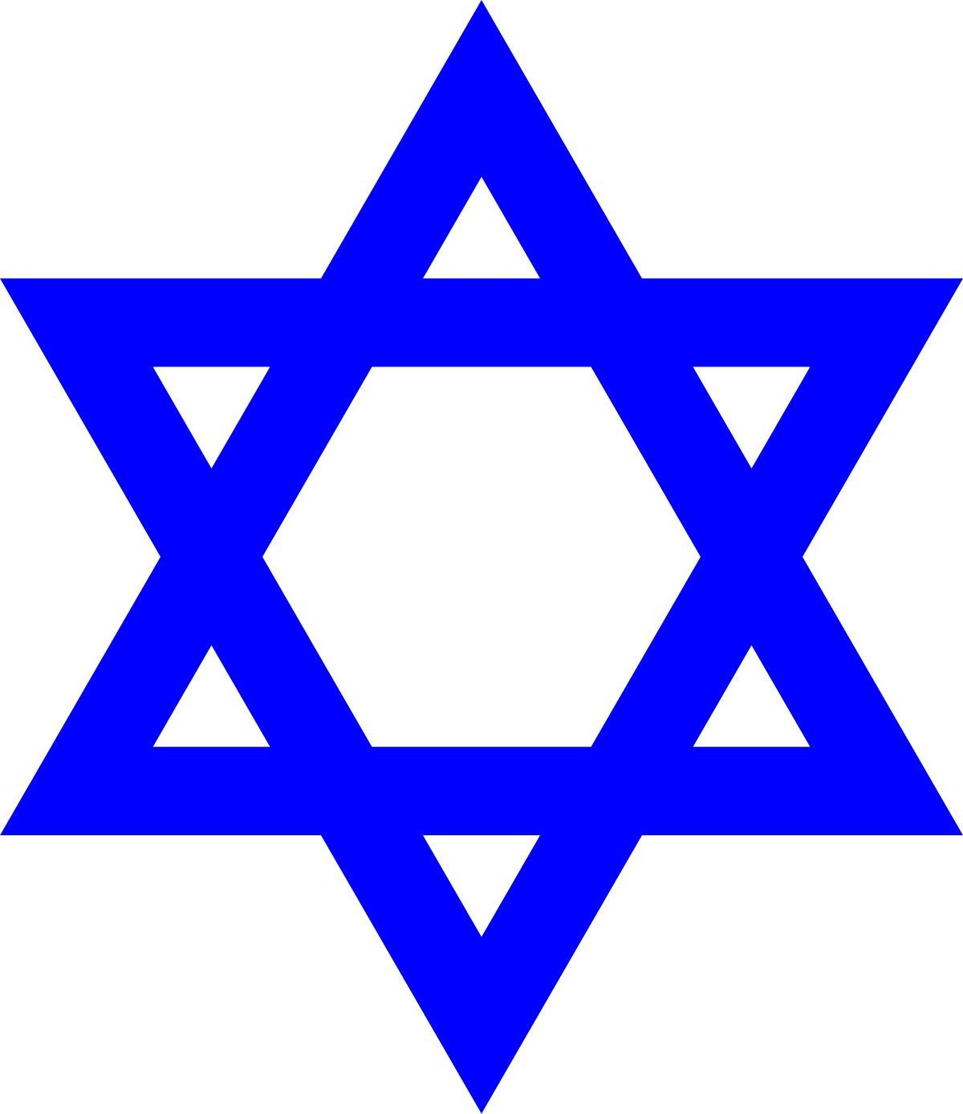
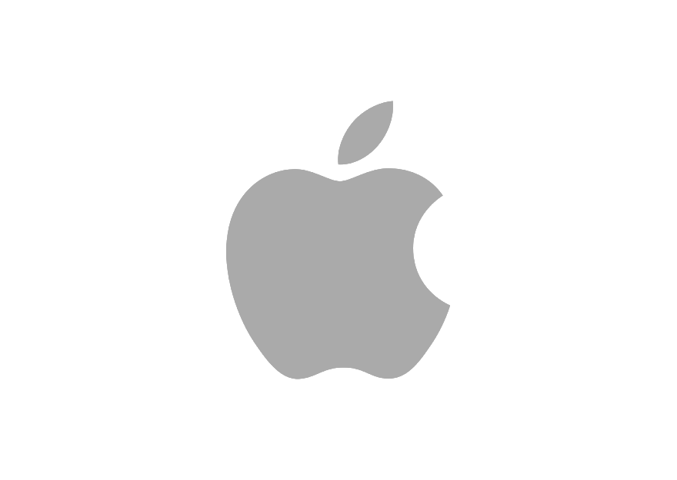
Symbols are Everywhere
Symbols communicate without words
Give ideas almost instantly
A universal language
Look at each of these symbols – do you know what they mean?

Slide 3
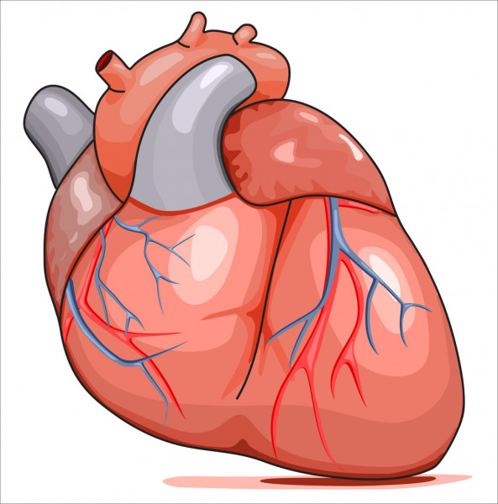
Symbolism
Symbolism in writing is when a literal object symbolises (stands for, represents) something that is not literal, like an idea or feeling.
Heart (literal)
Heart (symbol)

Slide 4
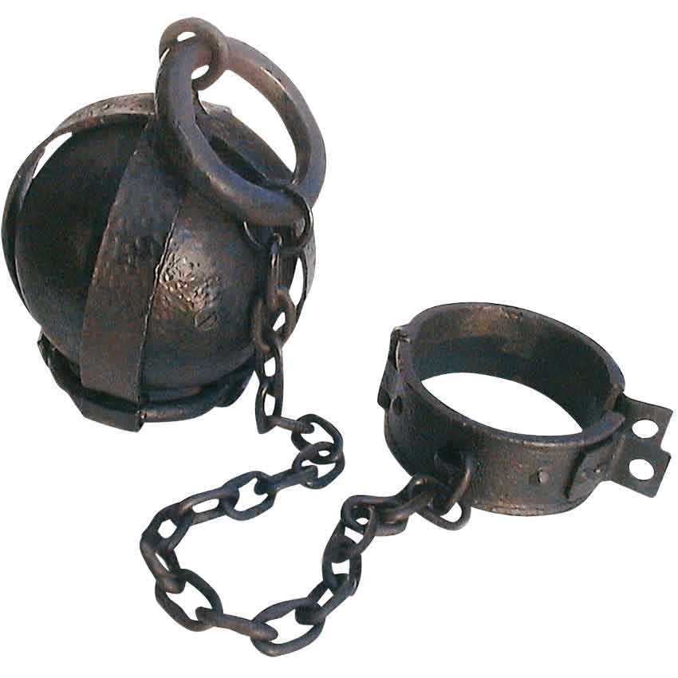
Symbolism
Example: chains are literal objects. We can see or hold them.
BUT: seeing chains often makes people think of ideas that are connected to them – like:
Slavery
Freedom, or lack of freedom
Prison
Cages

Slide 5
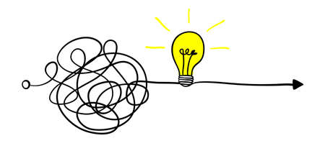
Decoding Symbols
To figure out the symbolic meaning of an object, ask these questions:
What is the first thing that comes to mind when I look at this object?
Who uses this object?
What is it used for?
When and where does it come from?

Slide 6
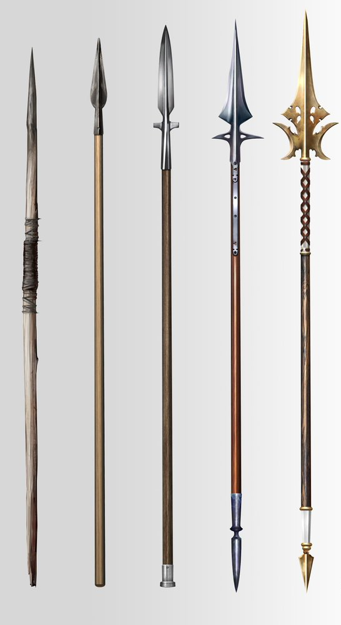
Decoding symbols: Practice
Look at the picture
What comes to mind when you think about spears?
When and where do they come from?
Who uses them?
What did they use them for?

Slide 7
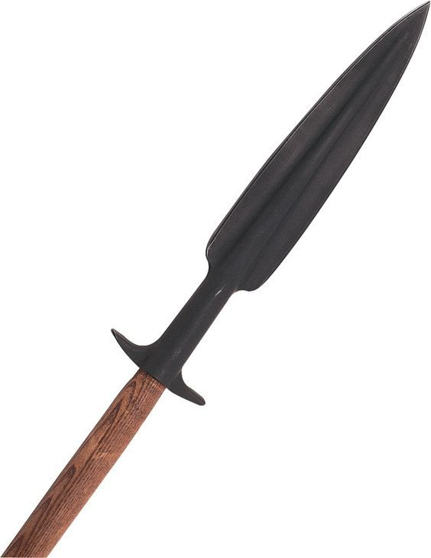
Decoding symbols: Practice
What comes to mind when you think about spears?
War, battle, bloodshed, violence
When and where do they come from?
A long time ago, ancient Greeks/Romans, Aboriginal people, Native Americans
Who uses them?
Soldiers or warriors, but also fishermen.
What did they use them for?
Fighting and killing (animals or other people)

Slide 8
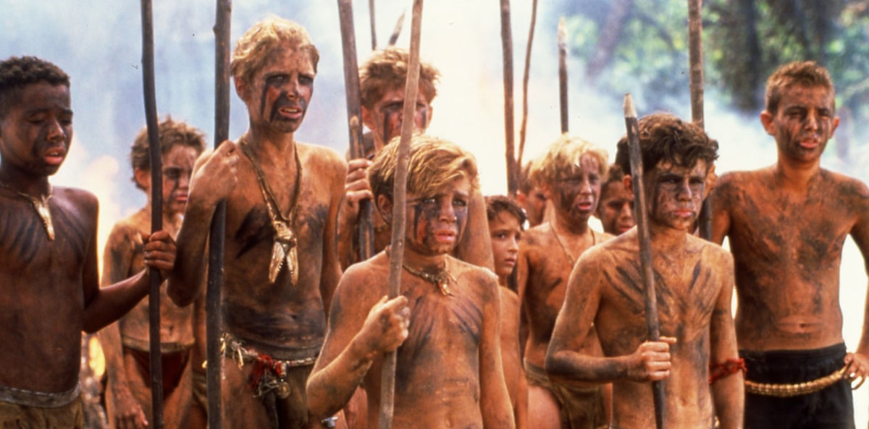
Spears = ‘savage’
William Goulding used spears as a symbol in his famous book Lord of the Flies
The book is about a group of school boys stranded on an island and their attempts to govern themselves
A major theme is the idea that people will revert back to their violent, animal-like instincts if they are separated from civilised society, rules & authority
By having the boys carry spears, the author indicates symbolically that they have become less civilized and more savage

Slide 9
Decoding Symbols: Practice
How many symbols do you recognise in this picture? There are at least six!

Slide 10
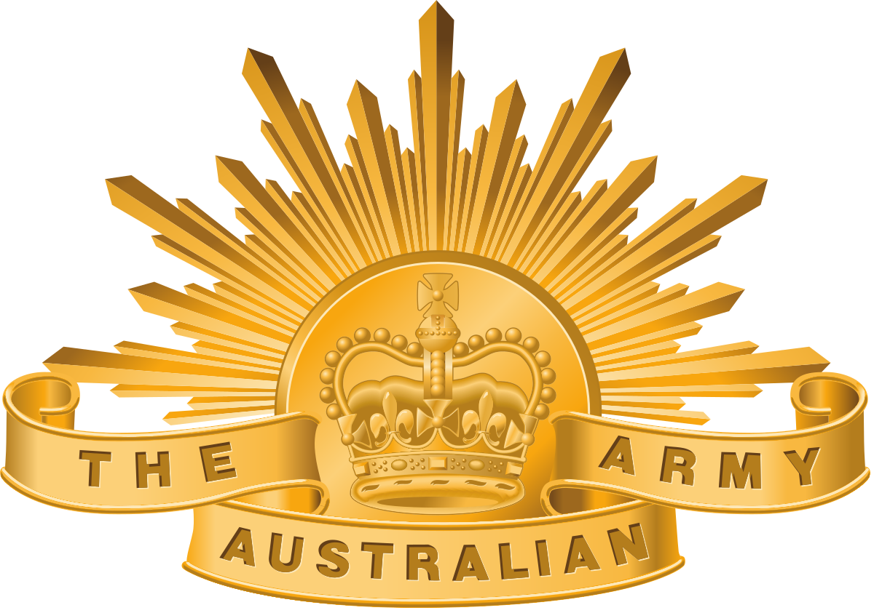
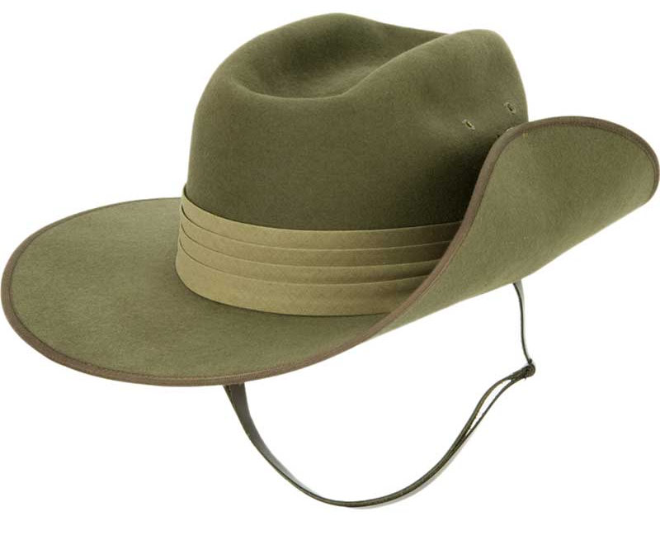
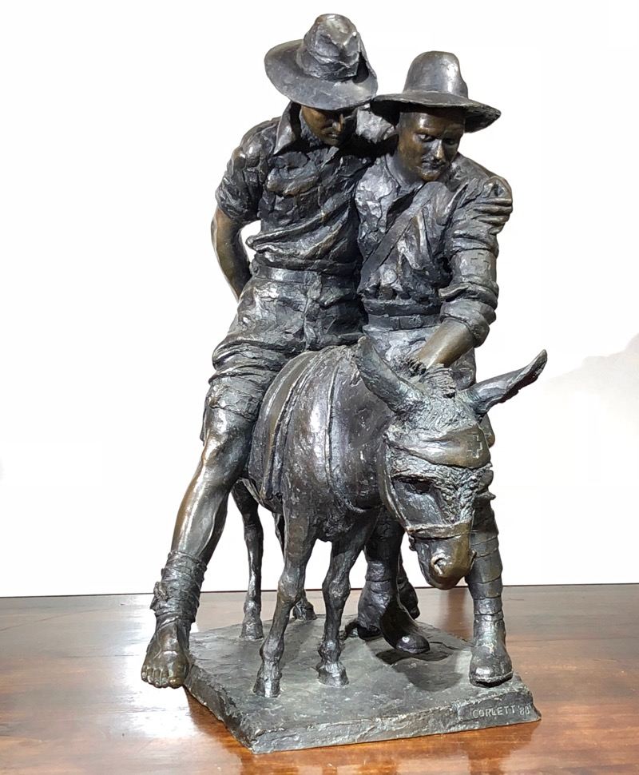
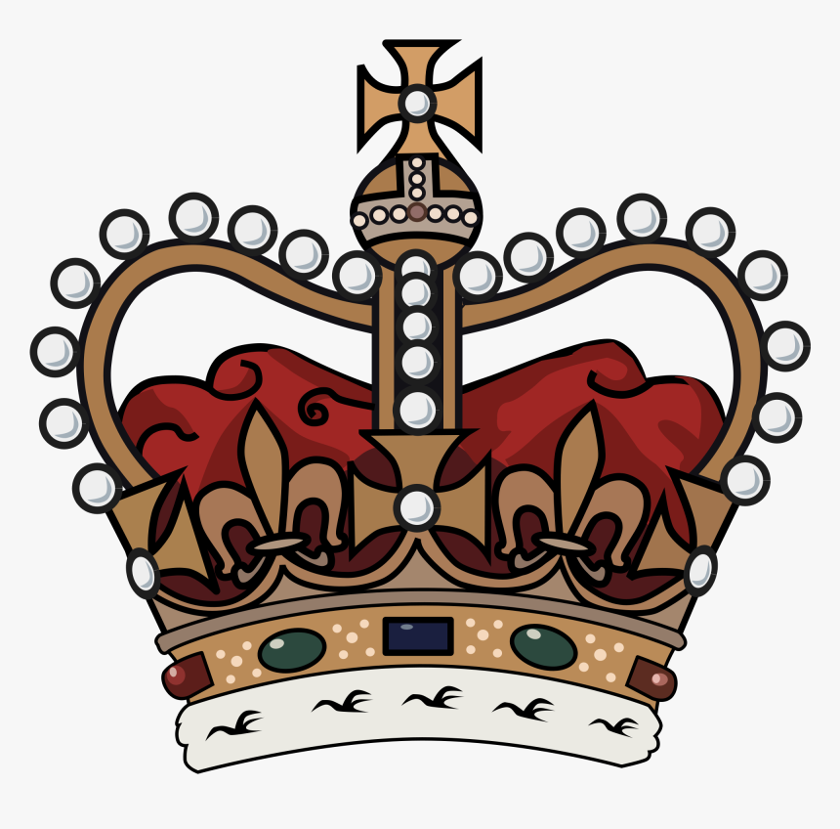
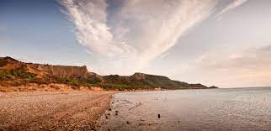
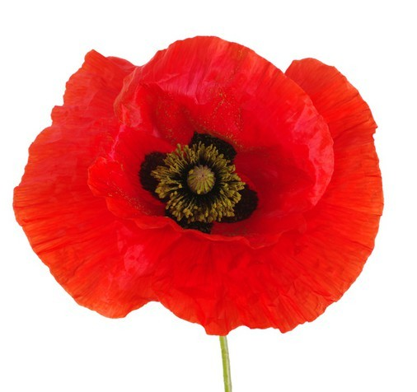
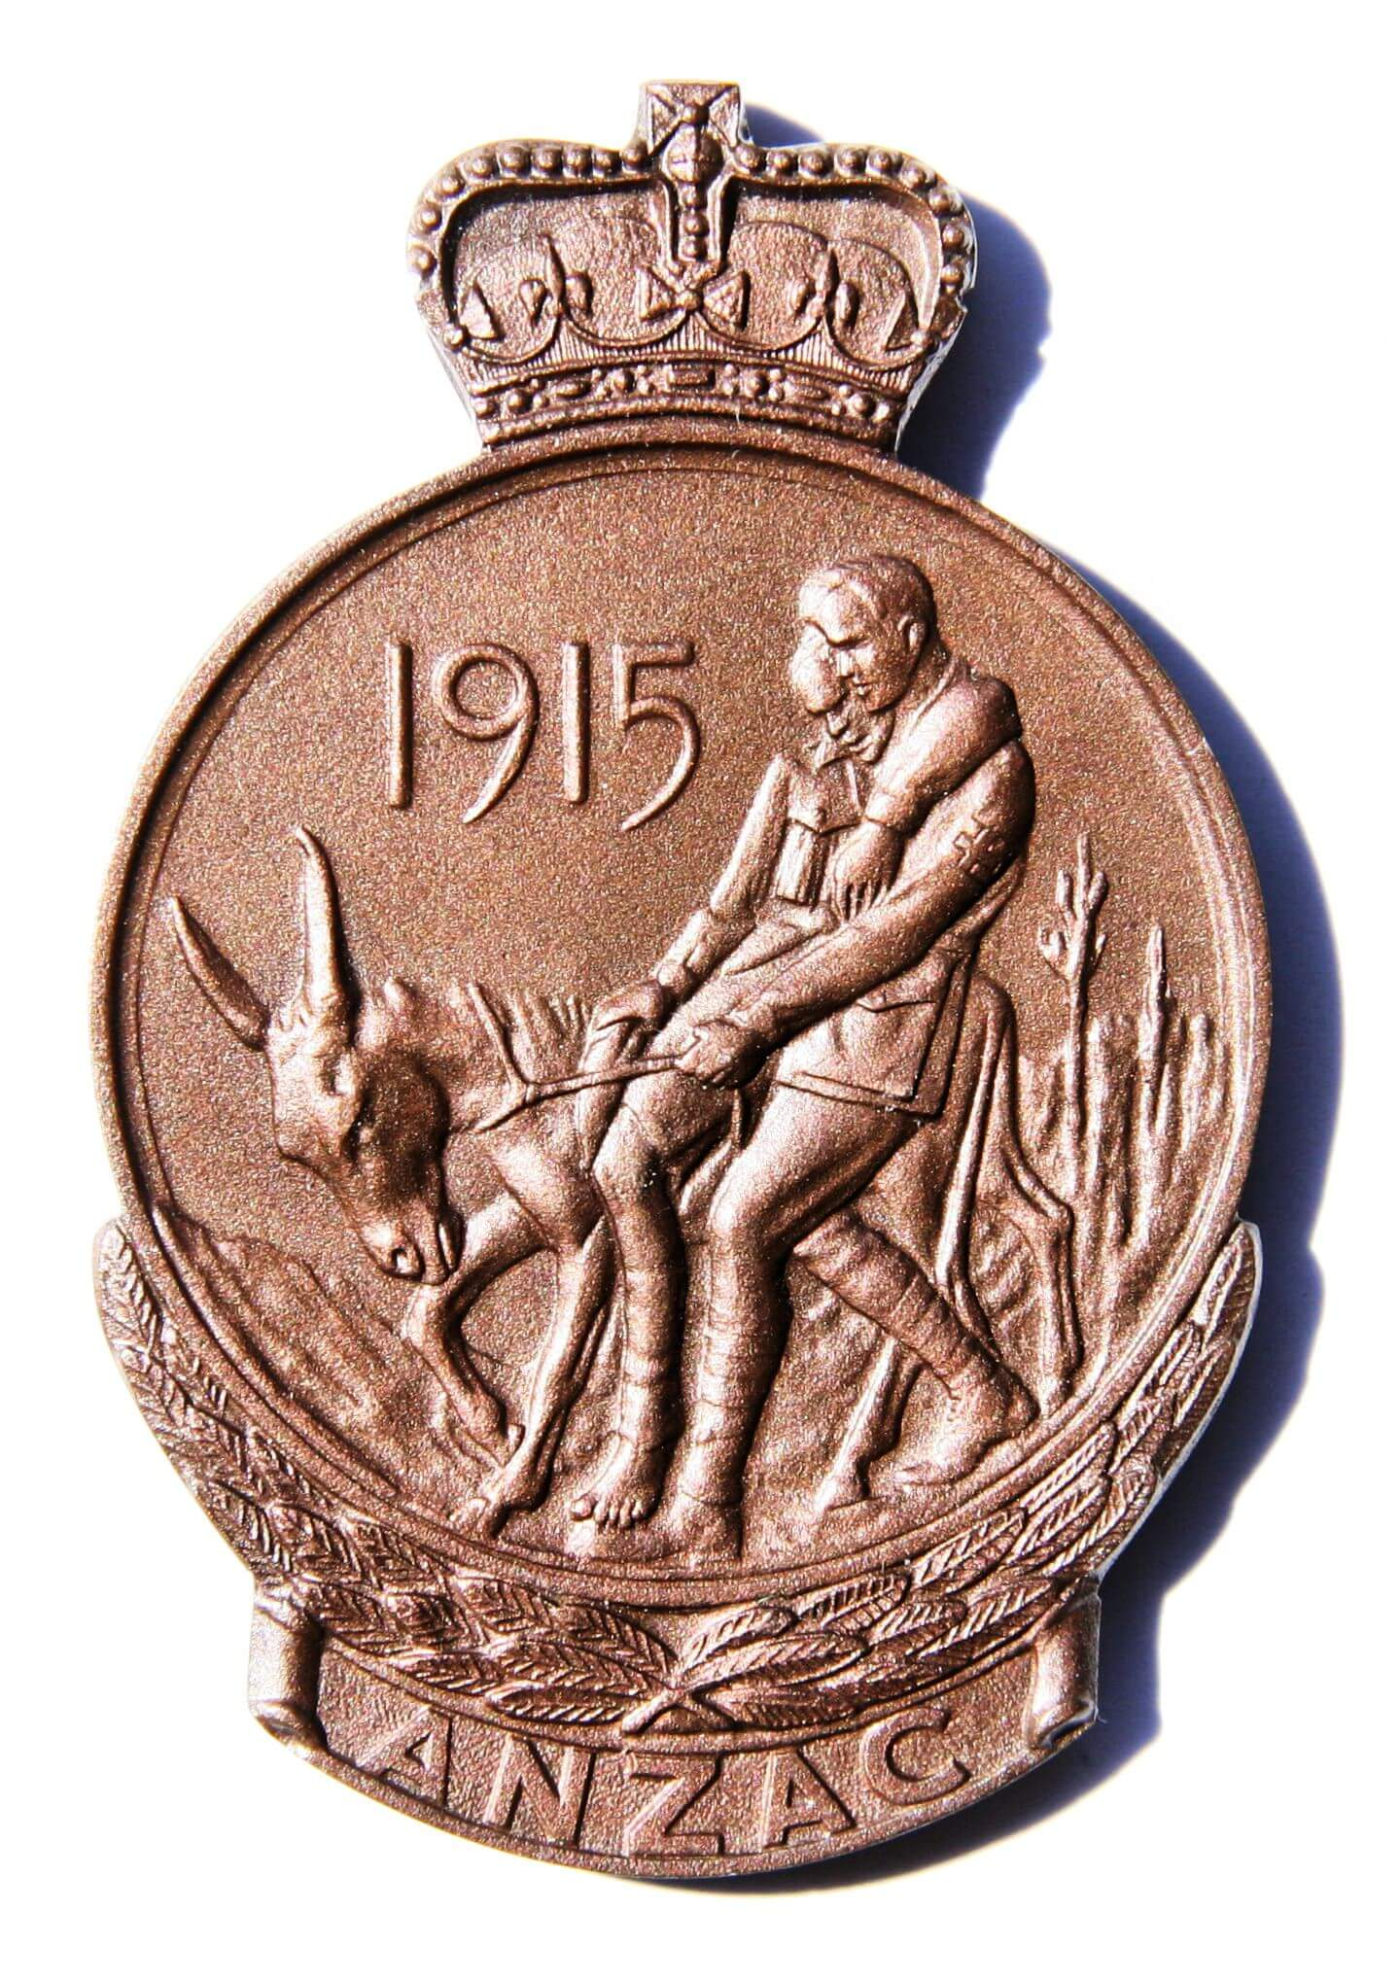
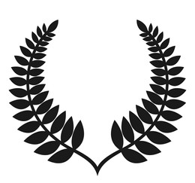
ANZAC Symbols
Australian Army badge
Slouch hat (worn by Australian soldiers)
British Crown (symbol of monarchy)
Simpson & his donkey (symbol of courage)
Gallipoli beach (where the battle was fought)
Poppies (symbol of remembrance)
New Zealand Fern (ANZAC = Australia & New Zealand Army Corps.)
ANZAC medallion (awarded to survivors)

Slide 11
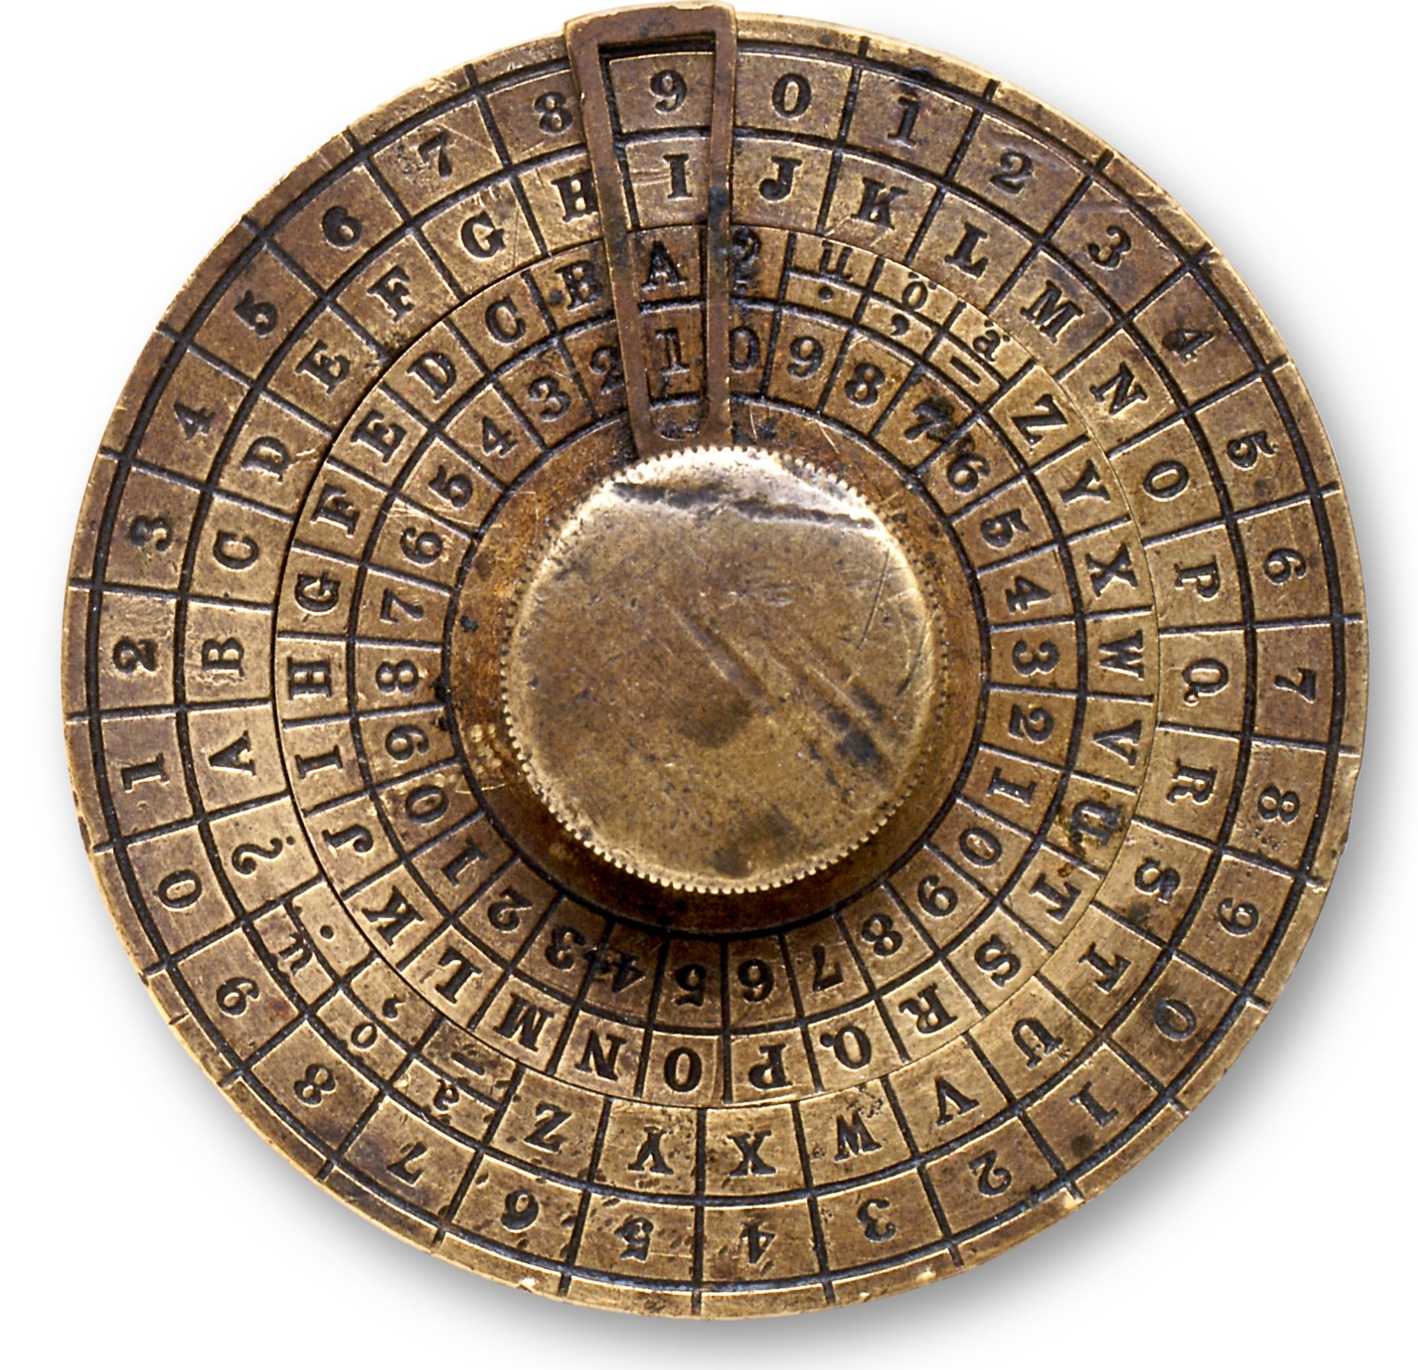
Why use symbols?
Symbols allow writers to hint at deeper layers of meaning – more complex than a simple literal statement could convey
Depending on the context, culture, or the reader’s personal experience, symbols can carry lots of different meanings
Symbols are like a ‘shorthand’, a code or a reference that can express many things in a few words
Symbols appeal to readers’ imaginations and stick with them

Slide 12
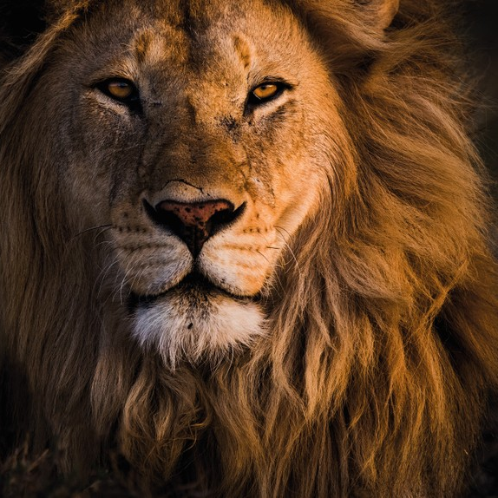
Common Symbols
Some symbols are used very often, not just by writers but in advertising or the media to represent common ideas.
Symbolic meanings are often attached to certain colours, seasons or animals.
Object | Symbolic meaning
Lion | Strength, royalty, courage
Snake | Death, evil, wisdom/cunning
Autumn | Change, maturity/getting older, harvest
Spring | New life, growth, birth, renewal, romance
Red | Love, passion, blood, heat, danger
White | Purity, innocence, cleanliness, peace

Slide 13
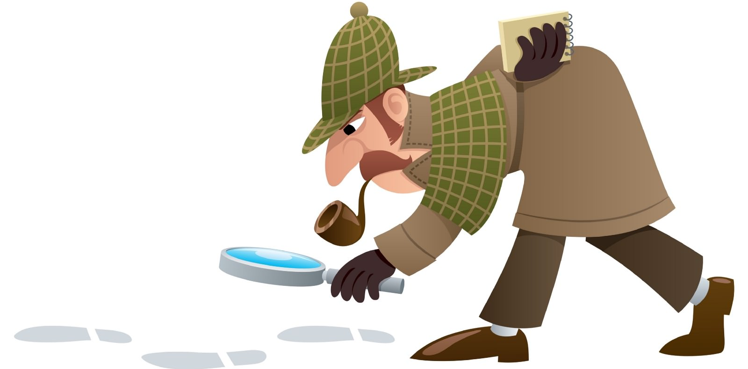
Recognising symbols in texts
Symbols in writing are not always obvious or easy to recognise
A good strategy is to look for patterns or repetition
Read carefully and see if you can spot any objects or things that are mentioned more than once – this is probably not a coincidence!

