Slide 1
Year 9 Vocab
Term 1 Week 1

Slide 2
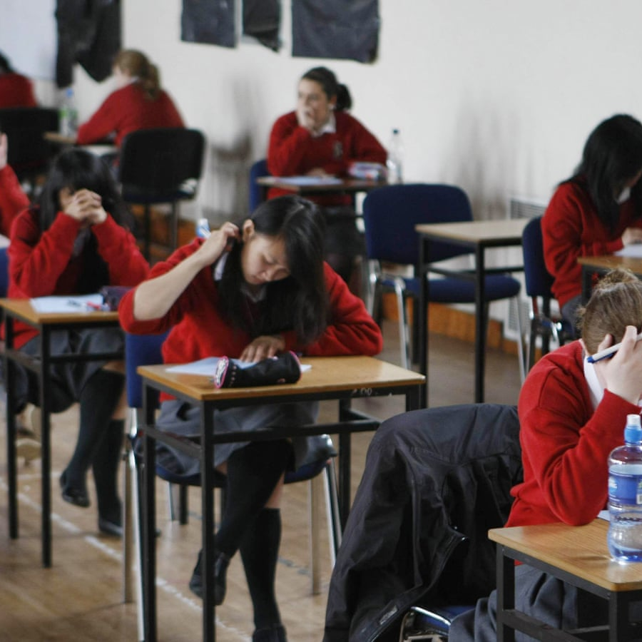
Allocate
Part of speech: verb
Meaning: to set apart for a particular purpose; to divide up and hand out
Make sure you allocate enough time to read the questions carefully.
Money from the sale of the house was allocated to each of the children.

Slide 3
Ascetic
Part of speech: adjective
Meaning: following strict self-discipline (sometimes for religious reasons). Avoiding anything easy, comfortable or luxurious.
He lives an ascetic life in his tiny cabin on the mountains.
Some Hindus believe that ascetic practices like fasting and living in poverty can bring them closer to enlightenment.

Slide 4
Beguile
Part of speech: verb
Meaning: to charm someone in order to trick them or get something out of them.
Zach somehow managed to beguile Ben into doing his art homework for him.
Advertisements often beguile customers to make them spend more money.

Slide 5
Crass
Part of speech: adjective
Meaning: stupid, tasteless, rude or offensive
He thought he was funny, but everyone found his jokes crass.
Ashley kept making crass comments about Jack’s worn-out clothes.

Slide 6
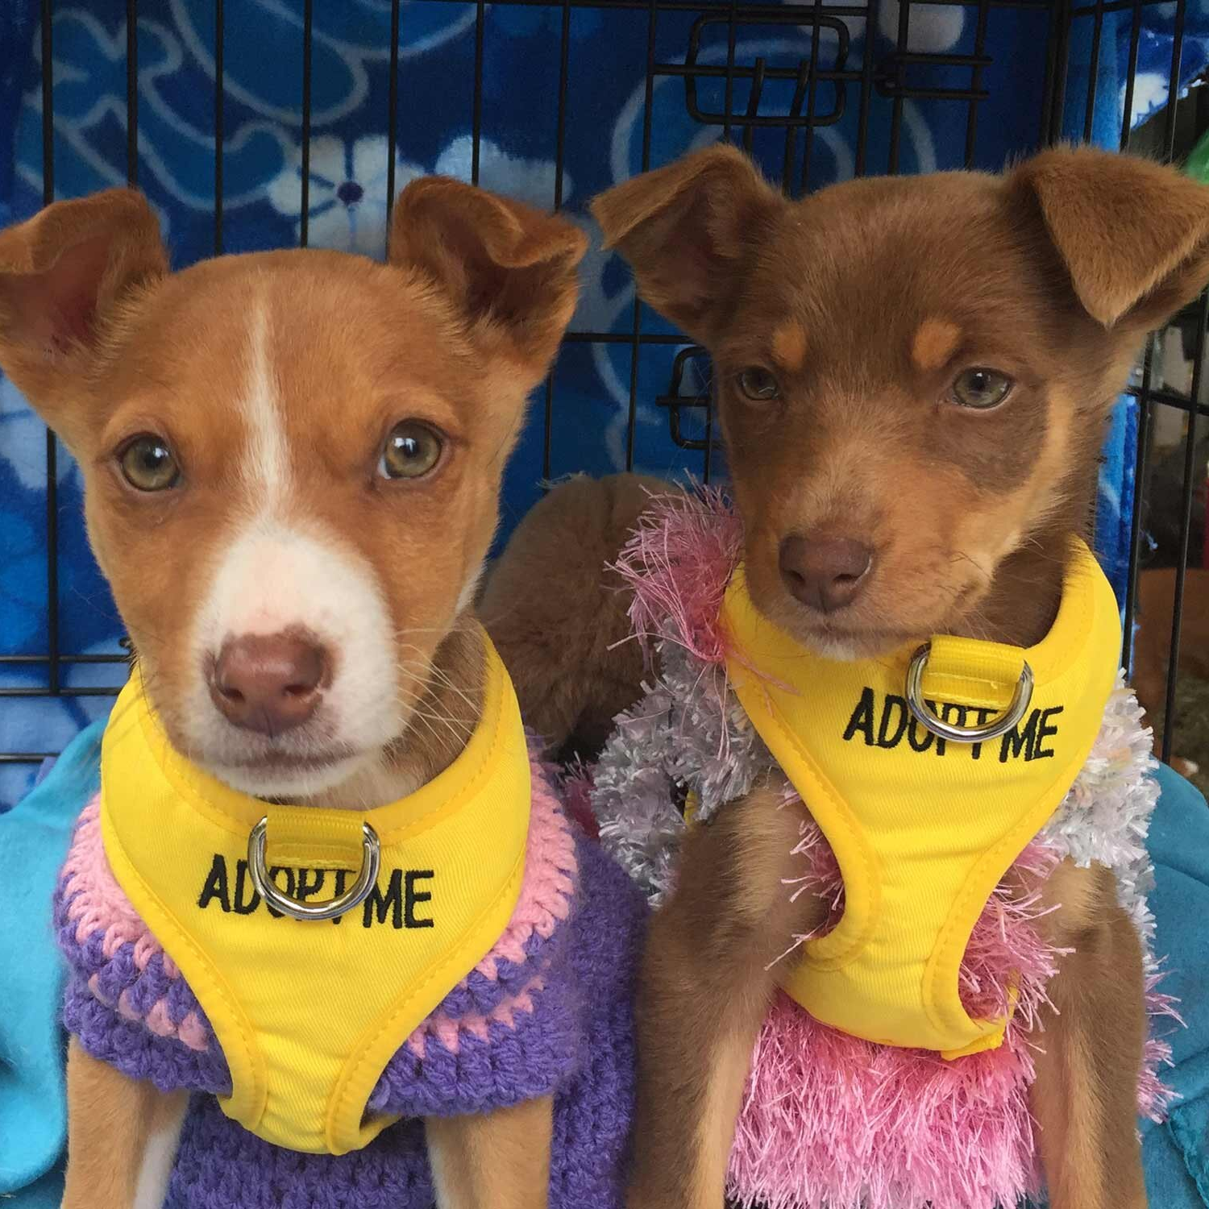
Defray
Part of speech: verb
Meaning: to provide money to pay for costs or expenses
The proceeds from the competition will defray some of the costs of running the animal shelter.
The company agreed to defray any expenses including car hire.

Slide 7
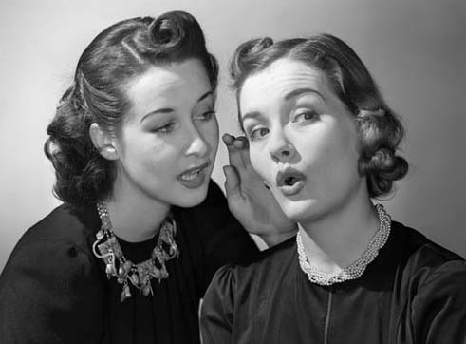
Enjoin
Part of speech: verb
Meaning: to instruct or command; to order someone to do something
His conscience enjoined him to speak the truth even if it got him into trouble.
She enjoined me strictly not to tell anyone else.

Slide 8
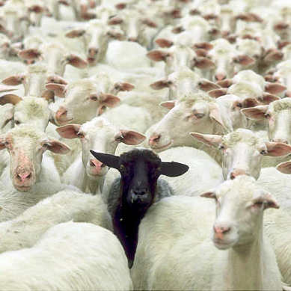
Interloper
Part of speech: noun
Meaning: an intruder; someone who is in a place where they don’t belong, aren’t wanted, or aren’t allowed
Lana sometimes felt like an interloper in her family.
Security failed to prevent an interloper from getting onto the stage during the presentation.

Slide 9
Feasible
Part of speech: adjective
Meaning: possible, able to be done
It may be feasible to clone human beings, but is it ethical?
With the extra resources, the project now seems feasible.

Slide 10
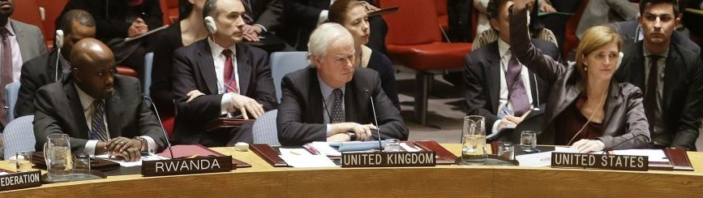
Envoy
Part of speech: noun
Meaning: a messenger or representative; someone who is sent to a meeting to speak on behalf of someone (usually the government of a country)
A United Nations special envoy attended the conference
The Prime Minister refused to negotiate with the foreign envoy.

Slide 11
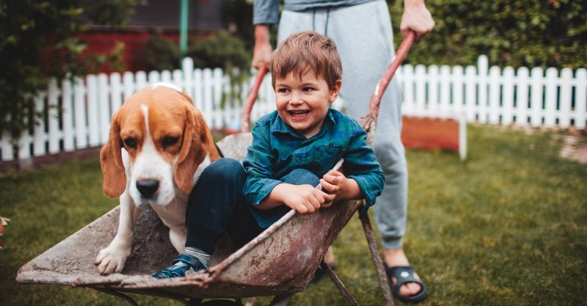
Vicarious
Part of speech: adjective
Meaning: experienced through watching, listening to or reading about others doing something rather than doing it yourself
She took vicarious pleasure in her friend’s success.
Tina tries to live vicariously through her son by giving him all the things she missed out on as a child.

