Slide 1
Year 9 Vocab
Term 1 Week 2

Slide 2
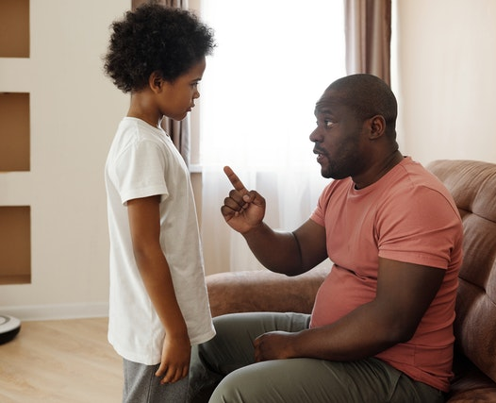
Admonish
Part of speech: verb
Meaning: to warn or scold someone, usually in a kind but firm way
Jonny’s father admonished him for playing too near the road.
Admonish your friends in private, praise them in public.

Slide 3
Lassitude
Part of speech: noun
Meaning: a state of physical or mental tiredness; lack of energy or interest
The students reacted to the new topic with total lassitude and apathy.
Symptoms may include nausea, headaches and lassitude.

Slide 4
Akimbo
Part of speech: adjective
Meaning: hands on hips
She stood with her arms akimbo.

Slide 5
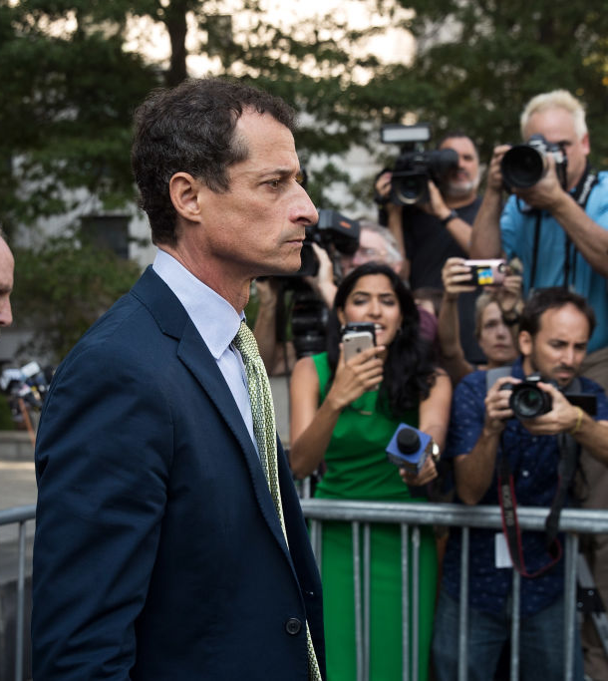
Licentious
Part of speech: adjective
Meaning: not following any rules or restraints; sexually immoral
Once the politician’s licentious behaviour became known, he was publicly disgraced.

Slide 6
Muse
Part of speech: verb
Meaning: to think about something carefully; to say something aloud in a thoughtful way
Terry had already begun to muse about starting his own business.
“I suppose I could sell the house,” she mused, “but then where would I live?”

Slide 7
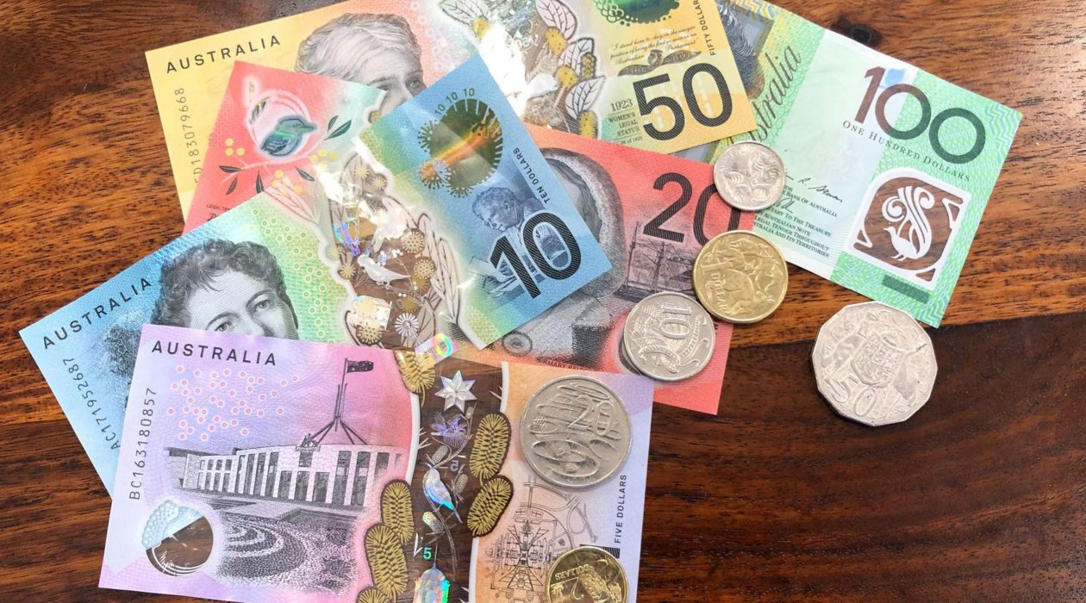
Pecuniary
Part of speech: adjective
Meaning: relating to money
His pecuniary troubles were over when he won the lottery.

Slide 8
Subversive
Part of speech: adjective
Meaning: working against something (usually a system or establishment); trying to destroy or undermine its power from within
The group published an anonymous magazine full of subversive articles about the government.

Slide 9
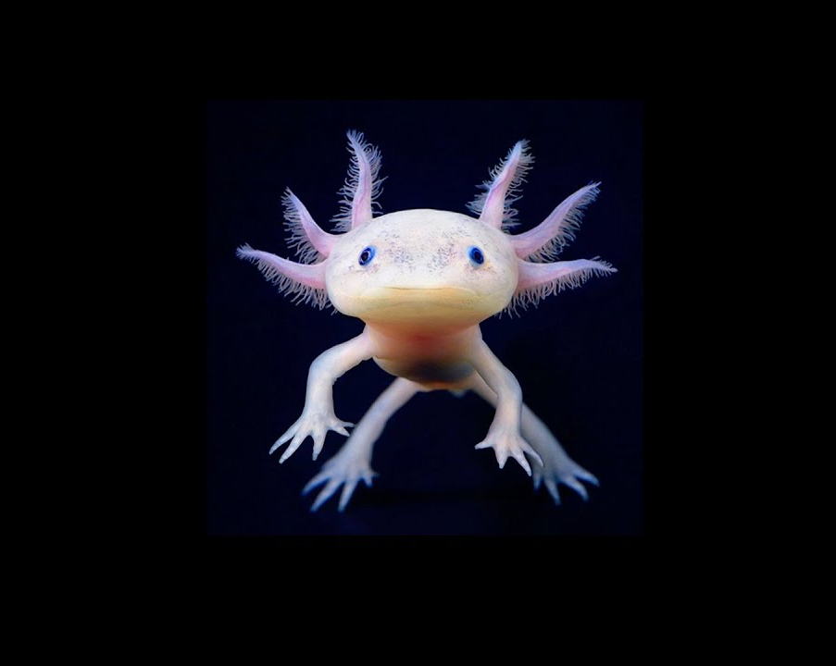
Plight
Part of speech: noun
Meaning: an unfortunate, dangerous, or difficult situation
The plight of the endangered axolotl cannot be ignored.
Nobody had any sympathy for his plight because it was his own fault.

Slide 10
Vacuous
Part of speech: adjective
Meaning: showing no intelligence; stupid or mindless; empty of any thoughts or ideas
The politician was known for making vacuous speeches.
Reality TV shows are often vacuous.

Slide 11
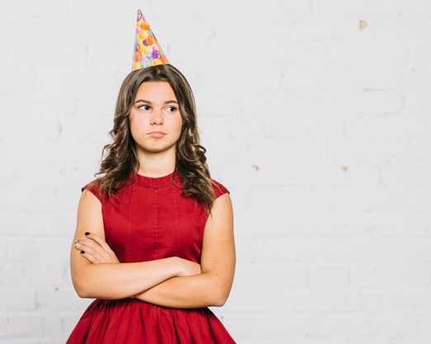
Presumptuous
Part of speech: adjective
Meaning: overconfident; doing or saying things when you have no right to; taking things for granted
It was presumptuous of her to assume I was going to give her a birthday present.
Rob says he thinks he knows more than his doctor, which is a bit presumptuous.

