Slide 1
Year 9 Vocab
Term 1 Week 3

Slide 2
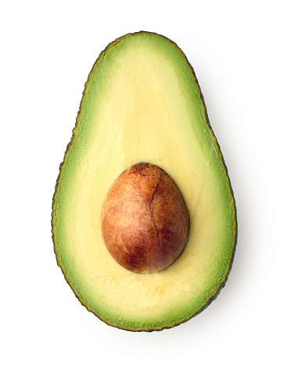
AVOCATION
Part of speech: noun
Meaning: a minor occupation; a hobby or activity that someone does as well as their regular job
Freya is a chemist by trade, but her avocation is growing avocadoes.
While he was at university, Harry didn’t have time for an avocation - he was too busy studying to pursue any hobbies.

Slide 3
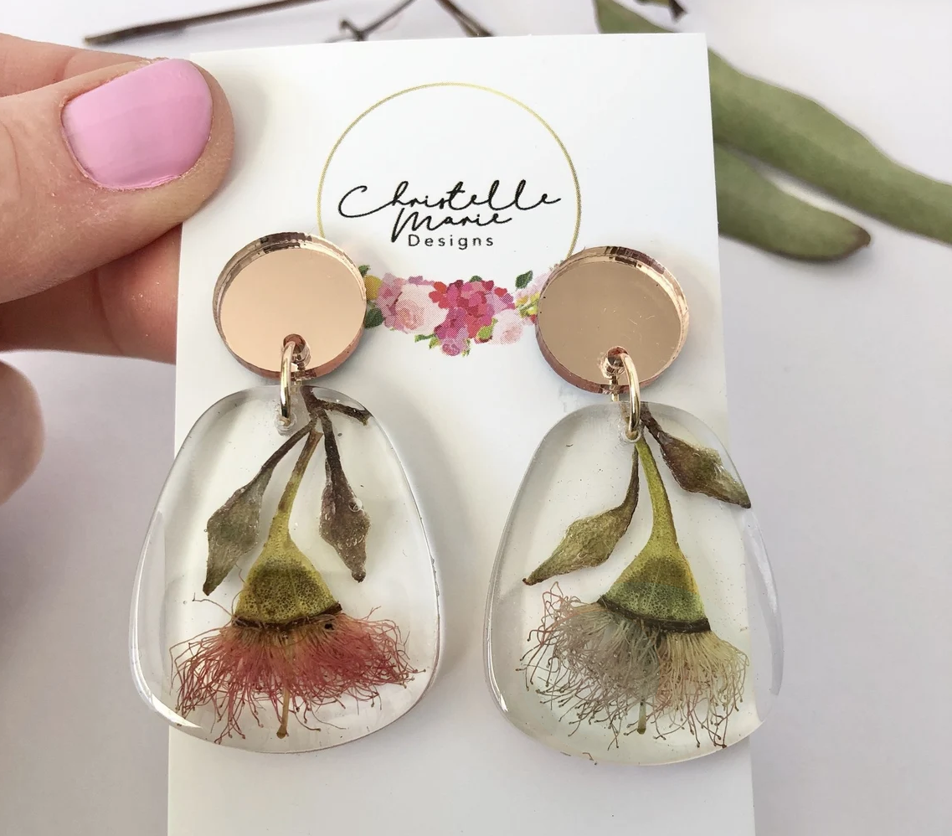
DISPARITY
Part of speech: noun
Meaning: a very noticeable difference; a situation in which two things are obviously not equal (often in a bad or unfair way)
The study showed a huge disparity between crime rates in urban cities and rural areas.
Each earring is created from a unique flower, so there may be some disparities between them.

Slide 4
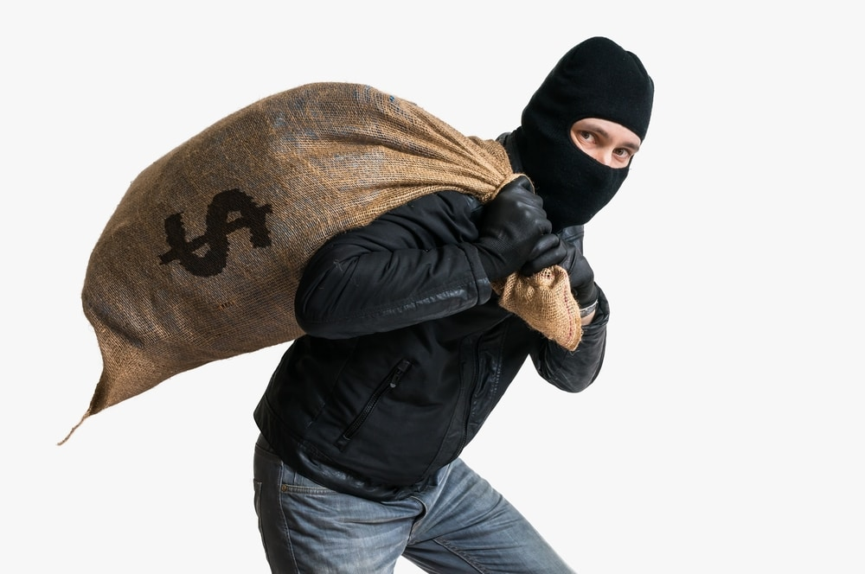
EFFICACY
Part of speech: noun
Meaning: effectiveness, usefulness. Ability to produce the right results.
The efficacy of the treatment is still uncertain.
In order to test the efficacy of their new security system, the bank staged a fake robbery.

Slide 5
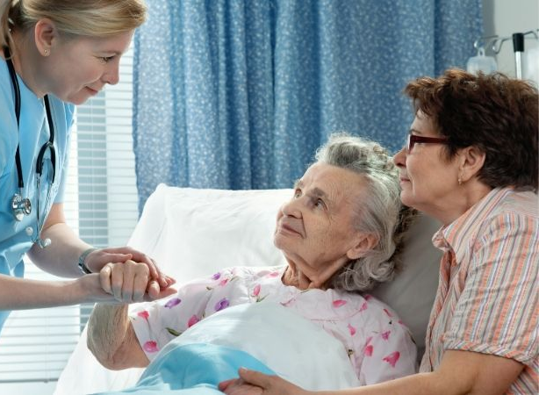
HOSPICE
Part of speech: noun
Meaning: a place where the terminally ill or dying are cared for and provided pain control and emotional support
After a long battle with cancer, Grandma was finally moved to the hospice this week.

Slide 6
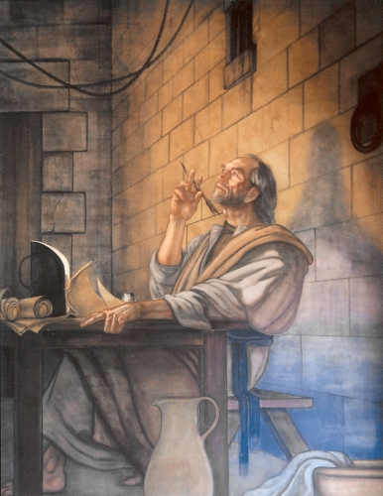
EPISTLE
Part of speech: noun
Meaning: a letter, usually one that is written to a group of people not an individual
Today’s reading is from Paul’s epistle to the Colossians.

Slide 7
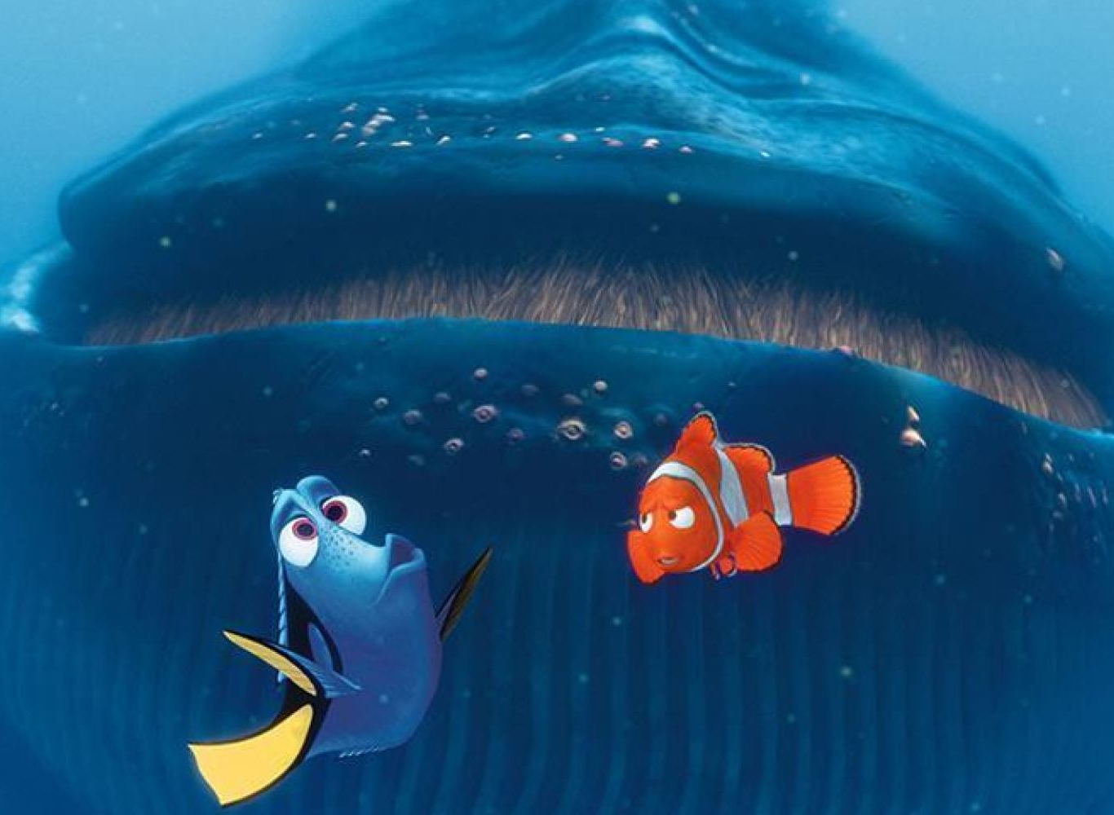
IMPETUS
Part of speech: noun
Meaning: a driving force; a thing that makes something happen
Marlin’s need to rescue his son is the impetus that drives the plot of Finding Nemo.
The high crime rate was the impetus for hiring one hundred new police officers.

Slide 8
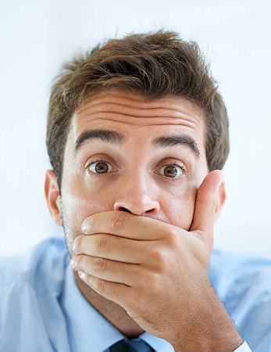
RETICENT
Part of speech: adjective
Meaning: reserved, keeping your thoughts and feelings to yourself
He was reticent at first, but when I got to know him he opened up a bit more.
Even the most reticent members of the group participated enthusiastically.

Slide 9
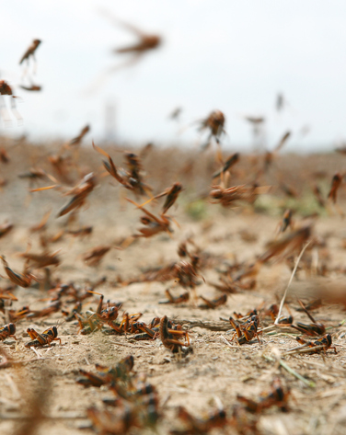
MORIBUND
Part of speech: adjective
Meaning: at the point of death; not progressing or improving
All that was left of the crop after the locust plague was a few moribund stalks.
Since the factory opened, our moribund town has sprung to life again.

Slide 10
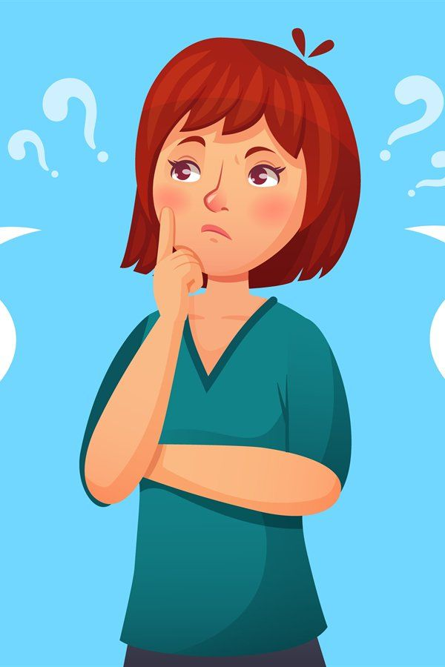
VACILLATE
Part of speech: verb
Meaning: to waver between two opinions or choices; to be indecisive
Don’t let Bonnie pick the restaurant, she’ll vacillate for hours.
King Henry was normally a good leader but he tended to vacillate when important decisions needed to be made.

Slide 11
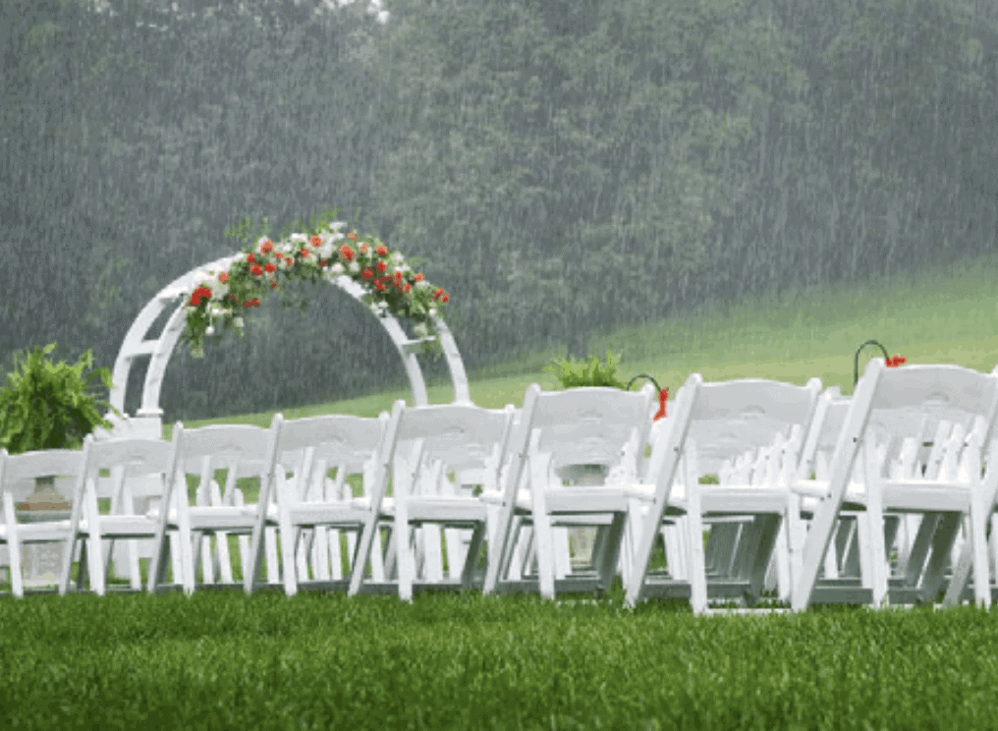
CAPRICIOUS
Part of speech: adjective
Meaning: not logical or reasonable; based on a sudden whim or mood; likely to change at any moment
The garden wedding was ruined by the capricious weather.
The King was known for his capricious temper, so nobody wanted to tell him the news about his daughter.

