Slide 1
Year 9 Vocab
Term 1 Week 4

Slide 2
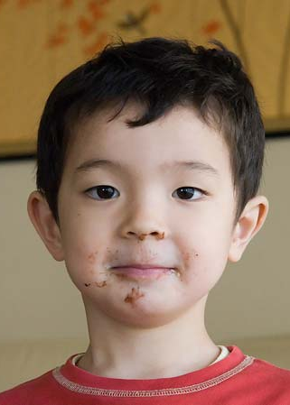
Corroborate
Part of speech: verb
Meaning: to confirm or make stronger; to provide evidence that helps prove
The sight of James’ face was enough to corroborate my theory that he was the chocolate thief.
Scientists have corroborated the findings of the study.

Slide 3
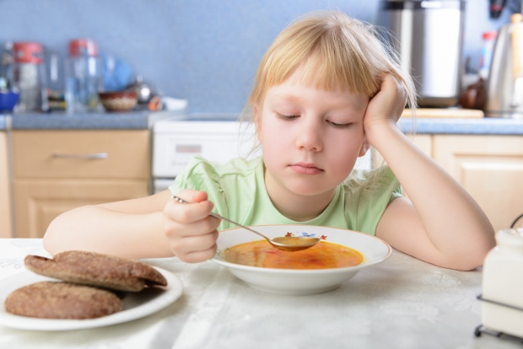
Insipid
Part of speech: adjective
Meaning: boring, bland; no flavour or interest
The insipid soup tasted like cardboard.
Don’t waste your time watching that insipid film.

Slide 4
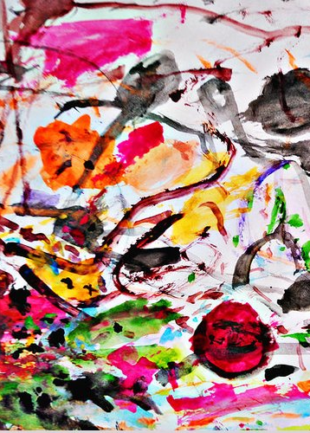
Akin
Part of speech: adjective
Meaning: similar, alike, related to
Anne believes her children’s artwork is akin to museum masterpieces.
The game is somewhat akin to rugby.

Slide 5
Nefarious
Part of speech: adjective
Meaning: evil, wicked, or criminal
In the movie, Maleficent is not as nefarious as the fairy-tale makes her out to be.
Your nefarious plan will never succeed, Dr. Horrible!

Slide 6
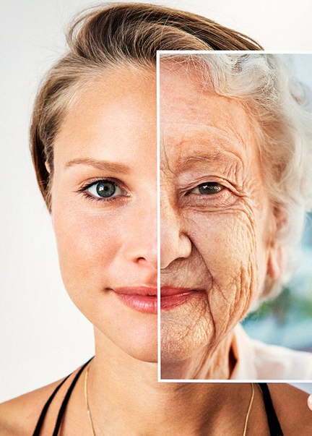
Inexorable
Part of speech: adjective
Meaning: impossible to stop or prevent; unable to be persuaded
Ageing is an inexorable process.
I tried to convince my mother to let me go to the party, but she was inexorable.

Slide 7
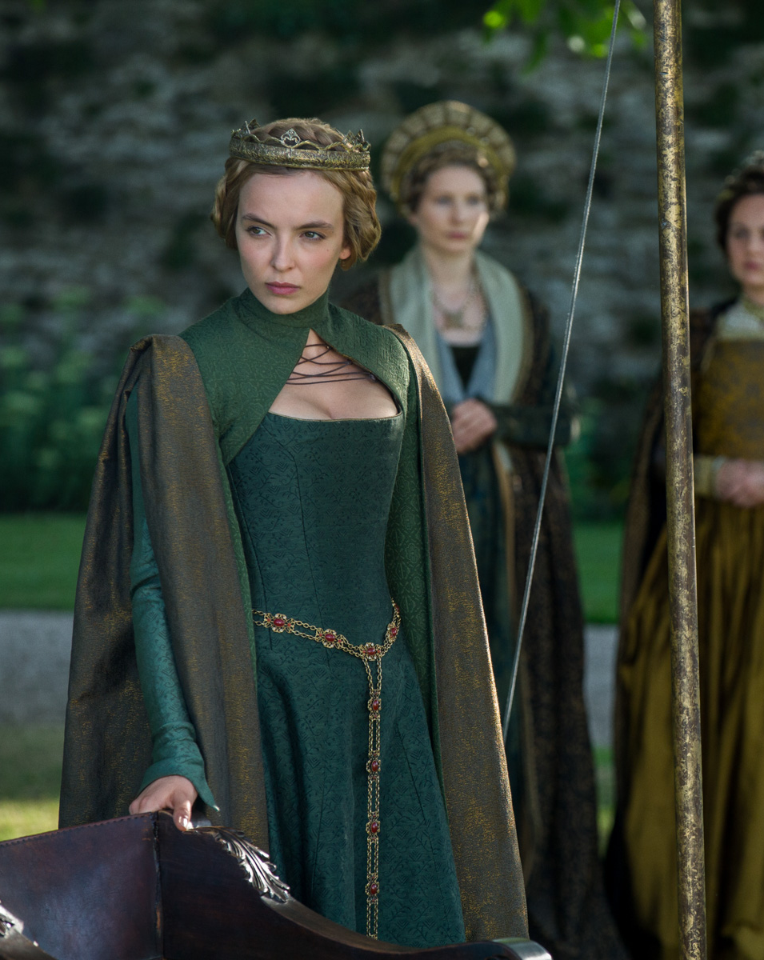
Retinue
Part of speech: noun
Meaning: a group of people that assist or advise someone famous or important, often travelling around with them
The arrogant queen insisted that members of her retinue never make eye contact with her.
The President’s retinue includes a publicist, an assistant and eight bodyguards.

Slide 8
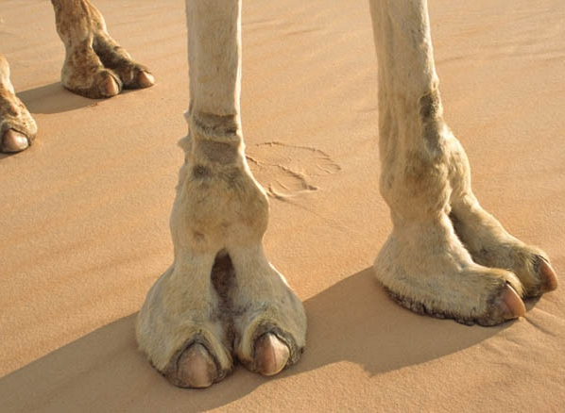
Torrid
Part of speech: adjective
Meaning: very hot and dry
Camel’s feet are perfectly designed to allow them to walk comfortably on torrid desert sands.

Slide 9
Jeopardise
Part of speech: verb
Meaning: to put in danger; to pose a threat or a risk
If we lose this game it might jeopardise our chances of getting through to the finals.
How dare you jeopardise the lives of others by driving dangerously!

Slide 10
Cynical
Part of speech: adjective
Meaning: doubting the goodness of people; believing that others are always selfish and dishonest
I couldn't help feeling cynical about the promises that the car salesman made.
Helen has become very bitter and cynical since her shop was burgled and vandalised.

Slide 11
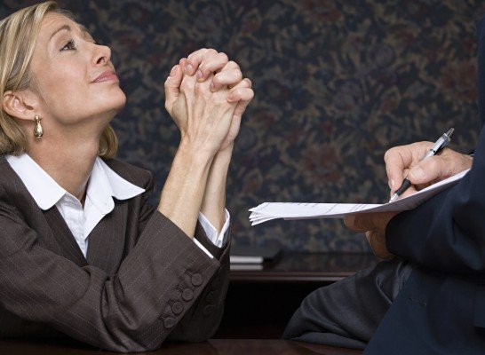
Supplicant
Part of speech: noun
Meaning: a person who humbly and respectfully asks for something from a powerful person or from God
Geraldine hated having to go to her boss like a supplicant every time she wanted some time off.
The governor dealt with long lines of supplicants every day asking for political favours.

