Slide 1
Year 9 Vocab
Term 1 Week 5

Slide 2
Blasé
Part of speech: adjective
Meaning: bored or unimpressed by something because you’ve seen it many times before
Kate tried to act blasé about flying first class even though it was her first time.
We don’t want children becoming blasé about violence due to seeing it so often on TV.

Slide 3
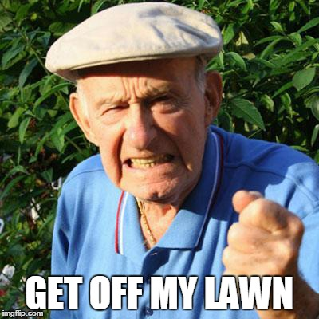
Affront
Part of speech: noun
Meaning: an action or remark that causes outrage or offence; an intentional insult
Frank saw children walking across his yard as a personal affront.
Building a shopping mall over the old cemetery would be an affront to the families of the deceased.

Slide 4
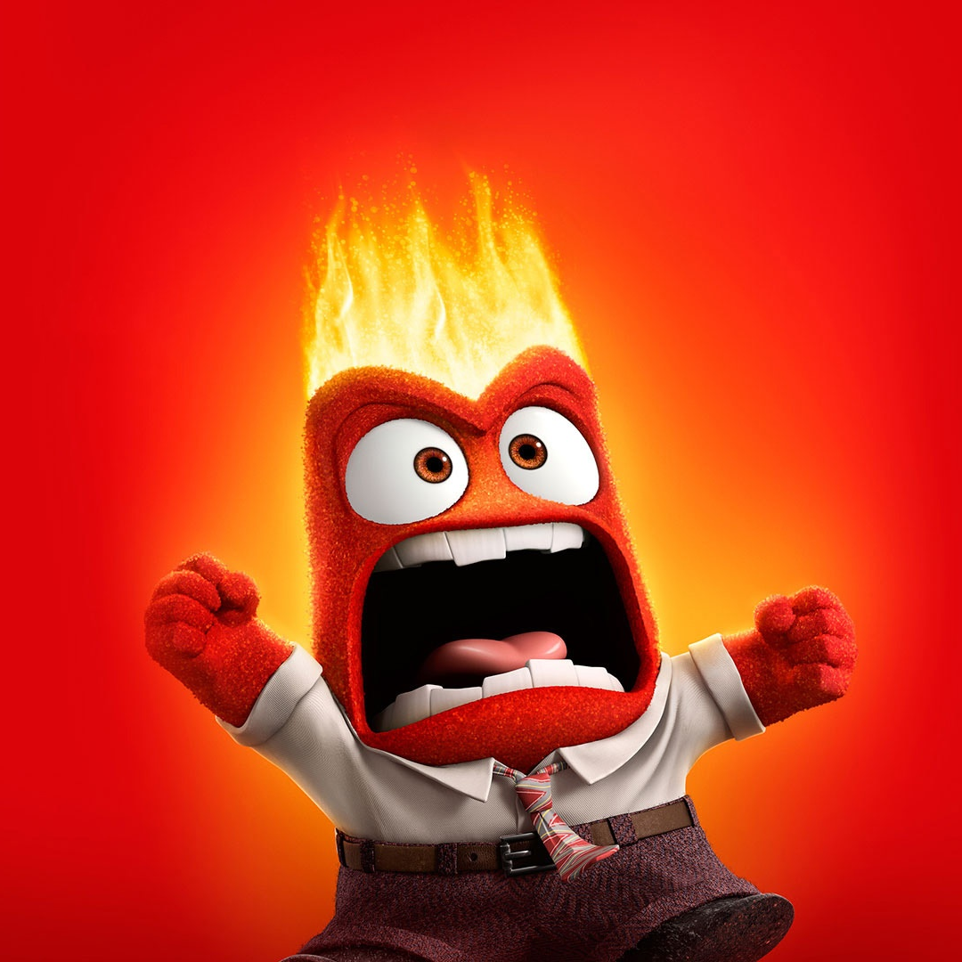
Choleric
Part of speech: adjective
Meaning: irritable or bad tempered; easily angered
Although Braden was having problems at home, he tried not to be choleric at school.
The choleric baby would not stop crying.

Slide 5
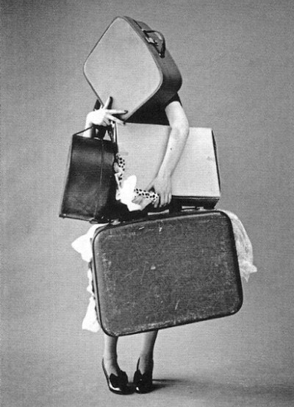
Encumber
Part of speech: verb
Meaning: to weigh down or burden; to restrict; to make free movement difficult
You don’t want to encumber yourself with unnecessary luggage on a holiday.
Not having a phone will encumber my social life!

Slide 6
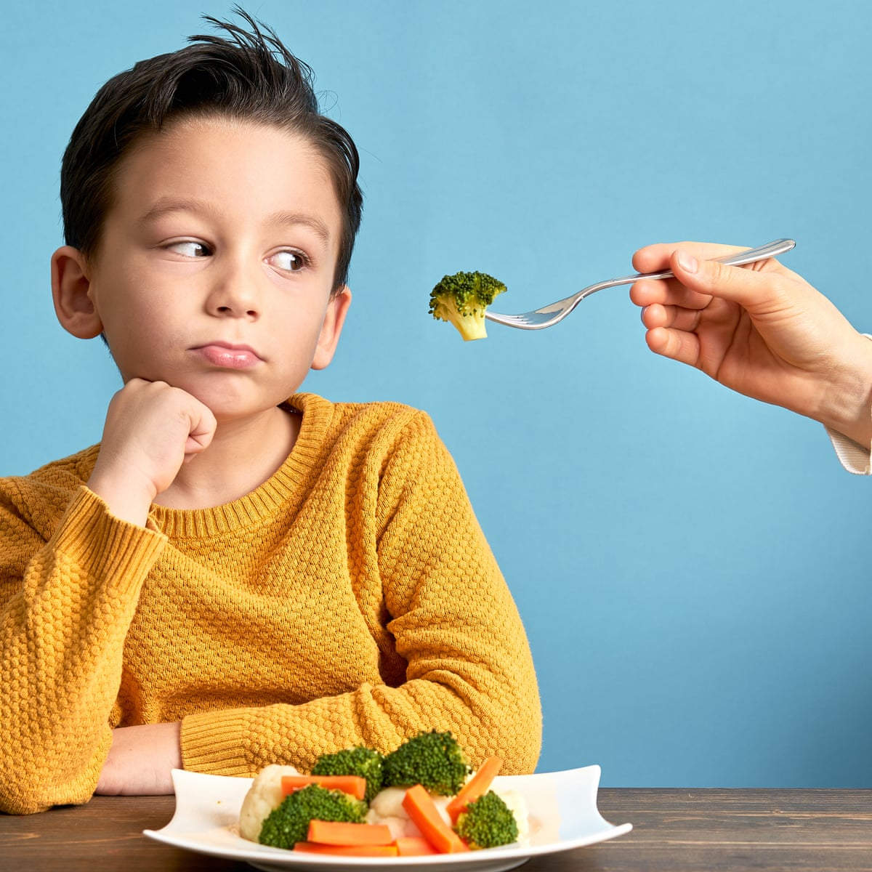
Cajole
Cajole:
Just one more bite and you can have dessert!
Part of speech: verb
Meaning: to persuade someone using flattery or sweet-talk; to convince or coax
Is it better to cajole or threaten when trying to get kids to eat their vegetables?
I managed to cajole Macy to go shopping with me.
Threaten:
Eat it, or you’ll get a smack!

Slide 7
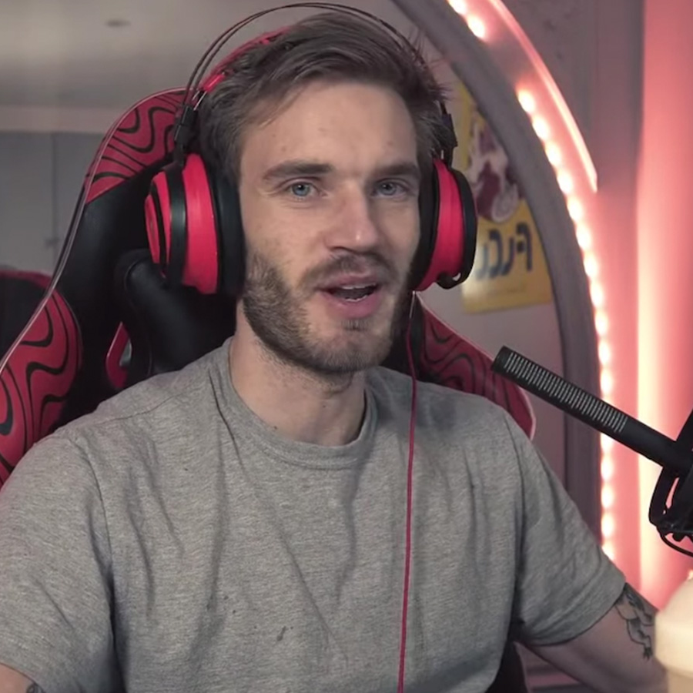
Feckless
Part of speech: adjective
Meaning: incompetent or irresponsible; weak in character, not motivated
The feckless manager made the company go bankrupt.
Despite his successful youtube channel, his parents treated him like a feckless layabout.

Slide 8
Impasse
Part of speech: noun
Meaning: a situation where it’s impossible to make any progress or escape; a deadlock, a stalemate
Neither of us were willing to compromise in the argument, so we were at an impasse.
The political impasse could have been avoided.

Slide 9
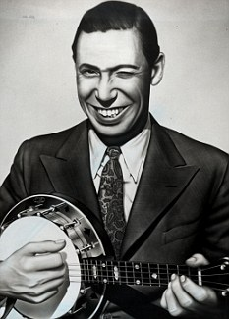
Ribald
Part of speech: adjective
Meaning: inappropriate or suggestive; making crude jokes
British musical hall in the 1930s was known for its ribald songs.
Larry was eventually fired when the boss overheard him making ribald comments.

Slide 10
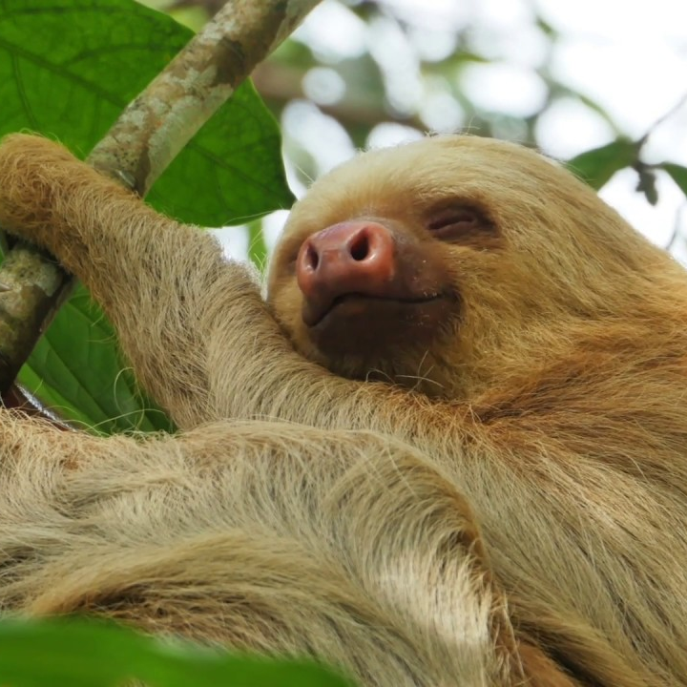
Indolent
Part of speech: adjective
Meaning: extremely lazy, avoiding any effort or movement
Although sloths may be indolent, they are an important part of the ecosystem.
My indolent daughter waited until the night before to start working on her research project.

Slide 11
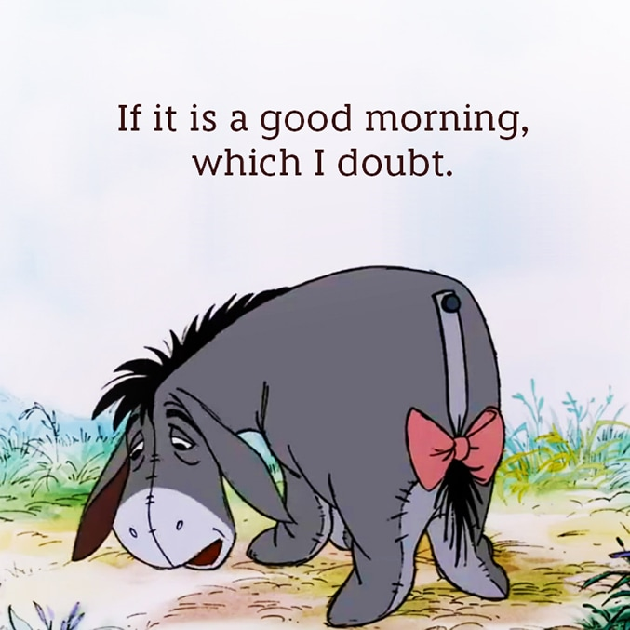
Lugubrious
Part of speech: adjective
Meaning: looking or sounding exaggeratedly sad and mournful
Eeyore is a very lugubrious character.
After he lost his job, he went around with a lugubrious expression on his face for months.

