Slide 1
Year 9 Vocab
Term 1 Week 6

Slide 2
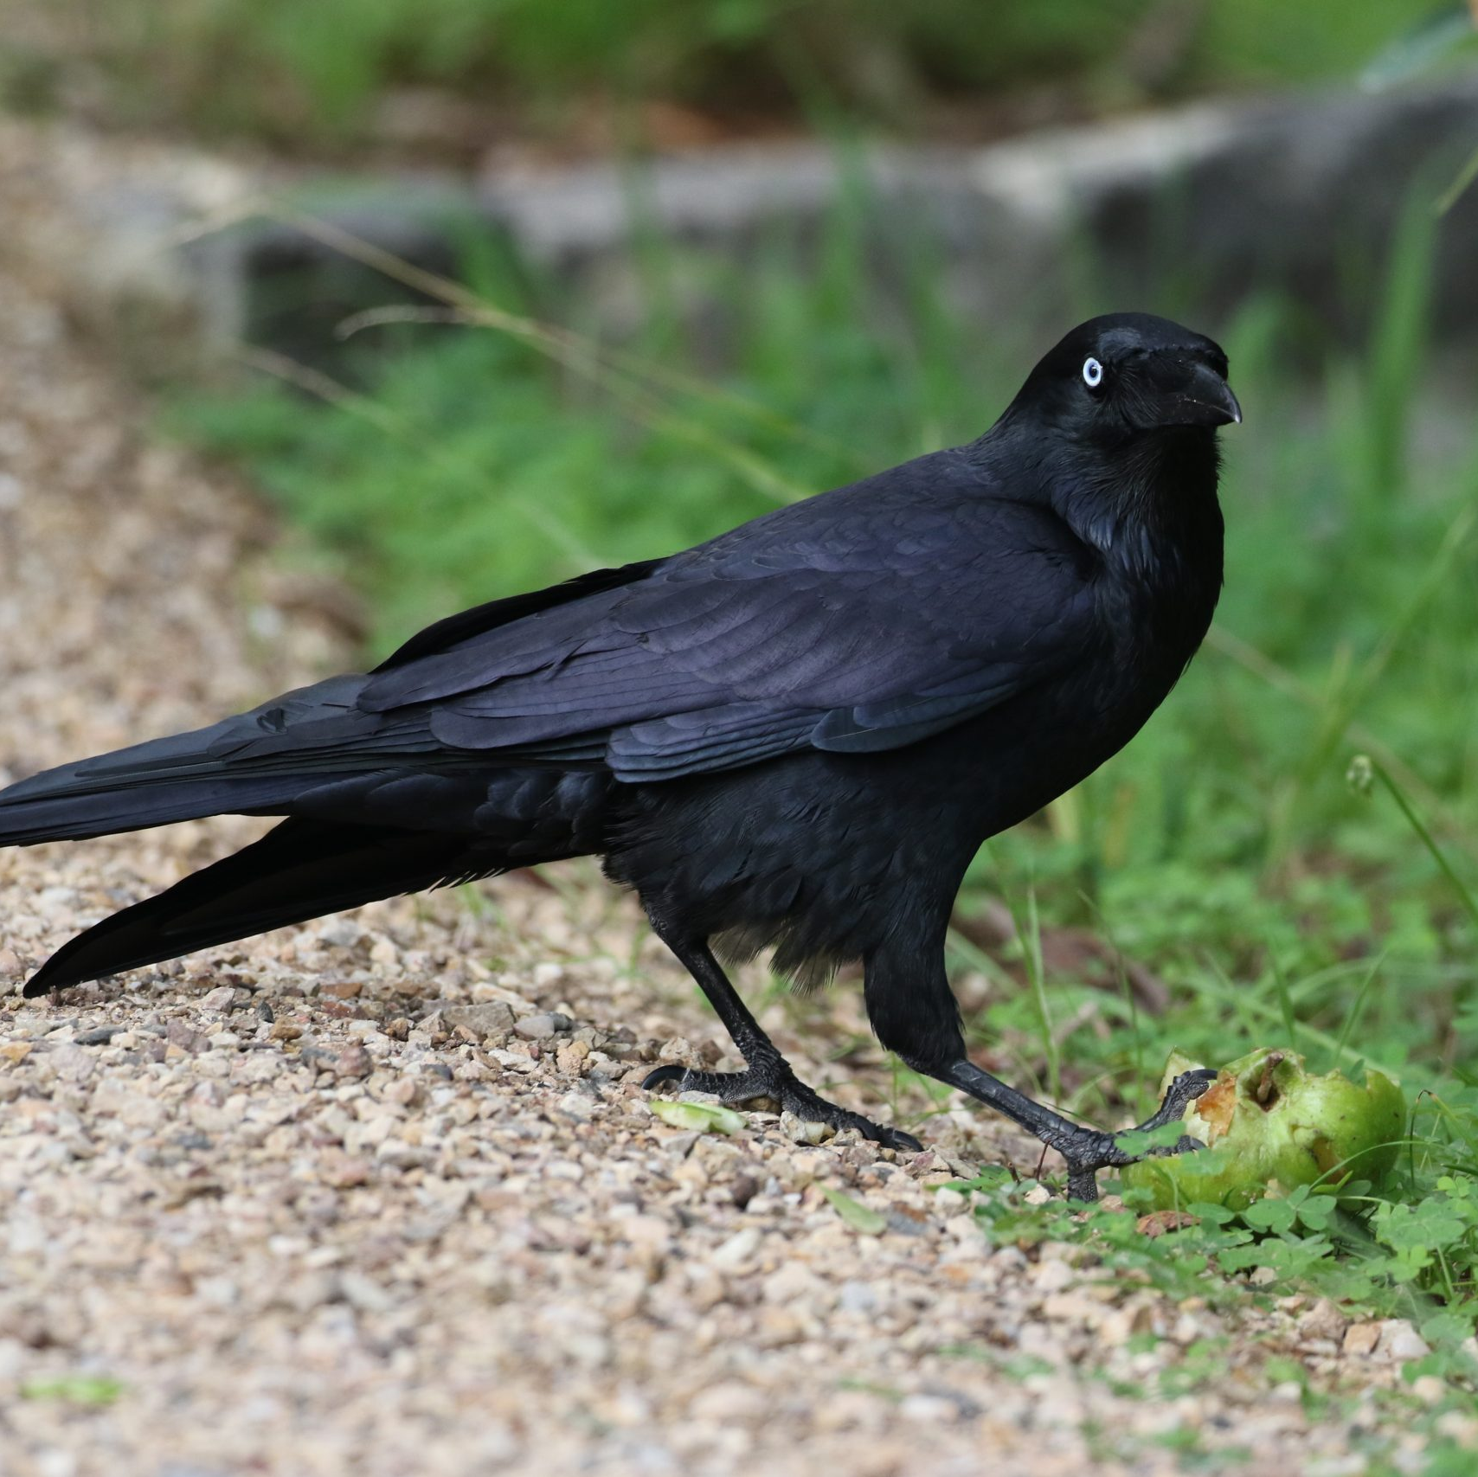
Dissemble
Part of speech: verb
Meaning: to hide your true thoughts or feelings; to put on a false appearance
Children learn to dissemble at a surprisingly young age.
Ravens are able to tell when other ravens are watching them, and will dissemble in order to conceal their food stash.

Slide 3
Protagonist
Part of speech: noun
Meaning: the main character in a film, play or novel
Harry is the protagonist, and Voldemort is the antagonist.

Slide 4
Censure
Part of speech: noun
Meaning: strong criticism or disapproval
When she married a Catholic she faced censure from her whole family.
“I deserve neither such praise nor such censure. I am not a great reader, and take pleasure in many things.” – Elizabeth Bennet

Slide 5
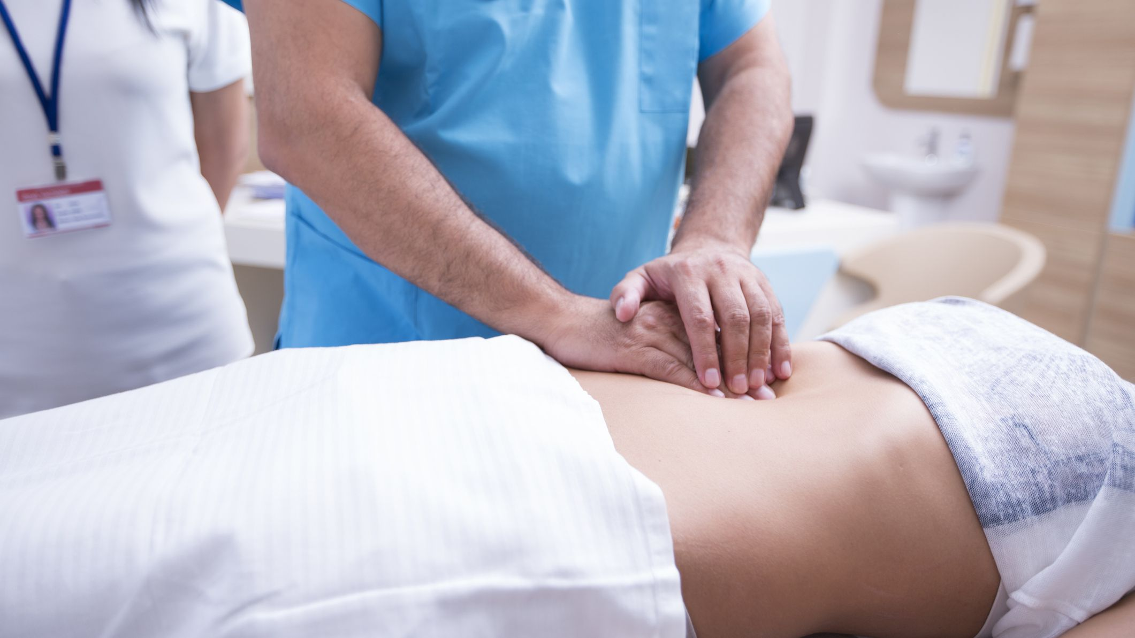
Palpate
Part of speech: verb
Meaning: to examine by touch for medical purposes
Palpate the skin to check for cysts and infection.
The doctor palpated the patient’s stomach.

Slide 6
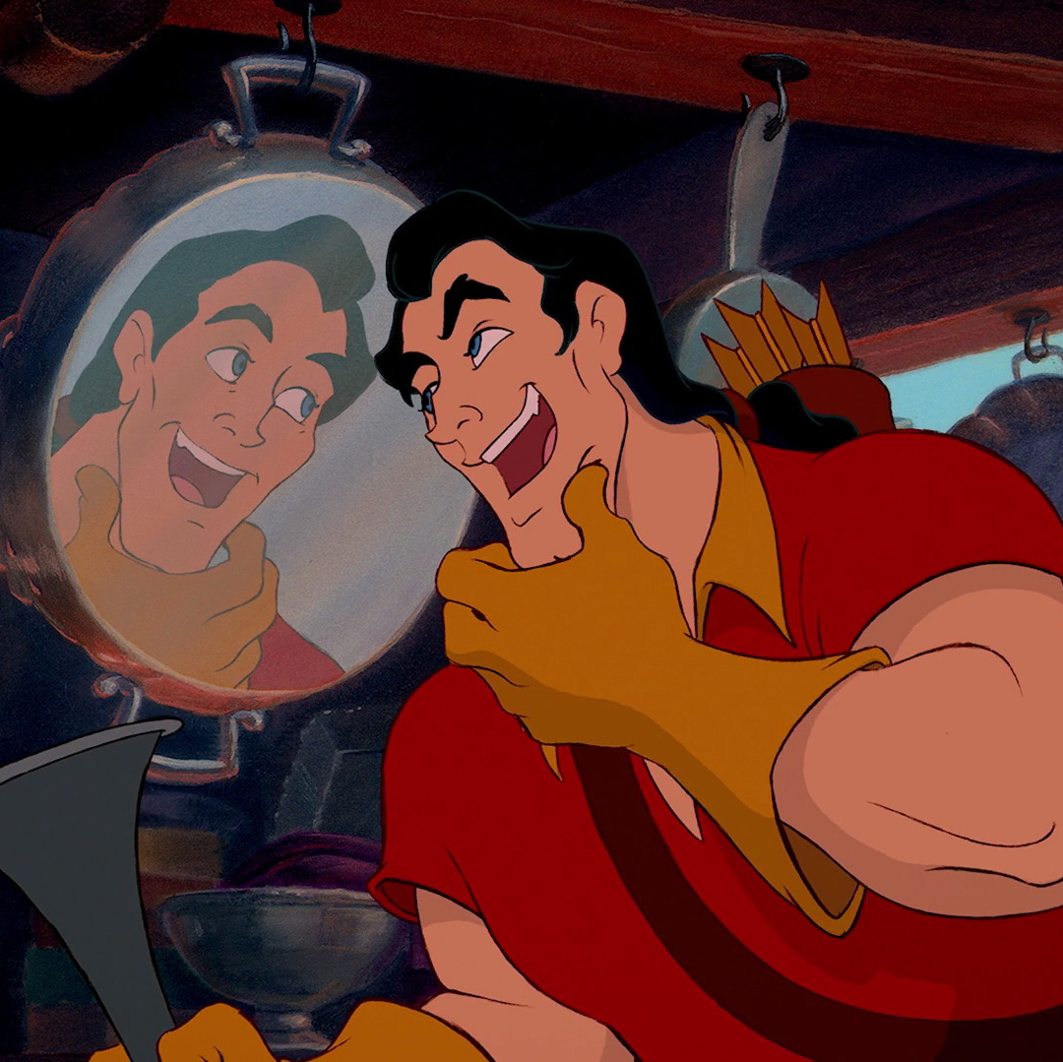
Expectorate
Part of speech: verb
Meaning: to cough or spit up phlegm from the lungs
“I’m especially good at expectorating!” – Gaston

Slide 7
Droll
Part of speech: adjective
Meaning: funny in an odd way
Nick’s droll commentary on other passengers made the journey very entertaining.
I love old-fashioned children’s books, the illustrations are so droll.

Slide 8
Peremptory
Part of speech: adjective
Meaning: expecting to be obeyed immediately and without question
The flight assistant said in a peremptory tone that he could either fasten his seatbelt or get off the plane.
Marie claims to be a good team player but she is always making peremptory suggestions that sound like demands.

Slide 9
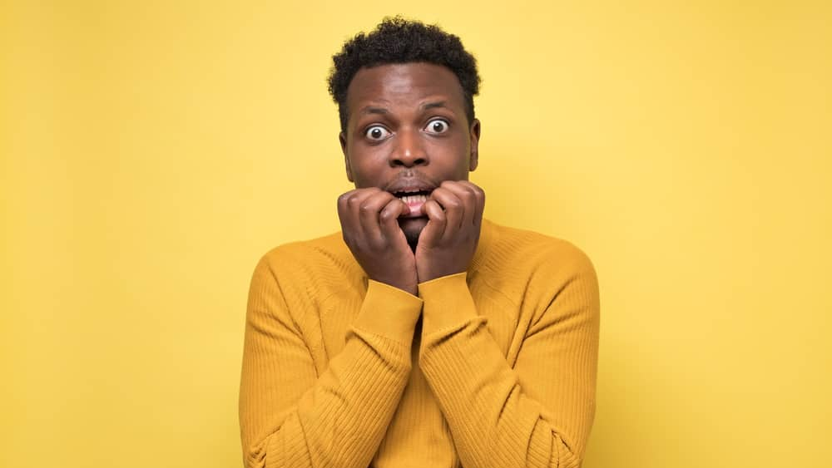
Pusillanimous
Part of speech: adjective
Meaning: weak and cowardly; lacking courage or determination
He’s too pusillanimous to stand up to his opponents.

Slide 10
Surfeit
Part of speech: noun
Meaning: an excessive amount; too much
The store manager accidentally ordered a surfeit of light bulbs.
We always have a surfeit of food at Christmas.

Slide 11
Unanimous
Part of speech: adjective
Meaning: in complete agreement; all voting for the same thing
He asked for a second opinion, but the doctors were unanimous.
The motion was passed by a unanimous vote.

