Slide 1
Year 9 Vocab
Term 1 Week 10

Slide 2
ambulatory
Part of speech: adjective
Meaning: able to walk or move from place to place
After the hip surgery, it was several weeks before the patient was ambulatory.

Slide 3
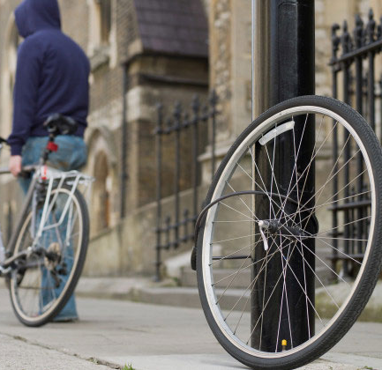
brazen
Part of speech: adjective
Meaning: bold and shameless
I can’t believe someone was brazen enough to steal my bike in broad daylight.

Slide 4
din
Part of speech: noun
Meaning: a loud, continuous noise
The teacher had to yell to be heard over the din.

Slide 5
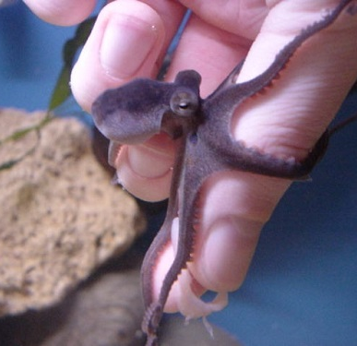
ennui
Part of speech: noun
Meaning: a feeling of weariness and dissatisfaction with life
Captive octopi need to be kept entertained with toys or puzzles, or they can die from boredom and ennui.

Slide 6
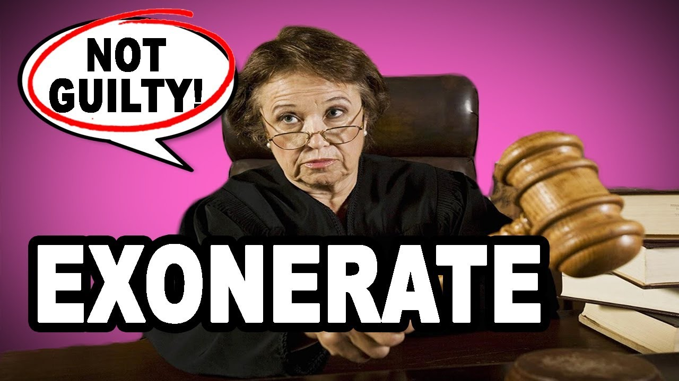
exonerate
Part of speech: verb
Meaning: to clear someone from blame or guilt
I’m confident the evidence will completely exonerate him.

Slide 7
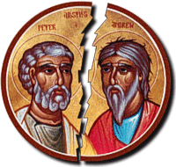
schism
Part of speech: noun
Meaning: a split between two groups with different beliefs
The two different interpretations of the passage caused a schism in the church.

Slide 8
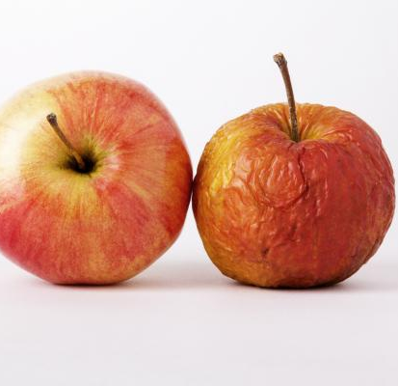
wizened
Part of speech: adjective
Meaning: shrivelled or wrinkled with age
My grandmother’s wizened face broke into a smile when I placed my baby daughter in her arms.
Those apples we bought last week are already looking a bit wizened.

Slide 9
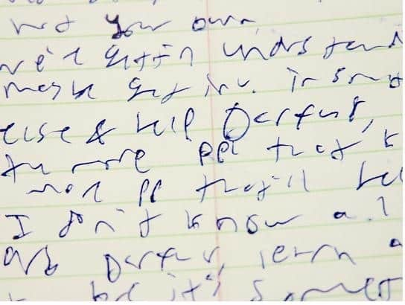
Inscrutable
Part of speech: adjective
Meaning: impossible to understand or interpret
I tried to guess how she was feeling but her face was inscrutable.
Larry’s writing was never particularly neat, but when he was in a hurry it was inscrutable.

Slide 10
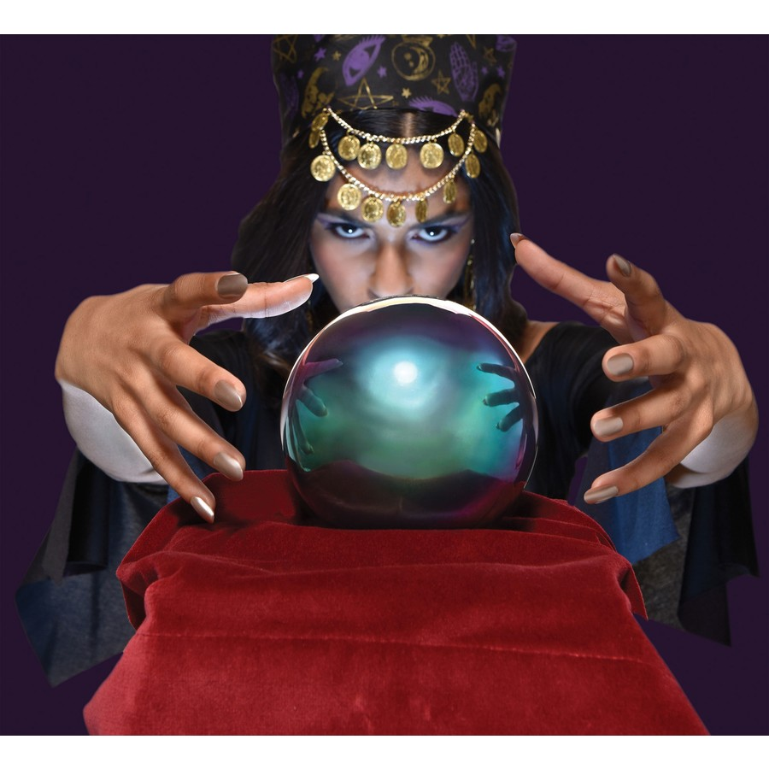
prognosticate
Part of speech: verb
Meaning: to foretell; to predict what might happen in the future.
My uncle believes his psychic advisor can prognosticate upcoming events in his life.

Slide 11
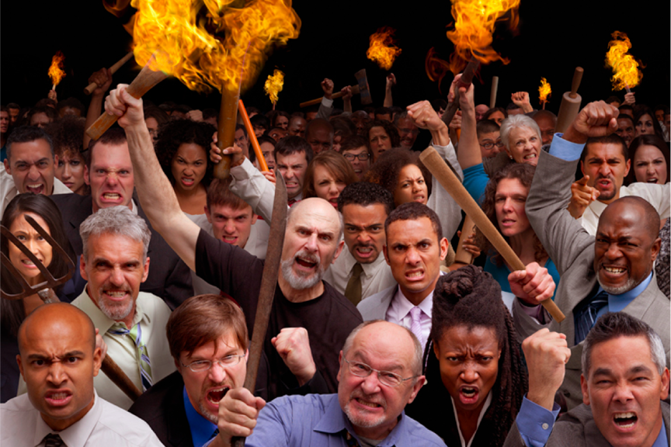
sedition
Part of speech: noun
Meaning: behaviour or speech intended to stir people up and make them rebel against authority
The cult leaders were charged with sedition after they encouraged a mob to burn down a government building.

