Slide 1
Year 9 Vocab
Term 1, Week 7

Slide 2
Allay
Part of speech: verb
Meaning: to make a negative emotion less strong or a problem less difficult; to subdue; to reduce
The nurse managed to allay Susie’s fears about her baby’s rash.

Slide 3
Capacious
Part of speech: adjective
Meaning: able to hold a large amount; roomy, spacious
The Millers traded in their hatchback for a more capacious sedan.

Slide 4
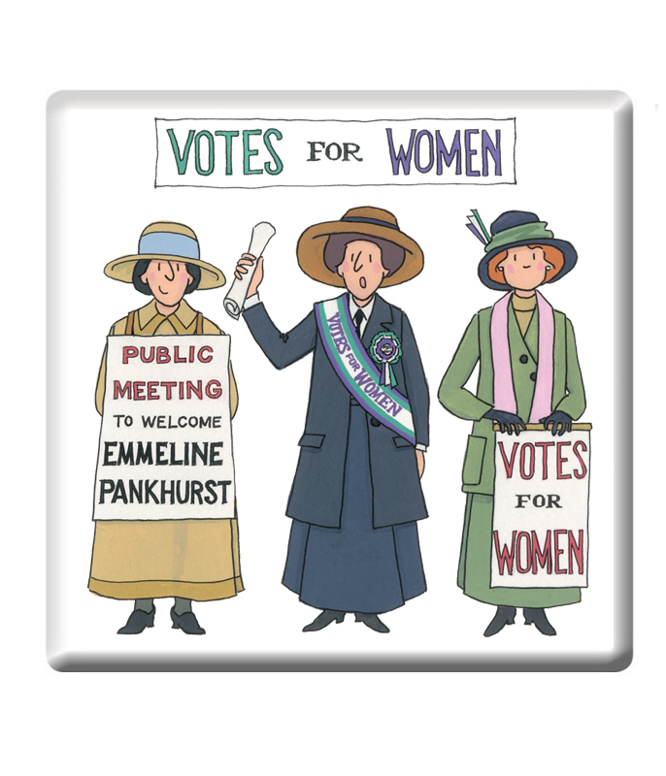
Suffrage
Part of speech: noun
Meaning: the right to vote in an election
South Australian women were granted suffrage in 1895.
Indigenous Australians did not have legal suffrage until 1962.

Slide 5
Extricate
Part of speech: verb
Meaning: to free or remove
Unfortunately the firemen couldn’t extricate the dog from the burning building.

Slide 6
Prostrate
Part of speech: adjective
Meaning: lying stretched out facedown, as a sign of respect or worship
Catholics who want to become priests must lie prostrate on the floor during the ordination ceremony.

Slide 7
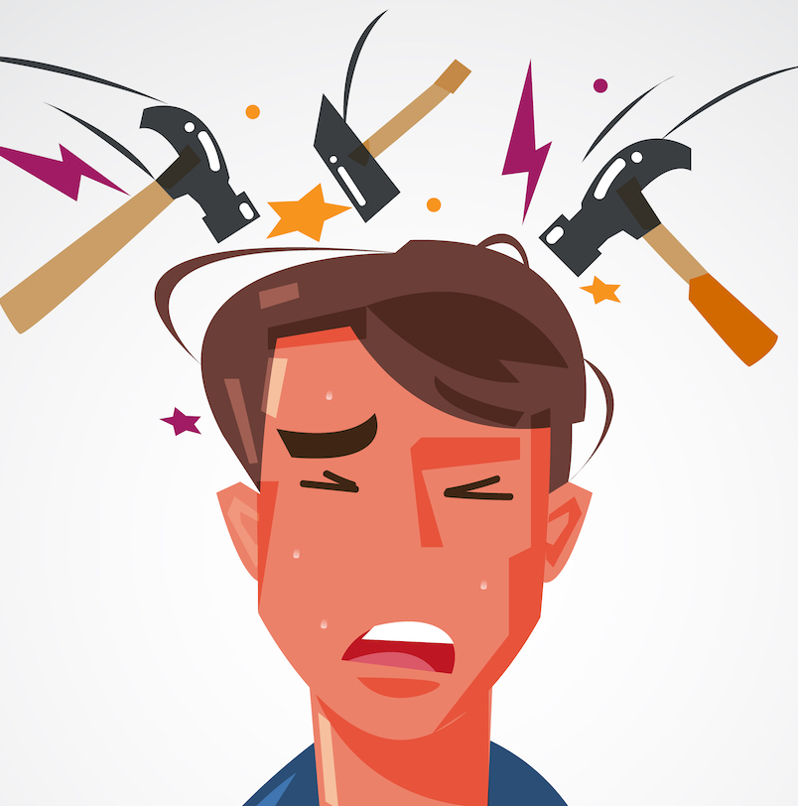
Mitigate
Part of speech: verb
Meaning: to make less severe or painful
Not even a Panadol could mitigate my headache.

Slide 8
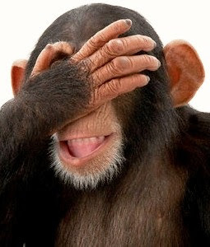
Ignominious
Part of speech: adjective
Meaning: very embarrassing, shameful or disgraceful
His political career came to an ignominious end after his public blunder.

Slide 9
Palpitate
Part of speech: verb
Meaning: (of the heart) to beat quickly or unevenly from fear
The sudden thump in the middle of the night made my heart palpitate.

Slide 10
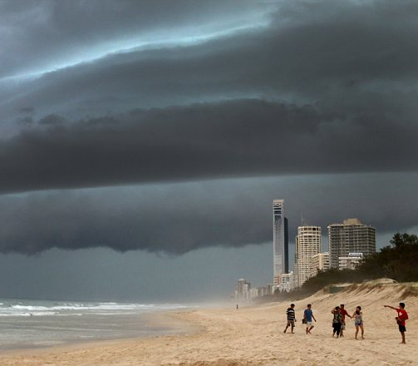
Propitious
Part of speech: adjective
Meaning: favourable, showing a good chance of success
It was obvious from the dark clouds that it was not a propitious day for a beach picnic.

Slide 11
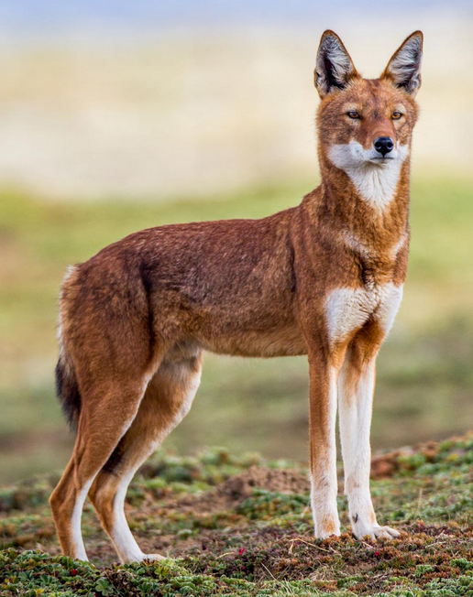
Diurnal
Part of speech: adjective
Meaning: active during the day
The Ethiopian Wolf is mostly diurnal, but becomes nocturnal in areas where it is persecuted.

