Slide 1
Year 9 Vocab
Term 1 Week 9

Slide 2
paradigm
Part of speech: noun
Meaning: a typical example; a model of how something should be
The factory was a paradigm of productivity.

Slide 3
aplomb
Part of speech: noun
Meaning: skill and confidence in a difficult situation; keeping your cool
He defused the bomb with aplomb.

Slide 4
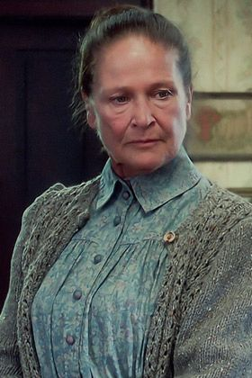
Austere
Part of speech: adjective
Meaning: severe or strict; without decoration or comforts
Marilla seemed like an austere woman, but she had a kind heart.
The monk chose to live an austere life.

Slide 5
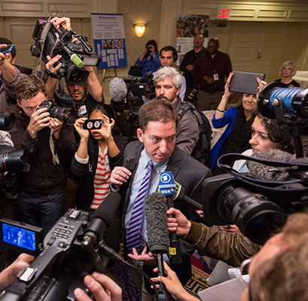
barrage
Part of speech: noun
Meaning: an outpouring; a large number of things happening at once
As soon as he stepped out of the courtroom he faced a barrage of questions from the press.

Slide 6
nebulous
Part of speech: adjective
Meaning: not clear; difficult to explain; vague or hazy
She only had a very nebulous idea of what she wanted to do when she left school.
What we call a nebulous star is actually a cluster of small indistinct stars.

Slide 7
unctuous
Part of speech: adjective
Meaning: full of false flattery; too eager to please; smooth or oily
The waiter acted very unctuous when he found out one of the guests was a minor celebrity.
We were served roast duck with a delicious, unctuous gravy.

Slide 8
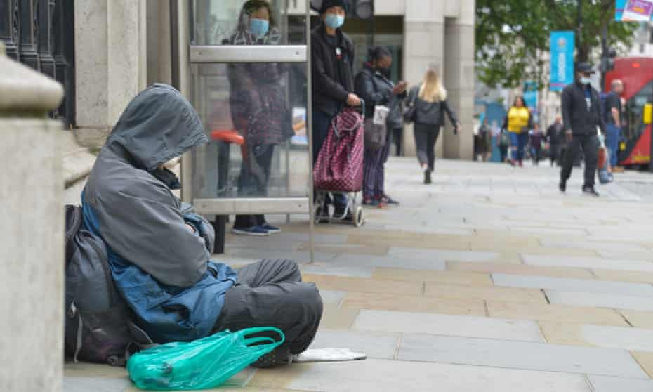
Cognisant
Part of speech: adjective
Meaning: fully aware or conscious; knowledgeable about something through experience
Having lived on the streets myself, I’m very cognisant of the dangers of homelessness.

Slide 9
collusion
Part of speech: noun
Meaning: a secret agreement to do something illegal or treacherous
Before their collusion was discovered, the partners managed to steal nearly $50,000 from the company.

Slide 10
urbane
Part of speech: adjective
Meaning: confident & charming; polished in social situations
He makes a good salesman because he’s urbane and easy to talk to.

Slide 11
sedentary
Part of speech: adjective
Meaning: not active, not doing much physical exercise; spending a lot of time sitting
Jack’s job was quite sedentary, so he decided to start cycling to work.

