Slide 1
Context
Chinese Cinderella

Slide 2
Context
Context = everything around something. Who, what, when, where, why, how?
Looking at context helps you understand the point of a story
A key part of context is the author’s perspective
Everyone sees the world differently – like looking through their own glasses
Where and when we live, our family, our previous experiences, our education, and lots of other factors influence our perspective

Slide 3
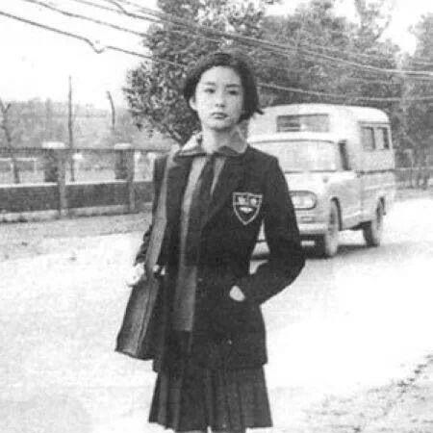
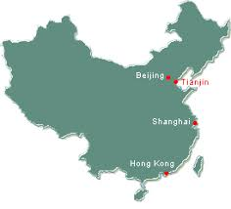
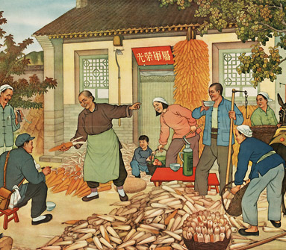
Context of Chinese Cinderella
Who? Adeline Yen Mah
What? Autobiography (story of her own life)
When? 1941-1952
Where? China (Tianjin, Shanghai, Hong Kong)
Why? Valuable to study other cultures and look at different perspectives

Slide 4
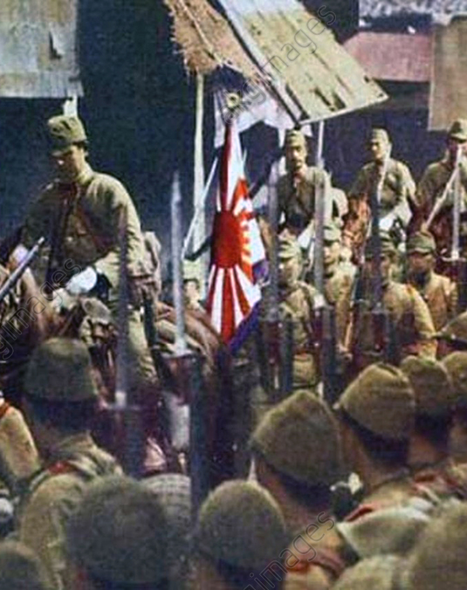
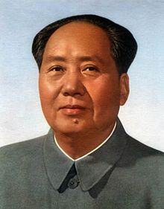
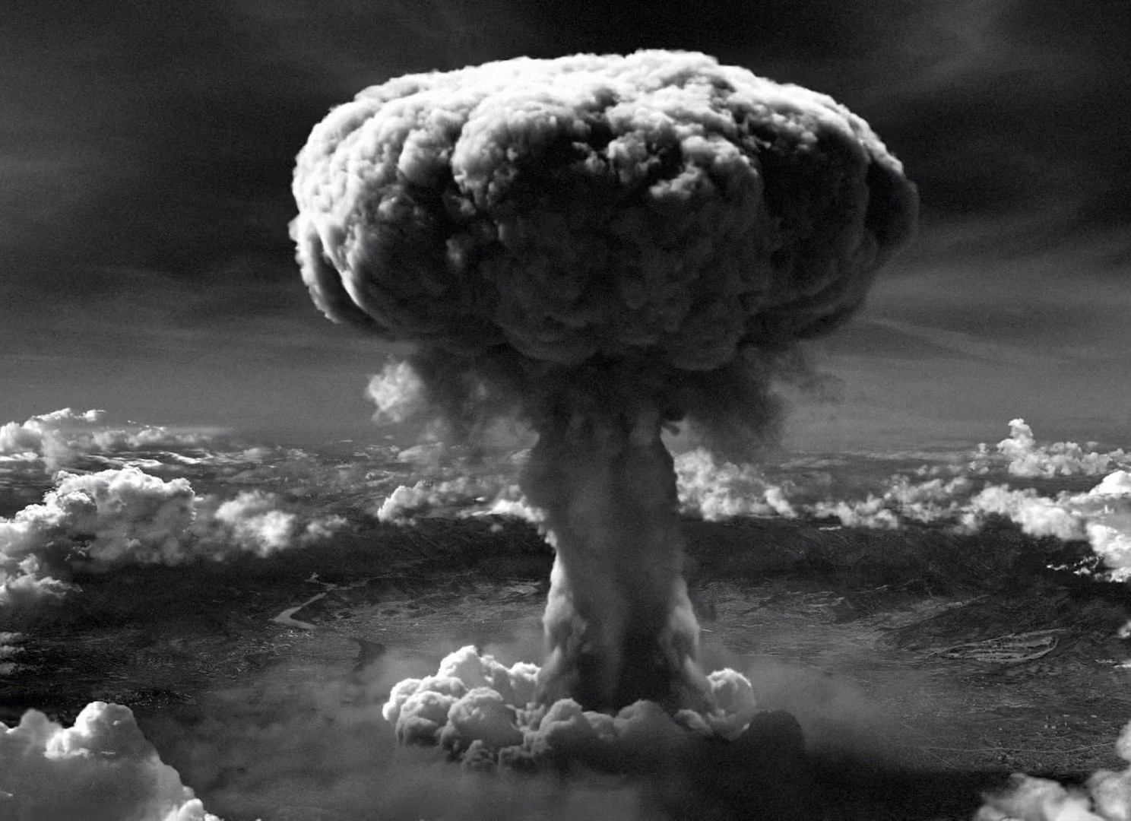
China 1940-1950
1941 – Japan and China at war (part of WWII), some sections of China under Japanese rule
1945 – America bombs Japan (Hiroshima, Nagasaki), Japanese retreat from China
1946-1948 – Civil war in China between communists and nationalists
1949 – Mao Zedong wins, establishes People’s Republic of China.
1958 – the “Great Leap Forward” a series of reforms intended to make China an industrial powerhouse. Ended up doing lots of damage & killing millions

Slide 5
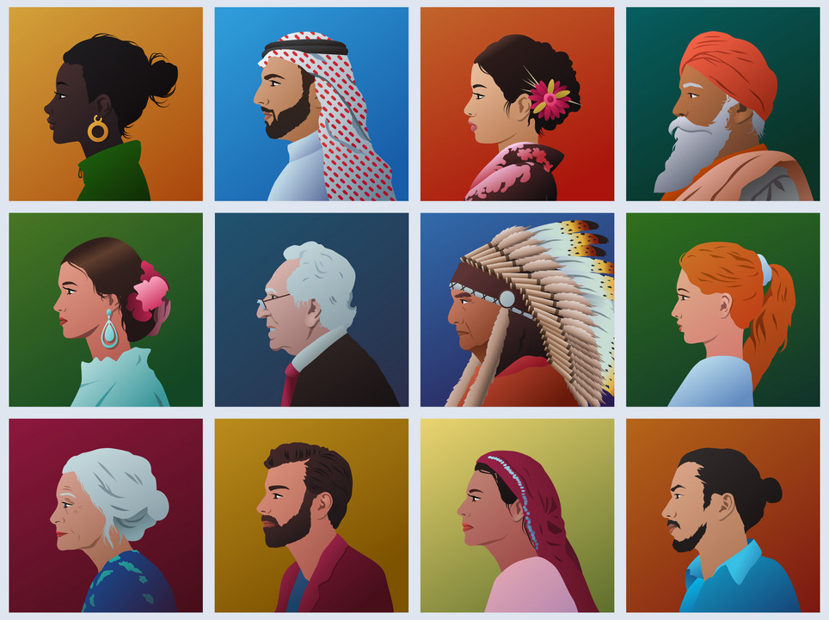
Cultural Diversity
Why Study Other Cultures?

Slide 6
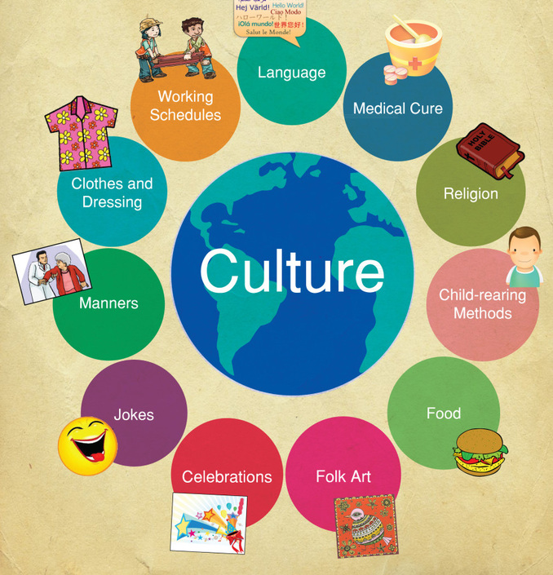
Brainstorm in Groups
Why is it valuable to study other cultures?

Slide 7
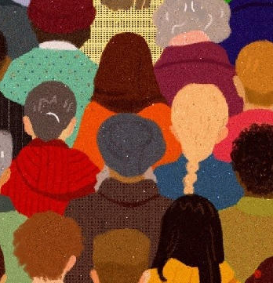
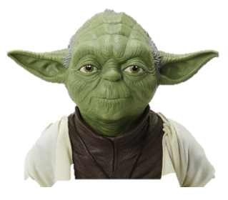
Value in Studying Other Cultures
Knowledge = respect
Human tendency to fear what we don’t understand
Understanding helps prevent conflicts based on race or ethnicity
“Fear leads to anger, anger leads to hate, hate leads to suffering”
Gives perspective
There is more than one way to see things
Makes you look at your own culture & customs in a new way
compare & contrast
think about reasons
Other customs or behaviours aren’t necessarily better or worse

Slide 8
Value in Studying Other Cultures
Become better employees, leaders & citizens
The world is becoming more multi-cultural
Understand people’s cultural background makes you better at working together with them
Helps you to preach the gospel to others
Appreciate that people from other cultures are individuals
Despite cultural differences, people are people
No matter their background, people have the same right to be respected and treated fairly
Understanding other cultures = less likely to use harmful or offensive stereotypes or generalisations

Slide 9
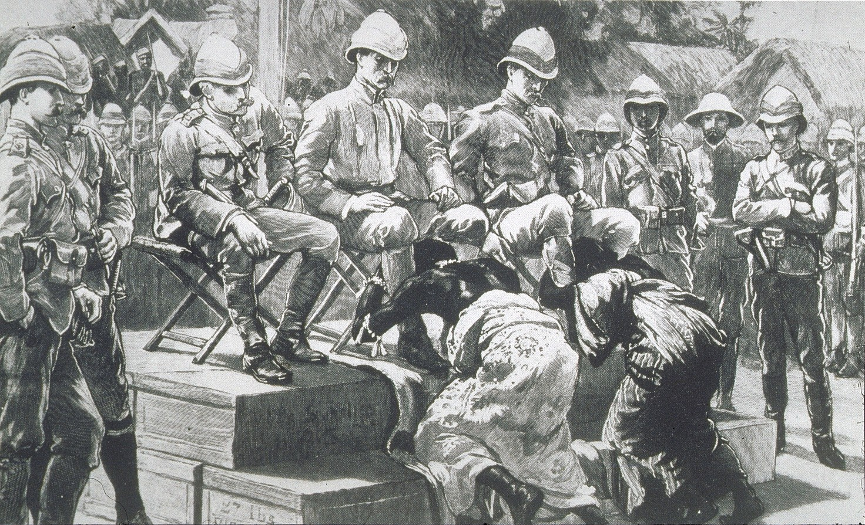
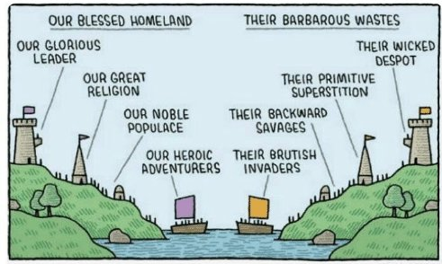
Ethnocentrism
Belief that your own culture is better than everyone else’s
Colonial mindset in Europe during 1800s-1900s
Other cultures were seen as uncivilized barbarians or savages
Believed white people were better, more advanced/evolved
Thought it was their responsibility was to educate & rule over them
Caused great harm and suffering
Many countries and people are still ethnocentric

Slide 10
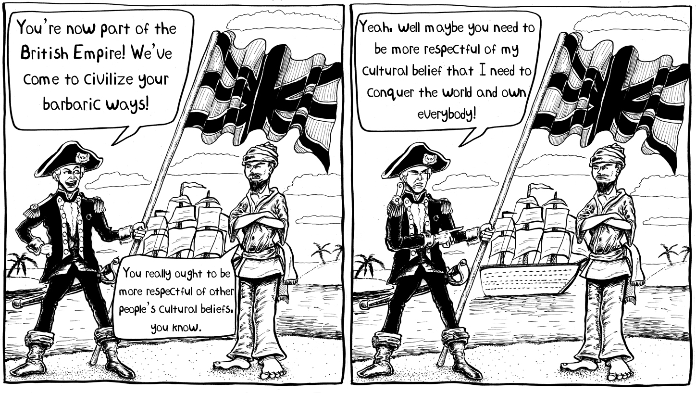
Cultural Relativism
This theory is the opposite of ethnocentrism
All beliefs, customs & ethics are relative and must be considered within cultural context
Can’t judge other cultures or say any practices are ‘better’ or ‘worse’
Right & wrong are different for different people
What’s right for them might seem wrong to us
Moral truth is subjective
Human rights violations are ‘cultural practices’ and must not be judged

Slide 11
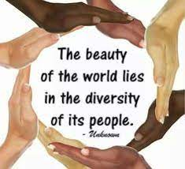
Basis for Judging Other Cultures
We SHOULD
Be accepting of different people and cultures
Try to understand & respect cultural traditions and customs
We should NOT:
Accept cultural customs that go against basic human rights, or against our moral and religious beliefs
We should NEVER:
Fight or kill other people whose beliefs we disagree with or don’t accept

Slide 12
Spiritual perspectives
Brainstorm in groups:
What attitude does God have towards different cultures?
What attitude did Jesus show towards other cultures?
What Bible verses/examples can you think of which give us advice on how to treat people from other cultures?

Slide 13
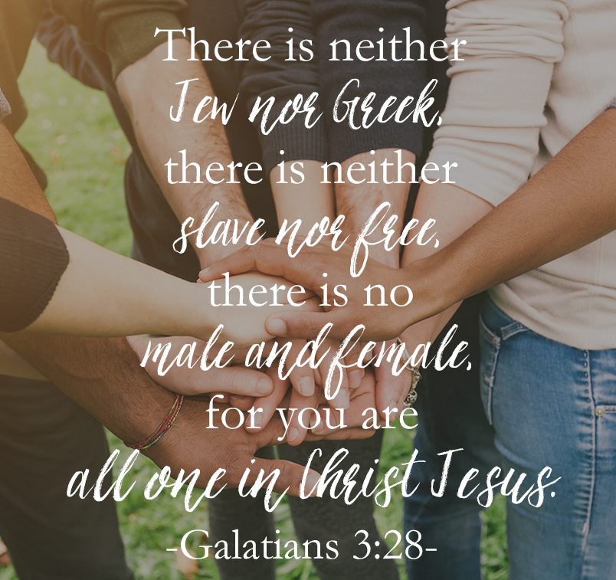
Examples & Quotes
God doesn’t judge based on culture
Gal 3:28 Neither Jew nor Greek, neither male nor female, neither bond nor free, but you are all one in Christ Jesus
Acts 10:34 God is no respecter of persons
However – God is angered by wicked cultural customs like burning babies
God accepted believers from countries that were enemies of His people
Rahab
Ruth
Cornelius
Egyptians – welcome to join Israel leaving Egypt
Nebuchadnezzar

Slide 14
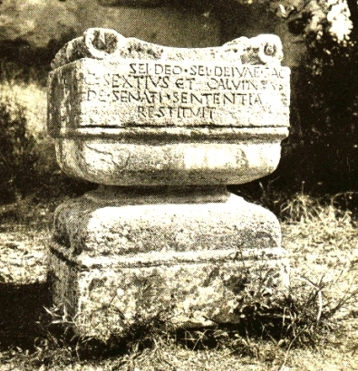
Examples & Quotes
Jesus:
Spoke to the Samaritan woman at the well
Told the story of a kind Samaritan to highlight the Jews’ cultural prejudice towards them
Paul - used the Altar to the Unknown God as an opportunity to preach – didn’t mock their culture but was respectful
Jonah – ethnocentric, God taught him to overcome this in order to preach
Aaron & Miriam – prejudiced against the Cushites, God punished them for this

Slide 15
Examples and quotes
Daniel
Didn’t practice cultural beliefs he didn’t agree with e.g. food offered to idols
Peter & the sheet of unclean animals
“What God has cleansed, don’t call unclean”
Romans 12:2 being transformed into what God wants you to be
we are all offered salvation despite cultural differences

