Slide 1
Writing style
The way the author tells the story
Choice of words/language
Use of techniques e.g. figurative language, description, emotive language
Intended to have an effect on the reader
Can change their understanding and interpretation of the novel

Slide 2
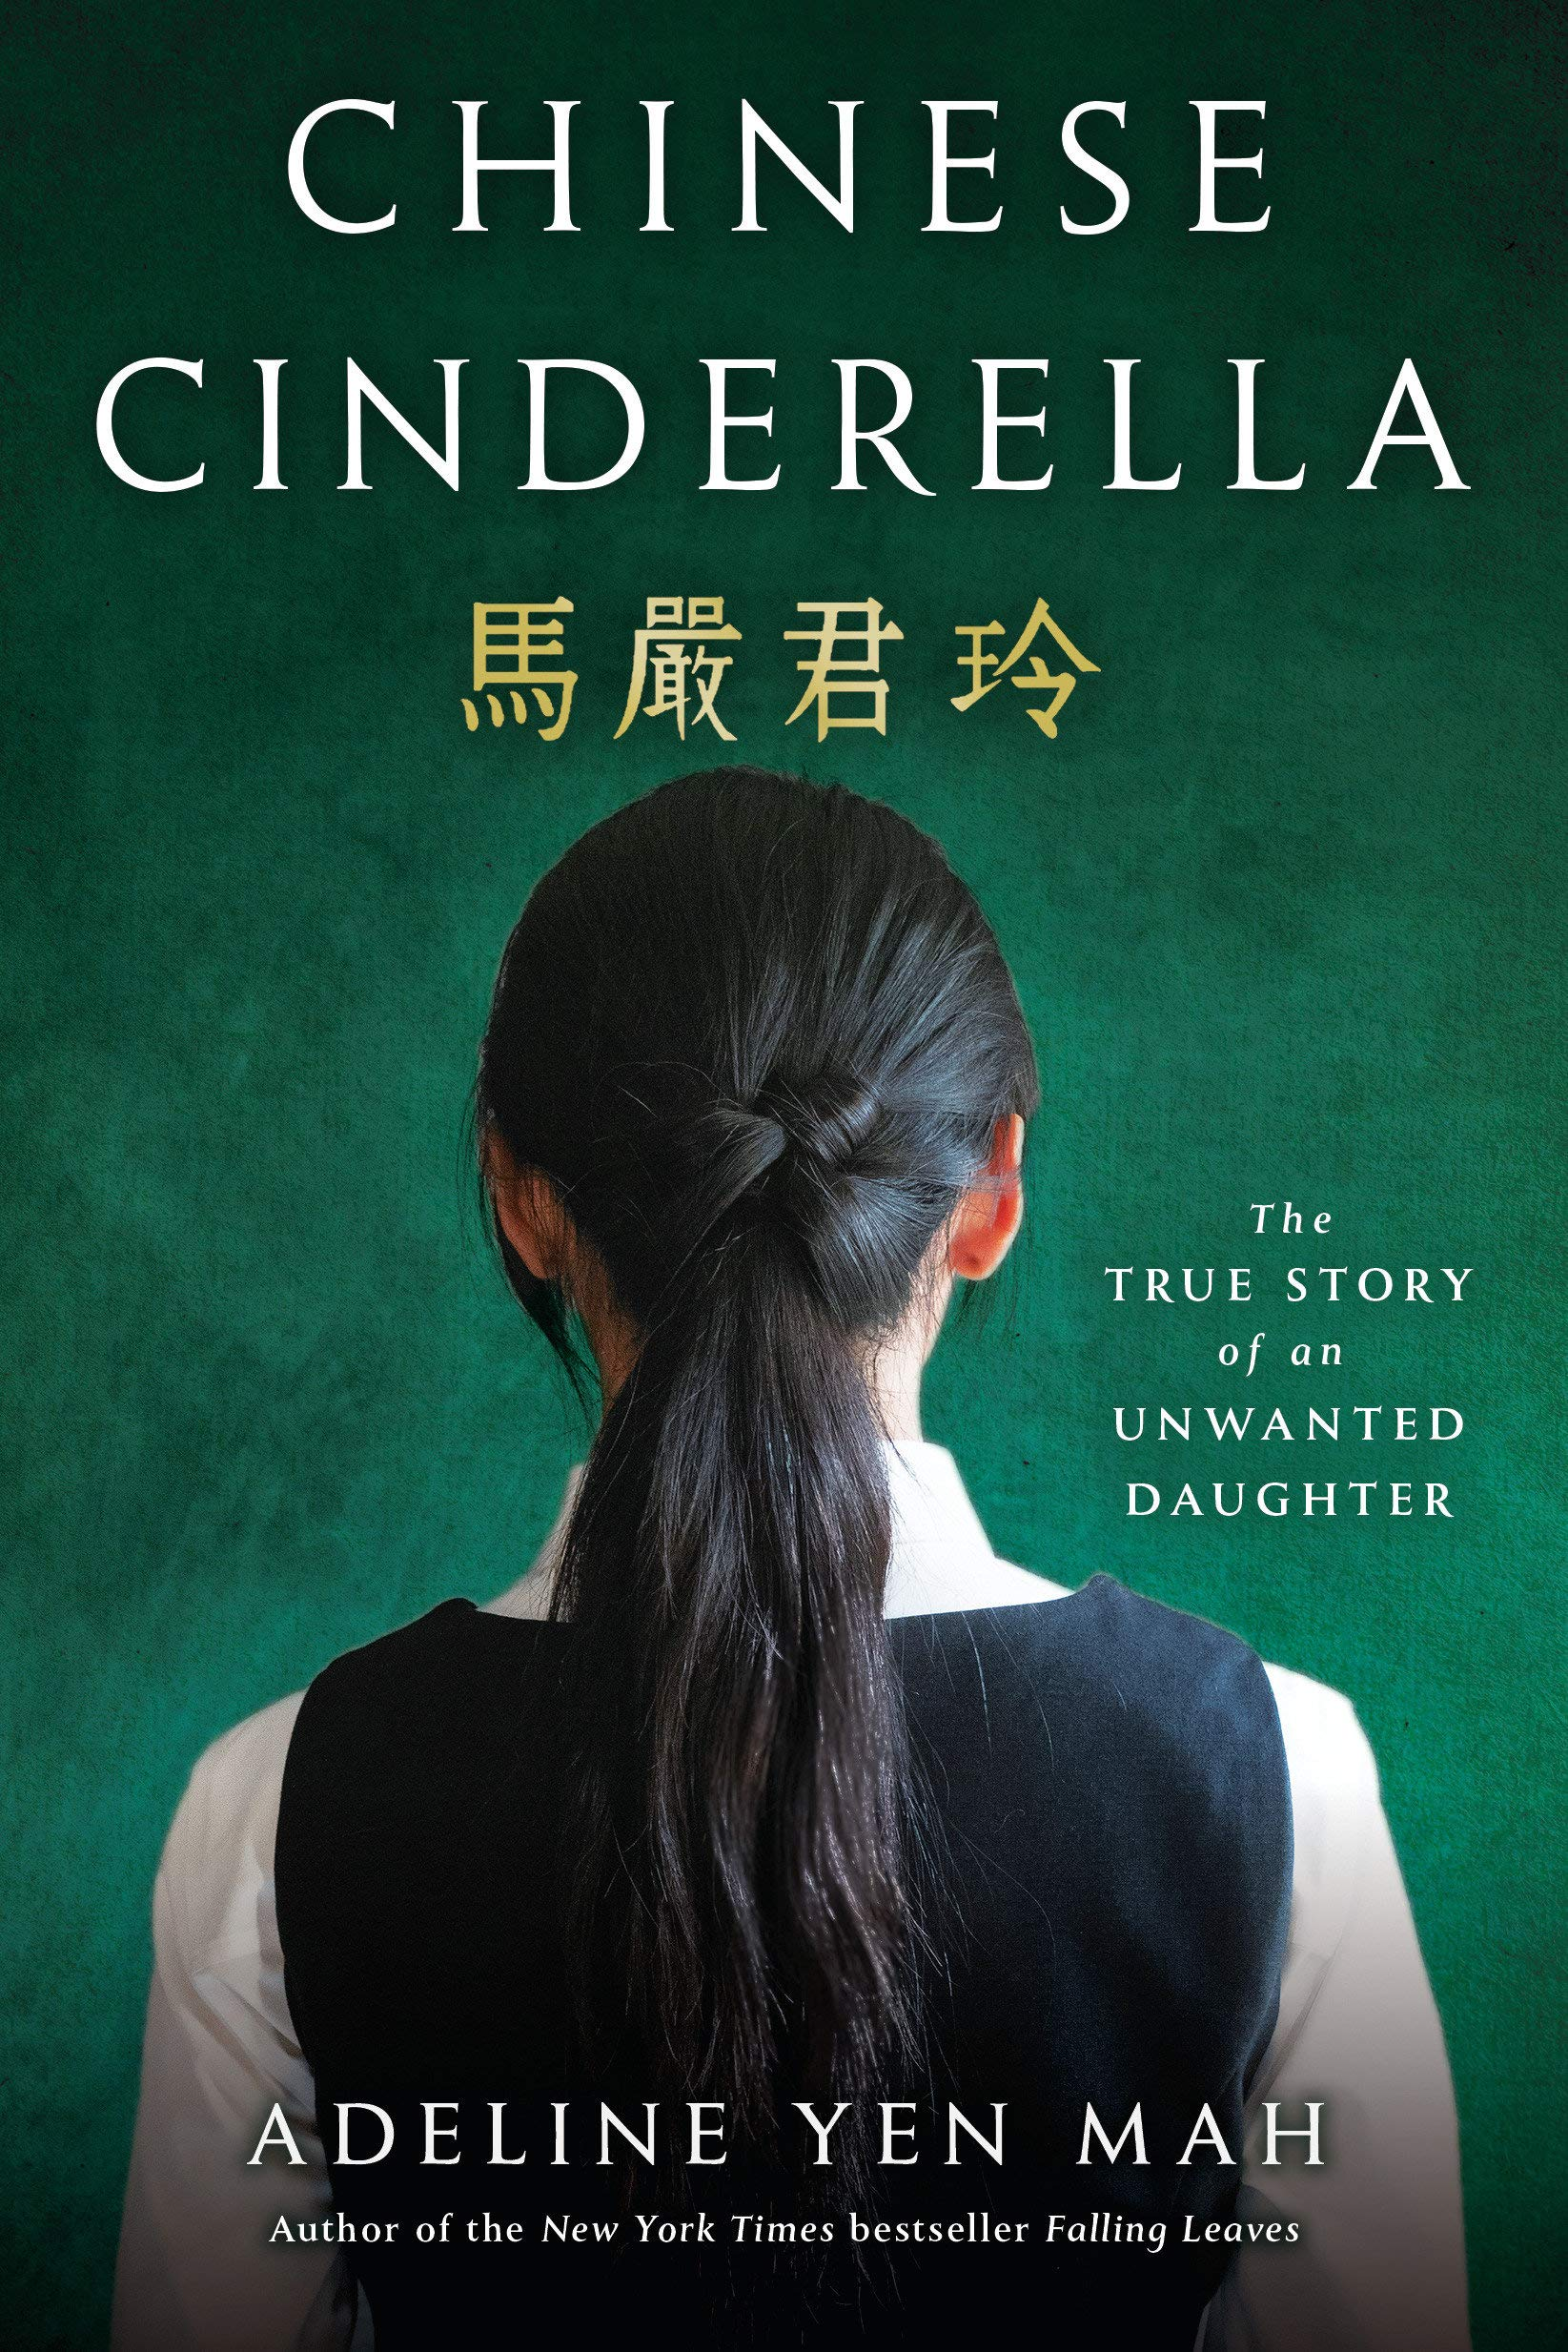
Style
Style Features Used in Chinese Cinderella

Slide 3
First Person Point of View
Story is told from the perspective of the main character.
Uses personal pronouns such as ‘I’, ‘my’ and ‘we’
Effect:
Helps the reader feel involved, as if they are being told the story directly from the author. As if Adeline is telling the story to us.
Example:
“I did as I was told. Though I was only four years old, I understood I should not ask too many questions.” (pg. 25)

Slide 4
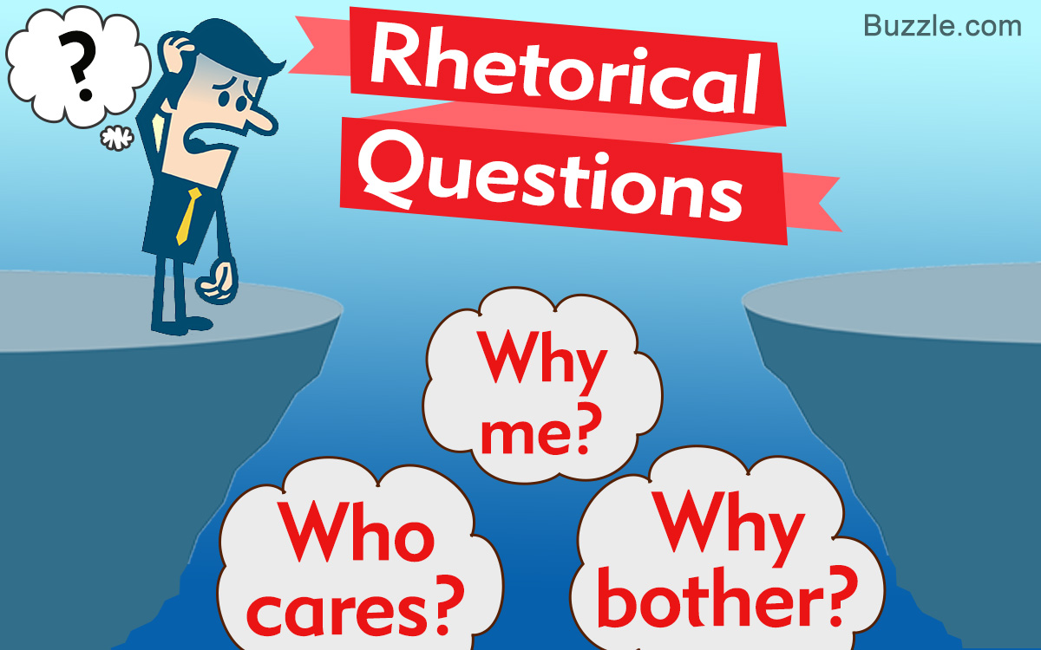
Rhetorical Questions
A question for which no answer is required
Effect:
Invite the reader to pause and consider the response so they are involved & interactive
Helps the reader understand the author’s internal voice and feel her anxiety and distress
Example:
“What will my friends say this time? How will my voters look at me? Will I be the laughingstock of my class? Will everyone sneer and whisper about me during recess?” (pg. 132)

Slide 5
Dialogue
Quoting exactly what the characters say to each other.
Effect:
Helps the reader imagine the characters speaking and ‘hear’ their voices.
Gives the reader clues about the personality and traits of the characters. You can tell a lot about people by the way they talk.
Do they use formal language or slang?
How do they speak to others?
Do they speak differently in front of people they respect?
Example:
“You don’t know because you are stupid! And you don’t deserve to wear this! …Take that! Medal winner! Teacher’s pet! Who do you think you are? Showing off week after week!”(pg. 12)

Slide 6
Connotations
Using words that bring to mind positive or negative emotions
Effect:
Suggests things without stating them directly
Helps the reader infer (guess, figure out) what the narrator thinks of the characters and their actions
Example:
Niang: “screaming futilely… again and again… in a piercing voice”.
“I looked at my grandfather, defeated and resigned with a blanket around his drooping shoulders in the blistering heat, his face contorted with sadness and anguish. A tired old man with no one to turn to…”

Slide 7
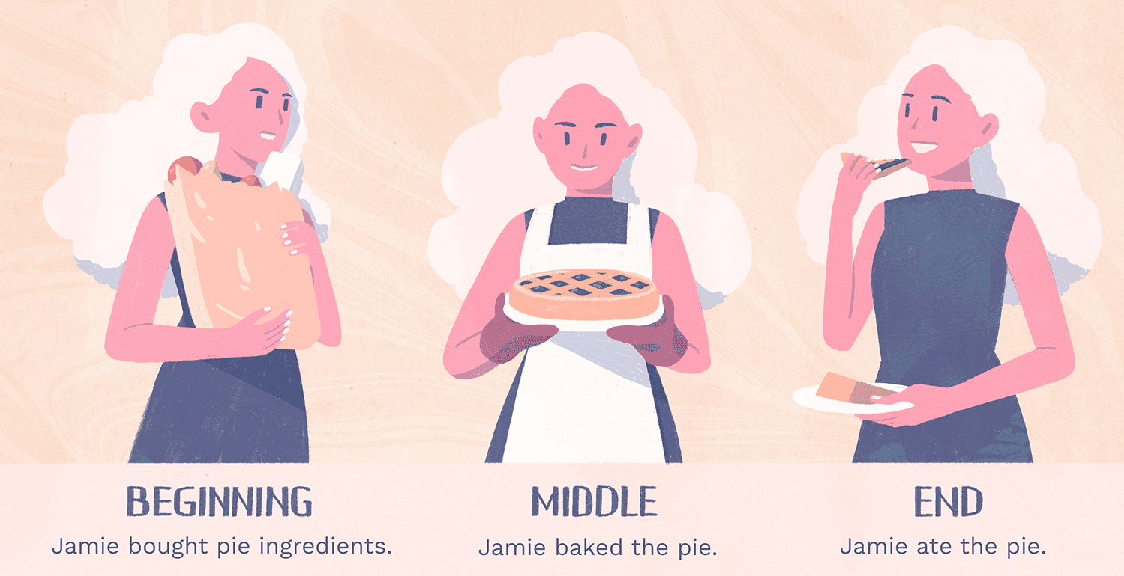
Chronological order
The story starts with some of Adeline’s earliest memories and lists the events in a linear (straight line) format.
No skipping forward or flashbacks
Effects:
Makes the story seem more realistic and believable
Easier to follow – less confusing
Not as surprising, dramatic, or suspenseful

Slide 8
Similes
Compares one thing to another using the words ‘like’ or ‘as’
Effect:
Helps to create a picture in the reader’s mind.
Example:
“…I lied, squirming like a worm” (pg. 111).
Adeline compares herself to a worm because she feels so uncomfortable and unhappy about lying to Niang.
Gives the reader mental image of her twisting with discomfort, like a worm trying to escape from a hungry bird by burrowing down into the earth.

