Slide 1
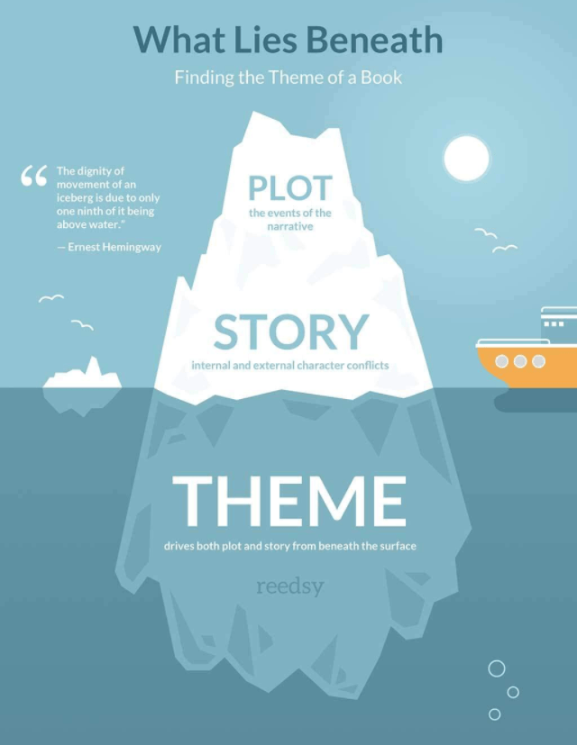
Themes

Slide 2
What is a theme?
An idea, lesson or message that is explored in a text
Different to the topic/subject
Usually comes up a number of times or re-occurs throughout the story
Themes are usually underlying (not directly stated)
All texts (books, movies, comics, stories) have themes

Slide 3
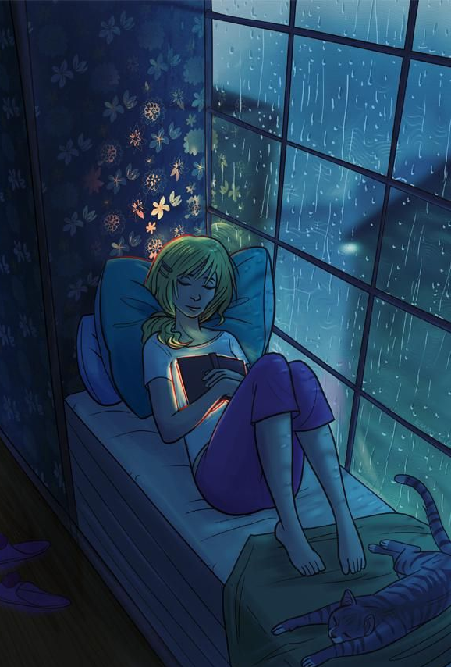
Why are themes important?
Helps the reader connect with the story
Relate to the characters
Recognise yourself or people you know
Care about what happens
Gives the reader something to take away
A message or lesson
An idea to consider
Think about life - why people act the way they do, what makes us who we are, what’s important to you etc

Slide 4
How to recognise themes
Think about the story as a whole. Look at the ‘big picture’ rather than just plot events
Wonder about the author’s message or why they shared this story
Look for incidents, situations or scenes that happen more than once in the story
Look for reoccurring symbols (physical objects that might represent an idea)
Balloons = hope
Mockingbird = innocence
Yellow brick road = opportunity, journey

Slide 5
Common themes in literature
Good vs evil (Harry Potter)
Love or Relationships
Family (Little Women)
Forbidden or unrequited (Romeo & Juliet, Phantom of the Opera)
Friendship (Lord of the Rings)
Redemption (A Christmas Carol, The Grinch)
Coming of age (To Kill a Mockingbird)
Revenge (The Count of Monte Cristo)
Survival (The Hatchet)
Courage or Triumph of Human Spirit (A Wrinkle in Time)

Slide 6
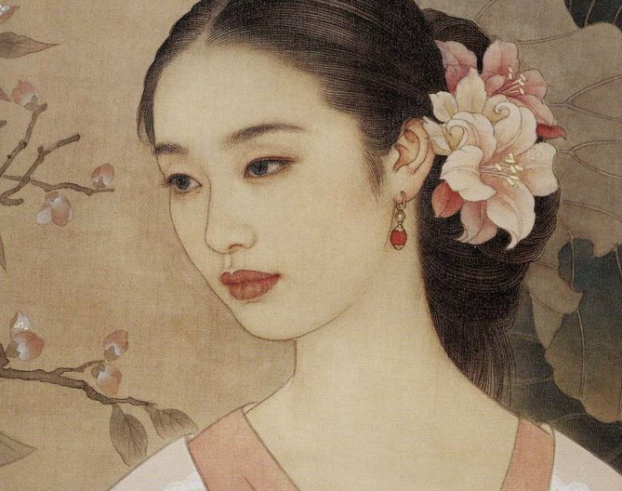
Themes in Chinese Cinderella

Slide 7
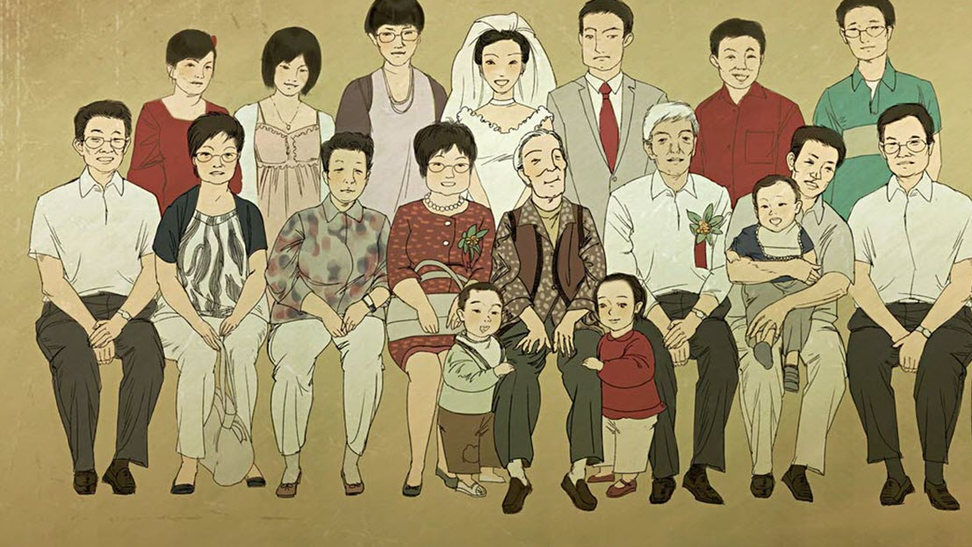
Family & Relationships
Adeline is ignored and/or disliked by her family,
Blamed for death of her mother – ‘bad luck’ (pg. 3)
Excluded by her siblings – think she is ‘showing off’
No friends her own age that she confides in
Keeps herself apart from others & pretends she is happy at home
Physical & psychological abuse from Niang
Relationship with father exists only through school performance or misbehaviour
He doesn’t know her birthday & forgets her name at one point
Aunt Baba & Ye Ye support Adeline
This helps her cope
Both encourage education as well

Slide 8
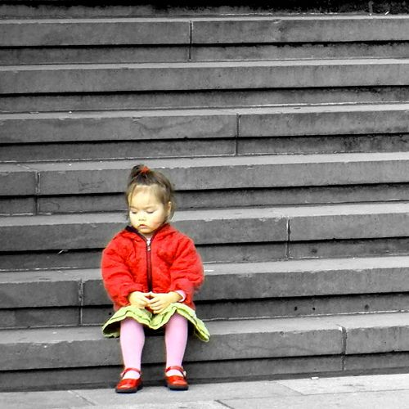
Abandonment and loneliness
Often taken away from only people she is close to e.g. Aunt Baba.
Sent to boarding school in Tianjin, nearly forgotten by family
Only time she feels needed is by her pet duck PLT
‘It comforted me to know I was needed.’ (page 84)
This is taken from her too when PLT is killed by Jackie
Feels she can’t confide in school friends about her family situation

Slide 9
Self Esteem
Adeline’s abusive and neglectful childhood affects her sense of self-worth
Made to feel constantly on the outside by her family
Rarely included in the family circle
Thrilled whenever they include her even slightly
Cruel pranks, unkindness & betrayal
Despite the trauma she endures, she eventually comes to realise:
Her self-worth is based on her own abilities and strengths
She can create her own future without the approval or acceptance of her family

Slide 10
The Power of Stories
Through reading and writing stories, Adeline can:
Hear other people express the emotions she feels
Understand she’s not alone
Escape from the horrors of her daily life
Re-shape the world around her
Reimagine herself as bold and powerful rather than powerless and afraid
This demonstrates the power of stories
Can play an important role in helping individuals process and handle abuse or trauma
Can counteract negative messages received from others

