Slide 1
Year 9 Vocab
Term 2, Week 1

Slide 2
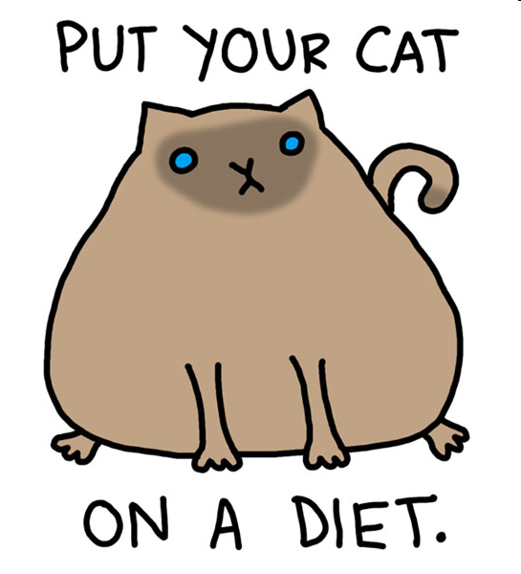
corpulent
Part of Speech: adjective
Meaning: Having a large, bulky body; obese
Charlie’s corpulent cat could not jump up onto the couch.

Slide 3
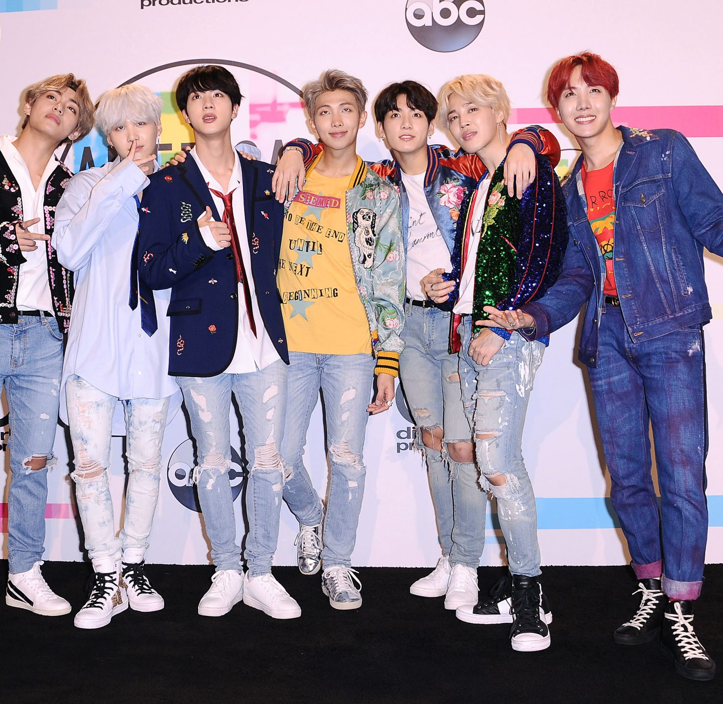
Effeminate
Part of speech: adjective
Meaning: unmanly; having feminine qualities of appearance or manner that are not typical of a man
Korean pop stars often dress and act in a way that Western men would see as effeminate.

Slide 4
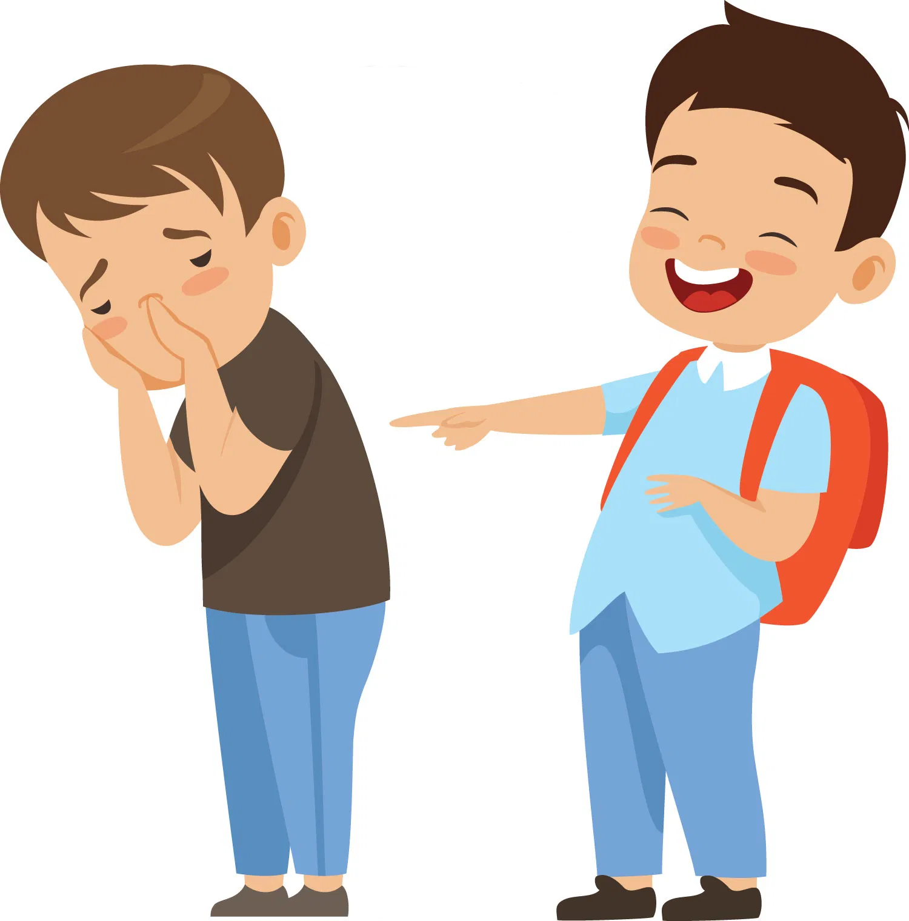
Derisive
Part of speech: adjective
Meaning: mocking; showing ridicule, scorn or contempt.
“I can’t believe how dumb you are!” said Bill with derisive laughter.

Slide 5
manifest
Part of speech: verb
Meaning: to make clear or obvious by signs or actions; to show.
She continues to manifest signs of nervousness such as nail-biting.

Slide 6
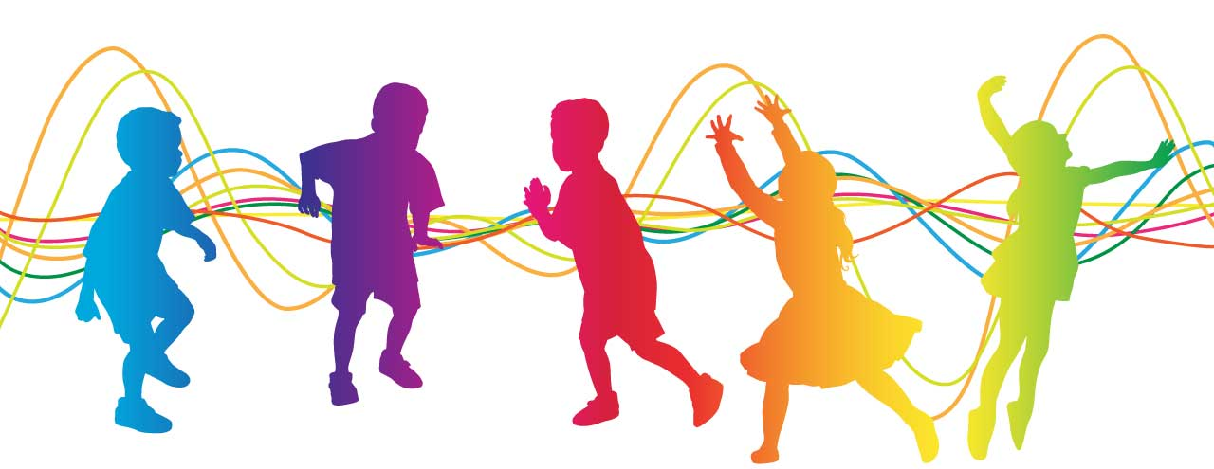
jocund
Part of speech: adjective
Meaning: cheerful and light-hearted; merry
The jocund music put everyone in a happy mood.

Slide 7
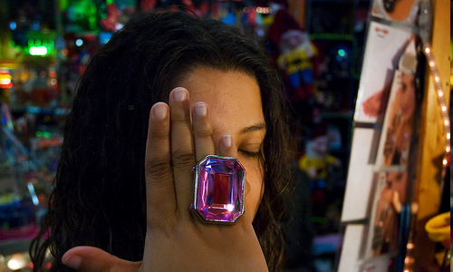
ostentatious
Part of speech: adjective
Meaning: showy; trying to impress or get attention, usually by flashing wealth or possessions.
Tanya wore her most ostentatious jewellery to the party to display her wealth.

Slide 8
Sanguine
Part of speech: adjective
Meaning: positive or cheerful, especially in a bad situation; optimistic.
He’s remarkably sanguine for someone whose company just went bankrupt.

Slide 9
strident
Part of speech: adjective
Meaning: loud and harsh sounding; too forceful or opinionated
Playing strident music late at night might annoy your neighbours.
At the meeting he aired so many strident opinions that nobody else could get a word in.

Slide 10
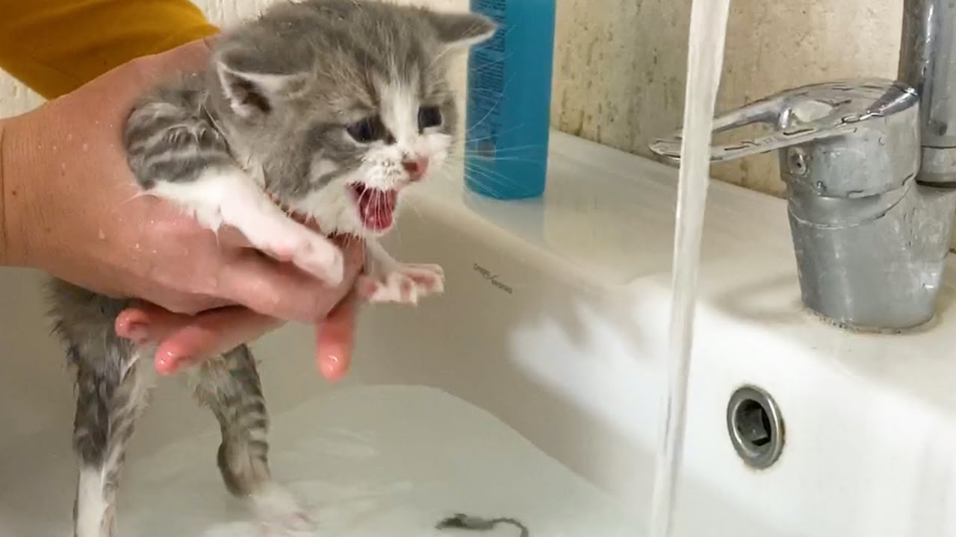
vehement
Part of speech: adjective
Meaning: showing strong feeling; forceful; passionate or intense.
Fluffy made a vehement protest when we tried to give her a bath.

Slide 11
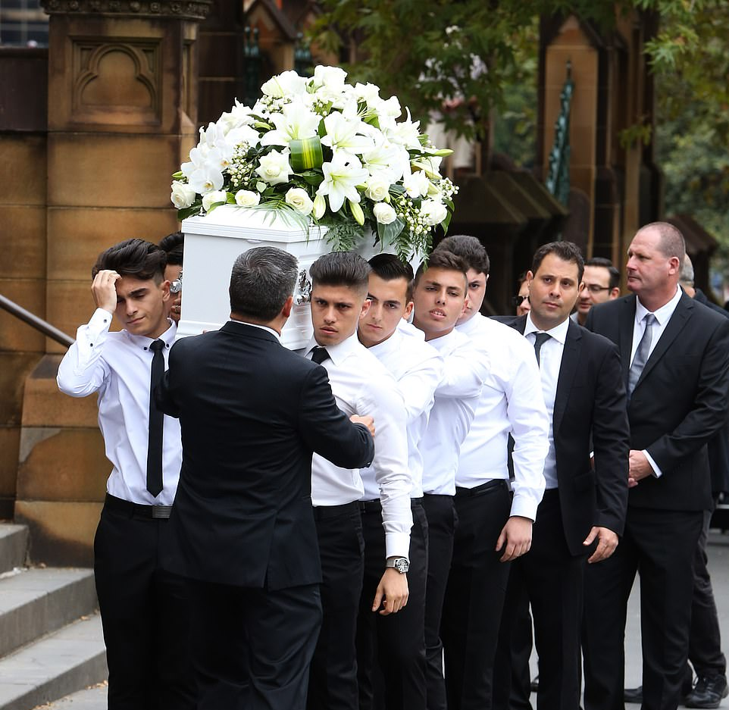
Elegy
Part of speech: noun
Meaning: a speech or poem expressing sorrow for someone who has died
When his best friend died in a car accident, Matthew wrote an elegy and read it at the funeral.

