Slide 1
Year 9 Vocab
Term 2, Week 2

Slide 2
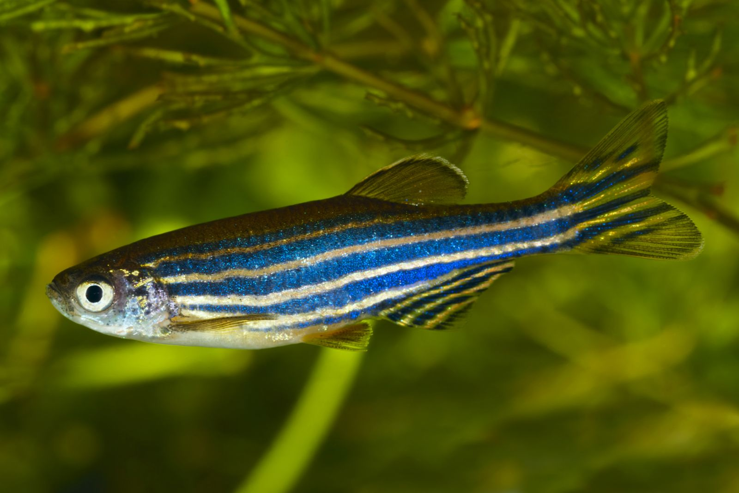
Fecund
Part of speech: adjective
Meaning: fertile or productive; fruitful in offspring or vegetation
Zebrafish are highly fecund and can lay 200 eggs per clutch.

Slide 3
Fortuitous
Part of speech: adjective
Meaning: fortunate, lucky
Some people believe four-leaf clovers are fortuitous.

Slide 4
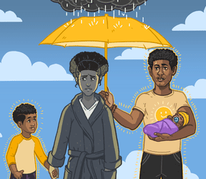
Malady
Part of speech: noun
Meaning: a disease or disorder of the body or mind; a serious problem
Depression is a malady that can strike even those whose lives seem perfect.

Slide 5
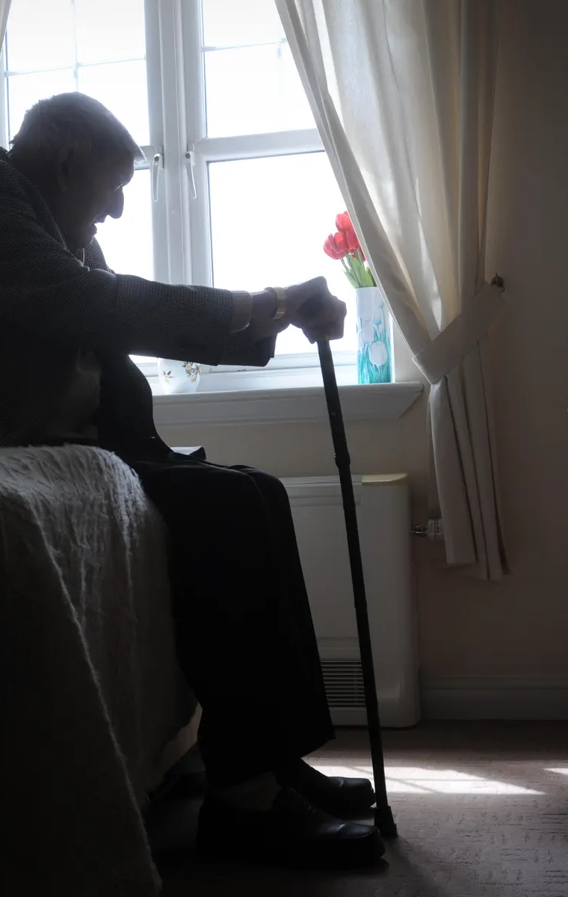
Infirmity
Part of speech: noun
Meaning: frailness caused by illness or old age; physical weakness.
Bob’s infirmity made it impossible for him to go to the meeting on Sundays.

Slide 6
Profligate
Part of speech: adjective
Meaning: wild; excessive and without restraint
Our profligate consumption of natural resources has caused global warming.

Slide 7
Nuance
Part of speech: noun
Meaning: a very slight difference, or a tiny detail that is hard to notice
Because she is a chef, she notices every nuance of flavour in her meal.

Slide 8
Remonstrance
Part of speech: noun
Meaning: a complaint; a strong protest or criticism.
Donna ignored her mother’s remonstrance about the state of her bedroom.

Slide 9
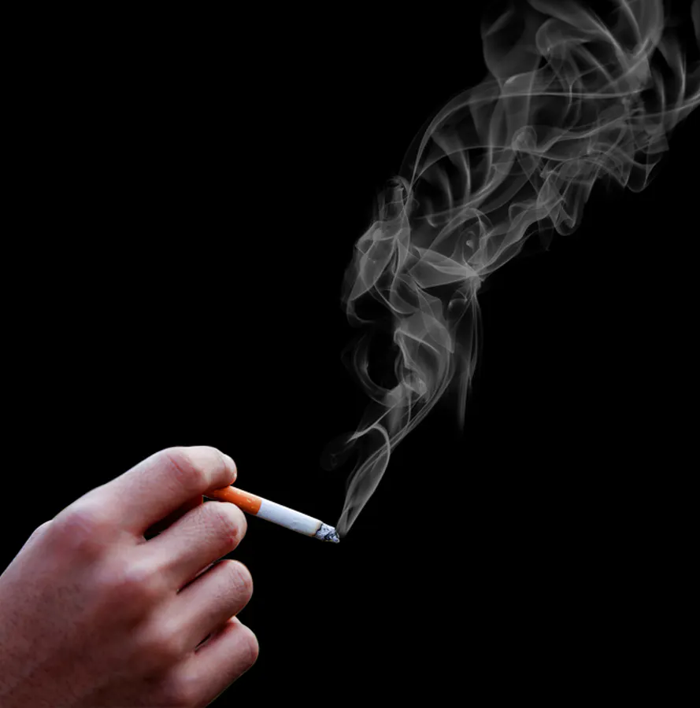
Vitiate
Part of speech: verb
Meaning: to destroy or damage something; to spoil or weaken; to reduce in value
Smoking vitiates the air and damages people’s lungs.

Slide 10
Scintillate
Part of speech: verb
Meaning: to sparkle; to perform brilliantly or be very lively and clever; to fascinate
Paula is an amazing actress who never fails to scintillate the audience.

Slide 11
Analogy
Part of speech: noun
Meaning: a comparison between two things with similar features, used to explain or make a point
In her analogy, the writer compared music to colour.

