Slide 1
Year 9 Vocab
Term 2, Week 3

Slide 2
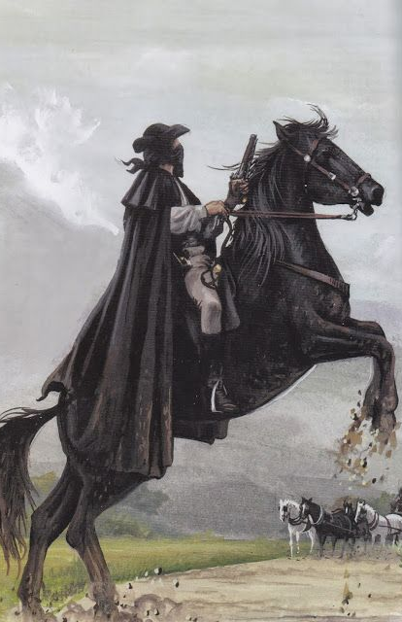
Brigand
Part of speech: noun
Meaning: a bandit; one who lives by stealing, usually as a member of a band
The brigand robbed us at gunpoint when we travelled by coach.

Slide 3
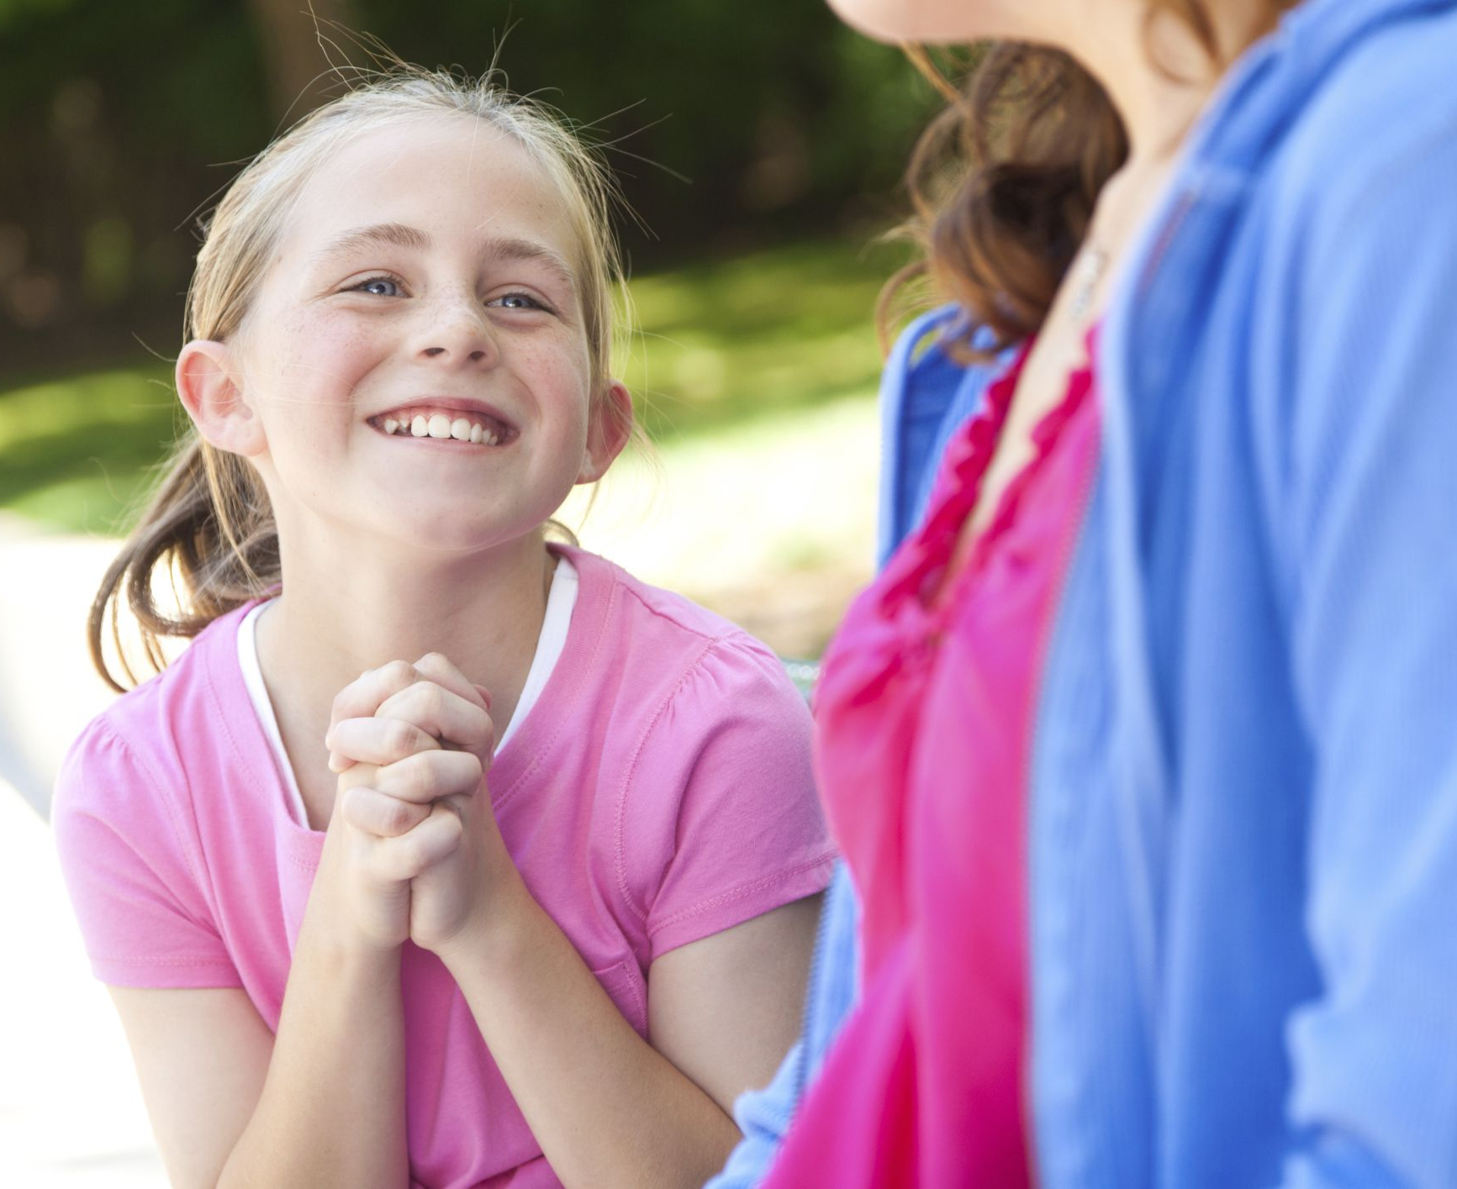
Emissary
Part of speech: noun
Meaning: a representative or ambassador; someone sent on a diplomatic mission
My friend sent me as an emissary to ask her Mum whether we could have a sleepover.

Slide 4
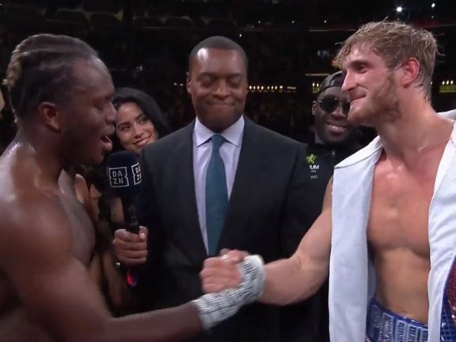
Magnanimous
Part of speech: adjective
Meaning: generous or forgiving, especially towards a rival
The boxer was magnanimous in victory and praised his opponent’s technique.

Slide 5
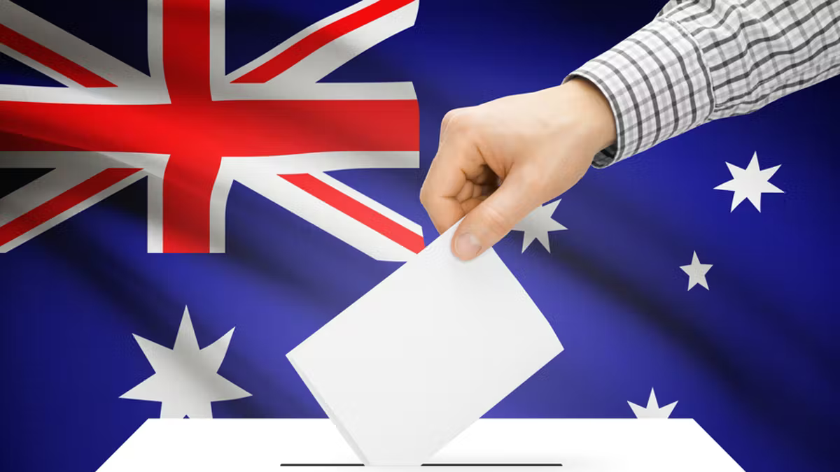
Mandatory
Part of speech: adjective
Meaning: required (by law or rules); compulsory; not optional.
It is mandatory for all Australian citizens to vote, unless they can provide a valid reason not to.

Slide 6
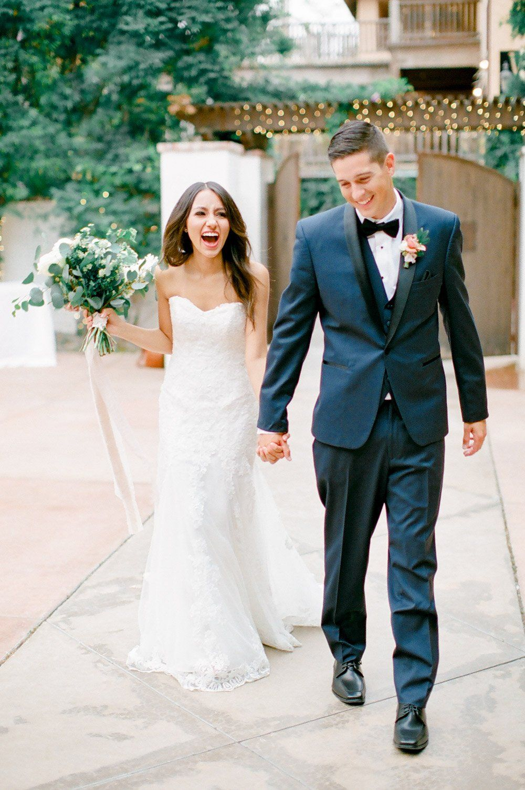
Felicity
Part of speech: noun
Meaning: great happiness; bliss
Their felicity was evident from the radiant expressions on their faces.

Slide 7
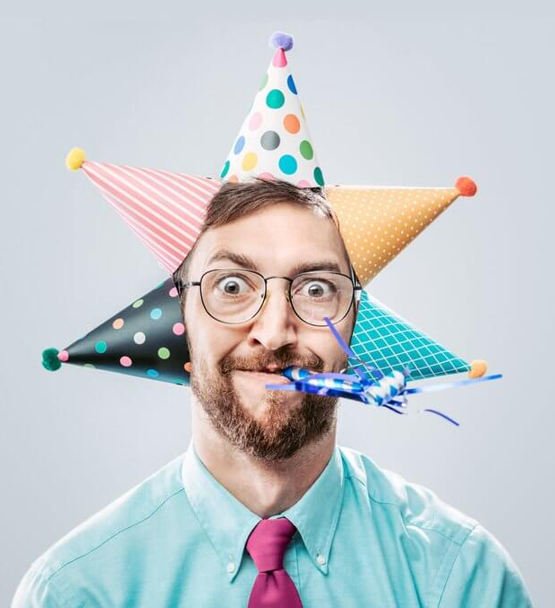
Repartee
Part of speech: noun
Meaning: a quick and witty reply
His jokes and funny repartees made him a popular guest at parties.

Slide 8
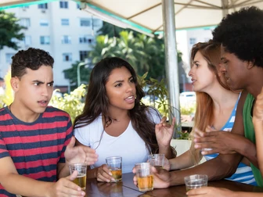
Incendiary
Part of speech: adjective
Meaning: inflammatory; tending to start fires or stir up conflict.
Harry’s incendiary comment started a huge argument.

Slide 9
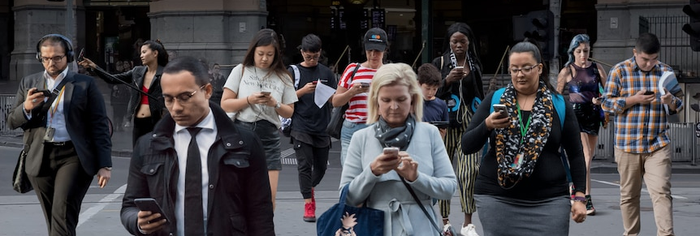
Ubiquitous
Part of speech: adjective
Meaning: widespread; found everywhere
Mobile phones have become ubiquitous in the last few decades.

Slide 10
Countenance
Part of speech: noun
Meaning: a person’s face or facial expression
A merry heart makes a cheerful countenance – Prov 15:15
I tried to see if he was joking, but his countenance gave nothing away.

Slide 11
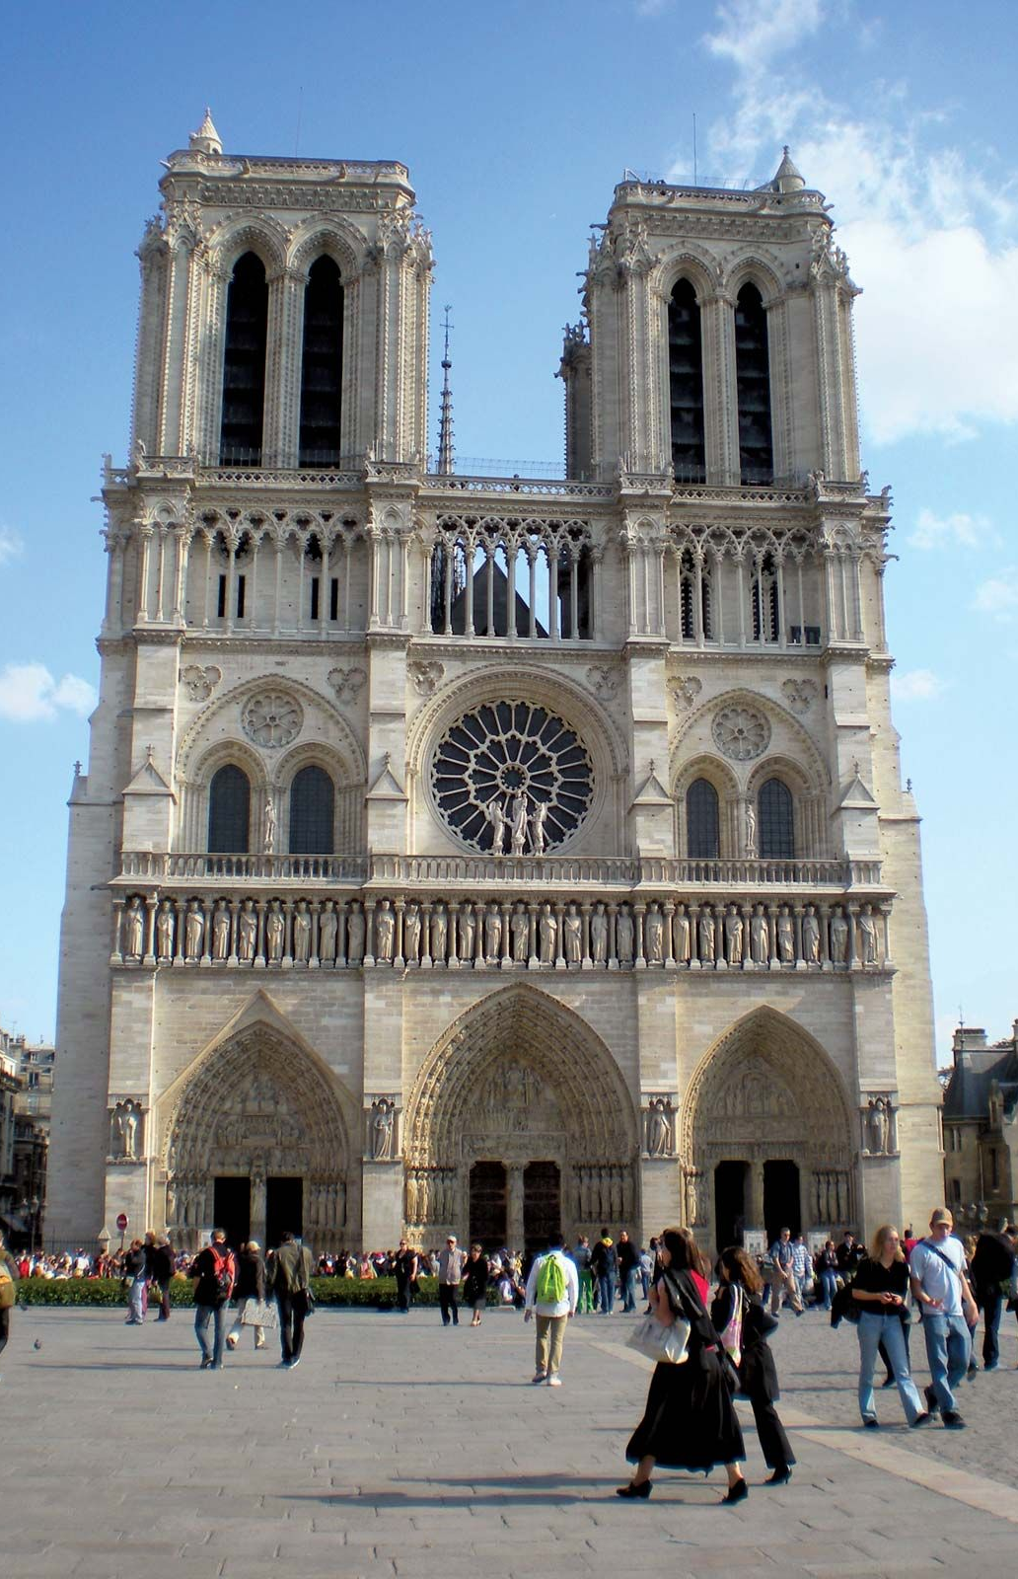
Venerable
Part of speech: adjective
Meaning: deserving respect because of great age or achievements
The cathedral of Notre Dame is a venerable building.

