Slide 1
Year 9 Vocab
Term 2, Week 6

Slide 2
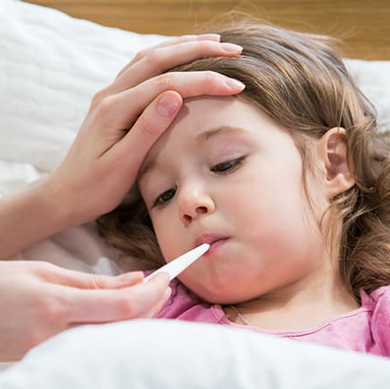
Febrile
Part of speech: adjective
Meaning: caused by a fever; feverish
Febrile seizures are common in children under five.

Slide 3
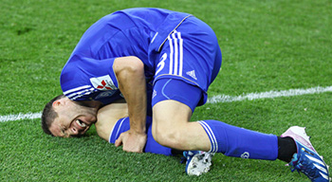
Writhe
Part of speech: verb
Meaning: to squirm or twist in discomfort or pain
The terrible injury made him writhe in agony.
She writhed with embarrassment when the teacher read out her poem.

Slide 4
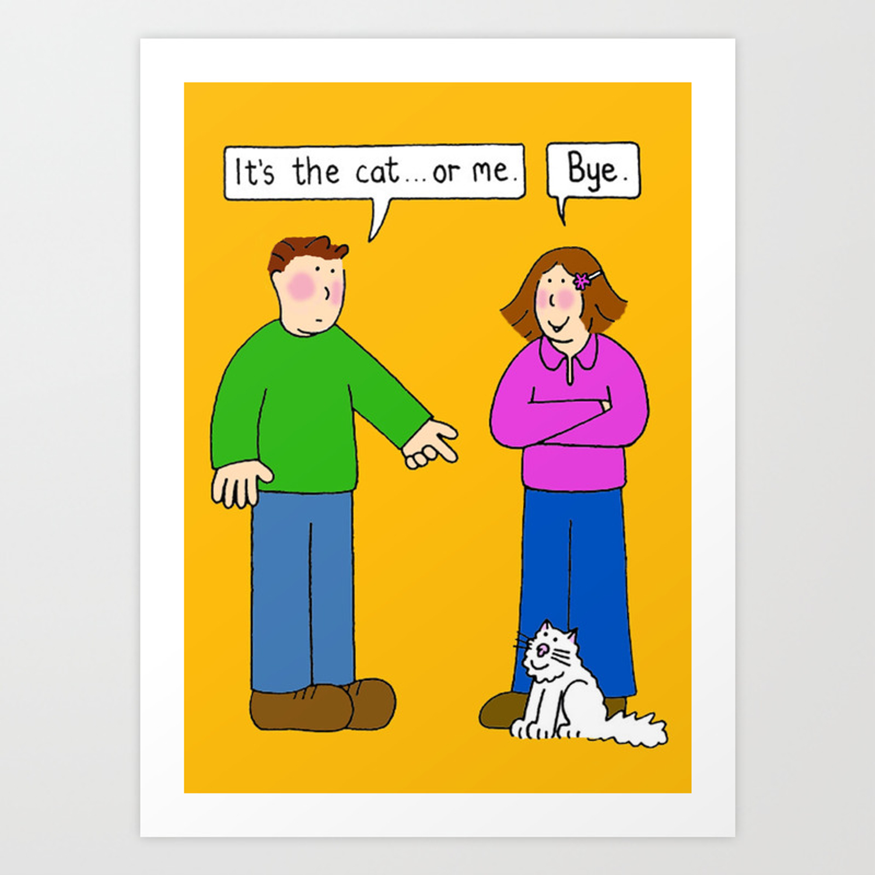
Ultimatum
Part of speech: noun
Meaning: a final demand; a warning that consequences will follow if conditions are not met
Josh gave her an ultimatum – him, or the cat.

Slide 5
Pernicious
Part of speech: adjective
Meaning: having a harmful effect or influence, especially in a slow and subtle way
Needle grass is a pernicious weed that can take over your garden.

Slide 6
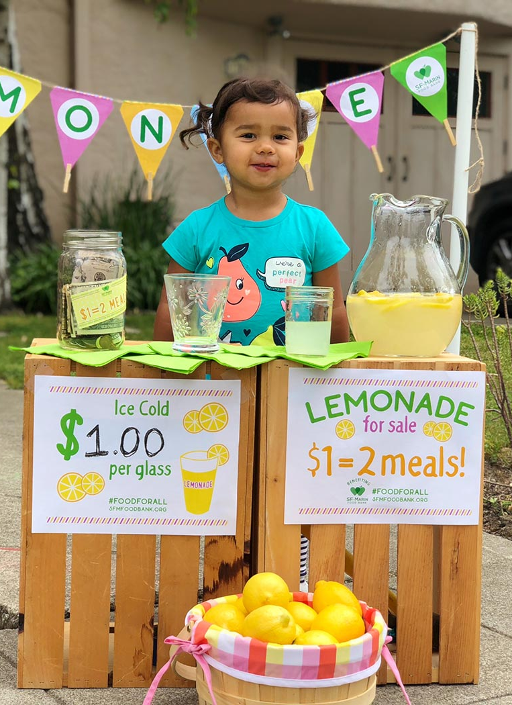
Astute
Part of speech: adjective
Meaning: quick to understand things and figure out how to use them to your advantage; clever and perceptive
My sister is an astute saleswoman.

Slide 7
Furtive
Part of speech: adjective
Meaning: sneaky, secretive; trying not to be noticed or seen
He stole a furtive glance at his neighbour’s test.

Slide 8
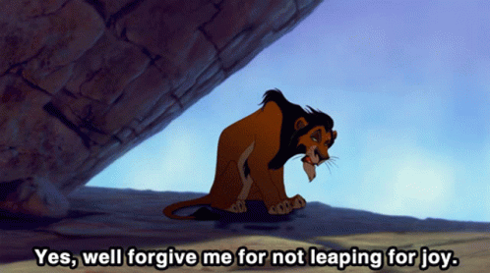
Sardonic
Part of speech: adjective
Meaning: grimly mocking; cynical; sarcastic.
Scar has a very sardonic way of talking.

Slide 9
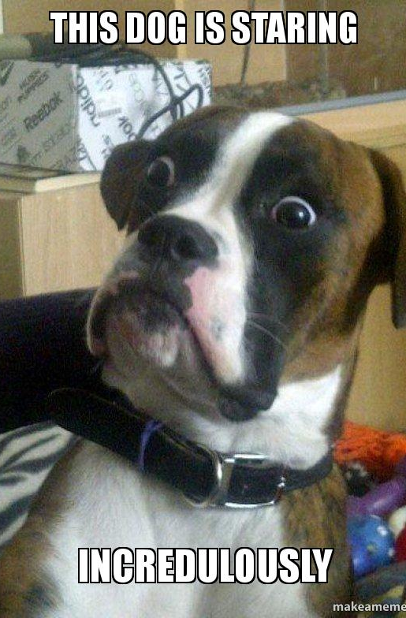
Incredulous
Part of speech: adjective
Meaning: disbelieving; unwilling to accept something is true
My dog gave me an incredulous look when I sneezed.

Slide 10
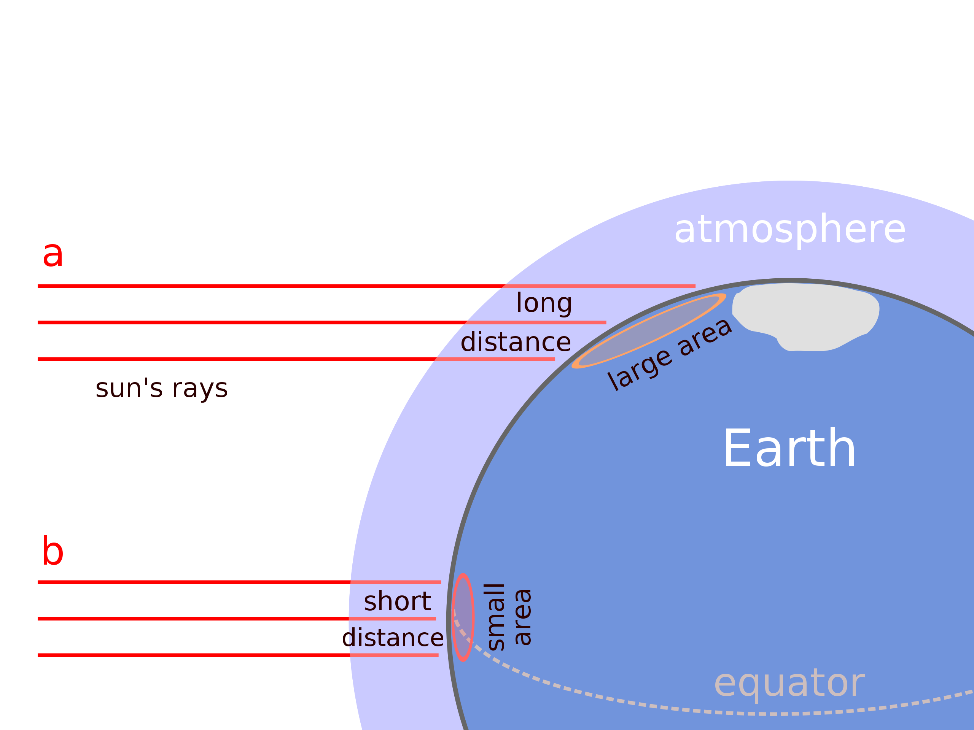
Obliquely
Part of speech: adverb
Meaning: indirectly; not in a straightforward way
Near the North Pole, the sun’s rays hit the Earth obliquely.
He referred obliquely to current events in his talk.

Slide 11
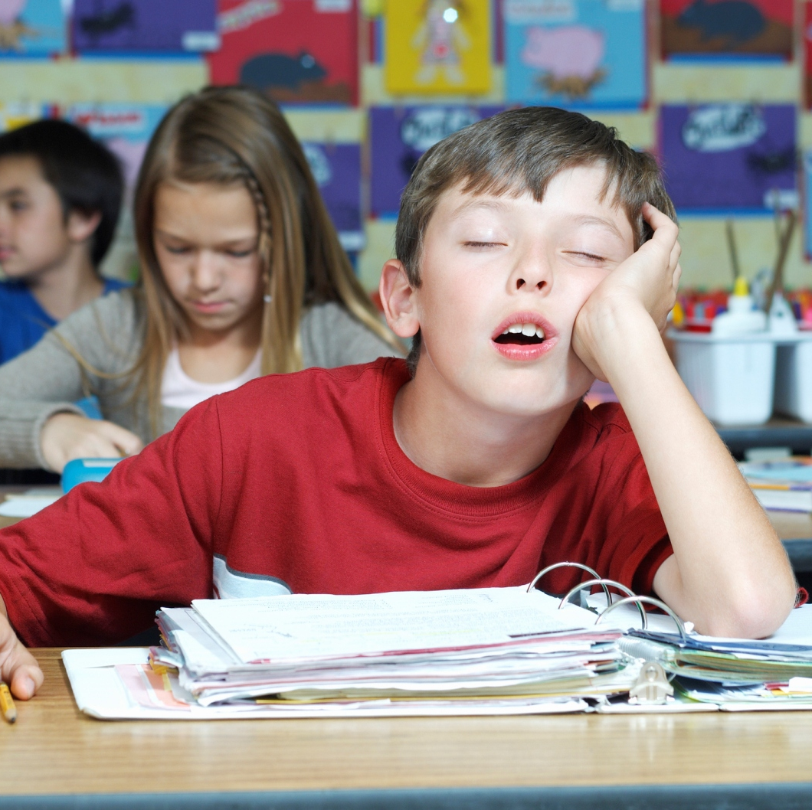
Interminable
Part of speech: adjective
Meaning: long and boring; seeming to go on forever
I fell asleep in that interminable English lesson.

