Slide 1
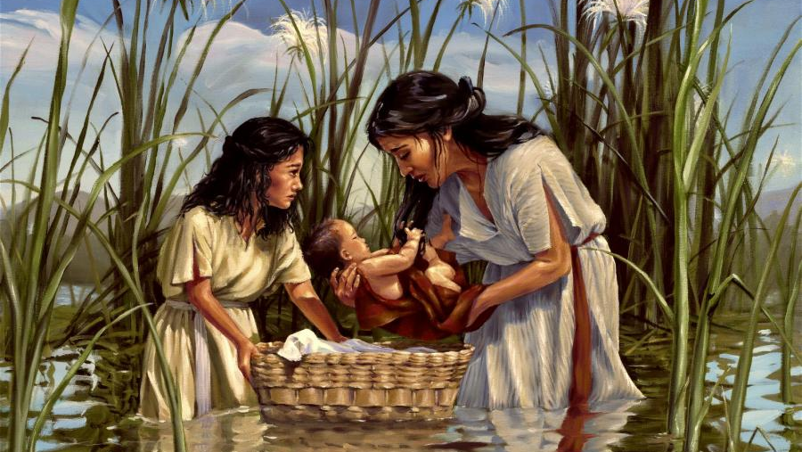
Year 9 Vocab
Term 2, Week 8

Slide 2
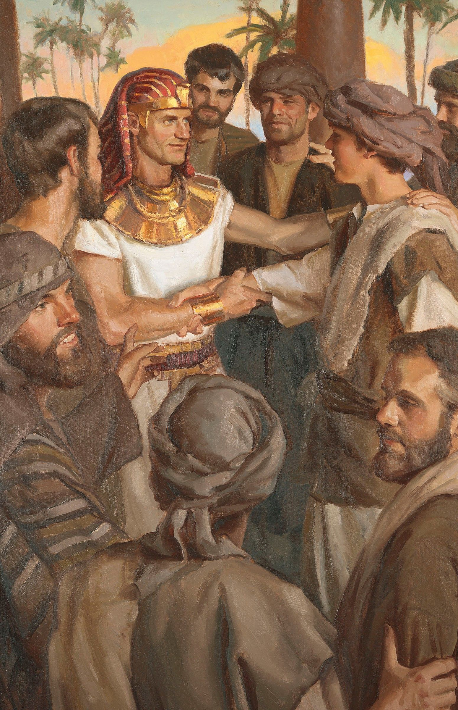
Providence
Part of speech: noun
Meaning: the protective care of God – can also mean forethought, preparing in advance for future events
It was through divine providence that Joseph was sent to Egypt.
Seeing that very worthy deeds are done unto this nation by thy providence, we accept it always, and in all places, most noble Felix, with all thankfulness (Acts 24:2)

Slide 3
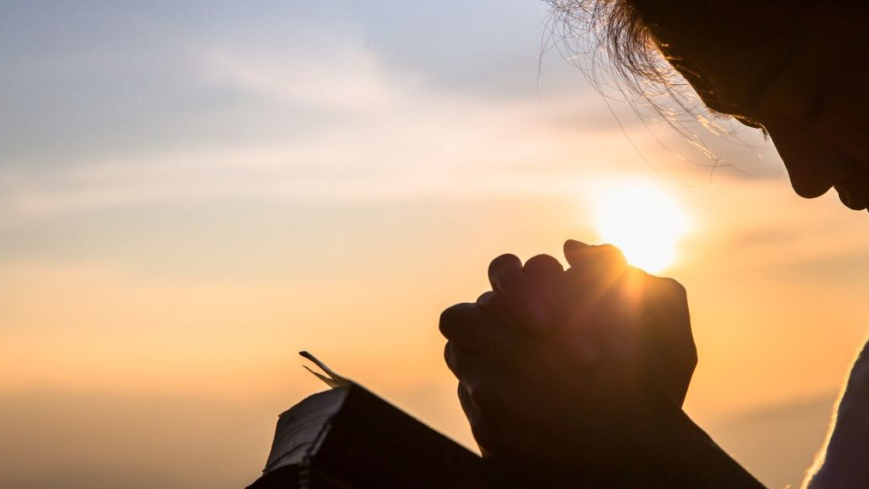
Intercession
Part of speech: noun
Meaning: a prayer or request on behalf of someone else
“He (Christ) ever liveth to make intercession for us.” (Hebrews 7:25)

Slide 4
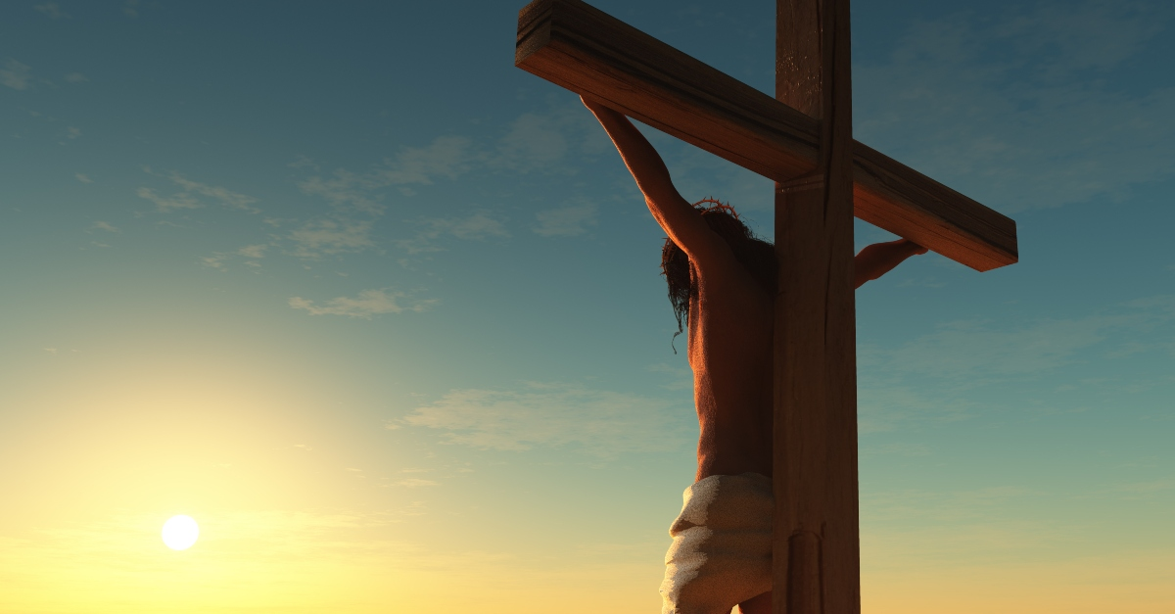
Visage
Part of speech: noun
Meaning: the face or appearance of a person
“His visage was so marred, more than any man.” (Isaiah 52:14)

Slide 5
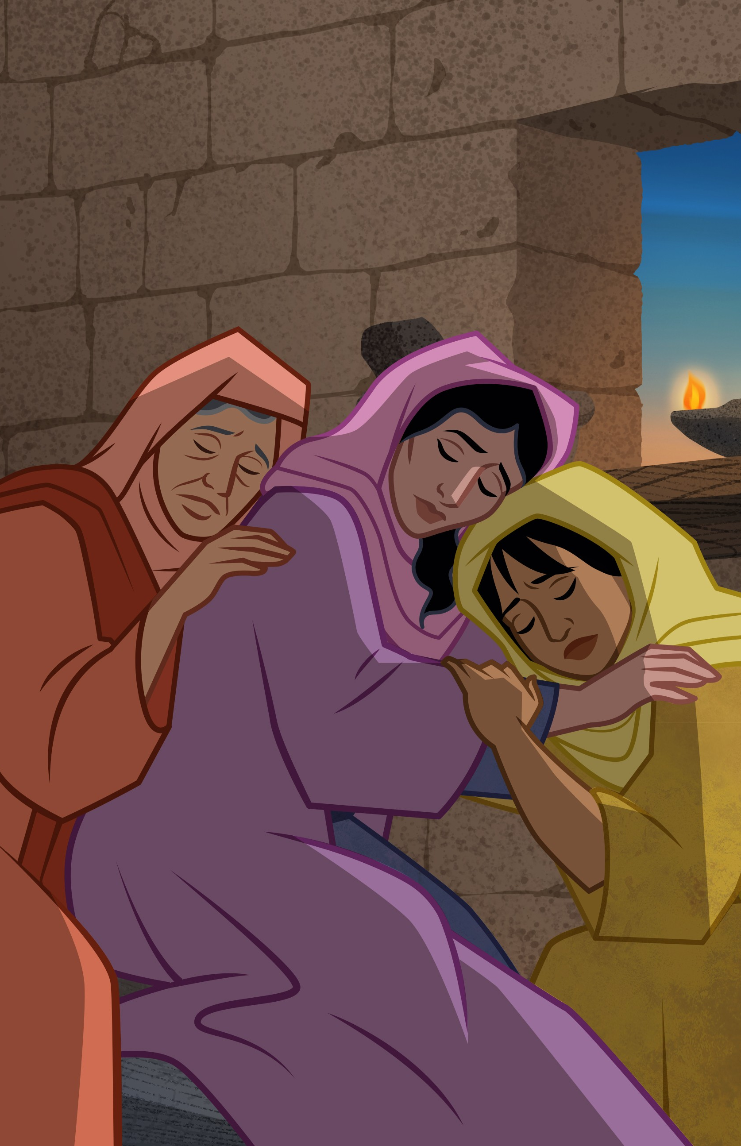
Bereft
Part of speech: adjective
Meaning: deprived of, lacking something
“Then both Mahlon and Chilion also died, and the woman was bereft of her two children and her husband.” (Ruth 1:5)

Slide 6
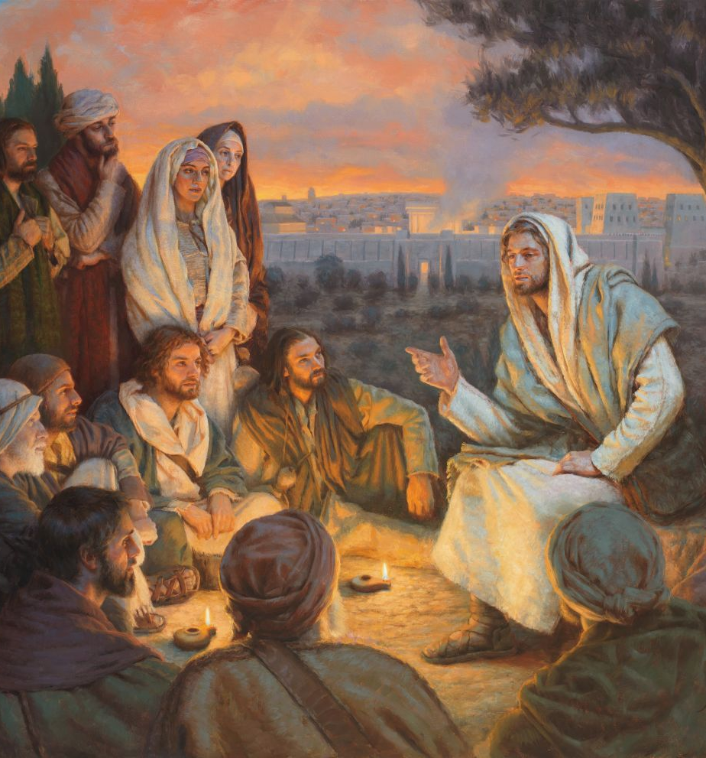
Upbraid
Part of speech: verb
Meaning: to find fault with; to scold
Then he began to upbraid the cities wherein most of his mighty works were done, because they repented not (Matthew 11:20)

Slide 7
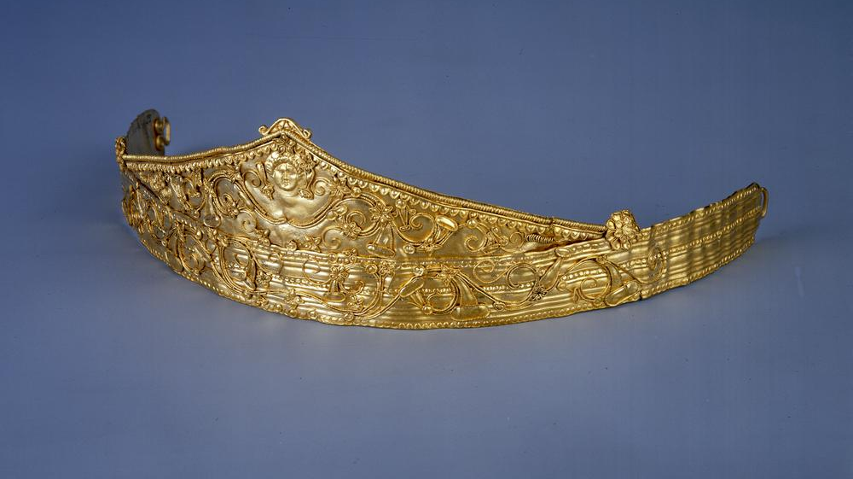
Diadem
Part of speech: noun
Meaning: a crown; a headpiece worn to show royalty or authority
Thus saith the Lord God; Remove the diadem, and take off the crown. (Ezekiel 21:26)

Slide 8
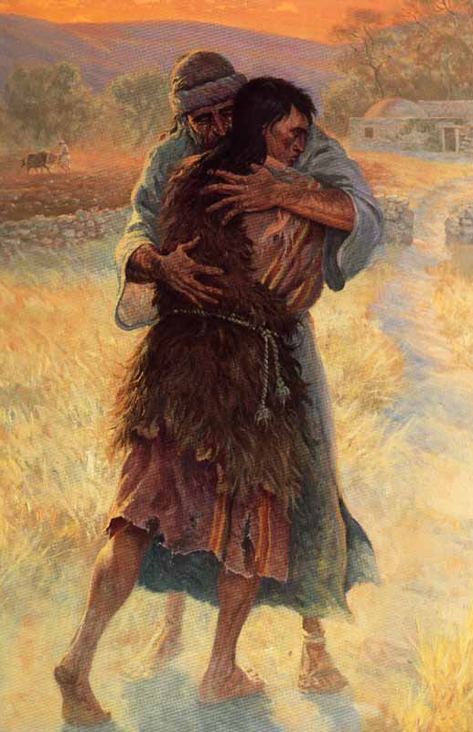
Prodigal
Part of speech: adjective
Meaning: wasteful and extravagant; spending money or using resources freely and recklessly.
The prodigal son realised he should return to his father.

Slide 9
Conduit
Part of speech: noun
Meaning: a channel or tunnel for directing the flow of water
And the rest of the acts of Hezekiah, and all his might, and how he made a pool, and a conduit, and brought water into the city, are they not written in the book of the chronicles of the kings of Judah? (2 Kings 20:20)

Slide 10
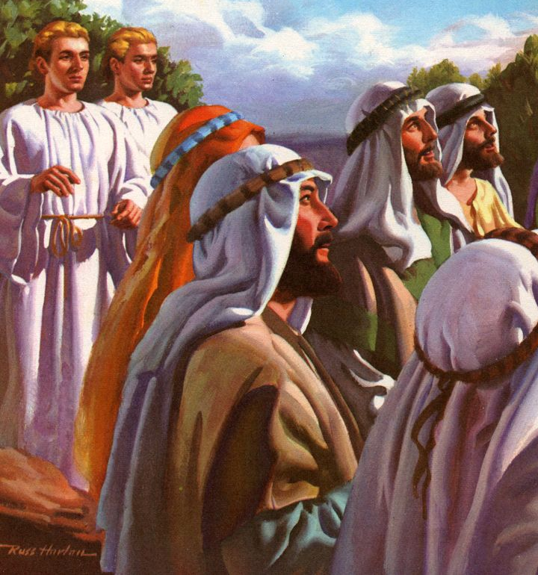
Apparel
Part of speech: noun
Meaning: clothing
And while they looked steadfastly toward heaven as he went up, behold, two men stood by them in white apparel (Acts 1:10)

Slide 11
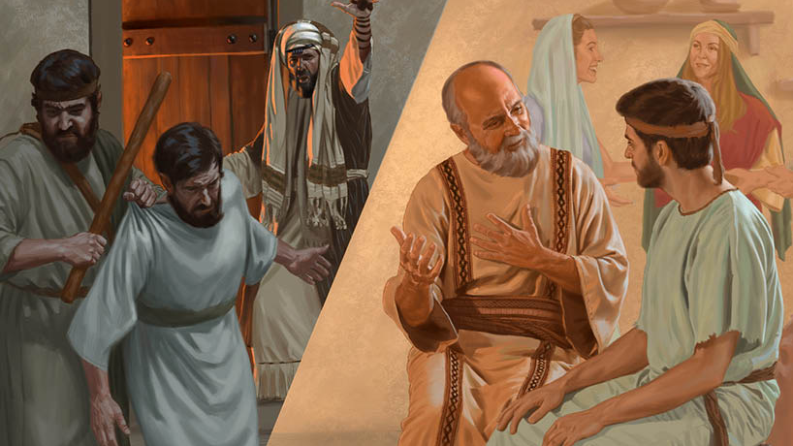
Profane
Part of speech: adjective
Meaning: non-religious; showing disrespect for God or for things that are sacred
But shun profane and vain babblings: for they will increase unto more ungodliness. (2 Timothy 2: 16)

