Slide 1
Year 9 Vocab
Term 2, Week 9

Slide 2
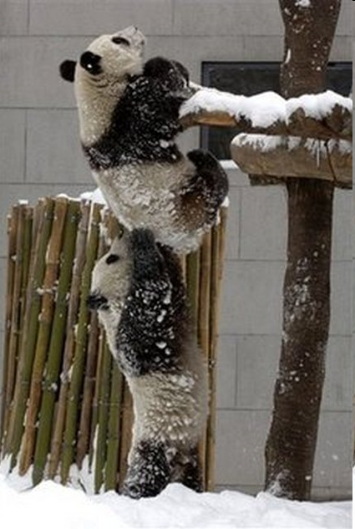
tenacity
Part of speech: noun
Meaning: determination or persistence; sticking with something no matter what
Because of their tenacity, the pandas were able to escape from the zoo.

Slide 3
Commemorate
Part of speech: verb
Meaning: to remember and show respect for an event or person, usually with a formal ceremony
Many Australians commemorate the soldiers who lost their lives at Gallipoli on Anzac Day.

Slide 4
Exposition
Part of speech: noun
Meaning: a detailed description and explanation of an idea or theory
Uncle John’s exposition of Revelation really helped me to understand it.

Slide 5
Temperance
Part of speech: noun
Meaning: self-control; restraint or moderation in words or actions
Gabby shows temperance by reacting calmly when other people annoy her.

Slide 6
impute
Part of speech: verb
Meaning: to lay the responsibility or blame on someone else
You can’t impute your brother for that broken window, I saw you kick the ball.
When he failed the exam, he imputed it to nerves rather than lack of study.

Slide 7
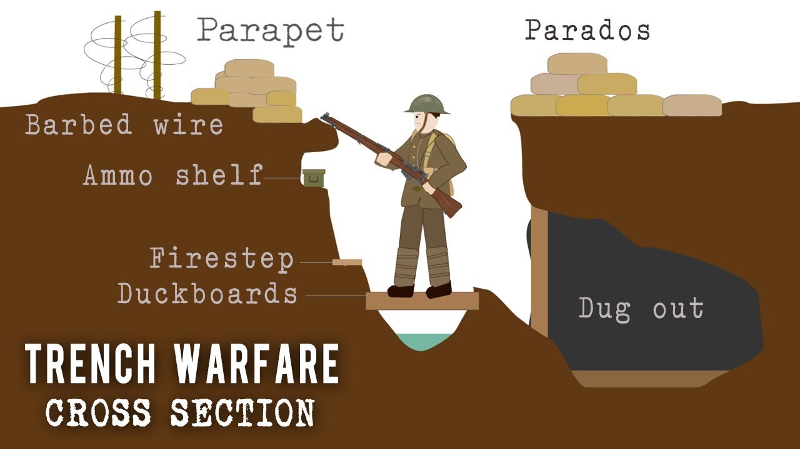
Parapet
Part of Speech: noun
Meaning: a low protective wall along a bridge or rooftop, or above a trench to protect soldiers
We had a good view of the enemy over the parapet of the castle.
The soldier positioned his rifle above the parapet.

Slide 8
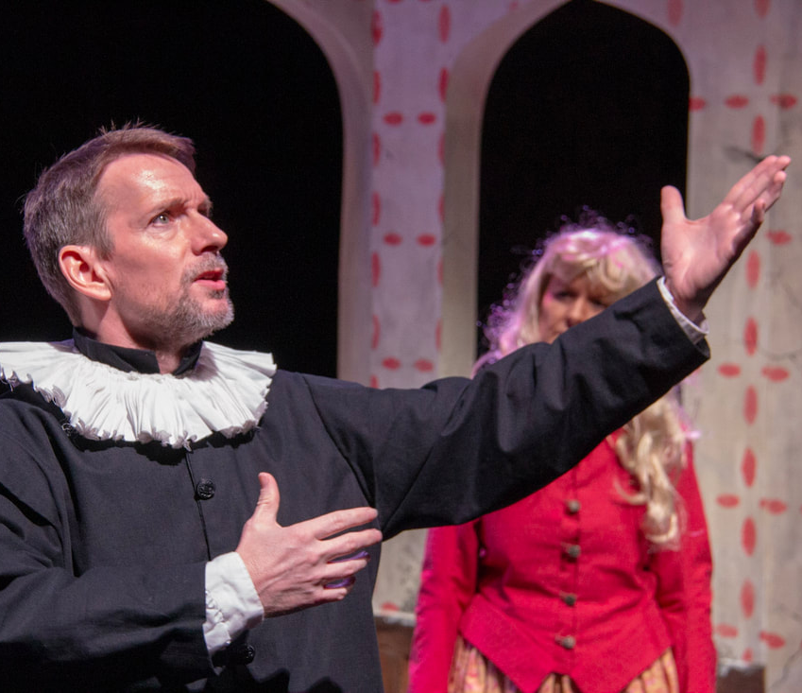
brevity
Part of speech: noun
Meaning: the quality of being brief or getting to the point in a few words; conciseness
Shakespeare’s famous line: “brevity is the soul of wit” is said by the most long-winded character in Hamlet.

Slide 9
Decorum
Part of speech: noun
Meaning: behaviour that is calm and polite; good manners
The children did not behave with decorum when they had a relief teacher.

Slide 10
divulge
Part of speech: verb
Meaning: to reveal or make known information that is private or secret
Doctors must be careful to not divulge confidential information about their patients.
The chef refused to divulge his secret ingredient.

Slide 11
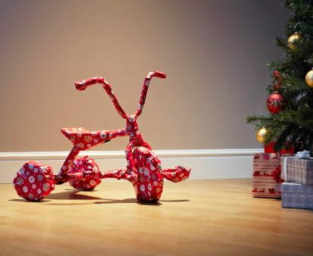
Inference
Part of speech: noun
Meaning: a conclusion that is based on evidence or reasoning; an educated guess
Looking at his present, it was pretty easy to make an inference about what he was getting for Christmas.

