Slide 1
Year 9 Vocab
Term 2, Week 10

Slide 2
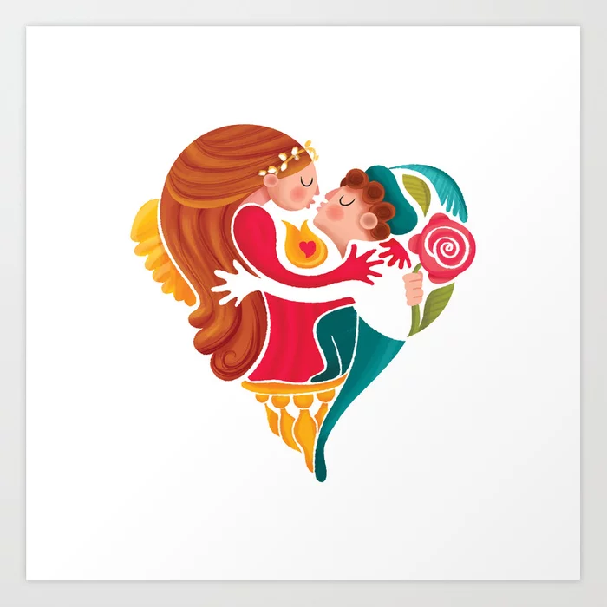
enamoured
Part of speech: adjective
Meaning: filled with love, admiration, or fascination.
Romeo was enamoured with Juliet.

Slide 3
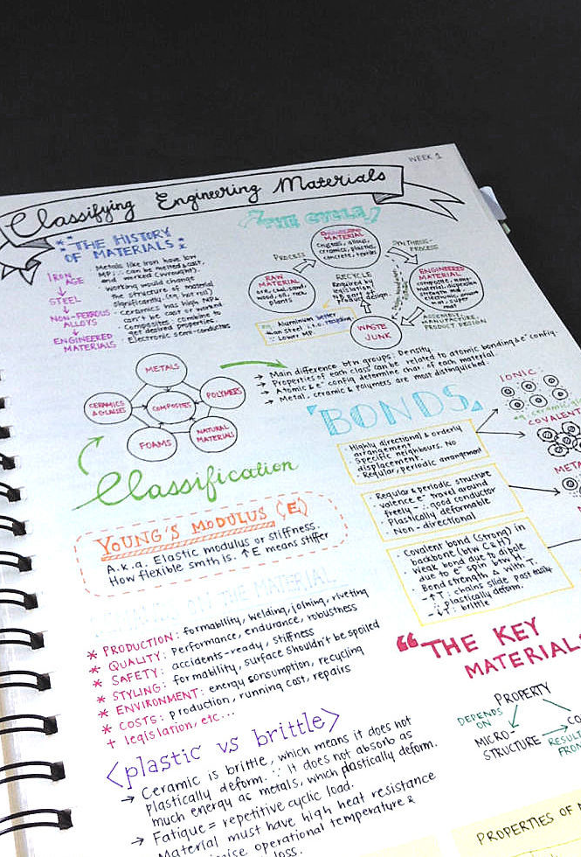
copious
Part of speech: adjective
Meaning: a large amount; abundant in supply or quantity; more than enough
Sam took copious notes during his engineering lecture.

Slide 4
Sundry
Part of speech: adjective
Meaning: of various kinds; several
Anna’s handbag contained her phone, wallet, keys, sunglasses, and other sundry items.

Slide 5
irksome
Part of speech: adjective
Meaning: boring and annoying
Kevin found posing for photographs particularly irksome.

Slide 6
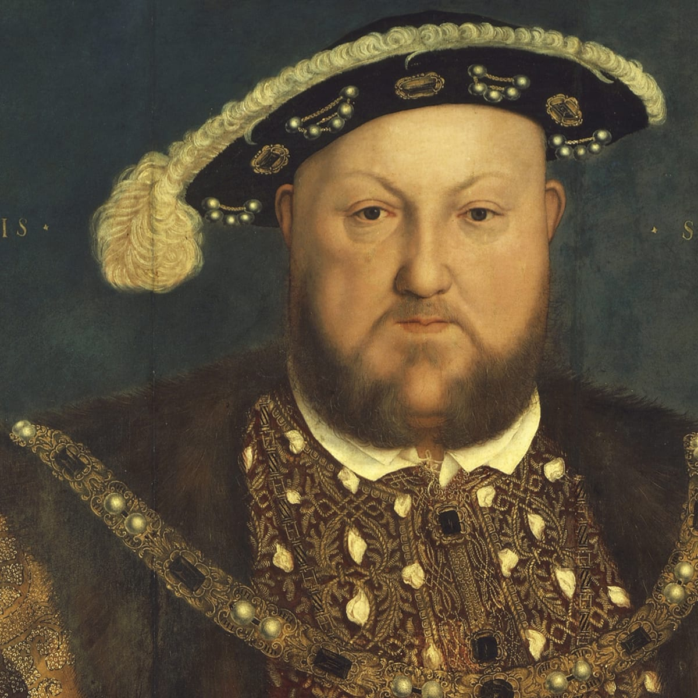
gout
Part of speech: noun
Meaning: a disease causing painful inflammation of the joints.
Henry VIII suffered from gout, which probably contributed to his bad temper.

Slide 7
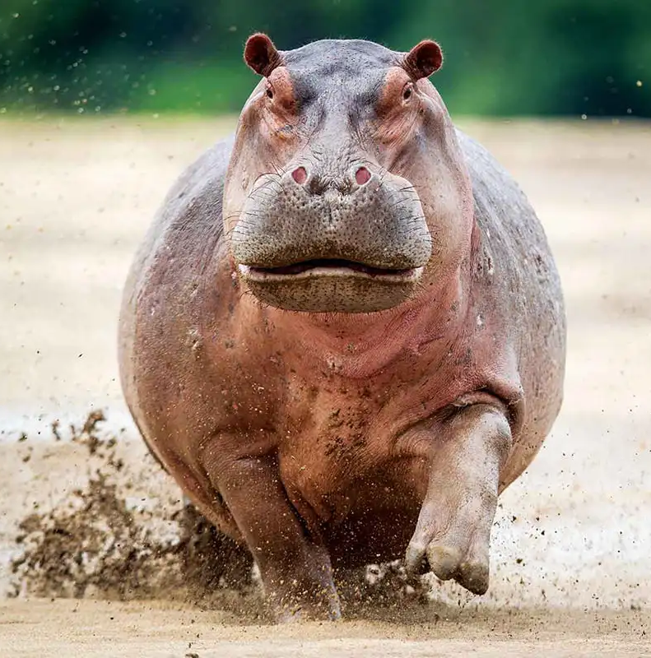
ponderous
Part of speech: adjective
Meaning: slow and clumsy because of great weight.
Hippos appear ponderous, but they can reach speeds of up to 50km/h when charging.

Slide 8
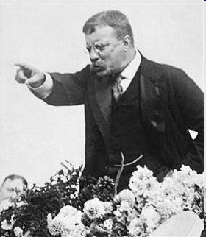
impugn
Part of speech: verb
Meaning: to call into question or challenge; to dispute the truth or validity of something.
How dare you impugn my motives!
The politician tried to impugn his opponent’s character.

Slide 9
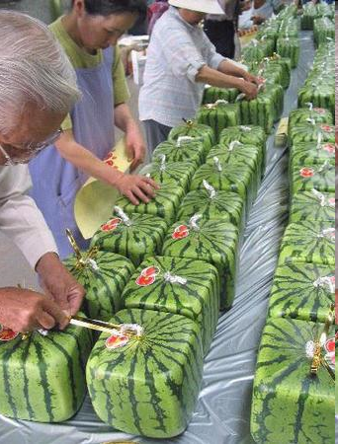
scrupulous
Part of speech: adjective
Meaning: careful and thorough; doing everything correctly.
The Japanese workers were scrupulous about packaging the square watermelons.

Slide 10
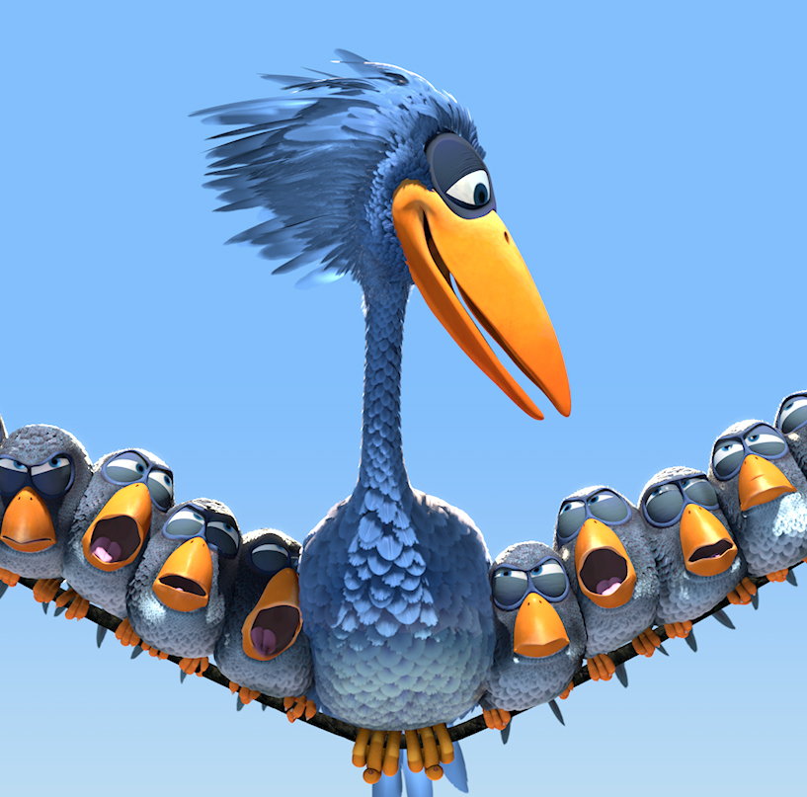
transcend
Part of speech: verb
Meaning: to go beyond, to surpass or be greater than
Some films can transcend age, culture, and language.
Infinity is a topic that transcends human understanding

Slide 11
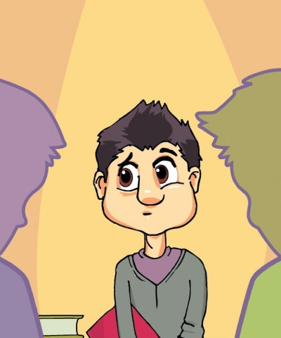
timorous
Part of speech: adjective
Meaning: timid and fearful; nervous; not confident.
Paul was too timorous to put his hand up in class.

