Slide 1
Abstract vs Concrete
Language

Slide 2
Compare these 2 Descriptions
Which one is easier to picture?
The man left his vehicle and gave his pet some food.
Captain Hook got off his Harley Davidson and gave his black Labrador puppy two dog biscuits.

Slide 3
Abstract Language
Abstract words describe thoughts, feelings or qualities.
freedom, equality, love, anger, danger, wisdom, power, beauty
These words convey broad general concepts and are good for setting out your main ideas.
Because they are ideas, not things, they can be hard for the reader to picture or imagine.

Slide 4
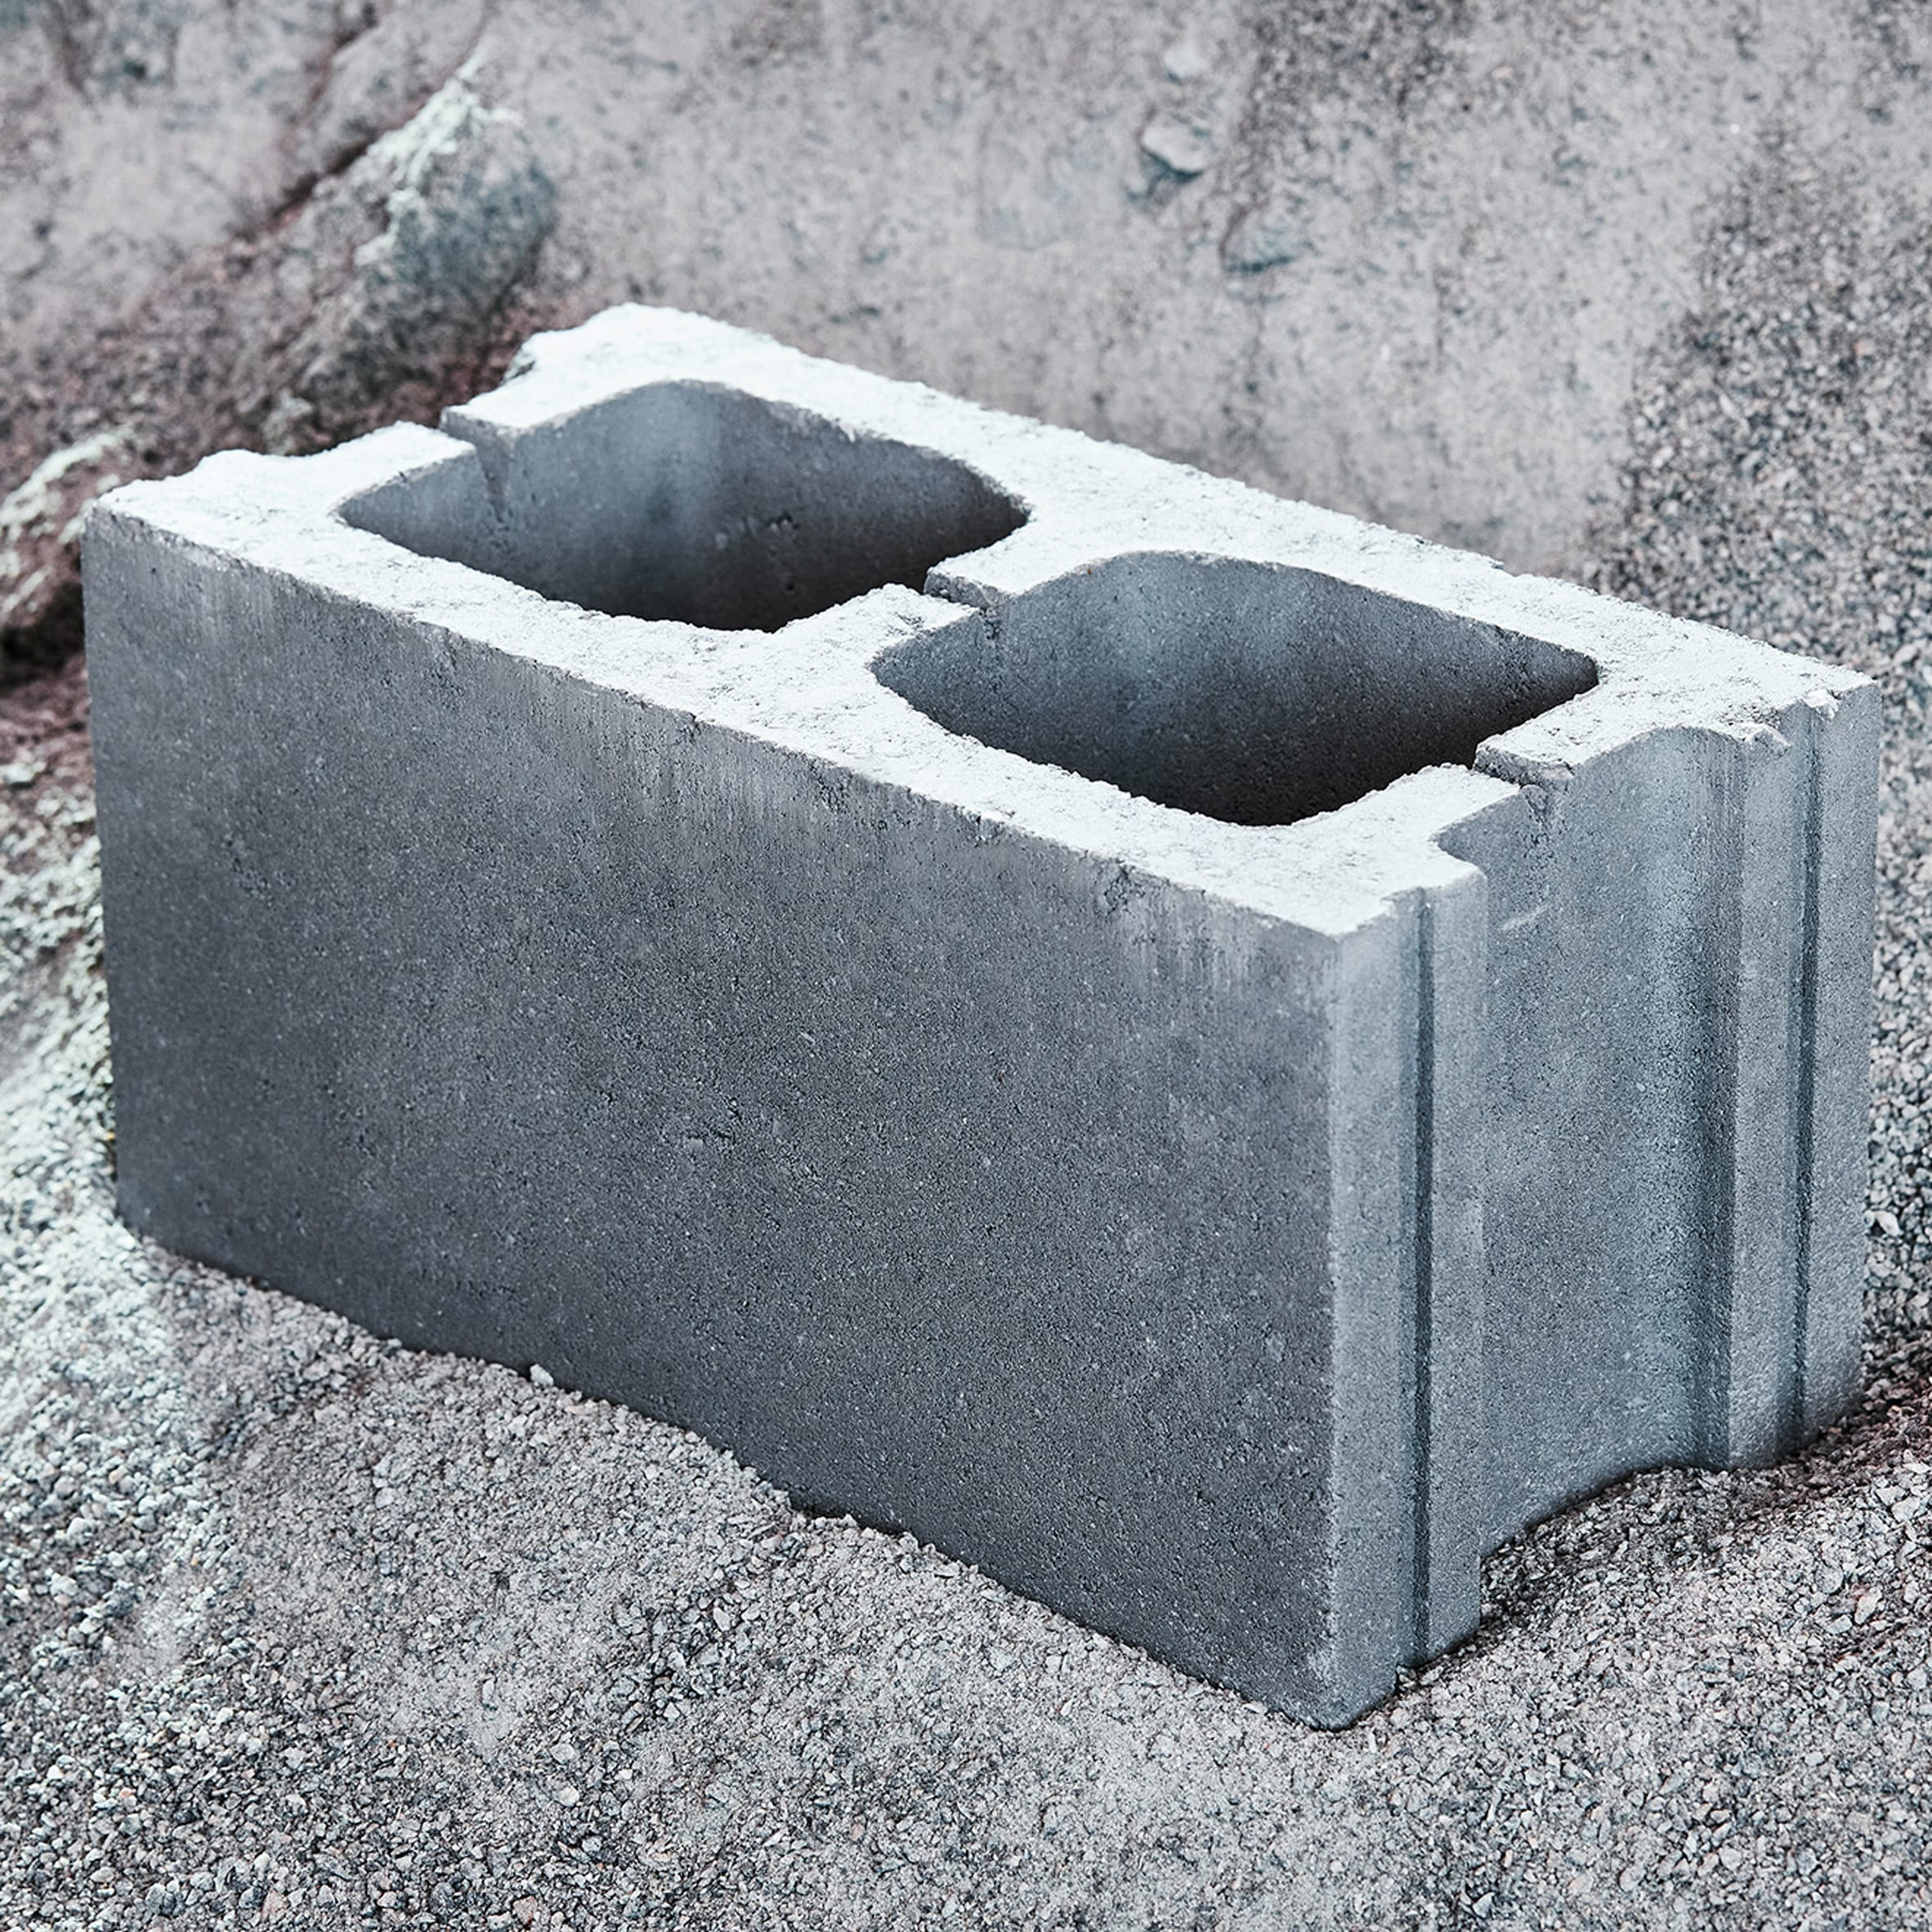
Abstract Language
Too many abstract words in a description can make it seem bland or vague.
To make a description effective, abstract language needs to be supported with concrete language.

Slide 5
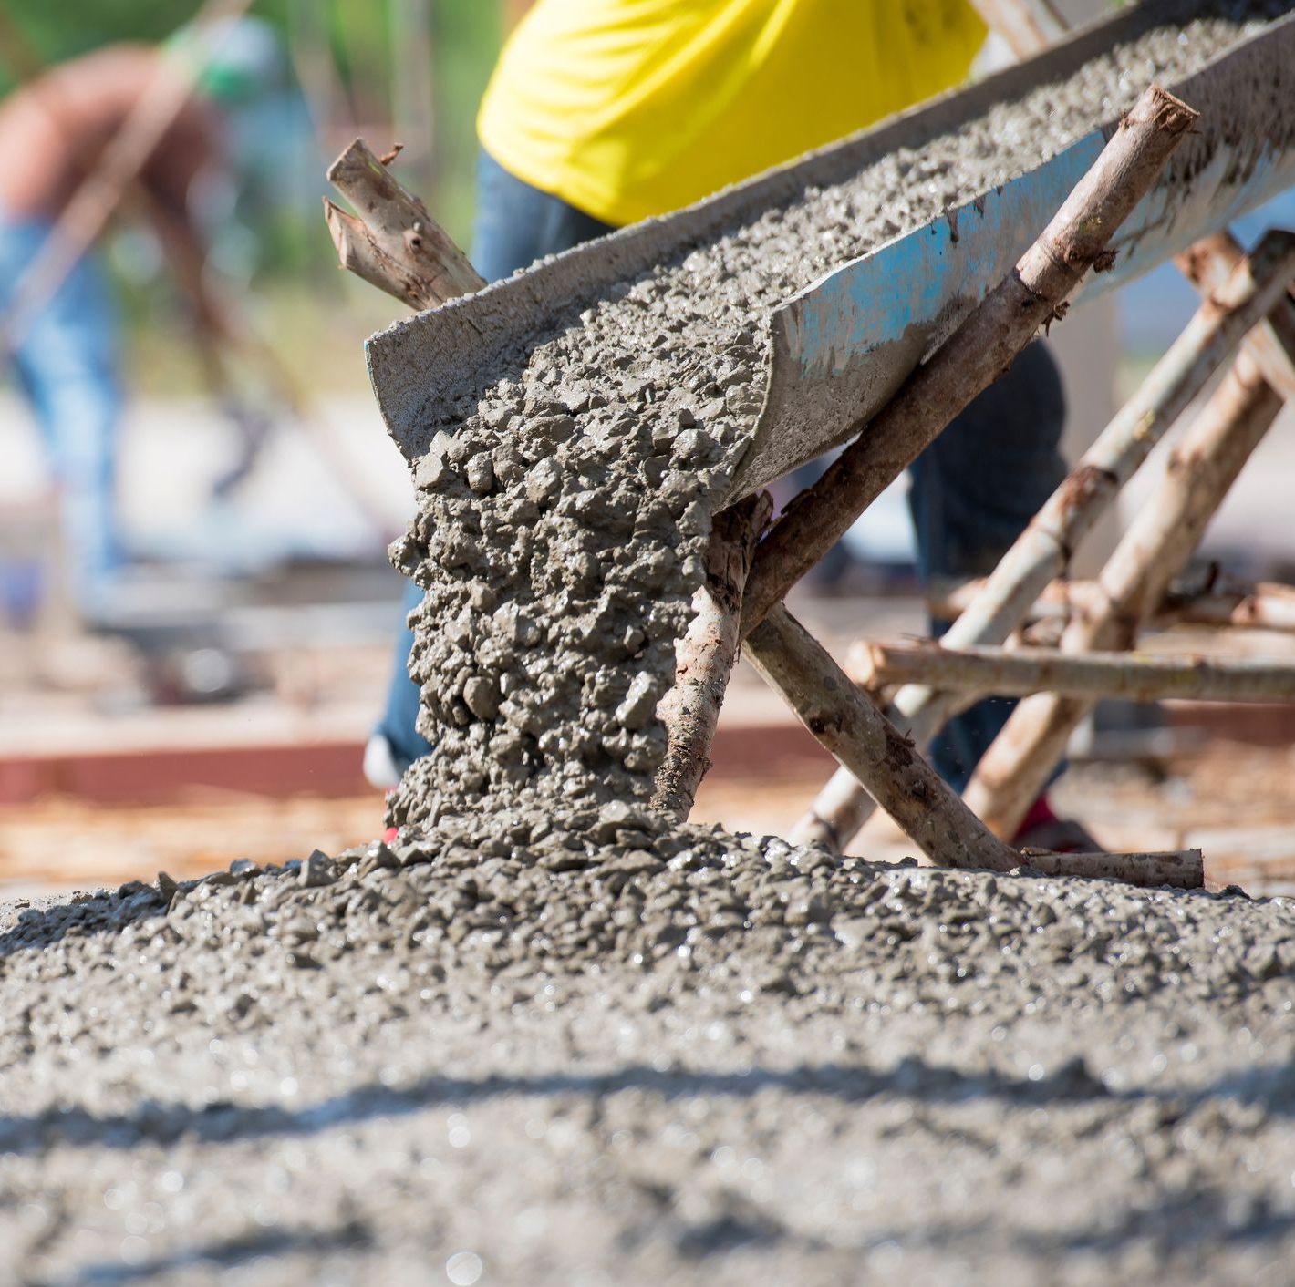
Concrete Language
Concrete language is more specific. It identifies a thing that exists and can be seen, heard or felt
headphones, beach, whistle, smoke, London, cello.
Concrete language gives the reader something to picture. It provides examples or images that reflect the abstract words.

Slide 6
Abstract vs Concrete Nouns
Concrete | Abstract
Can be observed with 5 senses | Can’t be observed with 5 senses
Doesn’t have to be observed with all of the senses, can be: Heard but not seen (music) Seen but not touched (smoke) Smelled but not seen (a fart) | Can’t be observed with ANY of the senses e.g. wisdom, anger, pride You might see or hear the physical EFFECTS, e.g. if someone is yelling you can assume they are angry. But you can’t see the actual anger itself.
Usually can be singular or plural e.g. 1 dog, 2 dogs | Usually can’t be counted e.g. two happiness?

Slide 7
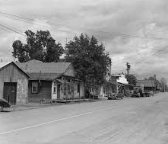
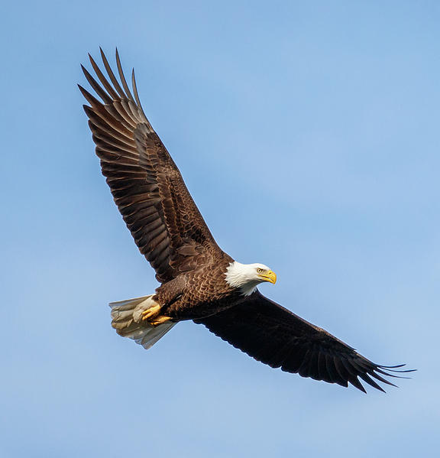
Connect Ideas with Imagery
For an effective description, use abstract words to establish the main ideas and then fill in the details with concrete words and images.
Examples:
They that wait upon the Lord shall renew their strength (abstract word); they shall soar on wings as eagles (concrete words and image)
– Isaiah 40:31
Maycomb was an old town, but it was a tired old town when I first knew it. In rainy weather the streets turned to red slop; grass grew on the sidewalks, the courthouse sagged in the square. Somehow, it was hotter then: a black dog suffered on a summer’s day.
– Harper Lee, To Kill a Mockingbird

