Slide 1
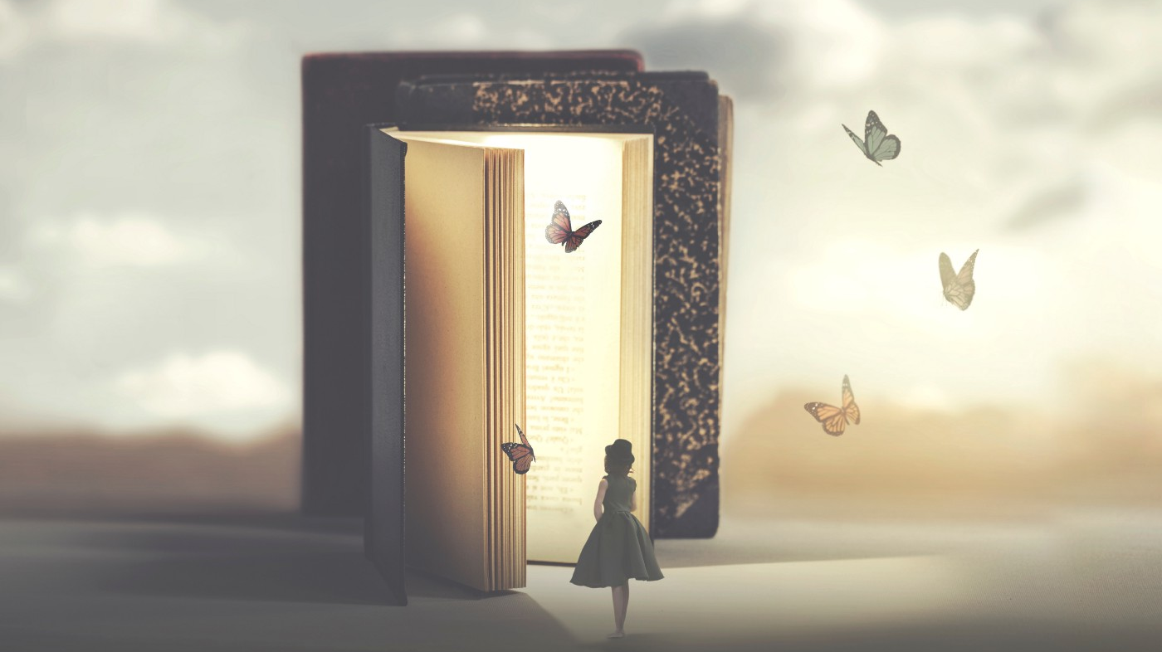
Descriptive Techniques 2:
Figurative Language

Slide 2
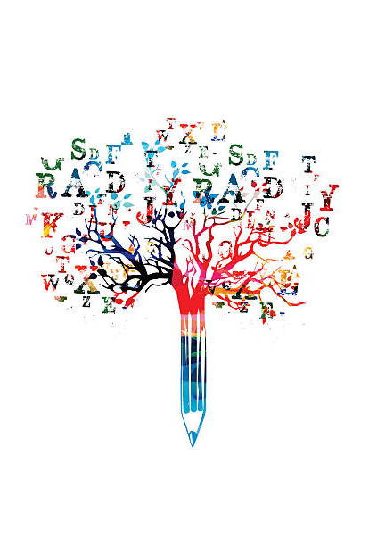
Figurative Language
Figurative language = non literal language
Similes & metaphors
Symbolism
Allusions
Personification
Hyperbole
Wordplay

Slide 3
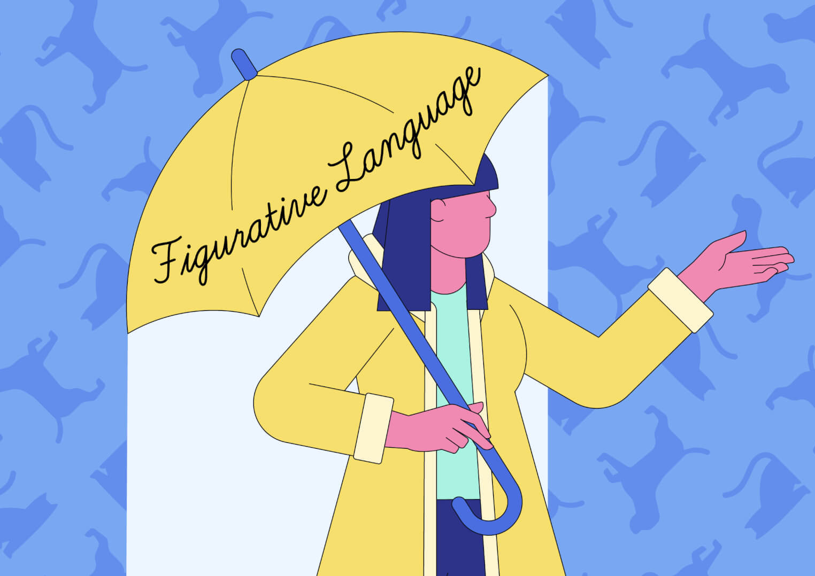
Figurative Language
Using creative figurative language can build a more powerful image in the reader’s mind.
Helps them get a sense of what the person/setting/object/scene that you are describing is actually like – not just visually

Slide 4
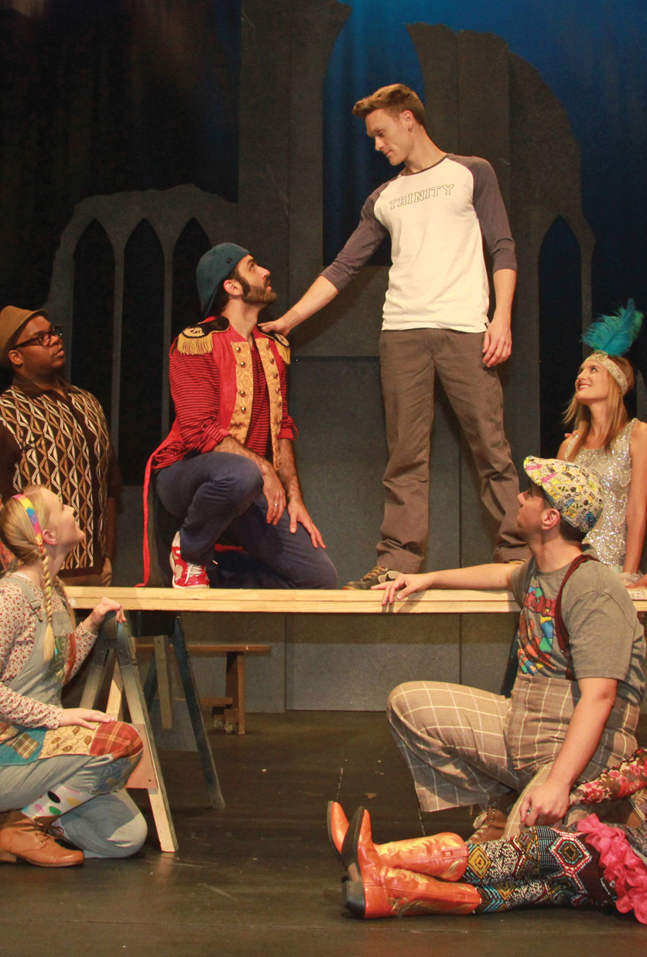
Layers of Meaning
All the world’s a stage, and all the men and women merely players. They have their exits and their entrances, and one man in his time plays many parts.
- ‘As You Like It’, Shakespeare
What type of figurative language is this?
Metaphor: compares life to a stage without using “like” or “as.”
Allusion: references a concept the audience are familiar with (theatre/play)
Using figurative language, the author communicates some complex ideas about life in a few words:
Everyone has different roles in their life, might play different ‘parts’ at different times (friend, sister, daughter, mum)
Life has different phases (like acts/scenes)
The world keeps moving on while people come and go
People, like actors, can put on an outward show that doesn’t always match what’s inside

Slide 5
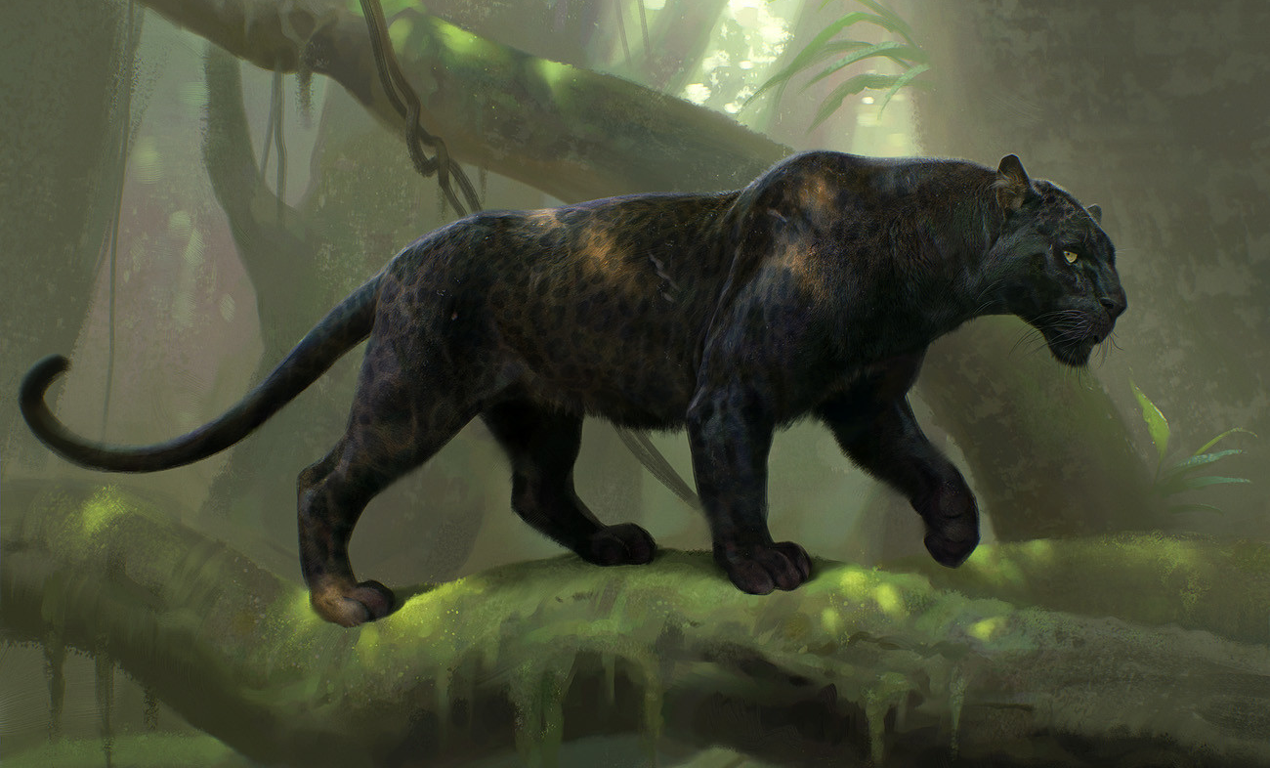
Similes & Metaphors
Help the reader picture it by making a comparison.
Similes – it’s like x….. it’s as y as x
Metaphors – it is x
He was as secret and self-contained and solitary as an oyster.
– A Christmas Carol by Charles Dickens
A black shadow dropped down into the circle. It was Bagheera the Black Panther, inky black all over, but with the panther markings showing up in certain lights like the pattern of watered silk
– The Jungle Book by Rudyard Kipling

Slide 6
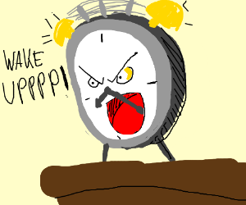
Personification
Giving human qualities to things.
Creates tone & mood
Gives the reader a vivid & memorable impression of the characteristics of the thing
Can trigger an emotional response, making the reader feel a connection to an inanimate object.
The alarm clock was screaming at me.
The angry clouds stomped across the sky.

Slide 7
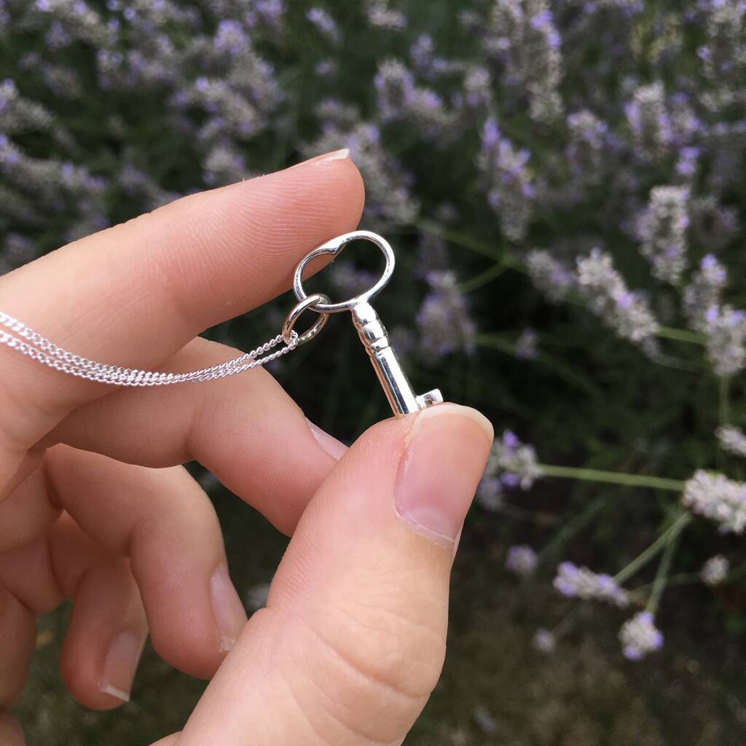
Symbolism
Using physical images or objects to suggest abstract ideas without saying so directly.
Some objects, colours or shapes are already strongly linked to concepts in the reader’s mind.
Describing the object will evoke that idea for them. For example:
Two characters watching a white dove fly away might imply they are going to make peace
A character wearing a key as a necklace might suggest they have secrets.

Slide 8
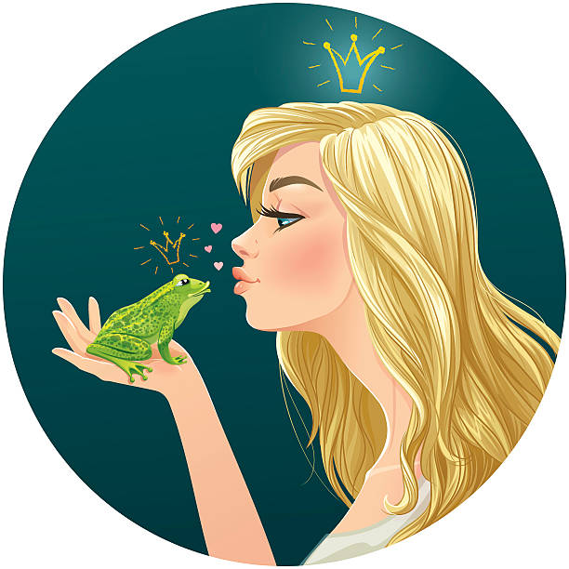
Allusion
A reference to a familiar concept. Might be a story, song, situation, or character that the audience already knows about.
Can be used to sum up a complicated situation, implying extra information without saying it.
Link to the reader’s memory.
I had to kiss a lot of frogs before I finally found my prince.
Chocolate is my Kryptonite
The car might turn into a pumpkin if you’re home after midnight.

Slide 9
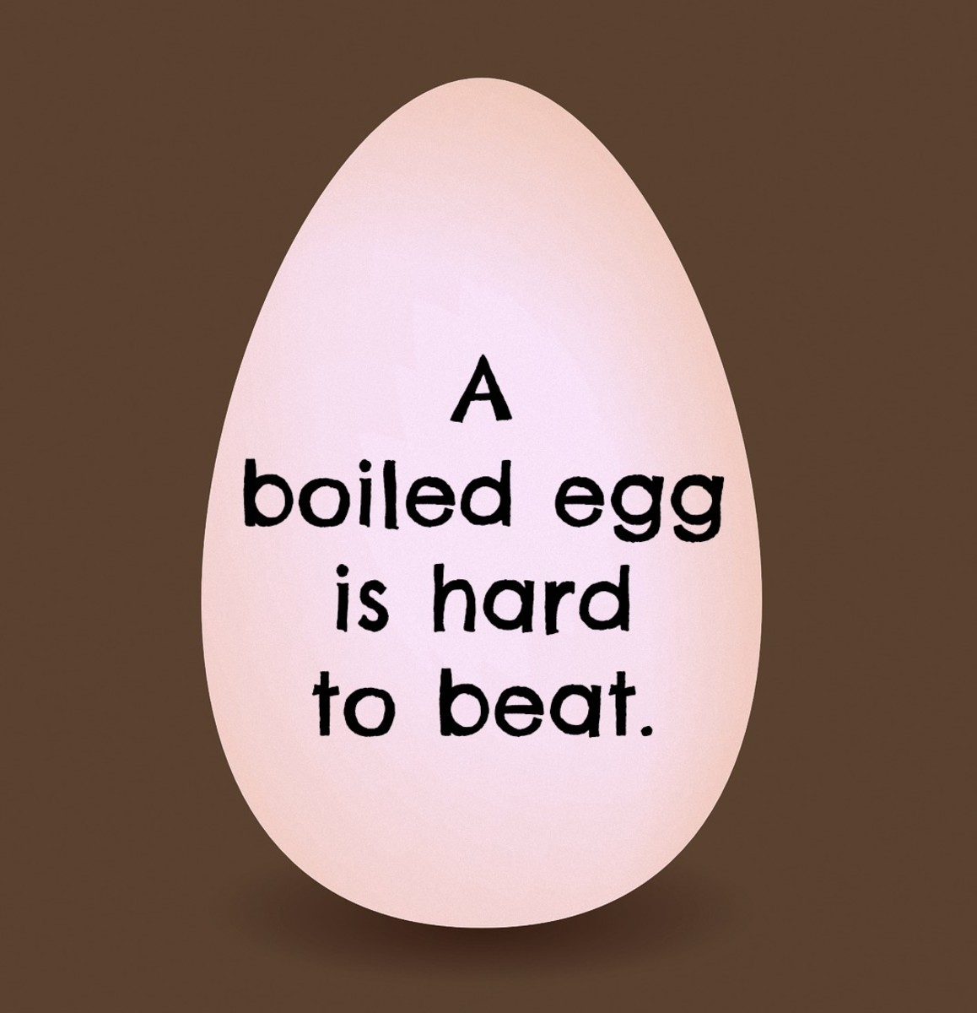
Wordplay
A joke involving words – using their meaning or spelling in creative ways.
Puns, spoonerisms, deliberate mistakes/word swaps etc
Subverts the reader’s expectations. Unexpected = funny.
Makes it more entertaining to read
The art competition ended in a draw.
I always advise people never to give advice
A flock of chickens ran across the road. It was poultry in motion (poetry in motion)

Slide 10
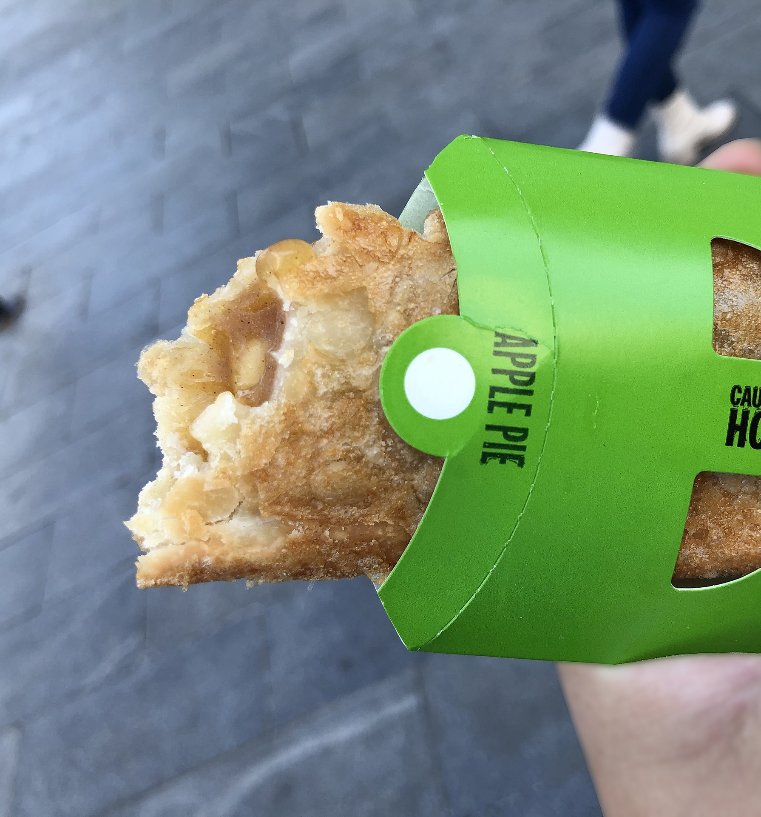
Hyperbole
Exaggeration, taking things to extremes
Tells you how the speaker feels about it
Can add humour or interest to a description, making it stand out in the reader’s mind.
Vivid and memorable.
The centre of the pie was hotter than the surface of the sun.
His brain is the size of a pea.

