Slide 1
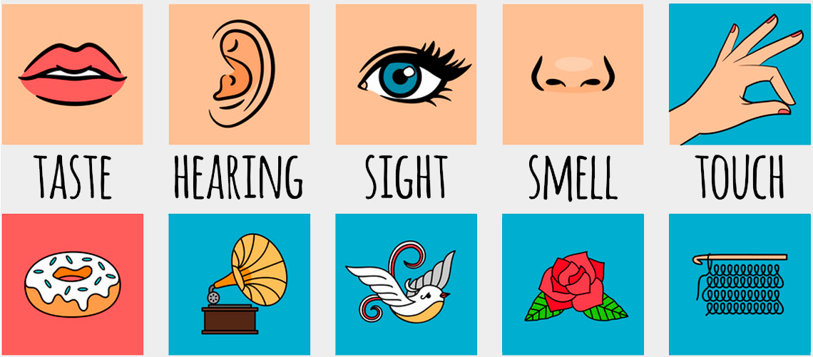
Descriptive Techniques 3:
Sensory Language

Slide 2
Not Just Visual
A lot of descriptions focus only on what something LOOKS like
This presents a one-sided picture. We use all of our senses to perceive things
The field on the left might LOOK beautiful, but what if…
The flowers are giving you terrible hay fever and you can’t stop sneezing.
There’s an icy cold wind and you aren’t dressed warmly enough.
There’s a dead possum nearby and all you can smell is rotten carcase.
Someone’s annoying mobile phone is playing the same song over and over loudly right next to you.

Slide 3
All Five Senses
Don’t forget to mention the smell, feel, sound, taste.
Don’t have to force every single one in, but just remember think about whether there WOULD be any.
Things like ‘atmosphere’ – how a place feels, the impression it gives you – are influenced by a mixture of things, including past experiences
E.g. if someone loves sports, the atmosphere of a basketball game would seem exciting and fun to them, but if they had a terrible fear of crowds it might seem terrifying, noisy and overwhelming

Slide 4
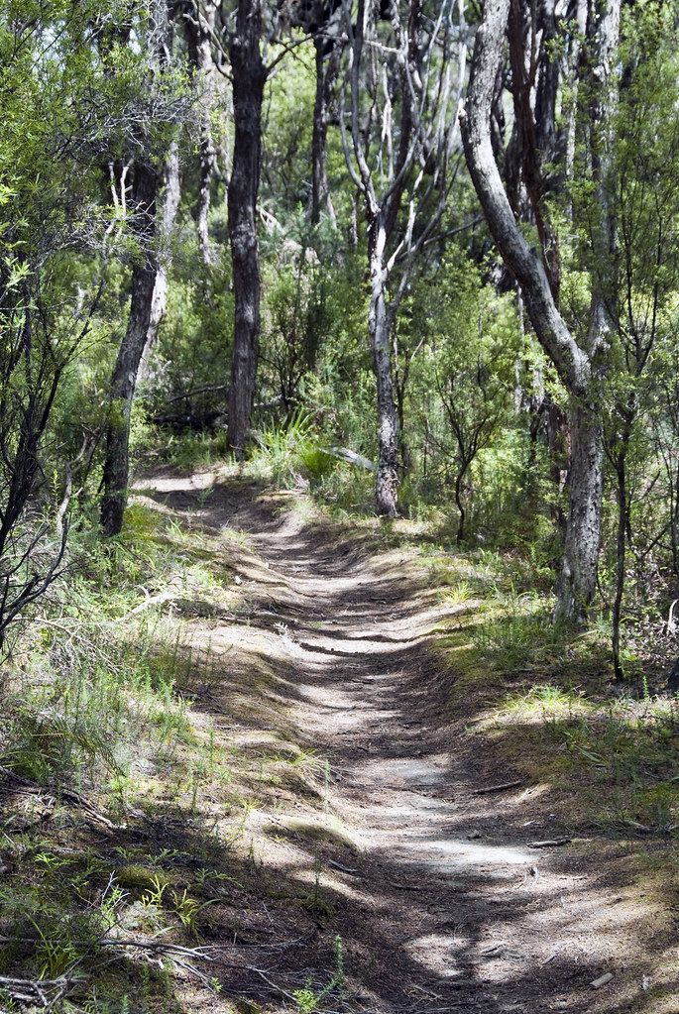
Example
When you walk along a hiking trail you might:
See: trees, bushes, wildflowers, insects, lizards, patterns of sunlight and shadow
Hear: birds chirping, wind in the trees, cicadas, footsteps on the track, water in creek
Feel: hot sun beating down, prickly grass or bushes, flies crawling on your face, stone in your shoe, heavy backpack on your back
Taste: water from drink bottle
Smell: fresh air, eucalyptus, animal poo, flowers, sun-cream

Slide 5
Suddenly a change passed over the tree. All the sun’s warmth left the air. I knew the sky was black because all the heat, which meant light to me, had died out of the atmosphere. A strange odour came up from the earth; I knew it: it was the odour that always precedes a thunderstorm, and a nameless fear clutched at my heart. There was a moment of sinister silence, then a multitudinous stirring of the leaves. A shiver ran through the tree, and the wind sent forth a blast that might have knocked me off had I not clung to the branch with might and main. The tree swayed and strained. The small twigs snapped and fell about me in showers. A wild impulse to jump seized me, but terror held me fast. I crouched down in the fork of the tree. The branches lashed about me. I felt the intermittent jarring that came now and then, as if something heavy had fallen and the shock had travelled up till it reached the limb I sat on.
- Helen Keller, The Story of My Life

