Slide 1
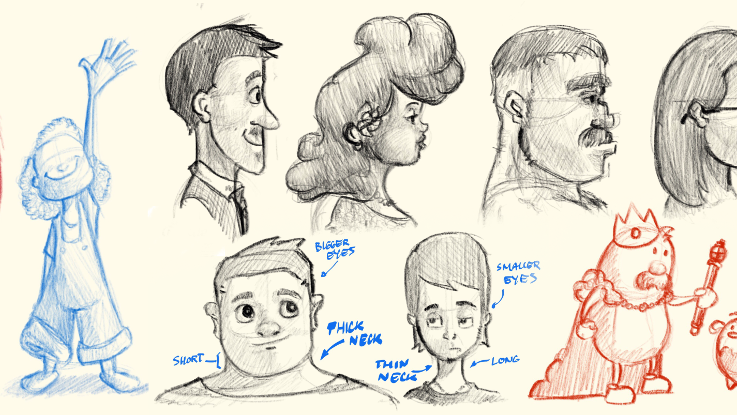
Descriptive Techniques 4:
Character Description

Slide 2
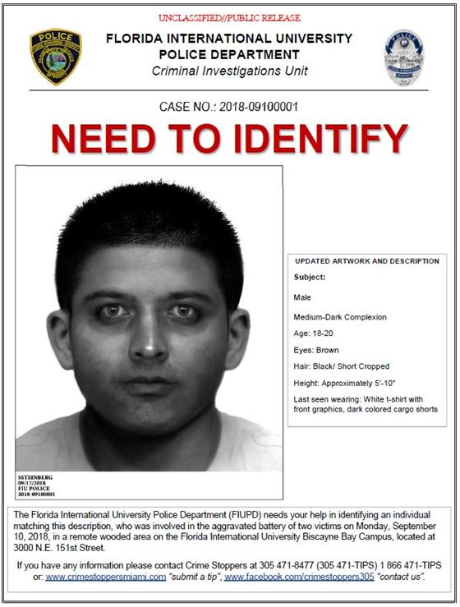
Character Descriptions:
Lazy character descriptions = police identikit
Hair colour, eye colour, skin colour, height, build, age, clothing
These facts can help build a surface image of the character but don’t tell you much about them as a person
You want the reader to be curious about this character, wanting to know more about them.

Slide 3
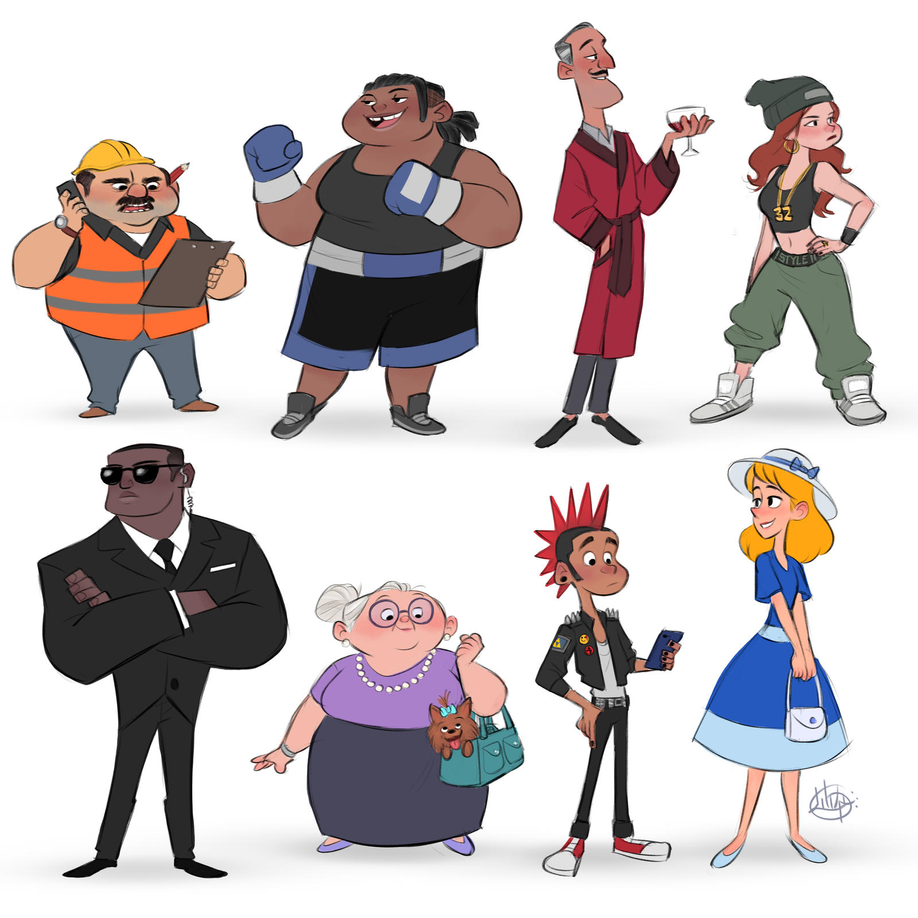
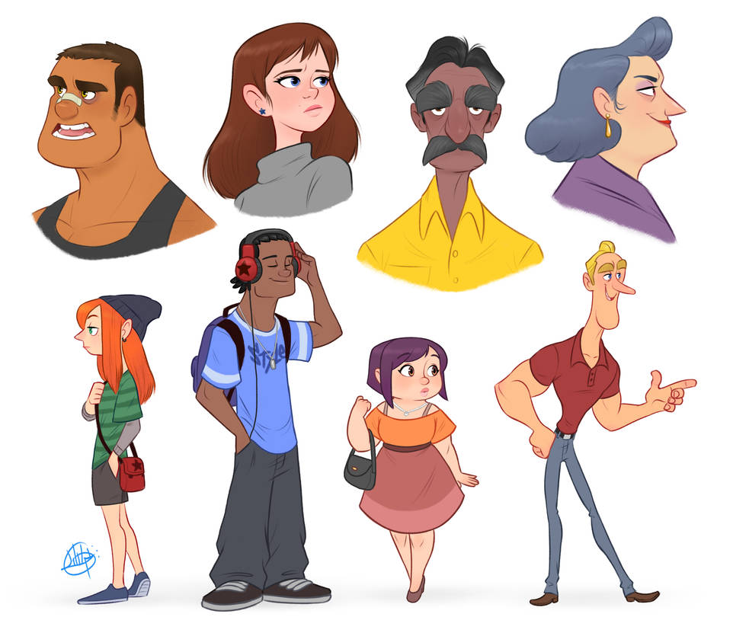
Look Past the Surface
Think of other categories as well as physical appearance.
How do they move?
What expression is always on their face?
How do other characters view them?
What aura or impression do they give others?
What type of person are they?
How do they react to situations?
What quirks or habits do they have?
What is their mental state?

Slide 4
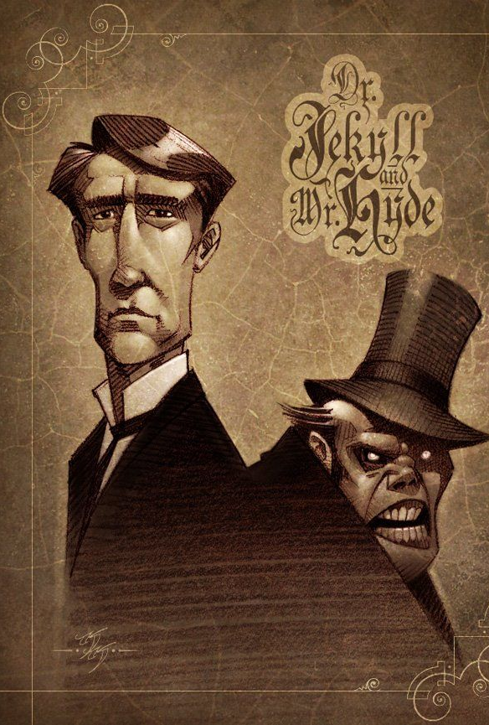
Mr Hyde
“Mr. Hyde was pale and dwarfish. He gave an impression of deformity without any nameable malformation. He had a displeasing smile, he had borne himself to the lawyer with a sort of murderous mixture of timidity and boldness, and he spoke with a husky, whispering, and somewhat broken voice: all these were points against him, but all of them together could not describe the hitherto unknown disgust, loathing, and fear with which Mr. Utterson regarded him.”
– The Strange Case of Dr. Jeykll & Mr Hyde, Robert Louis Stevenson
Nothing visibly deformed about him but gives the impression - suggests character/personality is deformed
‘Displeasing’ smile ‘murderous’ way of moving. Being somehow timid & bold at the same time, weird & unnerving
Other characters react to him with indescribable “disgust, loathing and fear”

Slide 5
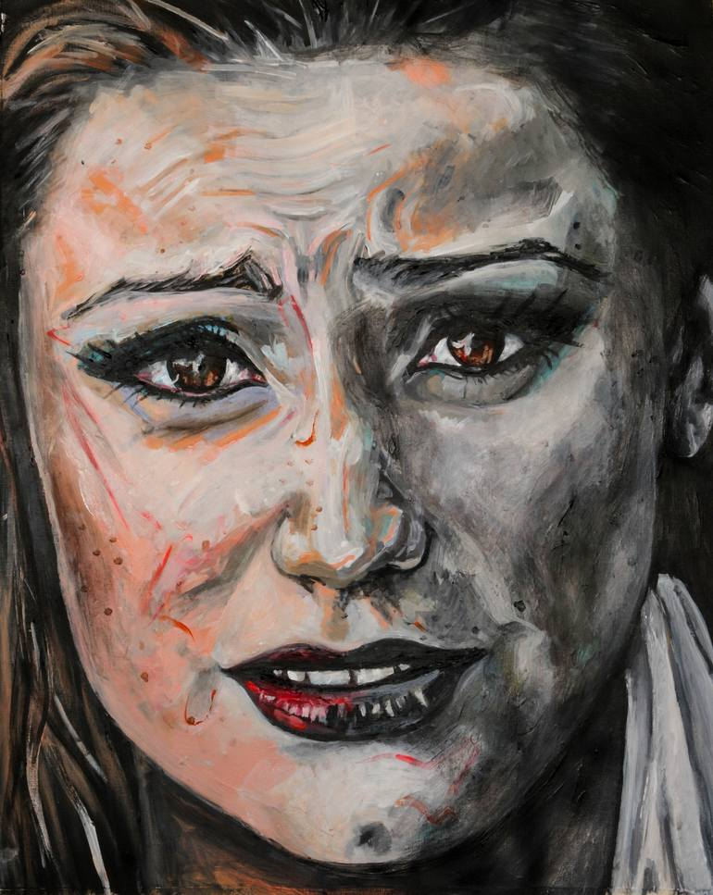
Anna
Her peroxide job has gone wrong, so that her hair has turned a strange yellow colour, standing out in angry spikes from her head. But more than this, something has changed inside her, which you can see from a long way off. She seems to burn with a luminous white light. Her face is knotted and anxious, bunched in on itself, and it takes her a long time to notice him.
In a Strange Room, Damon Galgut
Badly dyed messy hair = changeable, not caring about appearance
‘Angry’ spikes (personification), seems to ‘burn’ = intense emotions
Knotted anxious face, focused inwards, doesn’t notice the narrator = occupied with own thoughts/worries

Slide 6
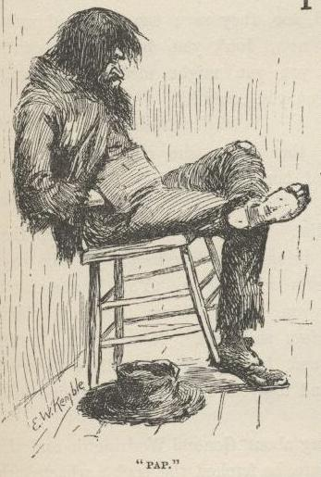
Pap Finn
His hair was long and tangled and greasy, and hung down, and you could see his eyes shining through like he was behind vines. There was no colour in his face, where his skin showed; it was white. Not like another man’s white, but a white to make you sick, a white to make your flesh crawl; a tree-toad white, a fish-belly white.
The Adventures of Huckleberry Finn, Mark Twain
Comparing the colour of his skin to slimy, repulsive animals. Eyes shining through hair like he is ‘behind vines’. Suggests reclusive, unnatural, hidden in some way.
“Make you sick… make your skin crawl” – narrator’s reaction tells you about the character

