Slide 1
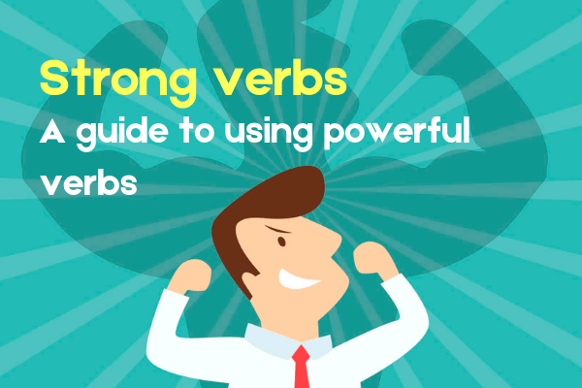
Descriptive Language Techniques 5:
Strong Verbs & Modifiers

Slide 2
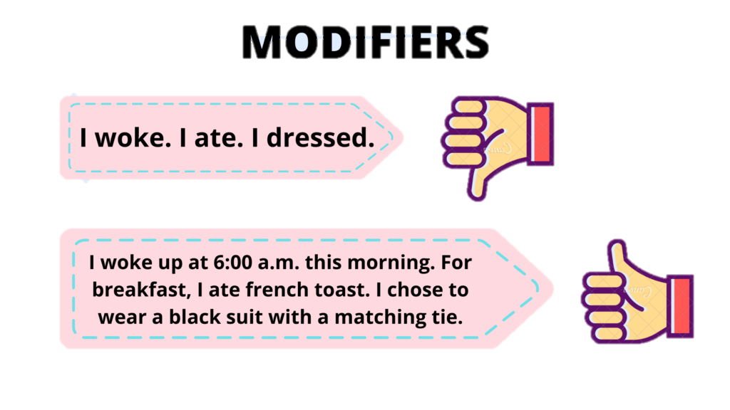
Modifiers (adjectives & adverbs)
Good descriptions are clear and specific, so the reader can form a vivid mental picture.
Modifiers can help by giving more information about the nouns and verbs you’ve used.
Use modifiers creatively. Reject the first adjective that pops into your head & think of a more interesting one.

Slide 3
Adjectives & Adverbs
Adjectives add more detail to nouns. Tell you which one, what kind, how many.
The man wore a suit.
The dapper old man wore a neat, chocolate brown business suit, shiny from wear.
Adverbs add more detail to verbs. They tell you how something happened or how someone did something.
The girl shrieked. She jumped into the water.
The girl shrieked joyously. She jumped exuberantly into the water.
The girl shrieked fearfully. She jumped reluctantly into the water.

Slide 4
I Made Tea
https://www.telescopictext.org/text/KPx0nlXlKTciC

Slide 5
Strong Descriptive Verbs
Weak verbs are simple, commonly used verbs that describe the bare minimum of the action
They are straightforward and easy to understand, but they can be a bit vague and boring.
Instead of using a generic verb, try and think of a verb which is more interesting and specific.
‘Strong’ or descriptive verbs are interesting and specific, adding to the picture in the reader’s mind.
Weak verb | Strong verb
Run | Bolt, sprint, jog, dash, fly, tear, hurtle
Walk | Slink, trot, saunter, creep, hurry, stride
Make | Create, forge, brew, build, design, produce
Say | Mutter, howl, prattle, whisper, drawl, stammer
Sit | Slouch, plonk down, slump, perch, settle
Laugh | Chuckle, guffaw, giggle, snicker, wheeze

Slide 6
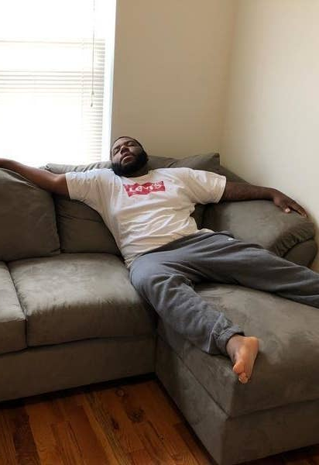
Benefits of Strong Verbs
In many cases a strong verb is more concise. It provides more information in one word than a commonly-used verb can.
Weak verbs: he walked into the room and sat on the couch.
Strong verbs: he sauntered into the room and sprawled on the couch.
Sometimes a strong verb can remove the need for an adverb, which makes your writing less wordy.
Weak verb + adverb: The man ran quickly towards the smoke.
Strong verb: The man sprinted towards the smoke.

